Slide 1
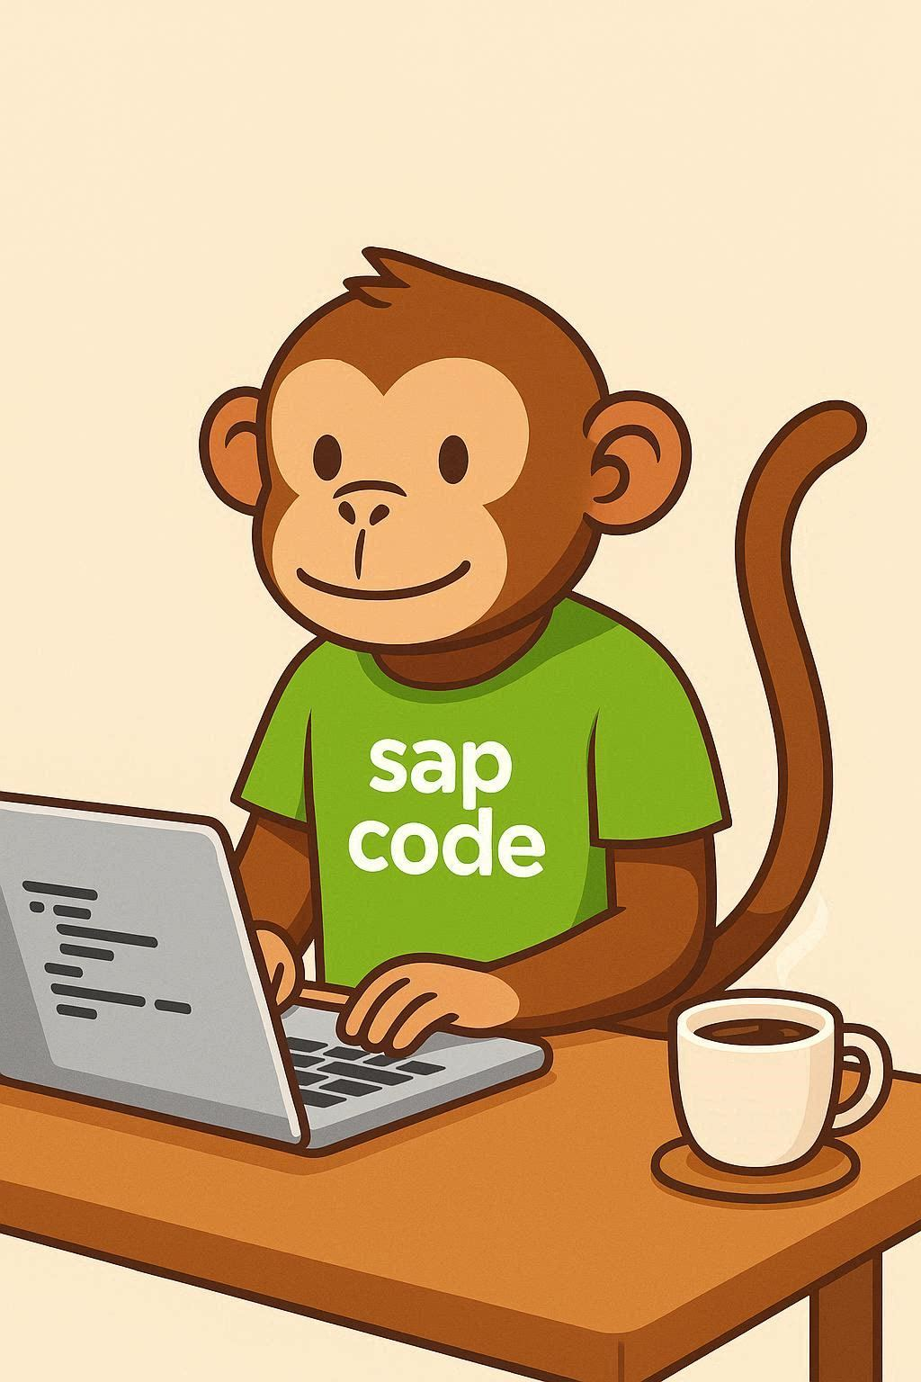
COMPANION DECK
CDS & OData
A skills guide — two tracks
DEVELOPER
FUNCTIONAL
Build CDS views, expose OData, RAP
Read the model, build reports — no code
sapcodemonkey.com · free download
Notes:
Two audiences, one foundation. Developers build it; functional consultants read and build on it.

Slide 2
The one-sentence version
Model the data, expose it, consume it. Everything else sits on this spine.
SAP Fiori app / analytical tile
what the user sees
OData service (V2 / V4)
the exposure — how the app reaches the data
CDS view
the model — meaning, associations, annotations
SAP HANA tables
the raw data
2

Slide 3
What CDS is
A data model with two properties classic reports never had.
PUSHDOWN
REUSE WITH MEANING
Data-intensive work runs down on the HANA database instead of looping rows up into the app server. Often the single biggest performance win available.
A named object any program, service or view can reference — carrying annotations Fiori, analytics and APIs understand automatically. A classic report can't be reused; a CDS view is a building block.
The S/4HANA virtual data model — thousands of delivered views — is built this way. CDS is now baseline, not optional.
3

Slide 4
OData exposes it — RAP ties it together
You model correctly; the framework generates the plumbing.
OData
The protocol that makes a CDS view reachable — a Fiori app reads/writes it, external systems call it as an API. Modern RAP targets V4. You rarely hand-build the plumbing.
RAP — what to learn, in order
1
2
3
4
CDS views
Behavior definition
Behavior implementation
Service definition + binding
the data model
what create/update/delete may do
where the ABAP logic lives
exposes it as OData
The framework handles OData, buffering and transactions. You write business logic, not plumbing — and RAP is where SAP is investing.
4

Slide 5
Developer path — six months, working artifact each phase
Concept-first, and none of it happens in SE80.
M1–2
Foundations
ADT/Eclipse working, modern ABAP + OO, refactor one report
M3
CDS proper
Views, associations, annotations — convert one loop report to pushdown, measure it
M4
OData exposure
Expose views, inspect metadata, test CRUD with Gateway client / Postman
M5
RAP fundamentals
One managed BO end to end with a Fiori Elements UI, then add CRUD
M6
Clean core
Released APIs only, ATC readiness checks, a mini-project
5
Notes:
The arrival test: can you create a CDS consumption view and expose it as an OData service? If yes, you can build the modern equivalent of most classic work.

Slide 6
Functional track: why this is now your concern
The work that used to need a developer and a transport often sits with you.
ECC
S/4HANA
Custom report → custom development or Report Painter
Real-time data often not reachable
IT owns the build, via transport
Analytical data exposed through CDS views
Fiori apps build reports & KPIs with no code
A power user can do it — faster than a dev request
That's leverage — if you know the tools exist. Most functional consultants don't yet.
6

Slide 7
The ladder: same foundation, four tools
The higher you sit, the less code and the more configuration.
Developer
Builds CDS views & RAP services in code
ECLIPSE / ADT
Key user
Extends & creates views via Fiori — no Eclipse
CUSTOM CDS VIEW APP
Power user
Builds reports, KPIs, calculated columns
CUSTOM ANALYTICAL QUERIES
End user
Runs and slices what others built
QUERY / VIEW BROWSER
7

Slide 8
Four Fiori apps worth knowing by name
This is the functional consultant's toolkit on S/4HANA.
View Browser
Custom Analytical Queries
Search the thousands of delivered CDS views. The highest-value habit — it stops you building what already exists.
Build a report or KPI on a view: dimensions, measures, calculated columns. Then publish.
Manage KPIs and Reports
Custom CDS View
Turn a query into a Smart Business tile with targets, thresholds and semantic coloring.
Create or extend a view graphically when delivered ones lack the fields you need.
8

Slide 9
The rule that saves projects, and a no-code path
Build on released objects — the functional-side equivalent of clean core.
Copy first, then adapt
You can't edit SAP-delivered KPIs and reports — changes get overwritten at the next update. Copy first, and only content on released CDS views can be copied. Build on released objects and your report survives the upgrade.
1
2
3
4
Browse
Build a report
Add a KPI
Extend a view
Open View Browser, explore delivered views in your area
Custom Analytical Queries: pick a view, add a calculated column, publish
Manage KPIs and Reports: target + thresholds on a tile
Custom CDS View app when a field is missing
9

Slide 10
BOTH TRACKS, ONE IDEA
The value moved from
writing to modeling.
DEVELOPER
FUNCTIONAL
Can you build a CDS consumption view and expose it as OData? Then you can build the modern equivalent of most classic work.
Know what standard already provides, and build on it directly — on released objects that survive the upgrade.
More at sapcodemonkey.com · Verify syntax and app availability against SAP Help for your release.

