Slide 1
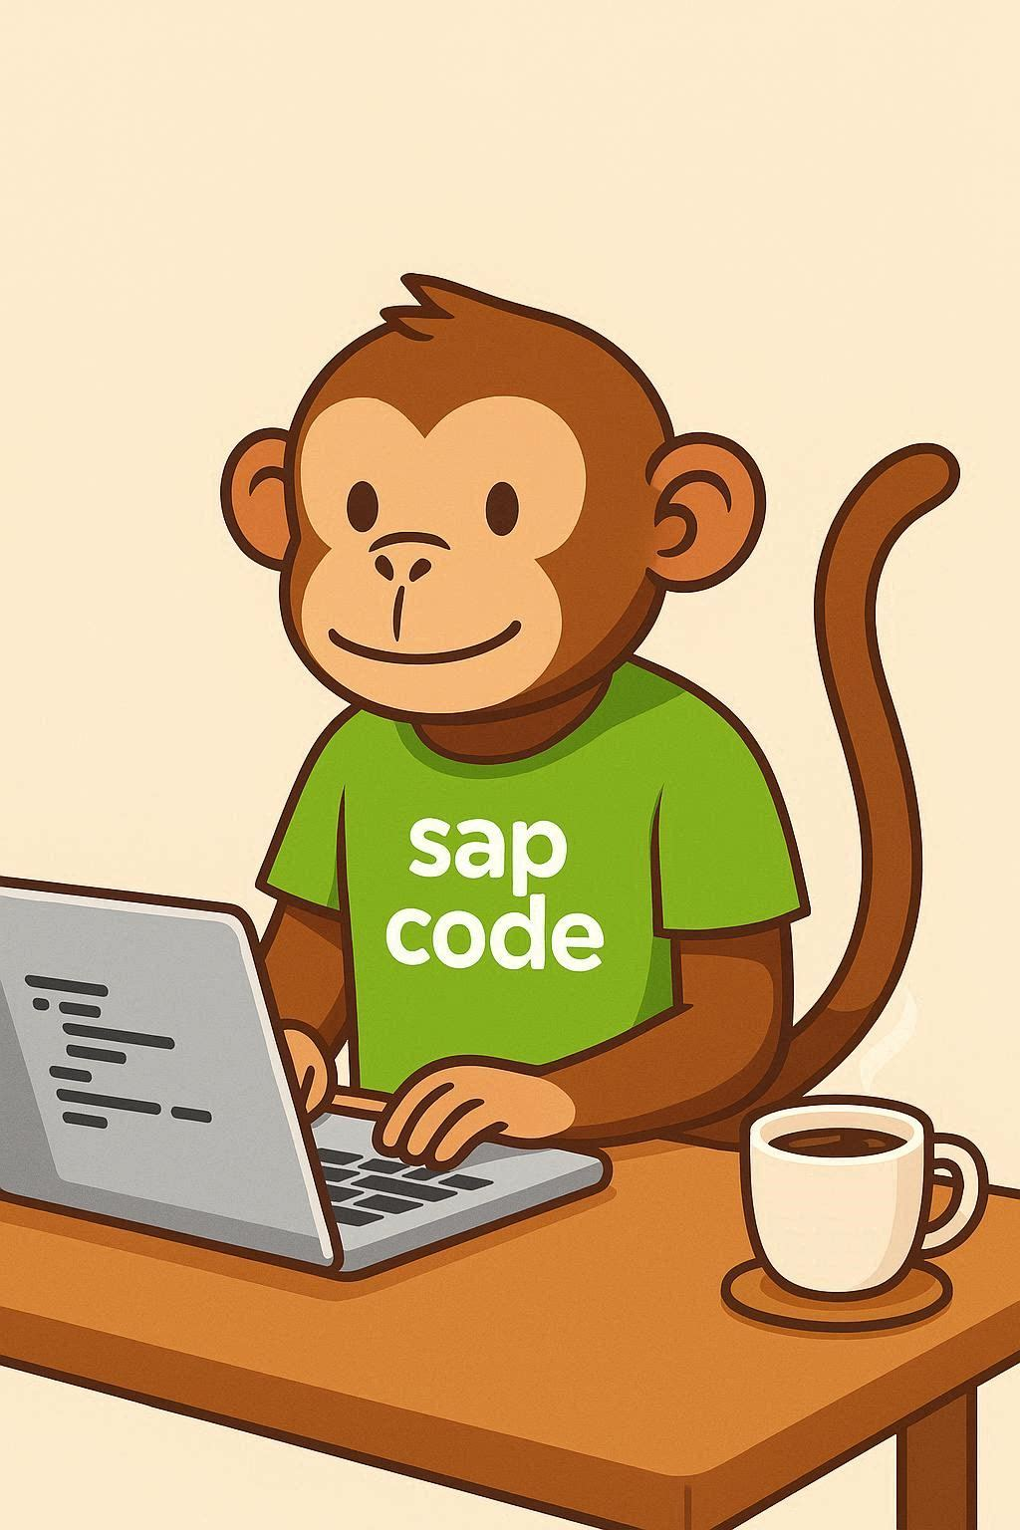
COMPANION DECK
Claude vs Joule
for ABAP
both
Which one for what — a practical guide to using
general AI and SAP-native AI together.
general
SAP-native
ABAP in the AI Era · free download
Notes:
Title slide. This deck is the downloadable companion to the 'Claude vs Joule for ABAP' video. Replace the channel name in the footer with your own branding.

Slide 2
Two kinds of AI, two different jobs
The question isn't which is better. It's which one for what.
G
GENERAL AI
J
SAP-NATIVE AI · JOULE
Breadth
Depth
Trained broadly across domains
Strong at open-ended reasoning
Knows a bit of everything
Does NOT know your SAP landscape
Lives outside your system boundary
Trained on SAP's own ABAP model
Embedded in ADT / VS Code
Knows your released APIs & data model
Respects your authorizations
Runs inside your SAP tenant
Everything else follows from this: one has SAP depth, the other has general breadth.
2
Notes:
Set up the two tools fairly. The whole deck rests on this depth-vs-breadth distinction.

Slide 3
Where Joule wins outright
Credit where it's due — on SAP-specific work, this isn't close.
1
Generating real ABAP and CDS
Suggests the correct released API, follows Clean Core patterns, respects the S/4HANA data model. A general model is guessing from broad training.
2
Catching mistakes in-system
Flags a deprecated function module as you type and hands you the compliant alternative. It knows what 'released' means in your release.
3
Explaining gnarly legacy ABAP
Understands SAP semantics, so code-explain on real SAP objects beats a general model reasoning from the outside.
4
Governance and data residency
Runs inside your tenant. Your code and data stay within the SAP boundary — decisive in a regulated environment.
3
Notes:
Lead with Joule's strengths. Visibly crediting the SAP-native tool is what earns credibility for the rest of the comparison.

Slide 4
Where a general model helps more
Mostly the work above and around the ABAP itself.
1
Architecture and design conversations
"Should this be RAP or a side-by-side extension, and why?" Open-ended, think-it-through-with-me reasoning before you commit code.
2
The non-ABAP layers
JavaScript, Fiori front end, integration logic, BTP glue, SQL reasoning — the full-stack breadth the modern role increasingly demands.
3
Translation and communication
Business requirement into a clean spec. Documentation. The stakeholder explanation. Test scenarios designed conceptually before Joule generates the classes.
4
Learning and rubber-ducking
"Explain why this pattern is bad." Talking a problem out loud, at a conceptual level, without touching proprietary code.
4
Notes:
Note that none of these are 'write my ABAP' — that's deliberate. The general model earns its place on breadth, not SAP depth.

Slide 5
The cheat sheet
Which tool to reach for, by task.
TASK
GENERAL AI
JOULE
Generating compliant ABAP / CDS
YES
Catching Clean Core violations
YES
Explaining gnarly legacy ABAP
YES
Anything with proprietary code or data
YES
Architecture and design tradeoffs
YES
Front end, JS, Fiori, integration
YES
Requirement to spec, docs, comms
YES
Learning and concept explanation
YES
Rule of thumb: if the task needs to know your system, it belongs in Joule.
5
Notes:
The centerpiece slide. On video, build this row by row rather than showing it all at once.

Slide 6
The workflow: think wide, build deep
Breadth first, depth second.
STEP 1
STEP 2
THINK
BUILD
General AI
Joule
Design the approach. Weigh the tradeoffs. Draft the spec. Reason across the whole stack — abstracted, no proprietary detail.
Generate the compliant code. Catch Clean Core violations. Validate against the real system, with real context and real authorizations.
You reason it through broadly, then execute and validate inside the tool that actually knows SAP.
6
Notes:
This is the most quotable slide — 'think general, build in Joule'. Good candidate to slice as a standalone Short.

Slide 7
!
Before you do any of this: data governance
Get this wrong and the workflow doesn't matter.
DO NOT paste into an external tool
DO use the general model for
Proprietary source code
Customer or employee data
Regulated financial data
System, config, or credential detail
Abstracted, non-sensitive reasoning
The shape of the problem, not the data
Generic patterns and public APIs
Anything you'd say in a public talk
Describe the shape, not the data.
Check your organisation's policy first. Unless you're covered by an enterprise agreement with the right data protections, an external model sits outside your SAP boundary — which is exactly the gap Joule's in-tenant model is designed to close.
7
Notes:
Do not soften this slide. In regulated environments — finance, public sector — this is the difference between a good workflow and a compliance incident.

Slide 8
In practice: a five-second decision
Ask these in order before you open either tool.
Does it touch proprietary code or data?
Joule. Full stop — it stays inside your tenant.
Does it need to know YOUR system?
Joule. Released APIs, data model, authorizations, Clean Core rules.
Am I still deciding the approach?
General AI. Design, tradeoffs, architecture — thinking before building.
Is it outside ABAP entirely?
General AI. Front end, integration, docs, stakeholder comms.
Most days you'll use both — often on the same ticket, in that order.
8
Notes:
A practical takeaway slide viewers can screenshot. Deliberately ordered so the governance question comes first.

Slide 9
The AI-fluent developer isn't the one
using the fanciest single tool.
It's the one who knows which tool the problem in front of them actually needs.
General = breadth · Joule = depth
ABAP in the AI Era · full video and series in the description
Notes:
Closing slide. Swap the footer for your channel name and link.

