Slide 1
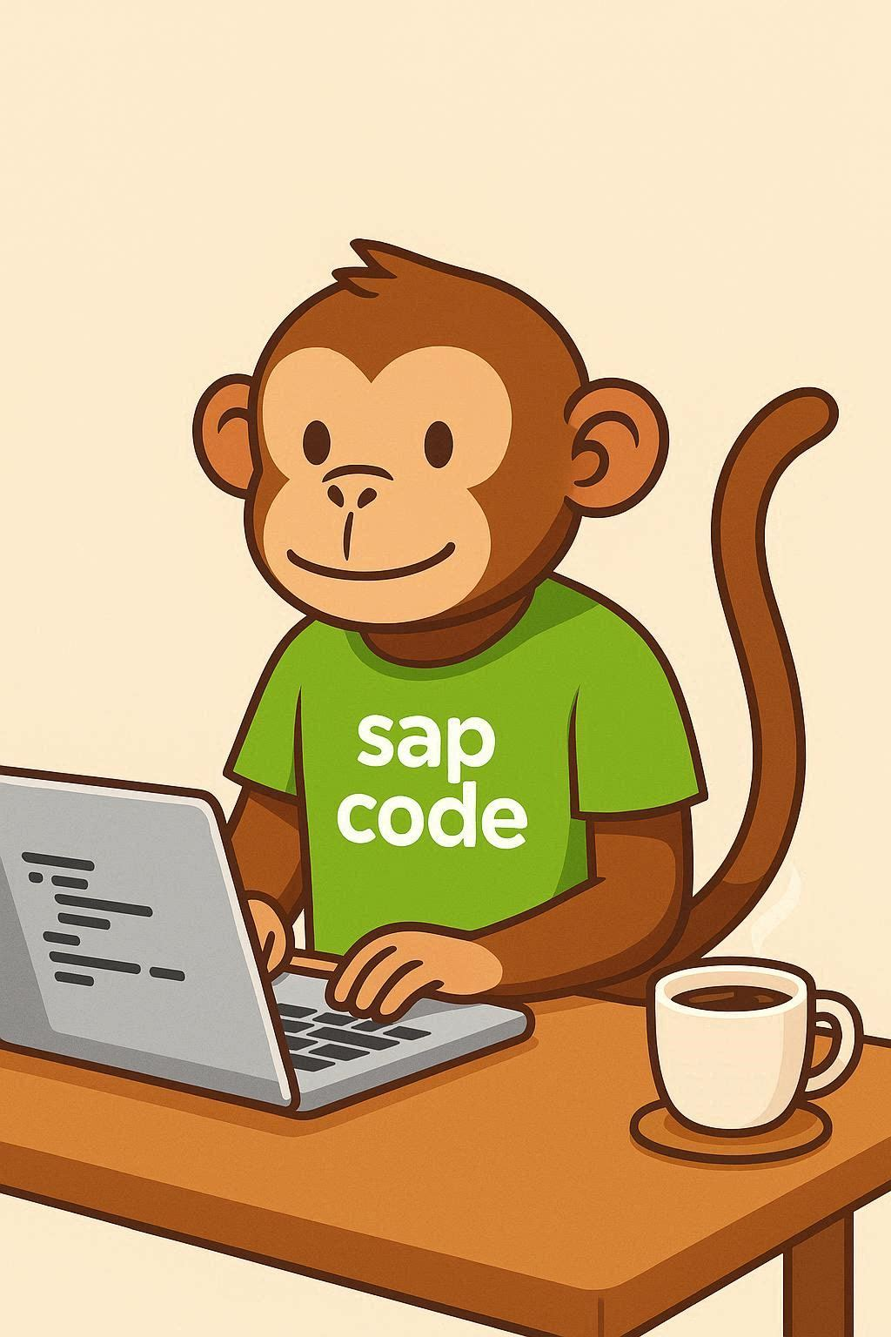
COMPANION DECK
Clean Core &
ABAP Cloud
A
B
C
D
upgrade-safe
technical debt
Not “stop customizing”. Customizing in a way
that survives the next upgrade.
sapcodemonkey.com · free download
Notes:
Companion deck to the Clean Core explainer at sapcodemonkey.com/clean-core.html. Swap the footer for your own branding.

Slide 2
What clean core actually means
The phrase gets used as if it means “stop building things”. It doesn't.
THE MISREADING
WHAT IT IS
“No more customization”
Build against contracts
Read this way, clean core sounds like an instruction to stop meeting business requirements — and it gets resisted accordingly. Teams either ignore it or treat it as a reason not to move.
Extend using interfaces SAP has formally committed to keeping stable, and your extension survives releases. Extend against internal objects, and you own the risk every time SAP ships.
The question isn't whether you customize. It's what you customize against.
2
Notes:
Lead with the misreading. Almost every room contains someone who thinks clean core means they can't meet a business requirement.

Slide 3
Six dimensions, not one
Developers hear “clean core” and think custom code. That's one dimension of six.
Software stack
Extensibility
Integrations
Stay on supported releases. No modifications to standard.
Where and how you build custom logic. The A–D levels live here.
Released APIs and governed interfaces, not point-to-point improvisation.
Processes
Data
Operations
Standard where standard works. Divergence is a cost, not a default.
Quality and volume under control. Archive what you don't need.
Predictable, monitored, upgrade-ready as routine rather than as a project.
3
Notes:
The highlighted dimension is the one this deck covers. Worth saying out loud that a project can be blocked by data or processes rather than code.

Slide 4
The model you learned was replaced
SAP moved from three tiers to four levels in August 2025. Most material hasn't caught up.
UNTIL AUG 2025
CURRENT
Three tiers
Levels A to D
Tier 1 — ABAP Cloud and BTP
Tier 2 — wrappers for unreleased objects
Tier 3 — classic ABAP
Verdict: clean, or not clean
A maturity scale, not a pass/fail
Classic ABAP no longer uniformly condemned
More released APIs → fewer wrappers
Every object gets a grade you can track
Why it matters practically: the old model told you your Tier 3 estate was “not clean” and left you there. The level scale gives you a backlog you can sequence.
4
Notes:
This slide is the reason the deck exists. Anyone quoting the three-tier model is working from superseded guidance.

Slide 5
The four levels at a glance
Graded on upgrade safety. A is the target; D is the thing being eliminated.
A
Released APIs only
Upgrade risk
Formal stability contract. On-stack via ABAP Cloud, or side-by-side on BTP.
None
B
Classic but documented APIs
Upgrade risk
Stable in practice, without the formal contract. Fine with governance sign-off.
Low
C
Internal SAP objects
Upgrade risk
Works today; SAP never promised it would. Needs a remediation roadmap.
Meaningful
D
Modifications & direct writes
Upgrade risk
Changes to SAP objects, implicit enhancements, writes bypassing SAP logic.
Severe
5
Notes:
Build this row by row on video rather than showing all four at once.

Slide 6
Levels A and B — where you want to be
One is the destination. The other is liveable, with a decision recorded.
A
Released APIs only
B
Classic but documented
Upgrade risk: none
Upgrade risk: low
ABAP Cloud on-stack — RAP, CDS, released APIs
Side-by-side on BTP — ABAP environment, CAP, SAP Build
Key user extensibility for in-app adaptations
Tightly coupled logic is fine here — proximity isn't the problem, unstable dependencies are
Documented classic APIs and interfaces
Recognized extension points with stated behavior
Stable in practice, without a formal contract
Only safe as a recorded decision — otherwise B quietly becomes the whole estate
6
Notes:
The B warning matters: without governance, B becomes the default and nobody notices until an upgrade.

Slide 7
Levels C and D — where the debt sits
One needs a roadmap. The other needs a retirement date.
C
Internal SAP objects
D
Modifications
Upgrade risk: meaningful
Upgrade risk: severe
Calls into unreleased classes and function modules
Reads from tables with no released equivalent
Isolate behind a wrapper so the dependency sits in one place
Track SAP's object changelogs so incompatible changes surface before an upgrade does
Modifications to standard SAP objects
Implicit enhancements
Direct writes to SAP tables, bypassing application logic
Block the patterns in new code with ATC. Every existing one needs a retirement date
7
Notes:
Level D is where upgrade projects turn into archaeology. The cost is unbounded because you can't estimate what you can't predict.

Slide 8
THE RULE THAT CATCHES PEOPLE OUT
An extension is graded by the
lowest-ranked thing inside it.
A
+
A
+
A
+
D
=
D
Three immaculate ABAP Cloud components and one direct table write produce a Level D extension. There is no averaging and no partial credit — which is why “mostly clean” isn't a status worth reporting.
Notes:
Strongest slide in the deck and the best standalone clip. The visual does the work — let it sit before you explain it.

Slide 9
What to do about it
Not a transformation program. Five things that move the needle.
01
Grade what you already have
Run ATC with the clean core and ABAP Cloud readiness checks. Most estates are less uniformly bad than feared and more concentrated than expected.
02
Stop the bleeding first
New development goes to Level A. Block Level D patterns in new code with ATC. Remediation is slow; prevention is immediate.
03
Triage by risk, not by count
A Level D object in a monthly process matters more than Level C in a report nobody opens. Retire dead code first — usually the cheapest win available.
04
Wrap what you can't yet replace
Isolate the dependency behind your own interface. When SAP releases a proper API you change one thing, not fifty. Retire the wrapper then.
05
Choose on-stack vs side-by-side deliberately
Both reach Level A. The choice is architectural, not compliance — treating it as compliance puts things in the wrong place.
9
Notes:
Step 2 is the one people skip. Preventing additions is far cheaper than remediating, and it stops the backlog growing while you work on it.

Slide 10
A
B
C
D
Clean core isn't a restriction.
It's a decision about who owns the risk.
Build against a contract and SAP carries it. Build against internals and you do — every single release, forever.
Interactive version at sapcodemonkey.com
Guidance is revised regularly — verify against the current ABAP extensibility guide for your release.
Notes:
Closing slide. Keep the verification line — it protects you and it signals you know the guidance moves.

