Slide 1
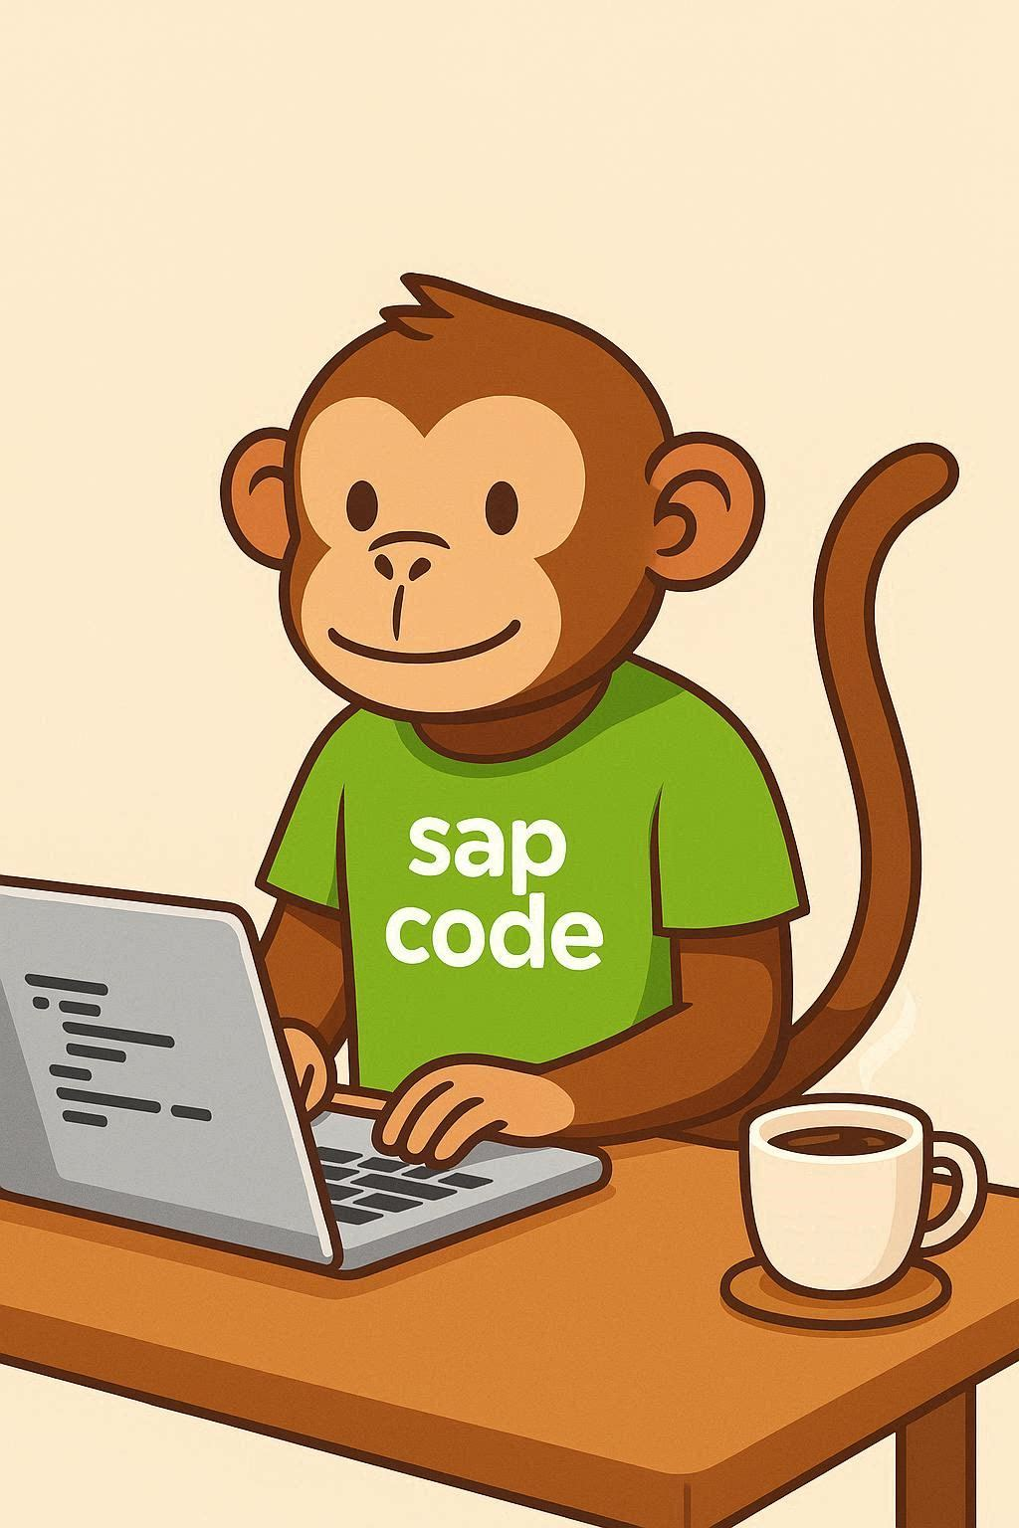
COMPANION DECK
Regearing
Developers
How SAP skills change by role — and
what to do about it in the next twelve months.
Functional
Written for people already doing the job, not for people deciding whether to hire them.
Support & Basis
sapcodemonkey.com · free download
Notes:
Set the tone early: this is not a warning and not a sales pitch. It's a map for people who intend to still be doing this work in five years.

Slide 2
Three things arriving at once
Any one of these would be manageable. Together they reshape the job.
01
02
03
Clean Core
AI tooling
Continuous change
Custom code moves out of the core and onto released APIs. Decades of modifications need rebuilding or retiring.
Generation is cheap. The scarce skill becomes knowing whether the output is right, fast and upgrade-safe.
Cloud release cadence replaces the three-year upgrade cycle. Nothing is ever finished.
None of these removes the need for people who understand why a system behaves the way it does. They move the value from producing work to judging it.
2
Notes:
The bottom line is the thesis of the whole deck. Say it once here and let the role slides prove it.

Slide 3
THE PATTERN, IN EVERY SEAT
Value moves from producing
the work to judging it.
Writing the code
Knowing if it's right
Configuring to the spec
Shaping the spec
Closing the ticket
Knowing why it reopens
Notes:
Best standalone clip in the deck. Three lines, three roles, one idea.

Slide 4
Three seats, three different problems
The forces are shared. What they do to your week is not.
Developers
Functional
Support & Basis
The tools now write what you used to write. Your value moves up into review, performance and upgrade safety.
More of what needed a developer becomes configuration. Knowing what standard already does becomes leverage.
More code arrives faster from more people. Someone has to gate production and keep autonomy auditable.
If you sit across two of these — and plenty of people do — the overlap is where the strongest positions are.
4
Notes:
Acknowledge hybrid roles. In smaller shops one person is often all three, and that breadth is now an advantage rather than a lack of specialization.

Slide 5
DEVELOPERS
What fades, what gains
Nothing here is about being replaced. It's about which half of the job grows.
LOSING VALUE
GAINING VALUE
Memorizing function modules and syntax
Raw speed at boilerplate and CRUD
Classic-only depth — GUI reports, exits, modifications
Writing code a model now produces in seconds
Judging output: performance, correctness, upgrade safety
Set-based thinking — pushdown, CDS, AMDP over loops
Clean Core patterns: ABAP Cloud, RAP, released APIs
Reading legacy code and deciding what to keep or kill
Breadth: OData, Fiori basics, BTP, the non-ABAP layers
5
Notes:
The 2am-production-dump veteran is the one who can supervise a tool that's fast and occasionally confidently wrong. Say that out loud — it reframes experience as an asset rather than legacy baggage.

Slide 6
DEVELOPERS
The twelve-month path
One meaningful thing per quarter. All of it doable alongside a full workload.
MONTH 1–3
MONTH 4–6
MONTH 7–9
MONTH 10–12
Get graded
Learn CDS properly
Build in RAP
Go off-stack
Run ATC with clean core and ABAP Cloud readiness on your own objects
Learn what “released API” means in your release
Read the levels model
Views, associations, annotations — not just consuming them
Convert one loop-heavy report to pushdown
Measure the before and after
One small business object end to end
Managed scenario first, then unmanaged
Deploy it and support it
One side-by-side extension on BTP
Use AI tooling daily; learn where it's wrong
Decide on-stack vs side-by-side deliberately
Build something real at each stage. A tutorial you followed proves nothing; an object running in your own system proves you can do the work.
6
Notes:
Measuring the before and after on the pushdown exercise is the single most persuasive thing a developer can put in front of a manager.

Slide 7
FUNCTIONAL
What fades, what gains
This is the seat that gains the most, and the one most people underestimate.
LOSING VALUE
GAINING VALUE
Transaction codes as the core professional skill
Configuration by rote in newly standardized areas
Acting as translator between business and developers
Hand-written process documentation
Knowing exactly what standard already does — pure leverage
Reading and reasoning about generated code and CDS
Launchpad and catalog design as a user-experience decision
Deciding where automation acts and where a human signs off
Business-case judgment: is this worth building at all?
7
Notes:
The translator role shrinking sounds like a loss but isn't. It frees the functional consultant to move upstream into shaping requirements rather than relaying them.

Slide 8
FUNCTIONAL
The twelve-month path
Built around one principle: never spec a custom build for something standard already does.
MONTH 1–3
MONTH 4–6
MONTH 7–9
MONTH 10–12
Learn the data model
Map what exists
Extend without a developer
Design a process
The tables your module actually posts to now
How the universal journal changed your reporting
Where Business Partner changed master data
Every standard Fiori app in your module
Which classic transactions are superseded
Build your own catalog of what's available
Key user and in-app extensibility
Custom fields and logic where supported
Ship one change end to end yourself
Flexible Workflow scenarios in your area
Where autonomy is allowed, where sign-off stays
Write the governance rule, not just the config
The catalog exercise in months 4–6 pays for itself the first time it stops a custom development that standard already covered.
8
Notes:
Killing one unnecessary custom build funds a lot of learning time. That's the argument to take to a manager.

Slide 9
SUPPORT & BASIS
What fades, what gains
The seat that feels most exposed and is actually holding the strongest hand.
LOSING VALUE
GAINING VALUE
Answering “what's the transaction code”
Manual repetitive checks and reports
The annual upgrade-project rhythm
Firefighting modifications nobody documented
Gatekeeping what reaches production — more code, faster, more authors
Governance and audit trails, especially for automated decisions
Launchpad, catalog and role diagnosis — the new ticket shape
Continuous release management and regression automation
Diagnostic judgment: why it keeps reopening, not just how to close it
9
Notes:
Lead with the reassurance. This audience arrives expecting bad news, and the honest answer is that their leverage increases if they move toward governance.

Slide 10
SUPPORT & BASIS
The twelve-month path
Move from closing tickets to owning the gate. Every step is learnable on the job.
MONTH 1–3
MONTH 4–6
MONTH 7–9
MONTH 10–12
Own the launchpad
Run the quality gate
Automate regression
Govern autonomy
Catalogs, groups, spaces and pages
The four-step diagnosis for a missing tile
Document it for the rest of the team
Become the person who runs and reads ATC
Define what blocks a transport
Report the estate by level
A test suite for the processes that matter most
Run it every release, not every project
Measure how much manual testing it removes
Audit trails for automated and agent-driven steps
Segregation of duties where systems act alone
Be the person who can answer the auditor
Month 10–12 is the highest-value square on this whole deck. Technology can route and decide. It cannot own accountability.
10
Notes:
In regulated environments — finance, public sector — the governance square is genuinely scarce and genuinely well paid.

Slide 11
What all three need
Four things that hold value regardless of which seat you're in.
Domain depth
AI fluency
The part that doesn't automate. A model can write the CDS view; it can't tell you which ledger the posting belongs in.
Not prompt tricks. Knowing what these tools do well, where they're confidently wrong, and what never leaves your tenant.
Judgment
Communication
Reviewing, deciding, saying no. Producing work is getting cheap; deciding whether it's right is not.
Turning business intent into a specification, and technical reality back into something a stakeholder can act on.
Three of these four are unteachable by a course and only earned by doing the work. That's the good news.
11
Notes:
Domain depth, judgment and communication all come from experience. Anyone with years in these systems already holds most of what matters.

Slide 12
THE PART MOST DECKS SKIP
The floor is rising and the
middle is getting squeezed.
WHAT'S GENUINELY EXPOSED
WHAT THE RESPONSE ISN'T
Commodity delivery. Routine custom reports, headcount billed by the day, work defined entirely by a ticket queue. If that describes the whole of the job, that's the exposed position.
Resisting the tools, or waiting for it to blow over. The people who treat this as a threat to avoid get outcompeted by people with identical experience who treat it as leverage.
Same person, different response, completely different next five years.
Notes:
Say the uncomfortable part plainly. Naming a real risk is what earns the right to the optimistic parts of the deck.

Slide 13
One thing to start this month
Not a plan. A first action, sized to fit around the day job.
Run ATC with clean core checks against code you wrote. Read the findings on your own work — abstract guidance never lands the way your own object does.
Developers
List every standard Fiori app in your module. You'll find capability nobody knew existed, and you'll stop a custom build within the quarter.
Functional
Write the four-step diagnosis for a missing tile and share it with the team. Small, useful, and it makes you the person who owns the new ticket shape.
Support & Basis
Each of these produces something you can show someone. That matters more than any certificate.
13
Notes:
Keep it to one action. Three-year plans don't survive contact with a support queue.

Slide 14
Nobody is being replaced by a tool
that needs supervising.
But the comfortable version of the job — where what you already knew kept you safe — is the part that's ending.
Pick your seat at sapcodemonkey.com
Notes:
Close on the honest note rather than the reassuring one. The site's role lens is the natural next step for anyone who wants their own version of this.

