Slide 1
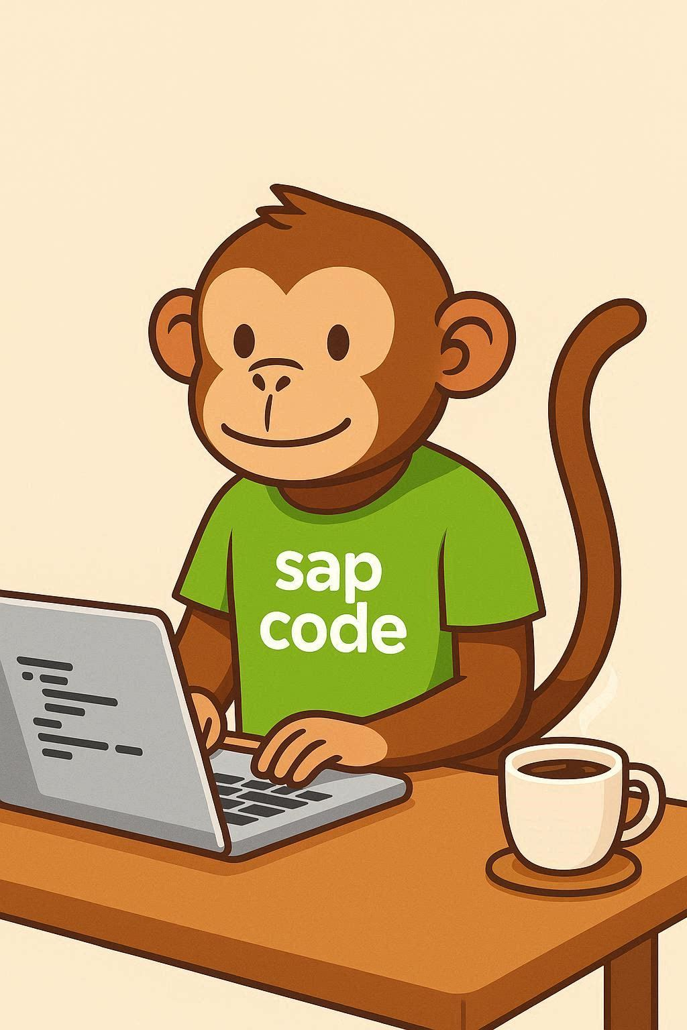
COMPANION DECK
Your SRM skills
have an expiry date
SRM
2027
2030
What replaces SRM, whether Ivalua is a real option,
and which of your skills actually transfer.
mainstream ends
extended ends
no planned innovations
sapcodemonkey.com · not affiliated with SAP, Ivalua or any implementation partner
Notes:
State the vendor neutrality out loud. The entire value of this material is that it isn't a pitch.

Slide 2
The dates, and what they cost
“We'll take extended maintenance” sounds like a free decision. It isn't.
2027
Mainstream maintenance ends
SRM is part of Business Suite 7 and follows its maintenance policy.
2030
Extended maintenance ends
Optional, and priced at an additional 2% on top of the standard 20% fee.
—
No planned innovations
The product is frozen. There is no better version coming to wait for.
A procurement transformation is a two-year program, plus a year for budget and partner selection. Work backwards from 2030 and the decision window is now.
2
Notes:
The backwards math is the most useful thing on this slide for anyone who needs to raise it with management.

Slide 3
Three paths, not two
Most conversations skip the third one entirely.
Central Procurement
SAP Ariba
Third party
SAP's own successor. Integrated into the core of S/4HANA as a procurement module, activated by configuration. A multi-backend scenario makes one S/4HANA system the hub for SAP and non-SAP systems.
The cloud path, and the one marketed hardest. Strongest on the external side — supplier network, collaboration, sourcing. A separate variant exists for public sector.
Leave the SAP stack. Ivalua, Coupa and others. Discussed least in SAP circles, which is exactly why it deserves proper examination.
Best when procurement is mostly internal.
Best when supplier collaboration is the driver.
Best when ERP independence has real value.
These aren't mutually exclusive. Hybrid architectures are common — one system for the internal process, another for supplier-facing work.
3
Notes:
Don't let the room collapse this into a two-horse race. The hybrid option is what many organizations actually land on.

Slide 4
Is Ivalua a real option for an SAP shop?
Yes. This is a done pattern, not a theory.
80%+
Connectivity that exists today
Plug-and-play connector for ECC and S/4HANA on-premise
Integration workplace covers S/4HANA Cloud via web services
Partners offer SRM-to-Ivalua replacement as a standard service
of Ivalua's own clients run SAP as their ERP. This isn't a vendor that occasionally meets SAP — the product assumes it.
The honest case for it
ERP independence and configurability. If you run more than one ERP — and plenty of organizations do after acquisitions — a procurement layer that doesn't care what sits underneath has genuine value. Ivalua is also highly configurable in a way SAP procurement historically hasn't been.
4
Notes:
Establish credibility for the option before criticizing it. The next slide is the counterweight.

Slide 5
Where the third-party path hurts
The part that doesn't come up in a sales meeting.
You own the integration. Permanently.
1
With Central Procurement the seam is largely SAP's problem — same product family. Go third-party and that seam becomes something your organization maintains, tests and troubleshoots through every release on both sides.
The standard interfaces are IDoc-based
2
Implementation partners are openly blunt that IDoc-based integration proves too rigid and costly to adapt in practice. That's why a market of certified third-party connectors exists at all.
Two data models, two sources of truth
3
The failure mode is specific enough that partners name it: suppliers blocked in one system while orders keep being placed in the other. Consistency has to be engineered, not assumed.
When a connector market exists around a product's standard interfaces, the standard interfaces aren't sufficient. Budget the connector as a workstream, not a line item.
5
Notes:
None of this rules Ivalua out. It rules out scoping the project as if integration were a phase rather than the whole thing.

Slide 6
What happens to your skills
The honest version, in both directions.
EXPIRES
TRANSFERS — AND GAINS VALUE
SRM-specific knowledge
The layer underneath
The SRM organizational structure
The SRM workflow engine
Classic vs extended-classic vs standalone design
SRM-side enhancements and catalog integration
The middleware between SRM and the back end
Purchase orders, goods receipt, invoice verification
Account assignment, material and supplier master
Sourcing, contracting, approval logic, three-way match
What a requisition becomes in the back end — and whether that's right
Supplier qualification and the process itself
6
Notes:
Say the left column plainly, then spend twice as long on the right. The ratio is the message.

Slide 7
THE POSITION WORTH AIMING FOR
Pure Ivalua consultants don't know SAP.
Pure SAP consultants don't know Ivalua.
Procurement process
you
SAP back end
That seat exists under Ariba too, and under Central Procurement. You're not betting on a vendor — you're betting on the seam, and there is always a seam.
Notes:
Strongest standalone clip in the deck. The point that this seat is vendor-independent is what makes it actionable rather than a gamble.

Slide 8
What to go and learn
Four things, none of which depend on which path your organization picks.
01
Deepen the back end, not the front end
If your procurement knowledge stops at the SRM boundary, push properly into MM — purchase order behavior, account assignment, goods receipt, invoice verification. Required in every scenario.
02
Move from IDoc thinking to API thinking
You don't need to become a developer. You need to read an interface specification and say “that mapping is wrong, and here's what it breaks.”
03
Learn the Business Partner model
Mandatory in S/4HANA if you're coming from ECC vendor master, and consistently underestimated in scope.
04
Get into the selection conversation
Whichever path is chosen, the person who understood the options early ends up leading the workstream. Highest leverage on this list, and it costs only attention.
8
Notes:
Item four is the one people skip and the one that changes careers.

Slide 9
systems
process
Systems expire. Process doesn't.
The SRM-specific skills have a date on them. The back-end knowledge and the process knowledge don't — they get more valuable, because they're what makes the integration correct.
More at sapcodemonkey.com
Maintenance dates and successor guidance have been revised before — verify against SAP's published maintenance strategy for your situation.
Notes:
Close on the reframe rather than the deadline. People leave with something they can act on rather than something to worry about.

