Slide 1
SMART AND CONNECTED WORLD HACKATHON
USING INTERNET OF THINGS - eDhara
05.05.18
Areti Raghuram
Dheeraj Dubey
Narahari Bijjala
Rahul Vasa

Slide 2

IDEATE * CRAFT IT * SHIP IT

Slide 3
Agenda
Idea Brief
Solution Overview
Story Line
DIY
DEMO

Slide 4
Story Line
The global population is set to touch 9.6 billion by 2050. So, to feed this much population, the farming industry must embrace IoT. Against the challenges such as extreme weather conditions and rising climate change, and environmental impact resulting from intensive farming practices, the demand for more food has to be met.
Population growth and limited resources put pressure on growers to produce more with less. Farmers must contend with increasing water shortages, limited land availability, and fluctuating costs. Our IDEA enables innovative smart farming solutions to help farmers overcome these challenges. These agriculture IoT solutions allow farmers to leverage sensors, smart gateways, and monitoring systems to collect and analyze information and make more informed decisions.

Slide 5
Solution Overview
The eDhara open-source IoT Platform is a crucial device that allows walking safely into the agriculture IoT field. By tying together different sensors, connected devices, and farming facilities, eDhara streamlines the development of smart farming systems to the maximum degree possible. eDhara is perfectly applicable for single-purpose smart farming products - such as smart metering devices, continuous monitory - as well as for notifying and taking corrective measures.

Slide 6






Internet of Things
What can you do with eDhara
Sensor based field
monitoring
Remote equipment monitoring
Remote crop monitoring
Climate monitoring
Power management
Smart logistics and warehousing

Slide 7
Story Line & Motivation
Story 1: Ravi, a daily worker in a farm, switches on water drip in the farm irrespective whether soil has enough moisture in it or not. This harms the crops as excess moisture is not good for them.
IoT Solves: A soil moisture sensor module determines soil moisture content and sends analog signals to the ESP32 microcontroller. On basis of soil moisture % it will send notification to Ravi whether to turn off/on water drip.
Story 2: Raghu, works as a farm caretaker and has to ensure that temperature and humidity in the warehouse is always stable for the good shell life of crops. But he finds is very difficult to monitor it when he is away. He wants a solution that he can use to monitor the warehouse temperature and humidity even when he is away.
IoT Solves: ESP32 has Wifi connectivity which can communicate over internet. The DHT11 (temperature and humidity sensor) module monitors the parameters passes it on to ESP32. Raghu can now simply login to the Farm App and monitor the live temperature and humidity as well as see graphs for last 24 hours.
Story 3: Thakur, the farm owner is worried about the electricity consumption in his farm. Even though he has solar panels most of the equipment are running on direct power. He wants to ensure use of Solar power if the sunlight is abundantly available and switch to direct power only when needed.
IoT Solves: A simple photo sensitive sensor with ESP32 can be used to detect the abundance of sunlight. If abundant sunlight is available ESP32 and route power to all system via solar else switch to normal power.

Slide 8
DIY

Slide 9
Devices Used
ESP32 Microcontroller
DHT11 Module – Temperature and Humidity Sensor
Soil Moisture Sensor
Photo sensor
Battery
USB cables and Jump wires
Resistors
Lots of Motivation ☺

Slide 10
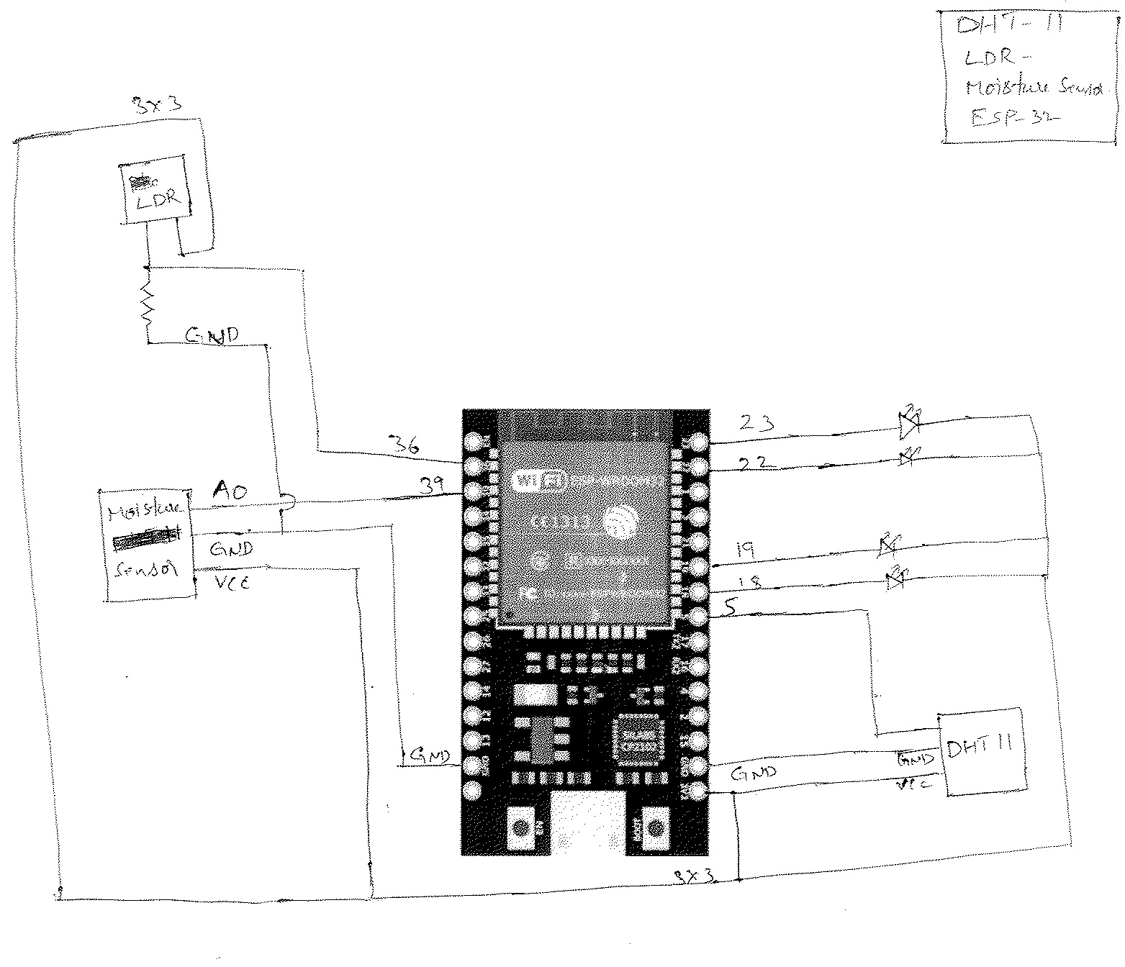
Pin Board & Circuit Diagram

Slide 11
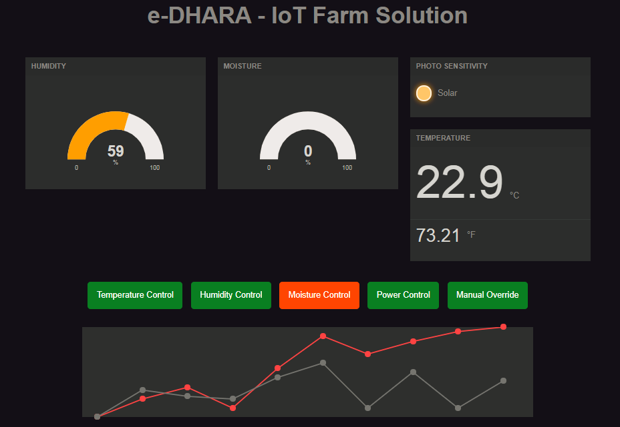
DEMO

Slide 12
Thanks

