Slide 1


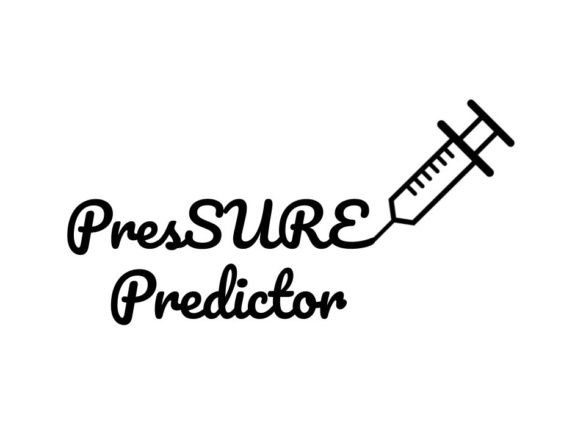

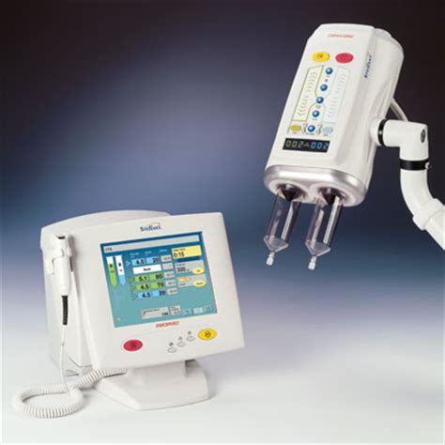

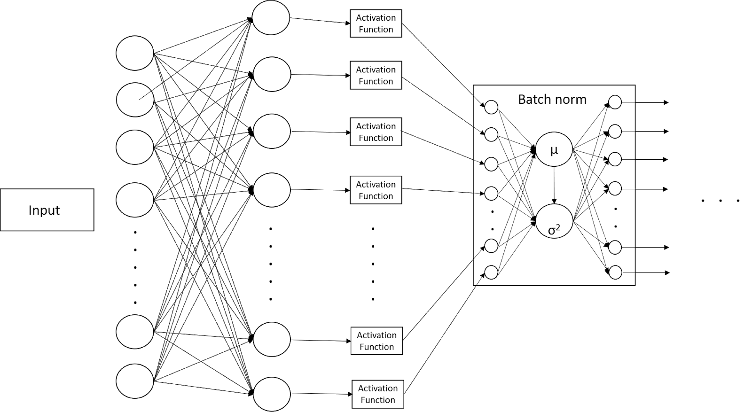

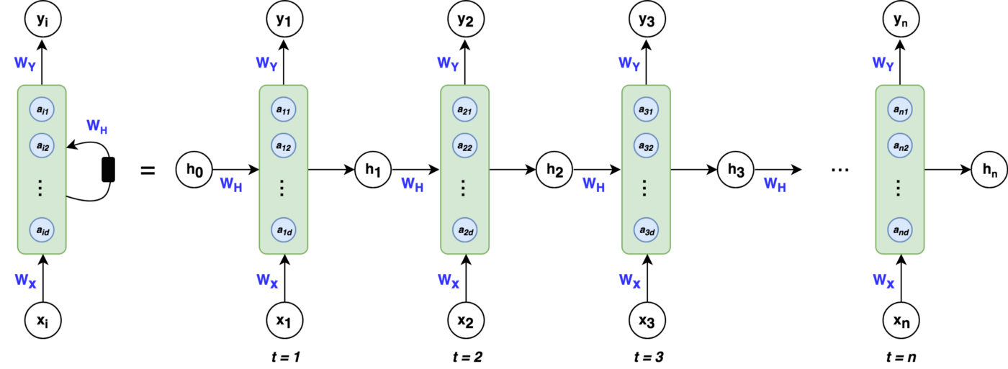
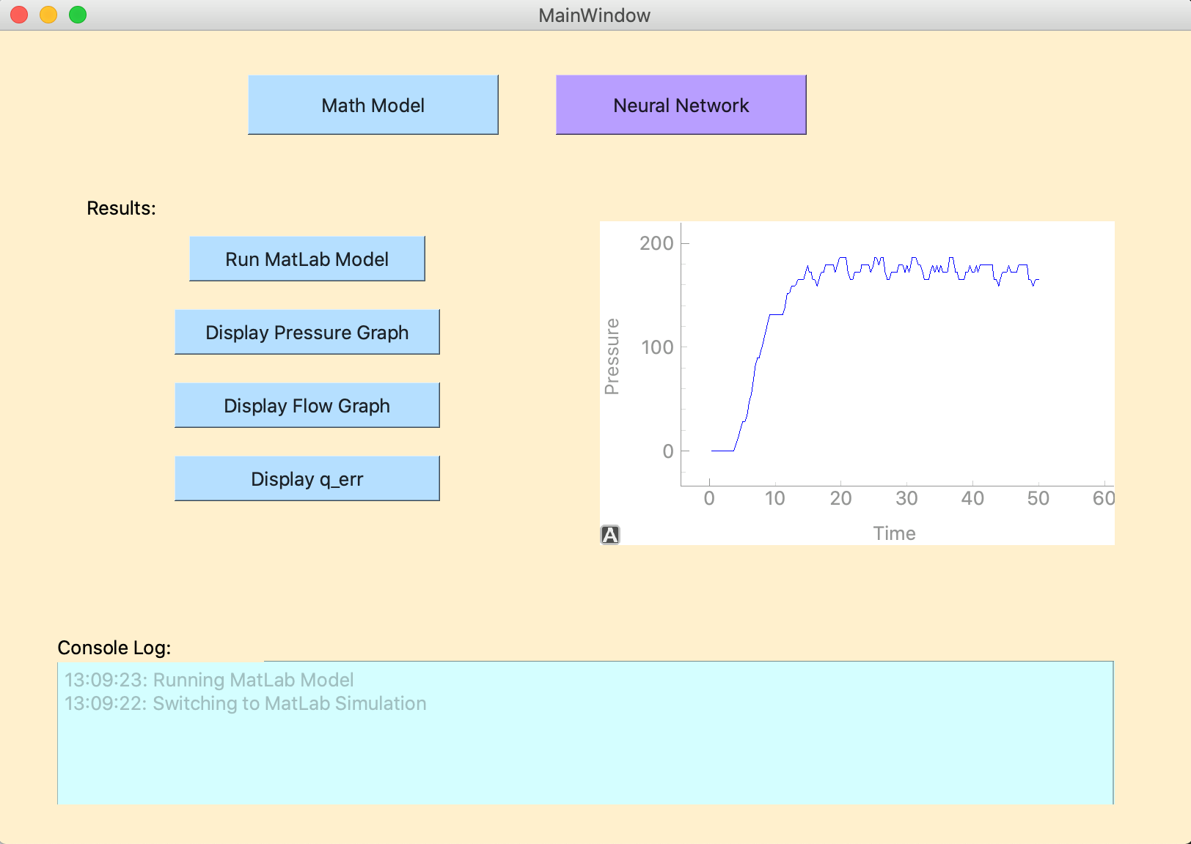
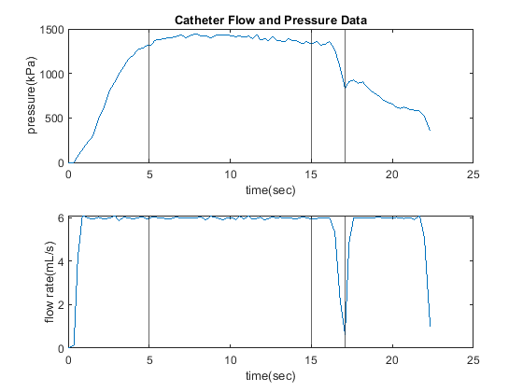
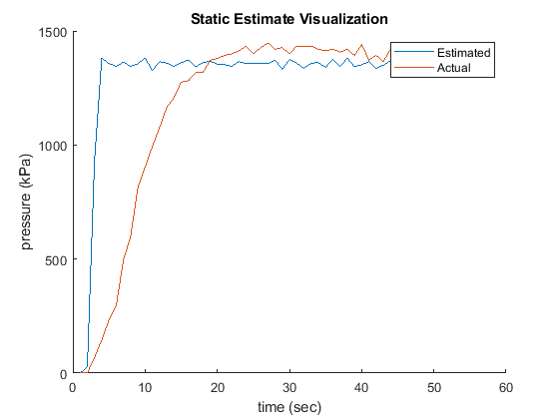
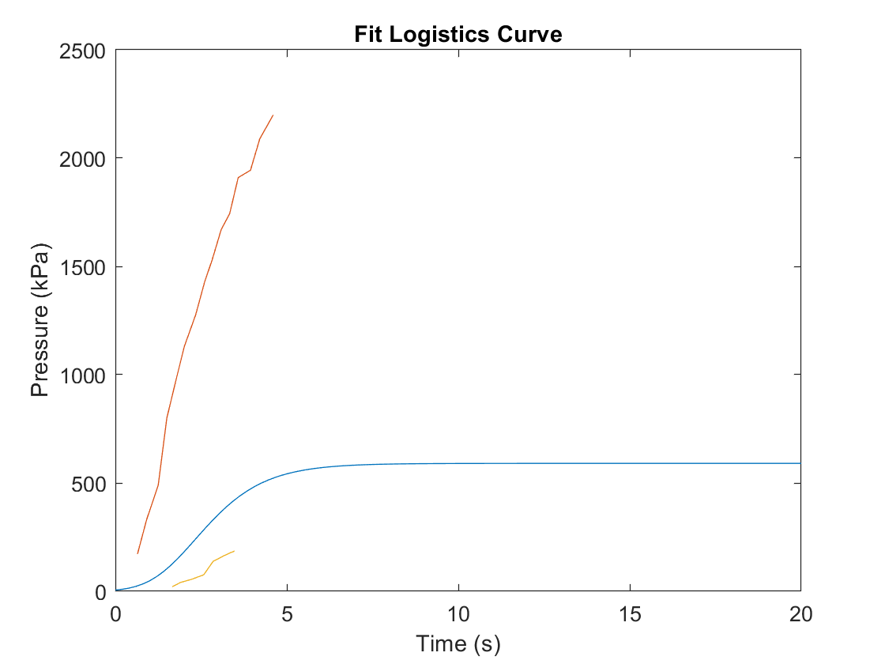
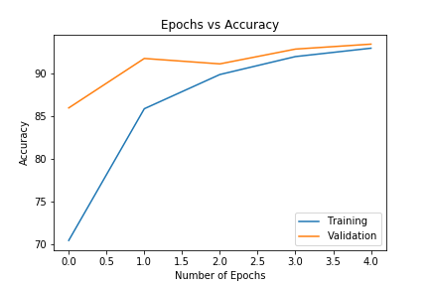
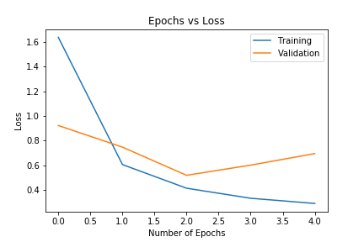
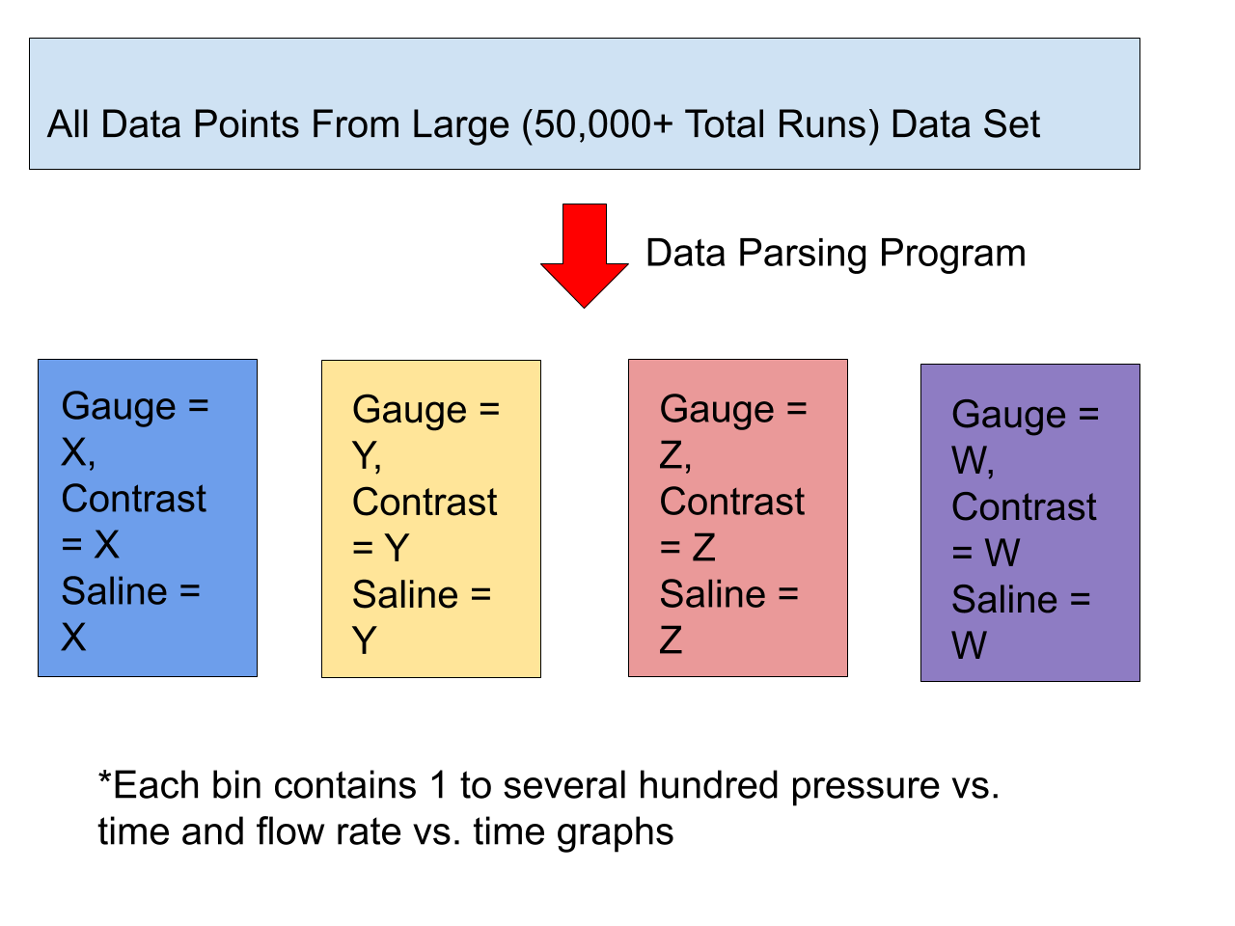
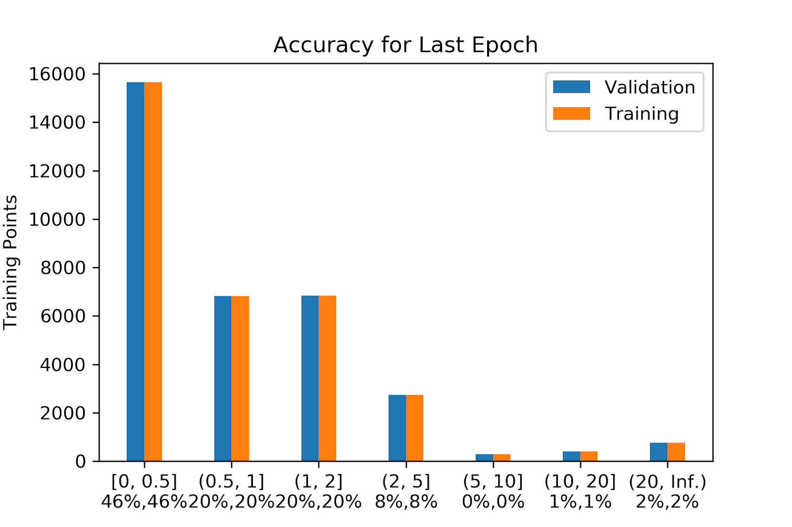
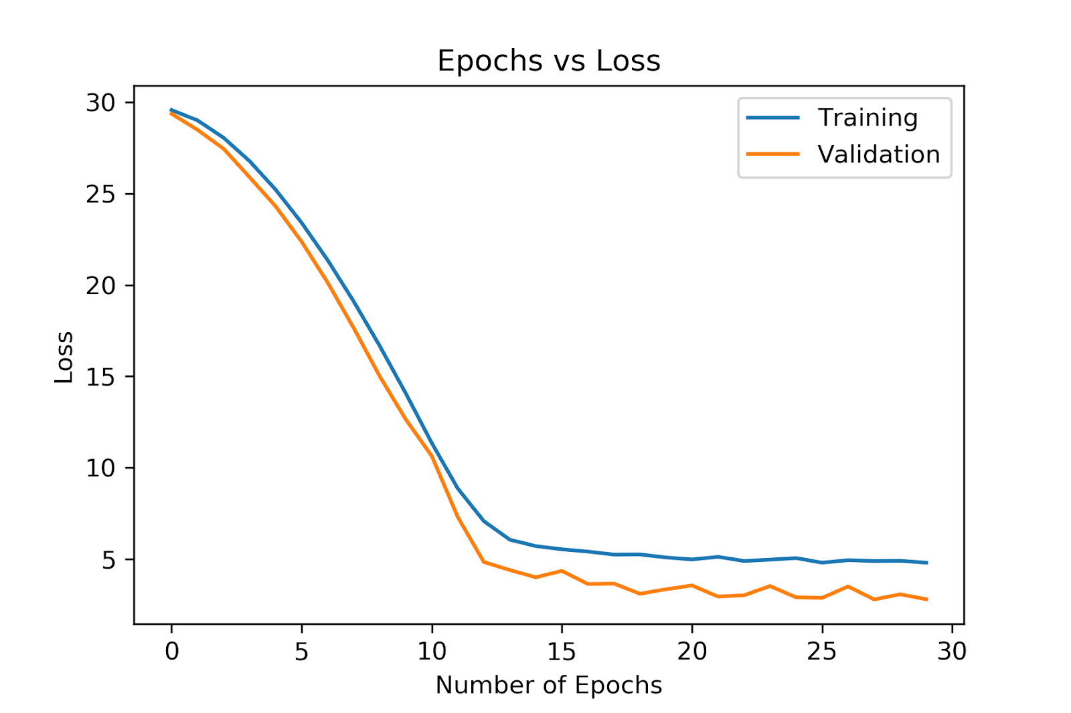
Bayer Pressure Prediction System Anusha Agarwala^{1,2}, Gage Anderson^{1,2}, Mia Han^{1,3}, Ricky Gupta^{1,3}, and Sean Pereira^{1,2}
1. Department of Biomedical Engineering 2. Department of Chemical Engineering 3. Department of Electrical Engineering
INTRODUCTION
DLNN Model
Conclusions
CT Scans are common in America, with over 70 million scans per year
Scans sometimes malfunction, exceeding maximum catheter pressure causing the technician to abort the procedure
There is no standard procedure for technicians to follow, rather each operator uses their own methods based on experience and unwritten rules
Developing a way to predict a pressure given the injection conditions in clinical use to ensure the clearest and most enhanced CT images.
Classification Based Model
Classifies the pressure into buckets within a range of 20 kPa based on the protocol settings
Regression Based Model
Estimates a singular pressure value in kPa based on the protocol settings.
Loss Functions
CrossEntropyLoss: Cross-entropy loss, or log loss, measures the performance of a classification model whose output is a probability value between 0 and 1. Cross-entropy loss increases as the predicted probability diverges from the actual label.
L1 Loss:
L2 Loss:
Architecture – Multiple Layers
Input: Types of Phases, Volume of Phases, and Flowrate of Phases
Linear Layer: Linear combination on the inputs plus a bias
Activation Function: Compute whether neuron should be fired based on input; provides non-linearity
Batch Normalization: Standardizes the inputs to a layer
Mathematical Model
Model can produce a graph for the technologists but is ineffective and inaccurate to be able to be used in the Stellant device.
Deep Learning Model
Our model is effectively and accurately able to determine the maximum pressure but is unable to create a continuous graph for the technologists.
Future Work
Recurrent Based Model – Change Data
Proper pressure output at the current time depends not only on current settings, but also past scenes and their change/trend.
We need the pressure to respond to current input, while remembering critical moments it has seen previously.
Figure 1: Stellant CT Injection System
BACKGROUND
No Standardization of protocols for technicians to follow
Configuration of injector and procedure is largely up to the technician and his/her background
PDS (Pressure-Disarm Scenario):
Occurs when the pressure in an injection reaches dangerously high levels, which could harm the patient or damage the catheter
Causes the injection to automatically abort
PLS (Pressure-Limiting Scenario):
Happens when the given setup for an injection procedure cannot reach an adequate pressure due to limitations such as catheter gauge in the setup
We will predict maximum pressure before the injection is run using empirical and theoretical models so that the probability of PDS and PLS is significantly reduced
Prediction of pressure on catheter gauge, contrast properties and saline properties
We want to prevent suboptimal scan leading to increased scan time or radiation exposure
RESULTS
Mathematical Model:
Step function fit the data well with ~2% error
However, Logistics function was not very effective, not capturing outliers
Models that used flow data to predict pressure data from Hagen-Poiseuille's equation were effective, but not practical for a priori prediction
Deep Learning Model:
Classification: Accuracy of 94.8% and a Loss of 0.4 was achieved with CrossEntropyLoss
Regression: Accuracy shows pressure shift in the graph from 0% to 46% in the 0 – 0.5 range and a Loss of 5 was achieved with L1 Loss.
Mathematical Model
Goal is to predict the maximum pressure an injection will reach within 5% of the actual value
Program consists of three segments: Data Parser, Nonlinear Analyzer, Output GUI
The data parser splits the large amount of data into chunks based on factors such as catheter gauge, saline type, and contrast type
The nonlinear analyzer uses nonlinear least squares regression to compare the model to empirical pressure vs. time data
The output GUI indicates a predicted waveform to the technician and predicts the maximum pressure as well as whether the injection should continue
We used a step-function model for the pressure curve and tried a logistics curve and fitting the data to the Hagen -Poiseuille equation.
Figure 4: Prediction of Pressure Data from experimental Flow data compared to actual data for that injection
Figure 5: Logistics Curve failed to capture outliers in pressure data, so other statistical models were necessary
Figure 10: Left: Prototype GUI. Runs the mathematical model using the MATLAB engine and displays the output in Python GUI can also use the DLNN to predict maximum pressure.
ACKNOWLEDGMENTS
The authors would like to give thanks to Bayer for their financial support in this project
The authors thanks Dr. Conrad Zapanta for his helpful feedback as well as our TAs especially Melanie Loppnow and fellow students for their valuable guidance and feedback.
REFERENCES
Figure 6: Epoch vs. Accuracy for the Classification Model; Validation accuracy increases with training.
1. "What Is a Stroke?". www.nhlbi.nih.gov/. March 26, 2014. Archived from the original on 18 February 2015. Retrieved 26 February 2015.
2. "Who Is at Risk for a Stroke?". www.nhlbi.nih.gov. March 26, 2014. Archived from the original on 27 February 2015. Retrieved 27 February 2015.
3. "How Is a Stroke Diagnosed?". www.nhlbi.nih.gov. March 26, 2014. Archived from the original on 27 February 2015. Retrieved 27 February 2015
4. Adams HP, Bendixen BH, Kappelle LJ, Biller J, Love BB, Gordon DL, Marsh EE (January 1993). "Classification of subtype of acute ischemic stroke. Definitions for use in a multicenter clinical trial. TOAST. Trial of Org 10172 in Acute Stroke Treatment". Stroke. 24 (1): 35–41.
5. Anonymous (2014-07-29). "Hemorrhagic stroke". National Stroke Association. Archived from the original on 27 June 2016. Retrieved 30 June 2016.
6. Hill MD (November 2005). "Diagnostic biomarkers for stroke: a stroke neurologist's perspective". Clinical Chemistry. 51 (11): 2001–2.
7. Bamford J, Sandercock P, Dennis M, Burn J, Warlow C (June 1991). "Classification and natural history of clinically identifiable subtypes of cerebral infarction". Lancet. 337 (8756): 1521–6.
8. Feigin VL, Rinkel GJ, Lawes CM, Algra A, Bennett DA, van Gijn J, Anderson CS (December 2005). "Risk factors for subarachnoid hemorrhage: an updated systematic review of epidemiological studies". Stroke. 36 (12): 2773–80.
9. Antonio Di Carlo, Human and economic burden of stroke, Age and Ageing, Volume 38, Issue 1, January 2009, Pages 4–5, https://doi.org/10.1093/ageing/afn282
10. “Bayer in Radiology Products.” Bayer Radiology, www.radiologysolutions.bayer.com/products.
11. “Contrast Agents Market Is Expected to Exceed US$ 5.65 Billion By 2022.” MarketWatch, 17 Aug. 2018, ww.marketwatch.com/press-release/contrast-agents- market-is-expected-to- exceed-us-565-billion-by-2022-2018-08-17.
12. “MEDRAD® Stellant CT Injection System: Radiology US.” Bayer in Radiology Official Site, www.radiologysolutions.bayer.com/products/injection-systems/medrad-stellant-ct.
13. A Guide to an Efficient Way to Build Neural Network ... https://towardsdatascience.com/a-guide-to-an-efficient-way-to-build-neural-network-architectures-part-i-hyper-parameter-8129009f131b.
14. Xing, Wanli, and Dongping Du. “Dropout Prediction in MOOCs: Using Deep Learning for Personalized Intervention.” Journal of Educational Computing Research, vol. 57, no. 3, 2018, pp. 547–570., doi:10.1177/0735633118757015.
15. Harvard Health Publishing. “Do CT Scans Cause Cancer?” Harvard Health, Mar. 2013, www.health.harvard.edu/staying-healthy/do-ct-scans-cause-cancer.
16. “Symptoms of a Stroke.” Www.goredforwomen.org, www.goredforwomen.org/en/about-heart-disease-in-women/signs-and-symptoms-in-women/symptoms-of-a-stroke.
17. United States, Food and Drug Administration, Center for Device and Regulatory Health. “Clinical Decision Support Software Draft Guidance for Industry and Food and Drug Administration Staff.” Clinical Decision Support Software Draft Guidance for Industry and Food and Drug Administration Staff.
18. “ISO/TS 13972:2015.” iso.org, International Organization for Standardization, Oct. 2015, www.iso.org/standard/62416.html.
Figure 7: Epoch vs. Loss for the Classification Model; Validation loss increases with Training; No overfitting.
Figure 2: Data parser sorts the data set into buckets grouped by contrast type, saline type, and catheter gauge
Figure 3: Logistics Model Failed to capture outliers, step model (pictured in GUI) worked better.
Figure 8: Epoch vs. Accuracy for the Regression Model; Represents deviation from True value
Figure 9: Epoch vs. Loss for the Regression Model; Validation loss increases with Training; No overfitting

