Slide 1

Tribhuvan University Institute Of Engineering Kathmandu Engineering College Kalimati, Kathmandu Bus Transit & Fare System
Submitted by:
Saphal Joshi - 69070
Saurabh Regmi - 69071
Srishan Bhattarai - 69077
Soraj Shrestha - 69079

Slide 2
Slide Overview
Introduction
Objective
Literature Review
Problem Statement
Block Diagram
Methodology
Application and Scope
Task Completed
Task Remaining
Screenshots
References

Slide 3
Introduction
An application to help people find bus routes within Kathmandu
Based on android platform
Aims at providing a new way for people to find their route reliably

Slide 4
Objectives
To help the majority of people who use an android device to easily find their bus routes around the valley easily
To provide accurate fare required for the travel helping also to give an estimate of time required

Slide 5
Literature Review
Very common and realized concept internationally.
Negligible progress in this sector in Nepal.
Projects like Trackmandu and Ktm- Routes have been previously attempted

Slide 6
Problem Statement
Lack of dependable and reliable transportation network
Lack of Popularity of Android phones in the past
Technically backward and less open minded

Slide 7
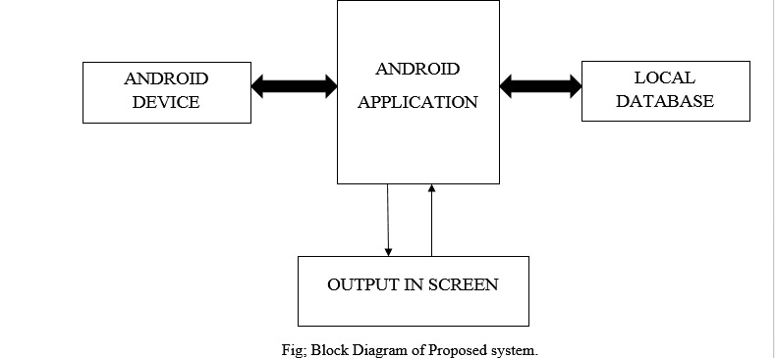
Block Diagram

Slide 8
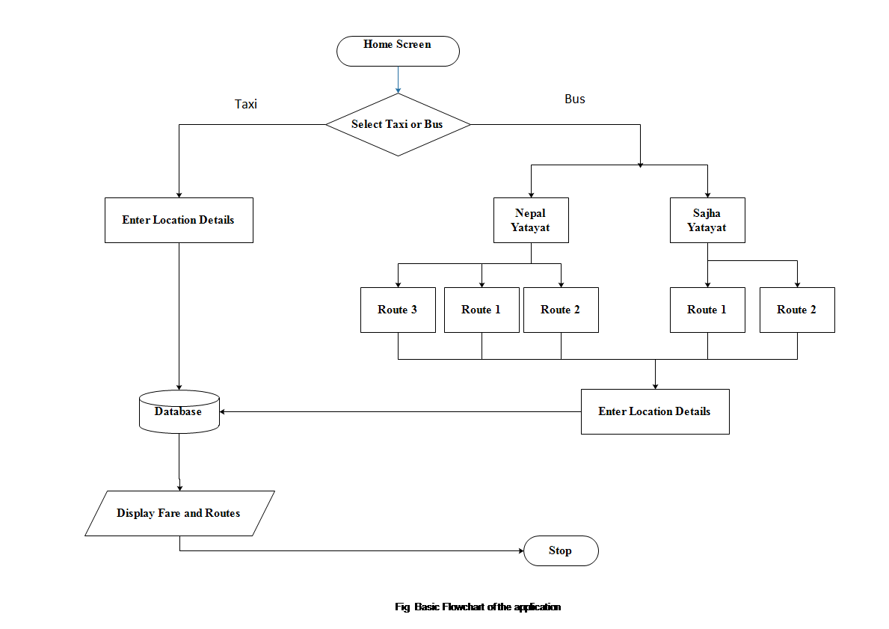
Generalized Flowchart

Slide 9
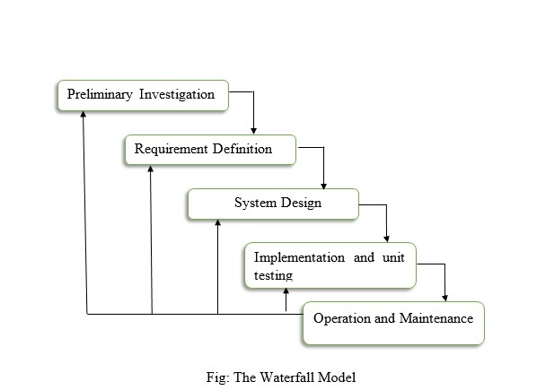
Methodology

Slide 10
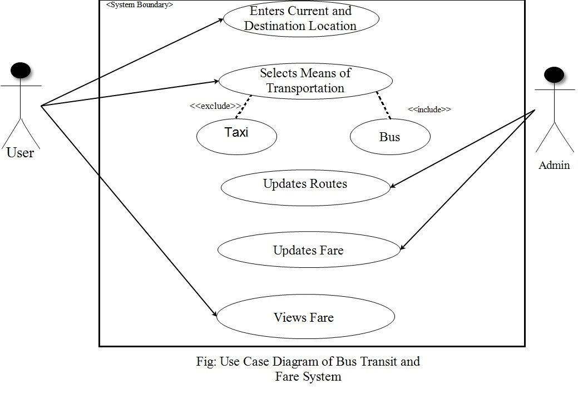
Use Case Diagram

Slide 11
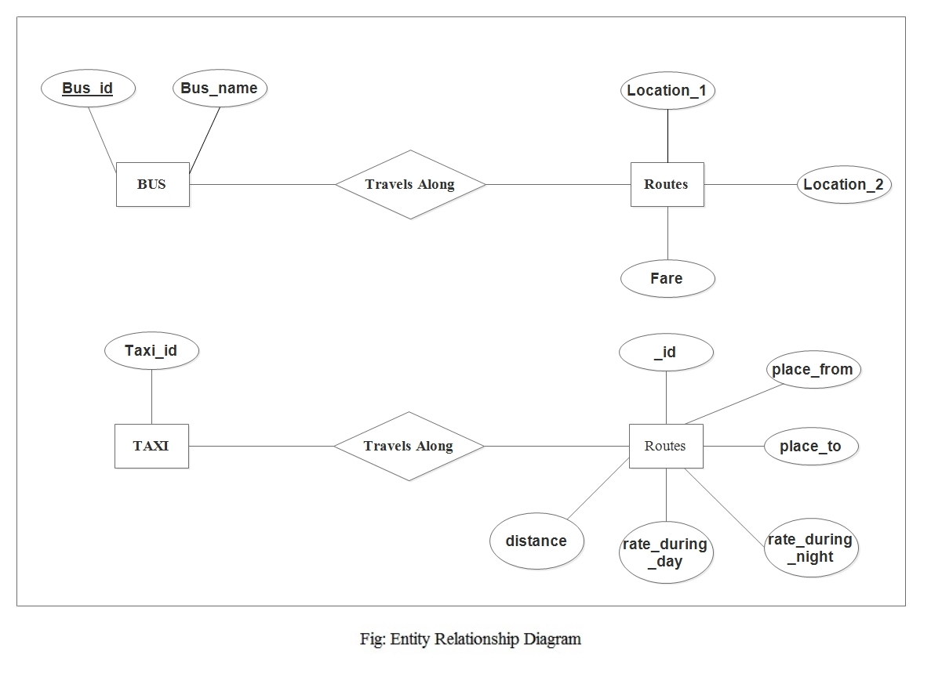
ER Diagram

Slide 12
Tools used
Hardware
Smartphone
Android system
Software
Java
Android Studio (IDE) - Application Development Software for Android Platform
SQLite

Slide 13
Functions Used
Activity
Broadcast Receiver
UI Layout
Java Class

Slide 14
Application
Fare Calculation: Gives an idea about cost involved
Distance calculation: This application provides a reliable information on it.
Day time (6 am to 9 pm) /Night Time(9 pm to 6 am)
Price per Km = Rs.37 / Rs.55
Waiting Charge = Rs.7.4 - 2min / Rs.11.1 - 2min
Flag Down Price = Rs.14 / Rs.21
Day Fare = 14+37*3.9= Rs.158.3
Night Fare=21+55.5*3.9= Rs.237.45

Slide 15
Scope
General commuters
Traffic police
Department of Transport Management
Foreigners and Tourists

Slide 16
Problems Encountered
Large Database- over 19800 entries
Transportation organizations: not willing to share ; confidential data

Slide 17
Future Enhancements
Extending to other platforms such as windows, iOS.
Extending routes
The searching algorithm can be optimized to reduce CPU load.

Slide 18
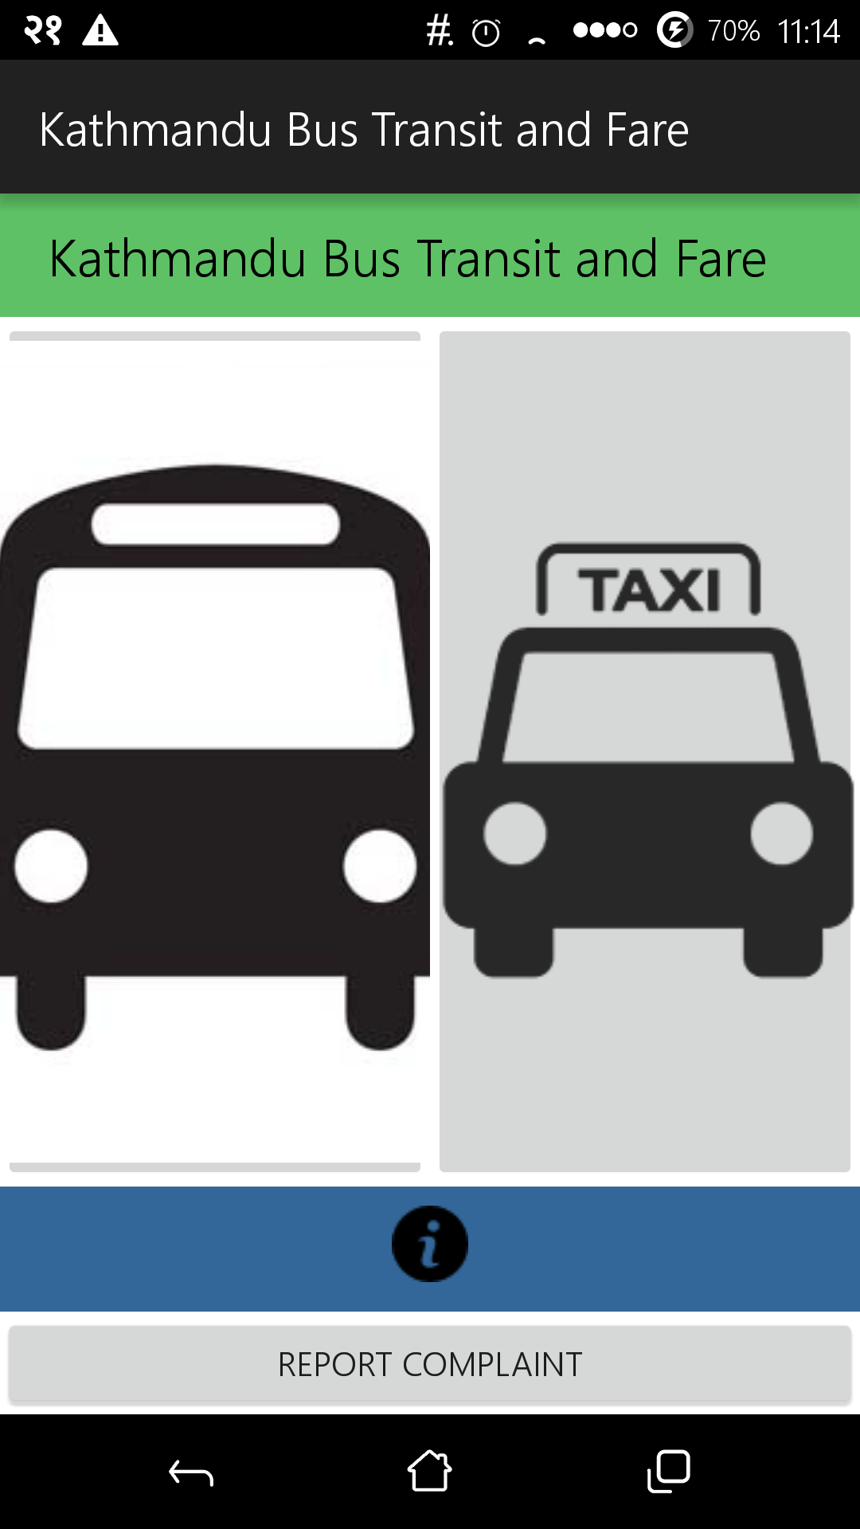
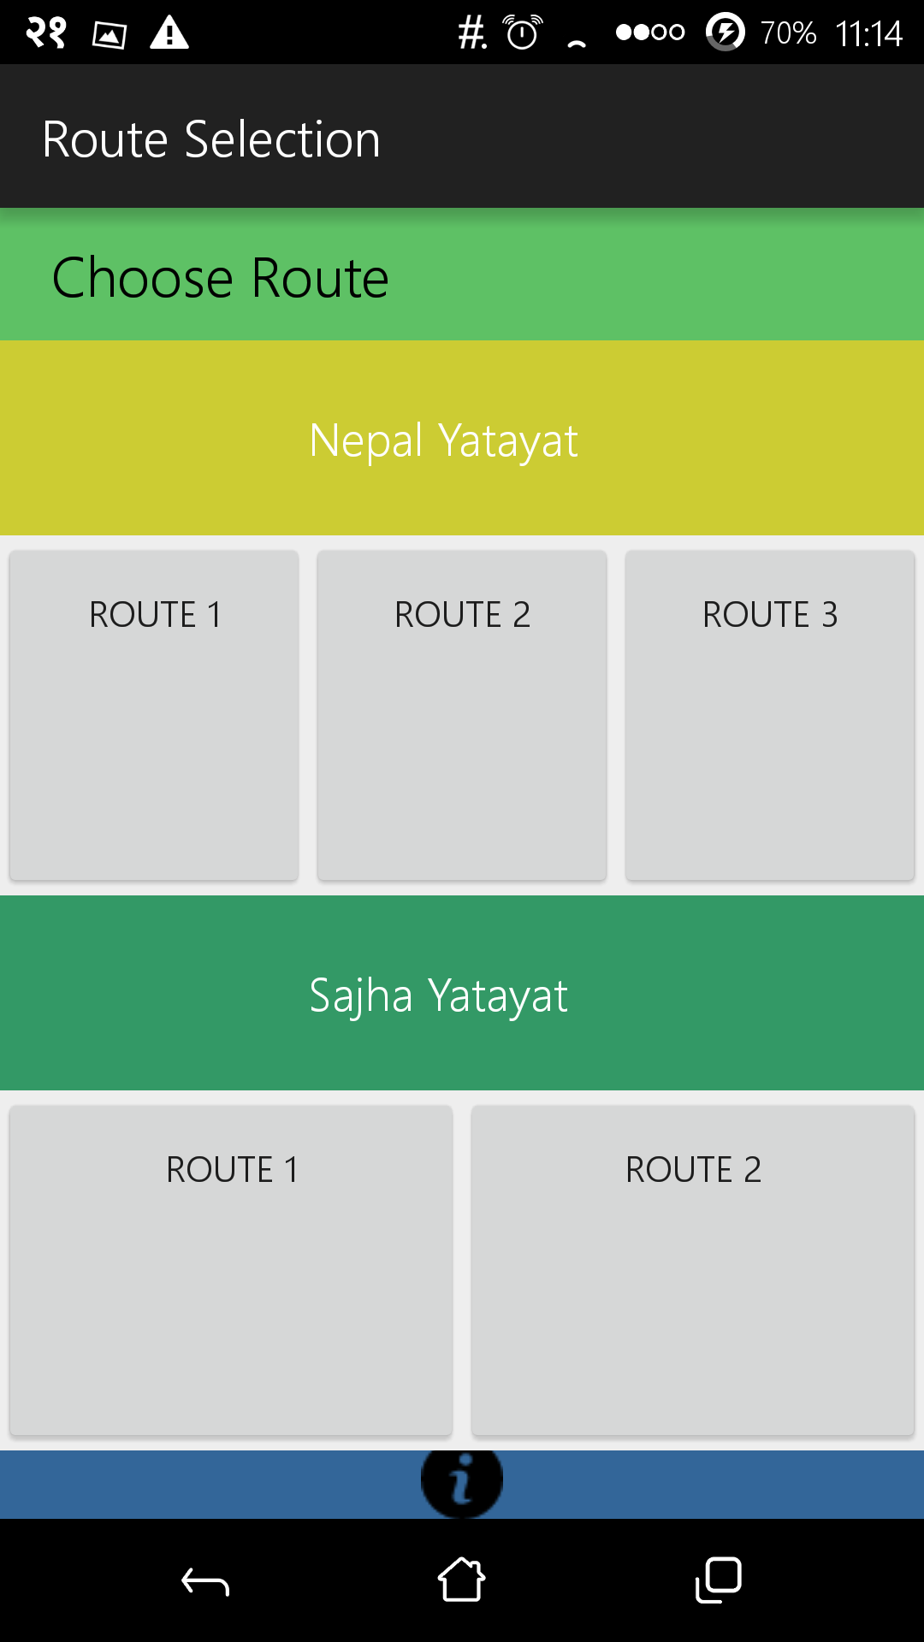
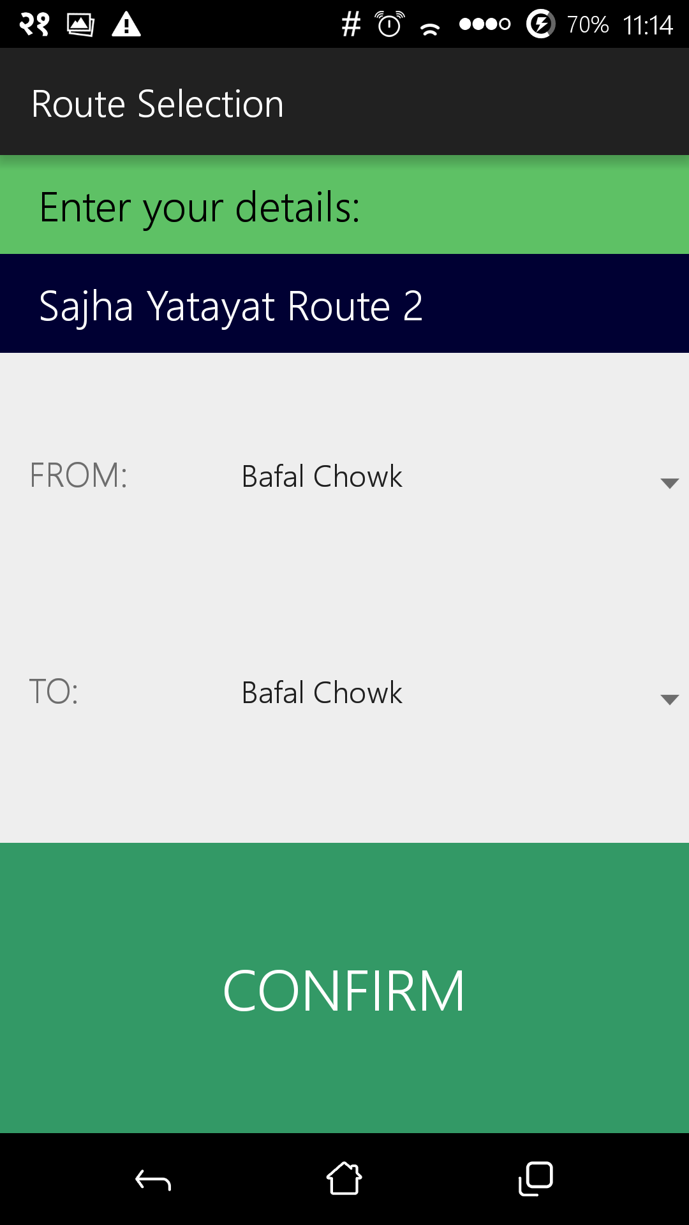
Screenshots

Slide 19
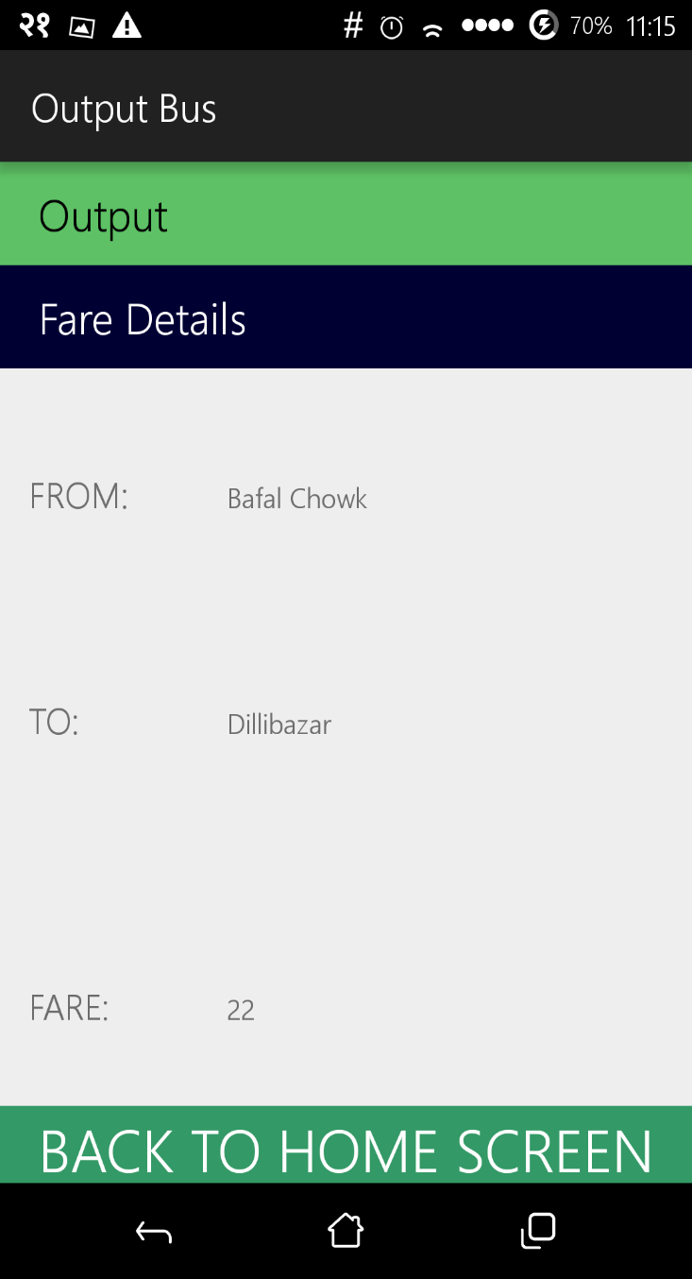
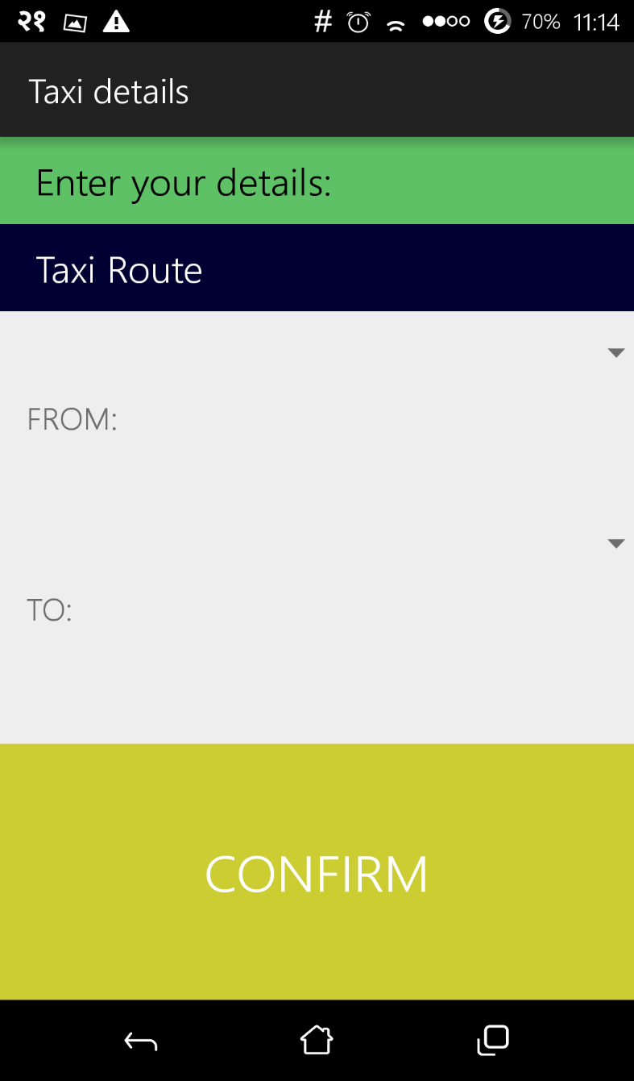

Slide 20
References
[1] Levinson, H., & Zimmerman, S., Clinger, J., Rutherford, S., Smith, R.L., Cracknell, J., & Soberman, R. “Bus Rapid Transit” (Vol 1). 2003
[2].Android SDK, http://developer.android.com/sdk/index.html, 2014
[3] Pressman, R.S., “Software Engineering: A practitioner’s Approach”. Tata McGraw-Hill Companies. 2010
[4] Schildt, H.,” Java, A Beginner’s Guide”, Fifth Edition. 2005
[5] “Nepal Yatayat Fare Log”. 2015
[6] “Sajha Yatayat Fare Log”. 2015
[7] Developers Point, www.stackoverflow.com
[8] Axgen Android Developers, www.tutorialforandroid.com, 2015

Slide 21
Demo

