Slide 1
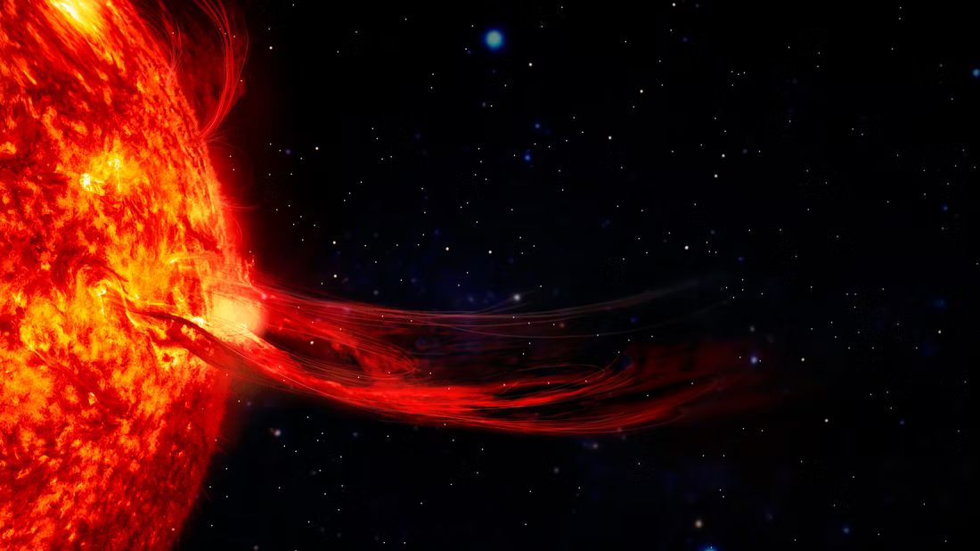
Flare Finder
Detecting Near-Ultraviolet Flares in
M-dwarfs in Swift UVOT Event Data
Sophia Wang
Institute for Computing in Research
Image: Dave McQuilling

Slide 2
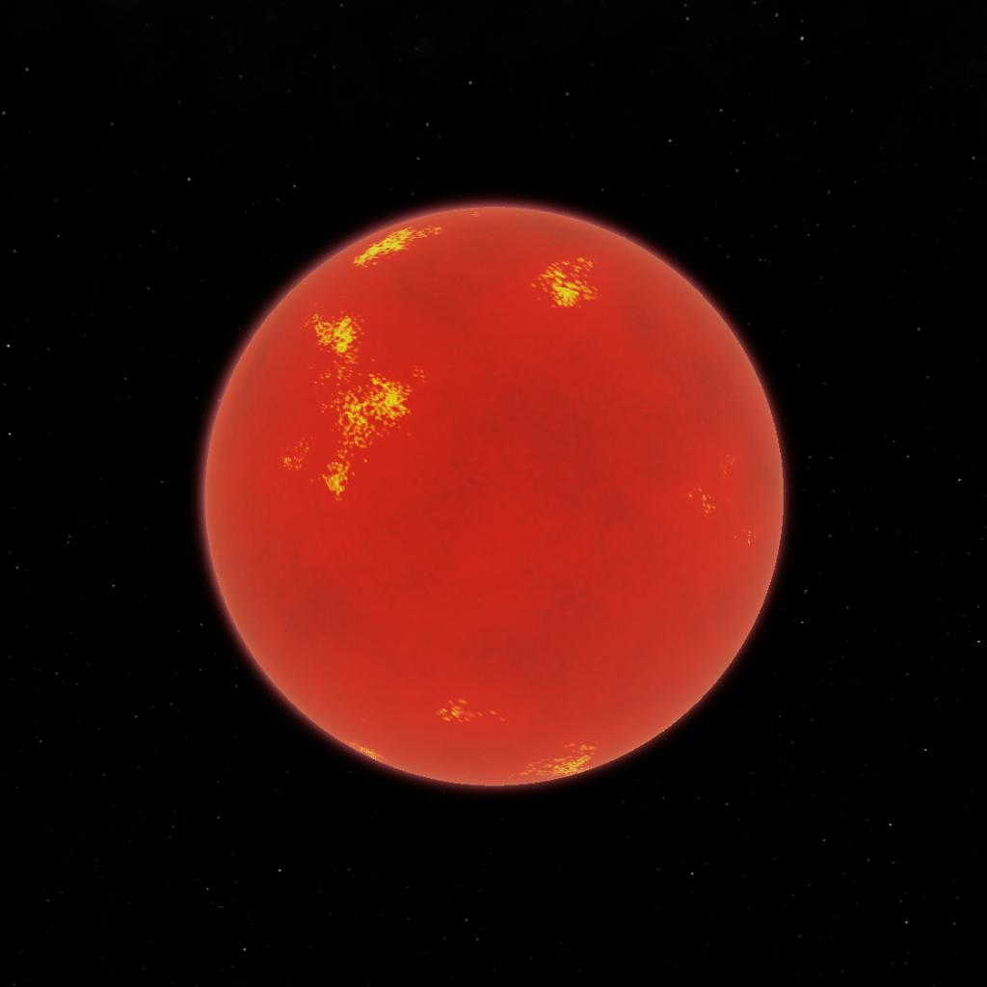
Image: Simple Rockets

Slide 3
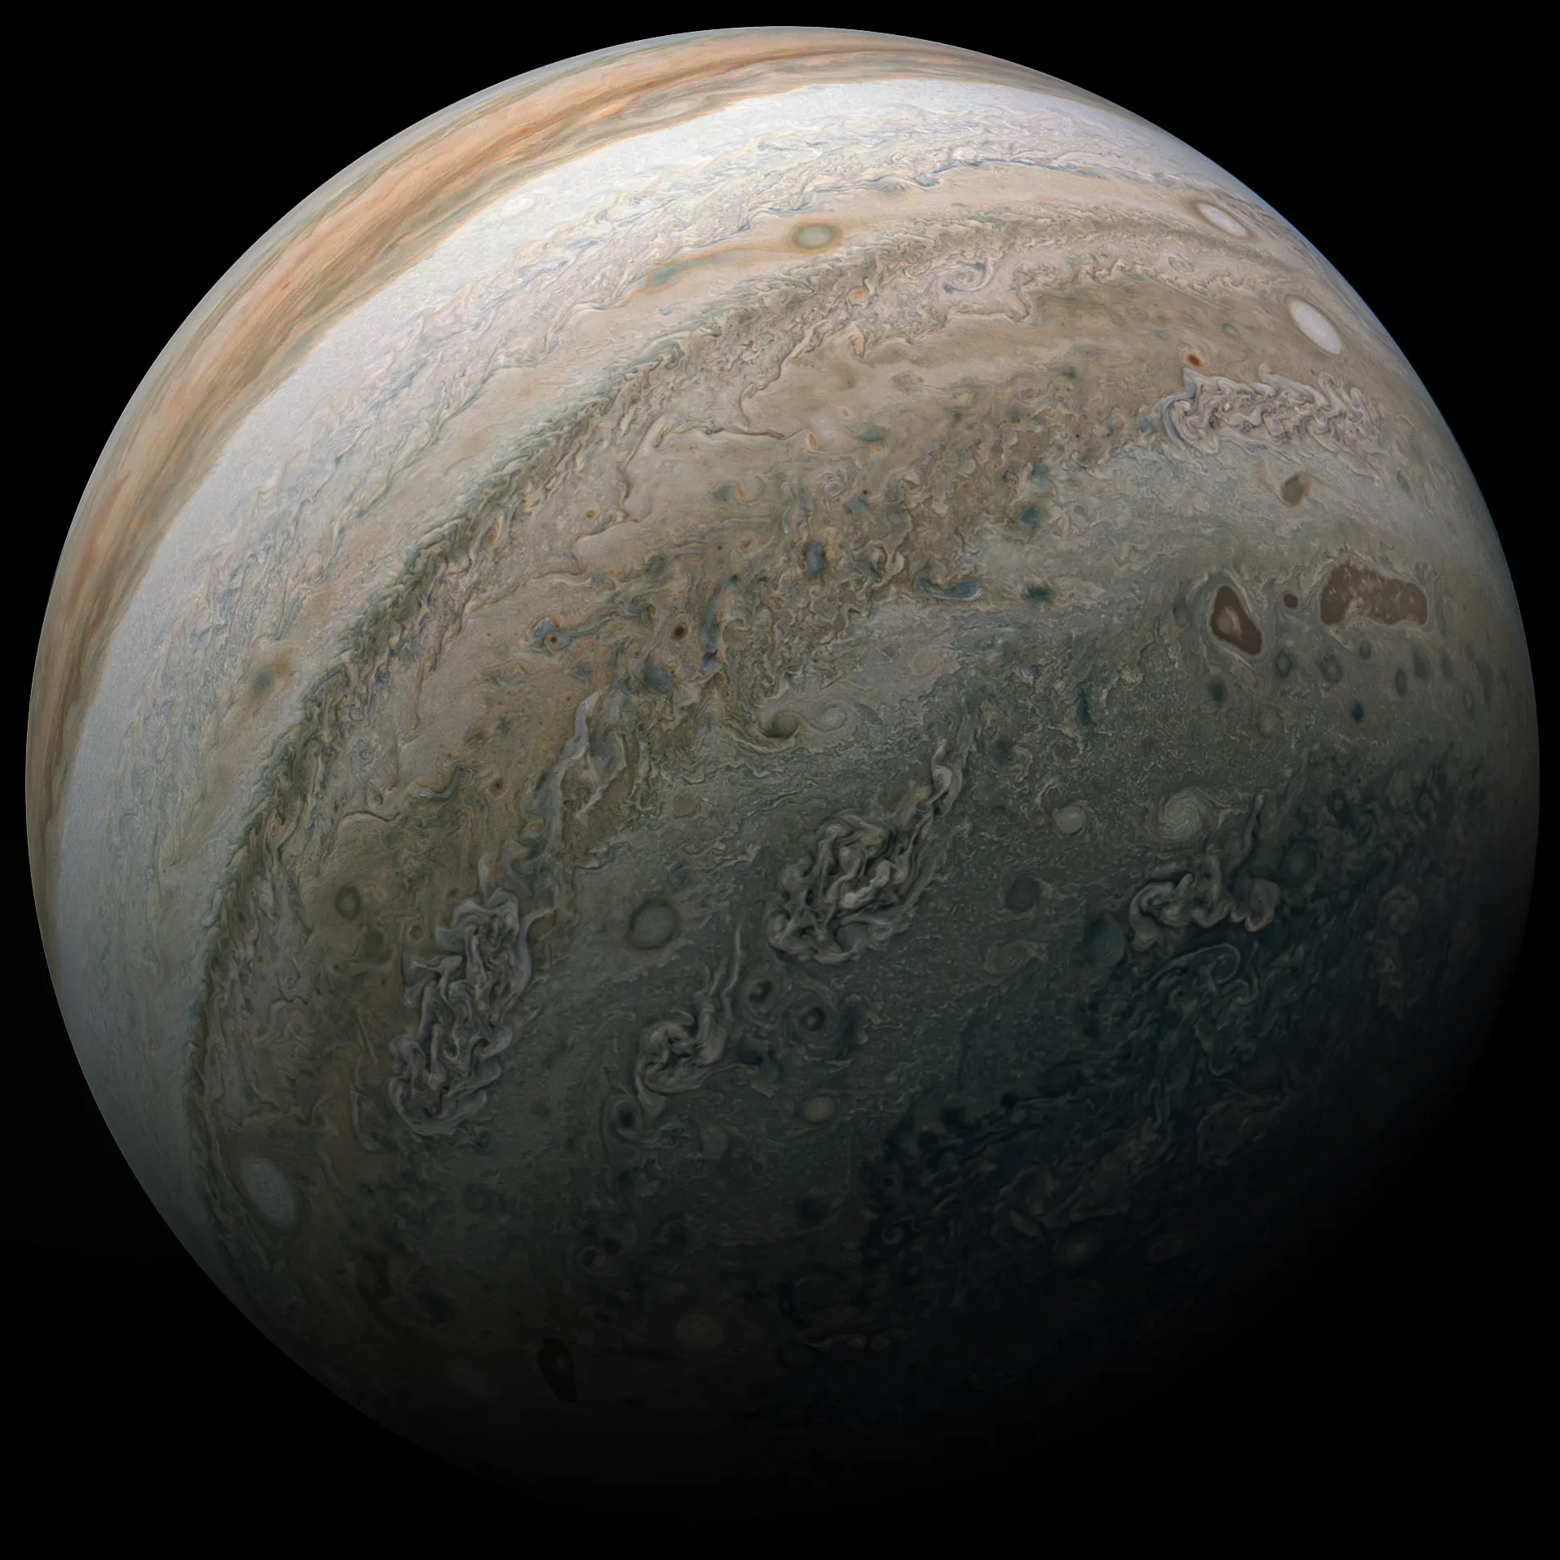
Images: Simple Rockets, NASA

Slide 4
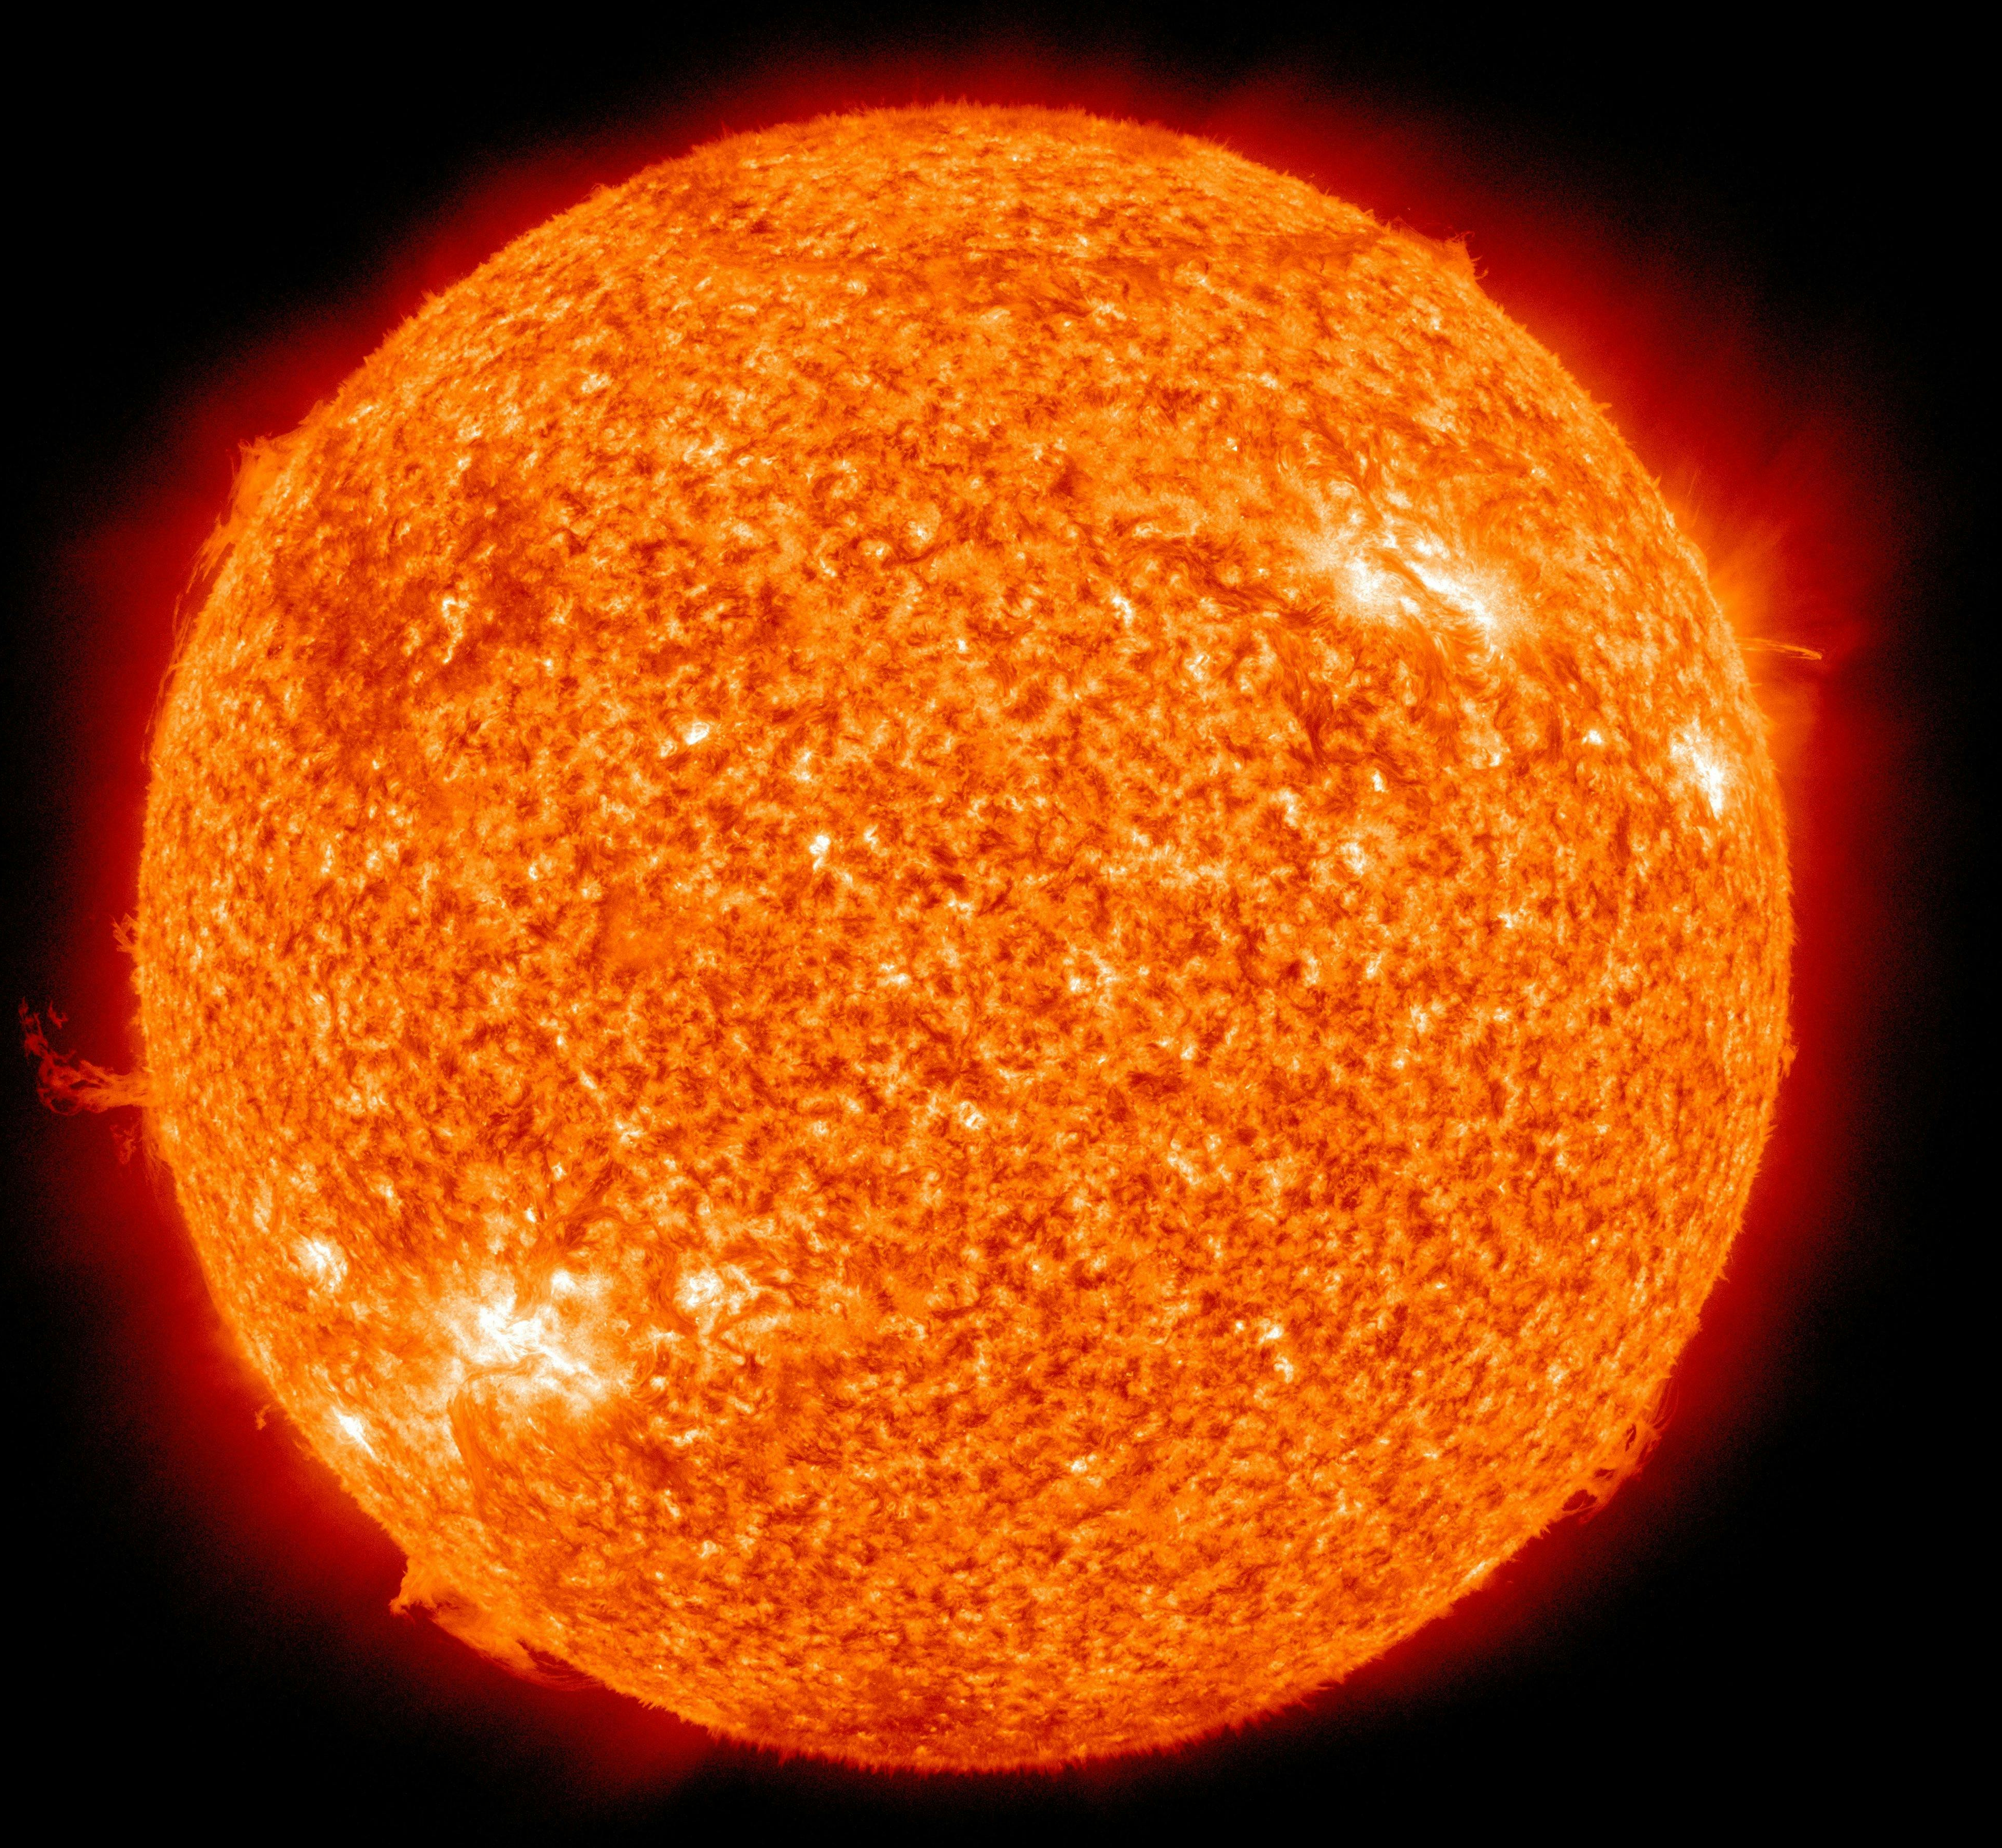
Images: Simple Rockets, NASA

Slide 5
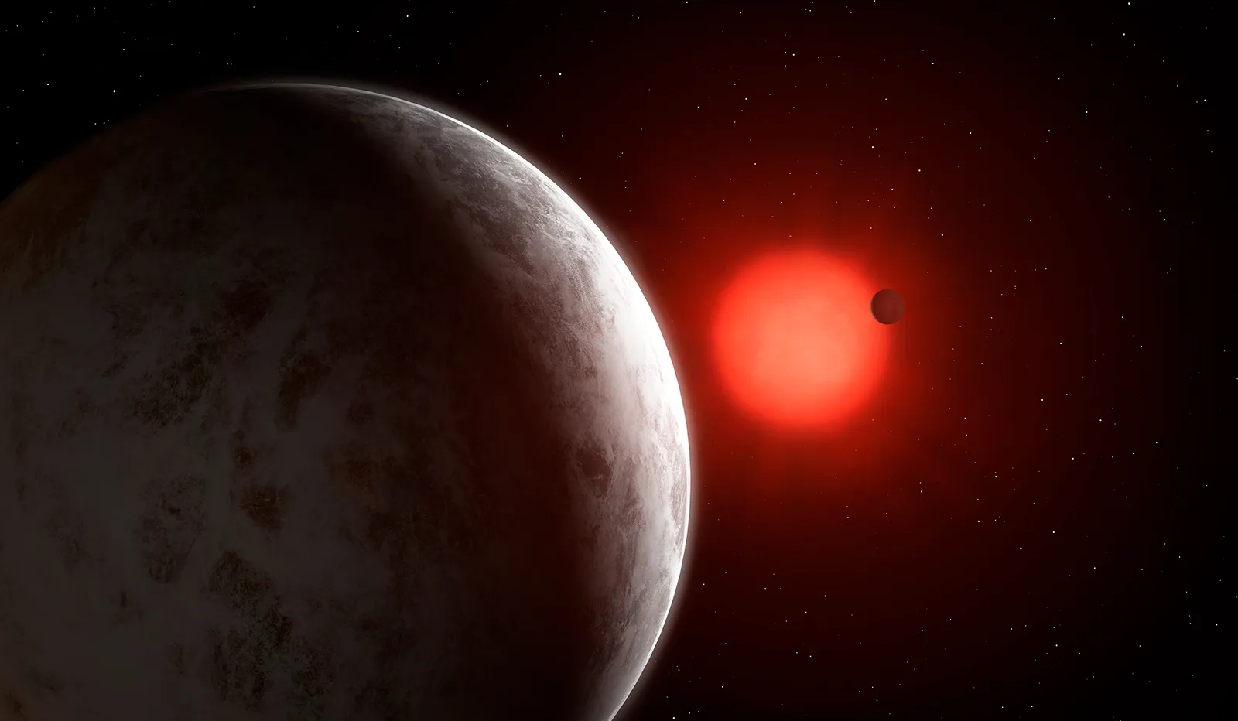
Image: Mark Garlick

Slide 6
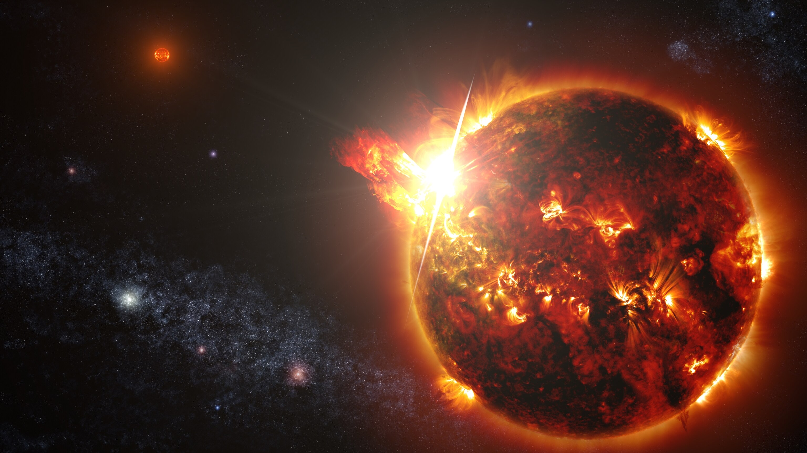
Image: National Geographic

Slide 7
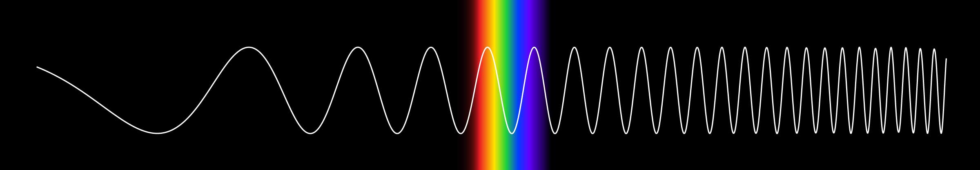
Radio Infrared Optical UV X-ray Gamma
Image: NASA

Slide 8
The Ultimate Goldilocks Scenario

Slide 9
The Ultimate Goldilocks Scenario
Not enough UV radiation

Slide 10
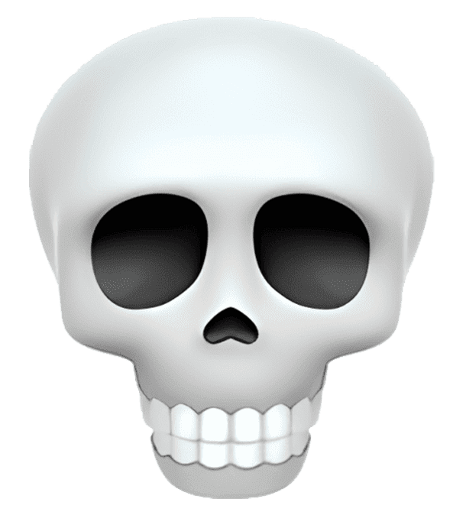
The Ultimate Goldilocks Scenario
Not enough UV radiation

Slide 11
The Ultimate Goldilocks Scenario
Not enough UV radiation
Too much
UV radiation

Slide 12
The Ultimate Goldilocks Scenario
Not enough UV radiation
Too much
UV radiation

Slide 13
Radio Infrared Optical UV X-ray Gamma
Image: NASA

Slide 14
Radio Infrared Optical UV X-ray Gamma
Image: NASA

Slide 15
Radio Infrared Optical UV X-ray Gamma
Image: NASA

Slide 16
Only 28%
of NUV-detected flares are detectable optically

Slide 17
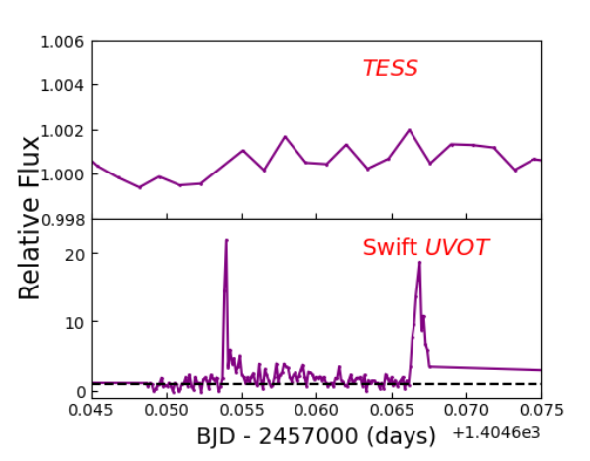
Optical
Near UV
Graph: Paudel et al., 2024

Slide 18

Optical
Near UV
Graph: Paudel et al., 2024; Waldo: Wesleyan

Slide 19
Flare Finder

Slide 20
Data
Flare Finder

Slide 21
Data
Flare Finder
Flares

Slide 22
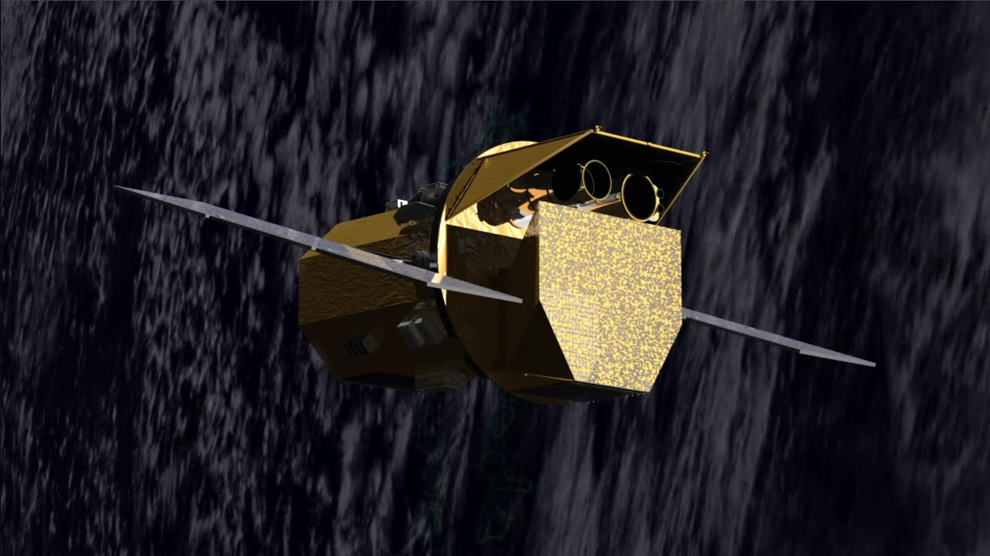
Image: NASA

Slide 23
Swift UVOT
Image: NASA

Slide 24
UVOT Event Mode

Slide 25
UVOT Event Mode
Time

Slide 26
UVOT Event Mode
Time
X and Y coordinates

Slide 27
UVOT Event Mode
Time
X and Y coordinates
Exposure references

Slide 28
UVOT Event Mode
Time
X and Y coordinates
Exposure references
Quality flag

Slide 29
UVOT Event Mode
Time
X and Y coordinates
Exposure references
Quality flag

Slide 30
UVOT Event Mode
Time
X and Y coordinates
Exposure references
Quality flag

Slide 31
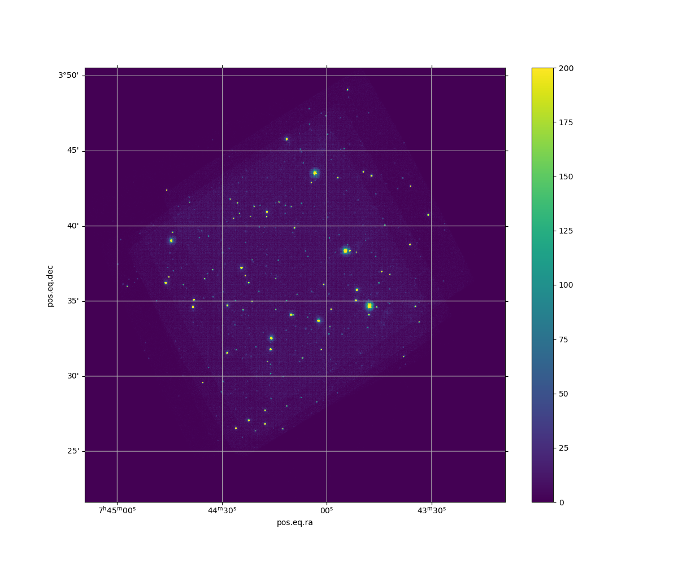

Slide 35
Counts in circle: 5
Counts in annulus: 15

Slide 38
Counts in circle: 500
Counts in annulus: 20

Slide 39
Counts in circle: 500
Counts in annulus: 20
How do we deal with noise?

Slide 40
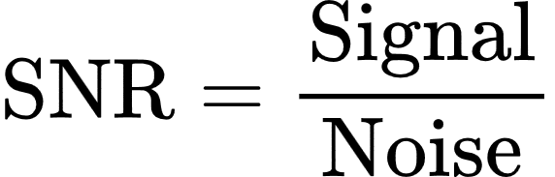

Slide 41
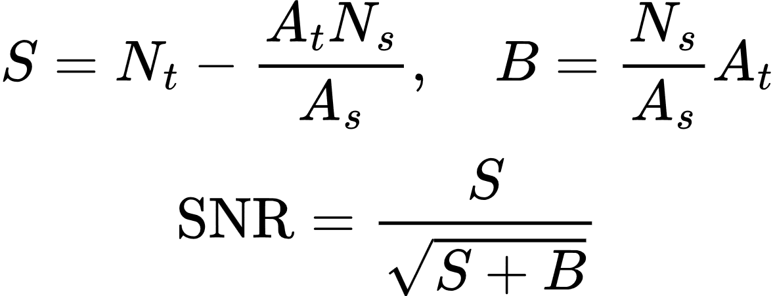

Slide 42
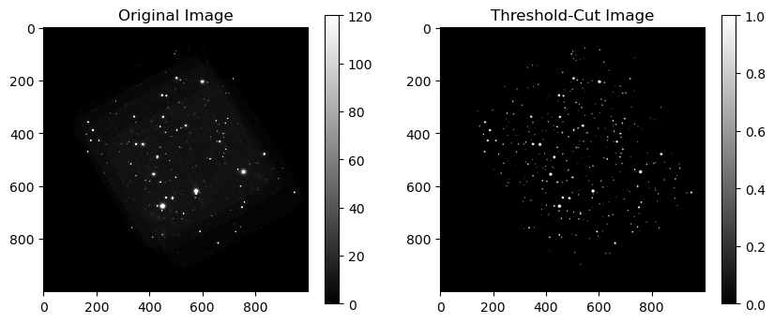

Slide 43
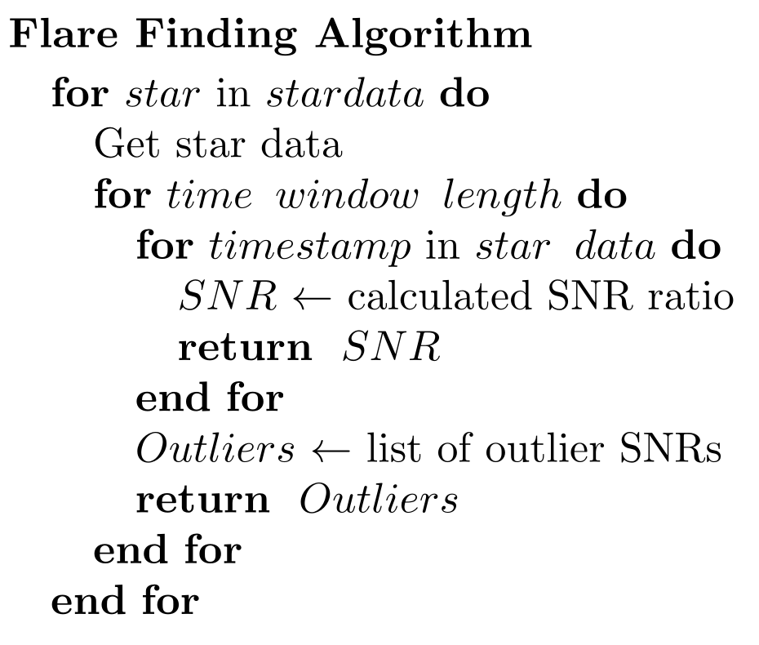

Slide 45
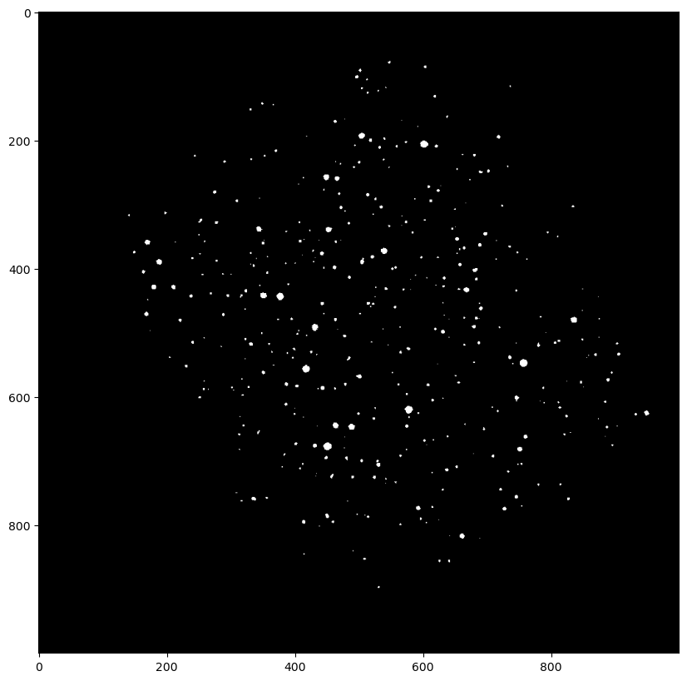

Slide 46
Star A

Slide 47
Star B
Star A

Slide 49
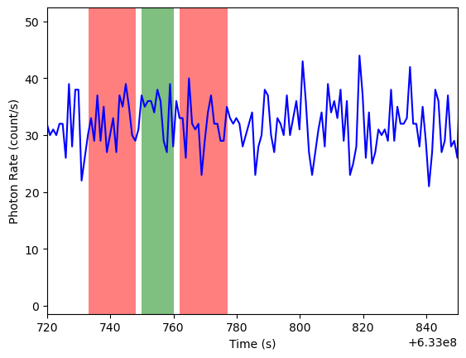

Slide 54
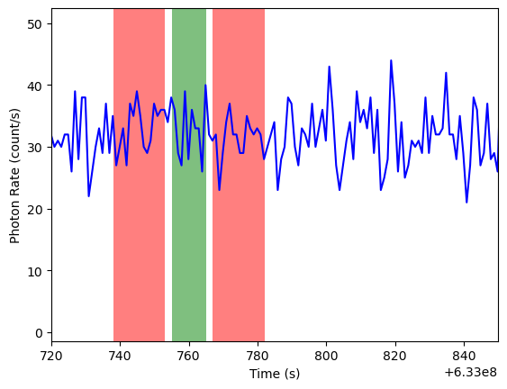

Slide 55
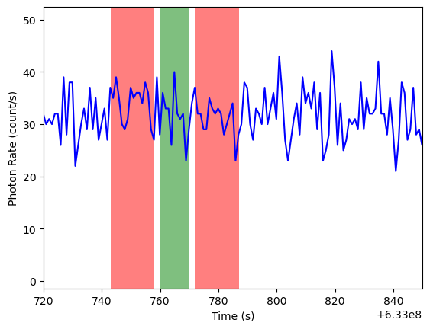

Slide 56
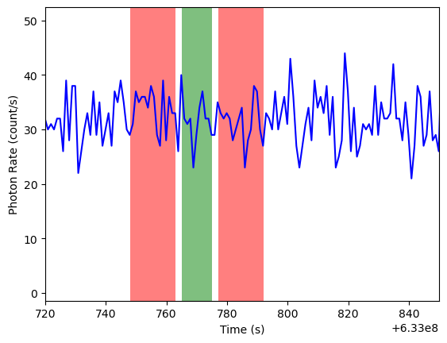

Slide 57
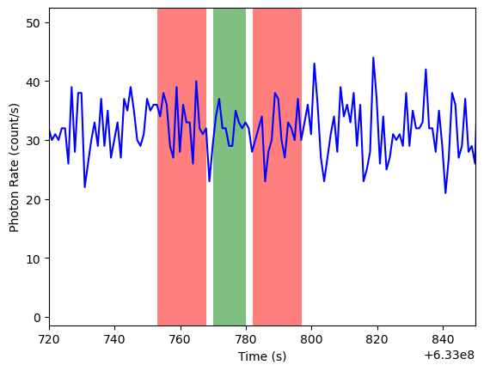

Slide 58
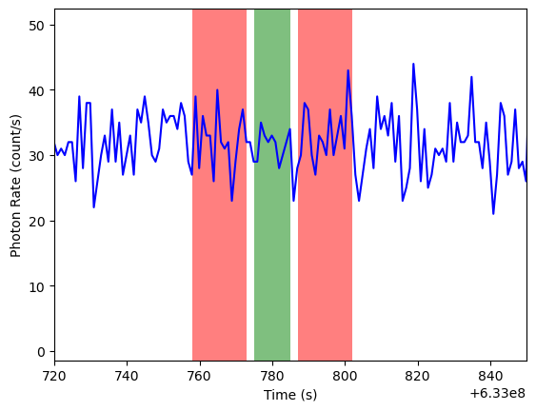

Slide 59
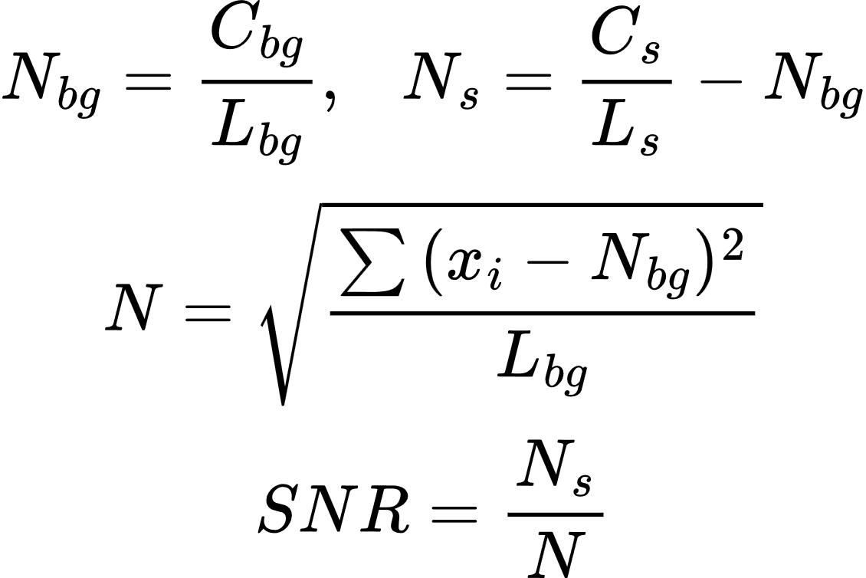

Slide 60
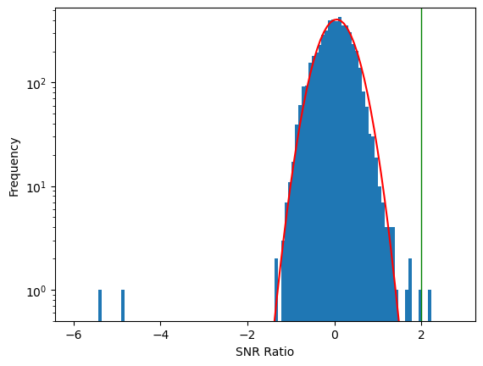
Star A

Slide 61
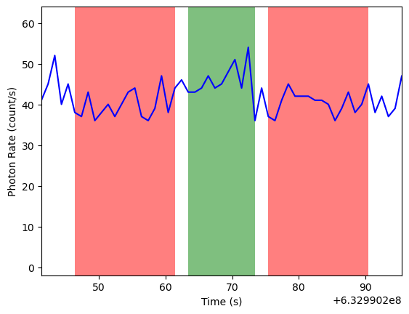

Slide 62
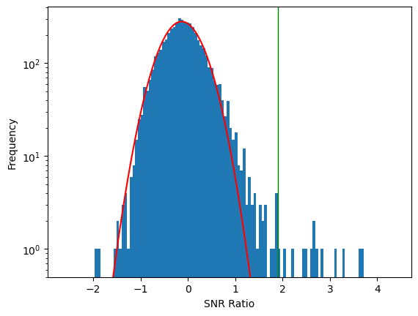
Star B

Slide 63
Star B

Slide 64
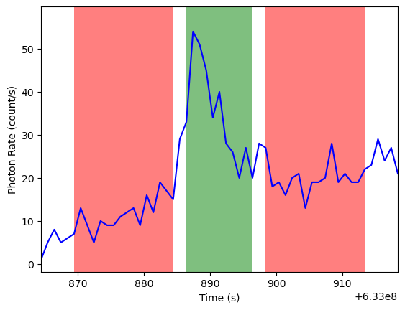

Slide 65
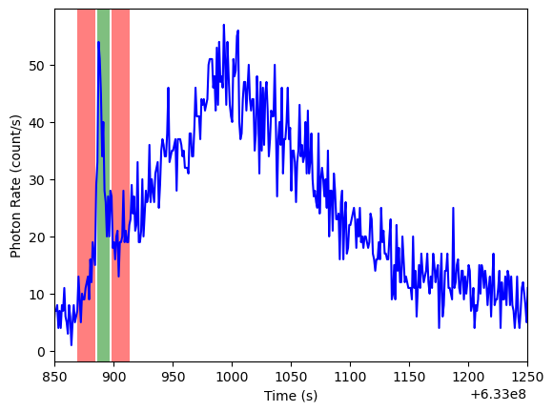

Slide 68
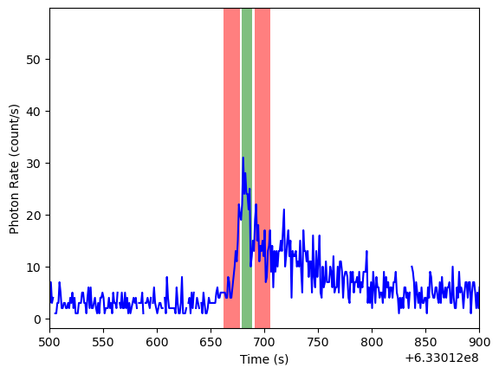

Slide 70
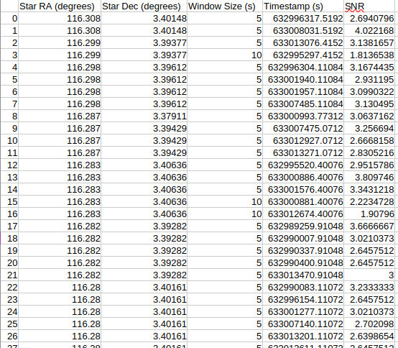

Slide 72
Data
Flare Finder
Flares

Slide 73
Data
Clean data
Visualize data
Flare Finder
Flares

Slide 74
Data
Clean data
Visualize data
Star detection
Flare detection
Flare Finder
Flares

Slide 75
Data
Clean data
Visualize data
Star detection
Flare detection
Search for outliers
Output to CSV
Flare Finder
Flares

Slide 76
Limitations and Future Improvements

Slide 77
Time window heuristic

Slide 78
Time window heuristic
Noise detection

Slide 79
Time window heuristic
Noise detection
SNR calculation

Slide 80
Time window heuristic
Noise detection
SNR calculation
Long flares

Slide 81
Time window heuristic
Noise detection
SNR calculation
Long flares
Removing flares

Slide 82
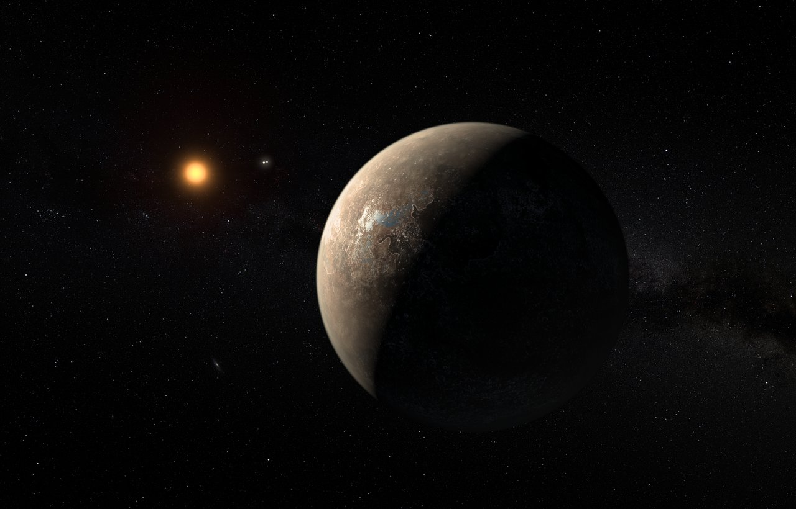
Q&A
Image: Webb

