Slide 1
AI workflow Capstone project
Saphira Baralonga
16/12/2020

Slide 2
Part I

Slide 3
(1) Business scenario and Testable hypotheses
Business opportunity: Predict monthly revenue per country for “a la carte” AAVAIL users around the world could generate revenue by saving managers revenue forecast time, “stabilizing staffing and budget projections”.
Null hypothesis : There is no difference per country for monthly revenue generated by “a la carte” AAVAIL users.
Alternative hypothesis: There is a difference per country for the monthly revenue generated by “a la carte” AAVAIL users.
Level of significance chosen: 0.1

Slide 4
(2) Ideal data to address the business opportunity
Transaction date: For each purchase, transaction date to be able to aggregate the total revenue per month
Transaction amount: For each purchase, transaction amount to be able to aggregate the total revenue generated by the monthly transactions
Transaction country: For each purchase, transaction country to be able to aggregate the total amount of monthly purchases per country

Slide 5
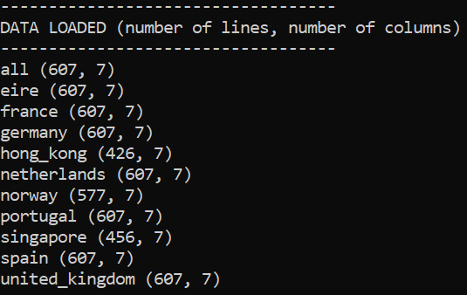
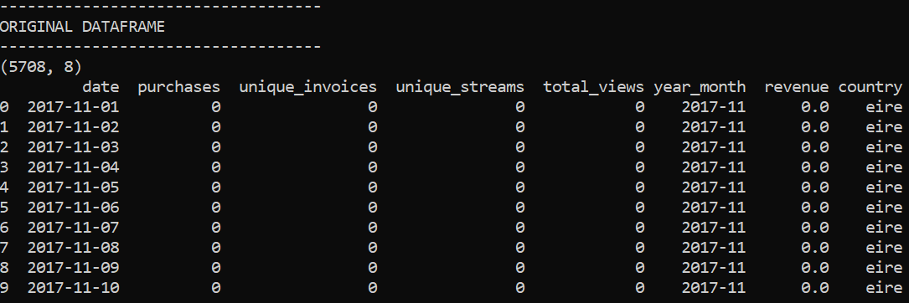
EXPLORATORY DATA ANALYSIS (1): Original dataset

Slide 6
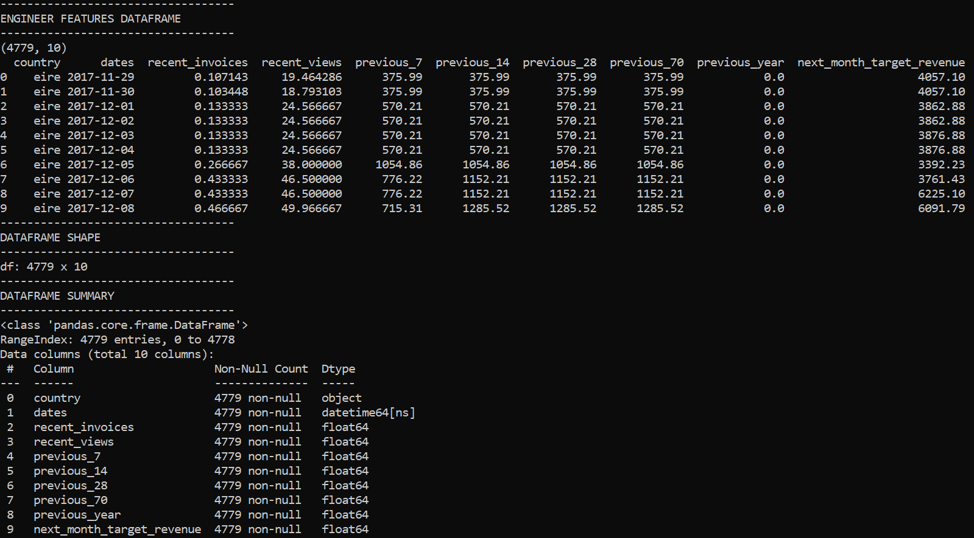
EXPLORATORY DATA ANALYSIS (2): Engineer features dataframe

Slide 7
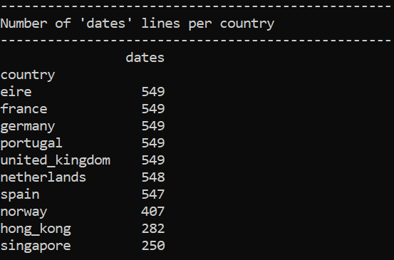
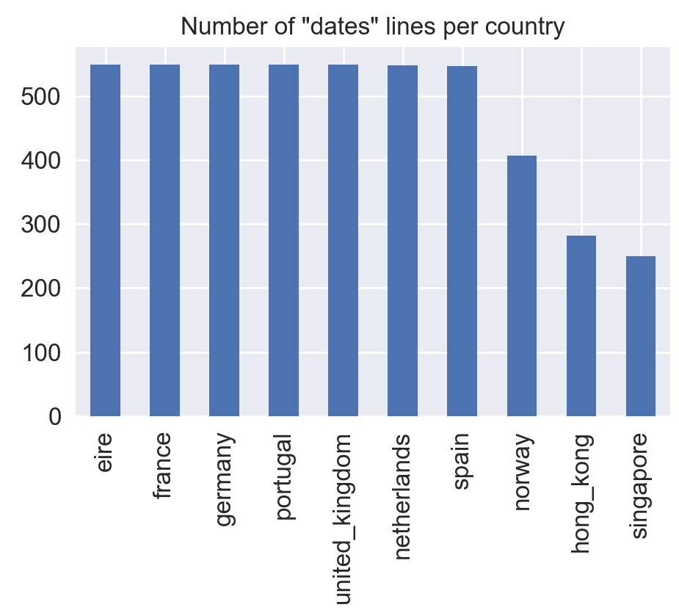
EXPLORATORY DATA ANALYSIS (3): Engineer features dataframe

Slide 8
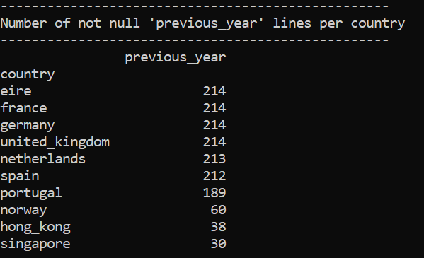
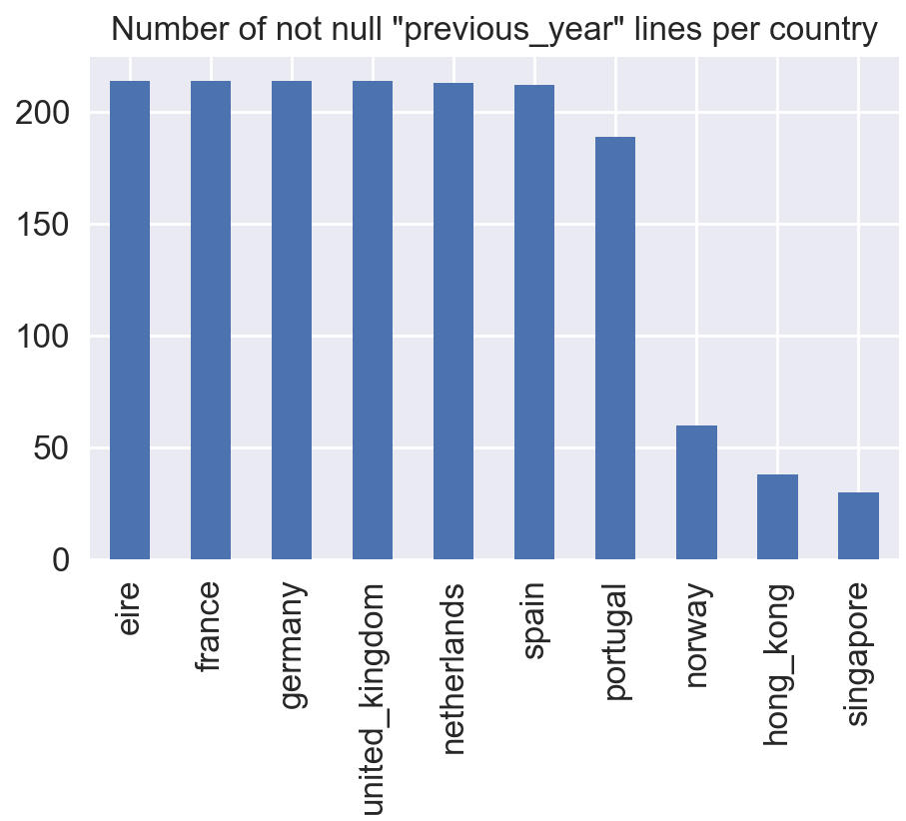
EXPLORATORY DATA ANALYSIS (4): Engineer features dataframe

Slide 9
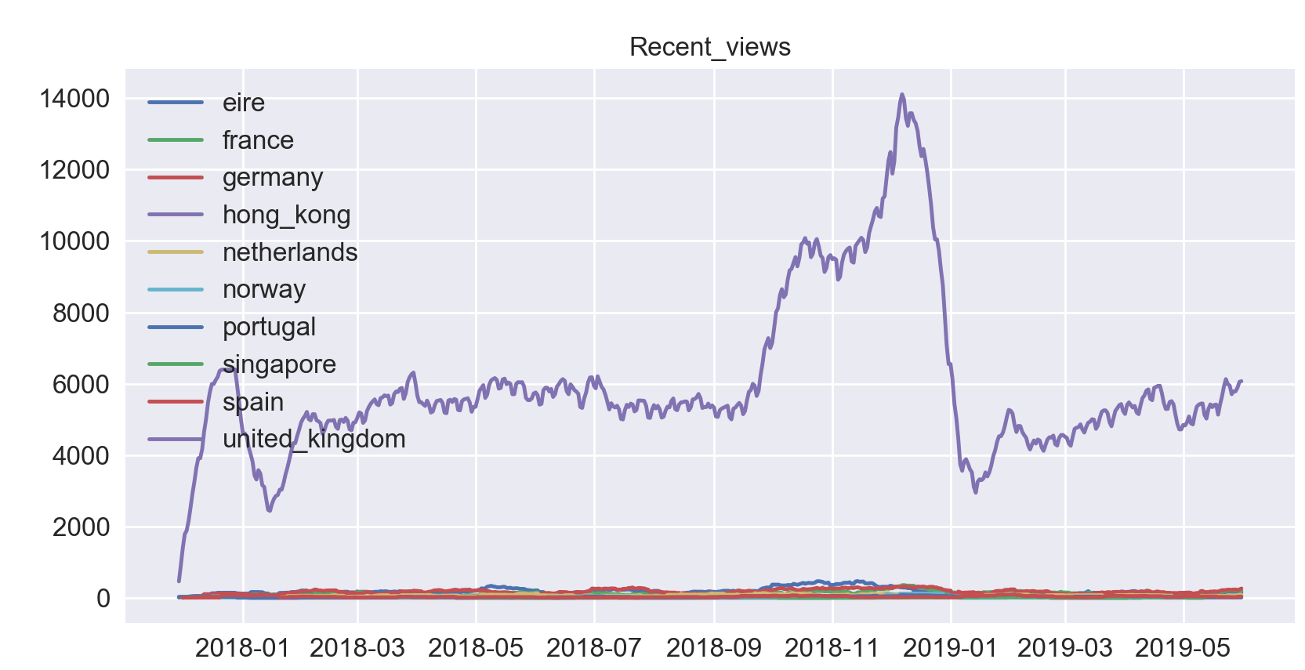
EXPLORATORY DATA ANALYSIS (5): Engineer features dataframe: number of views (incl. United_kingdom)

Slide 10
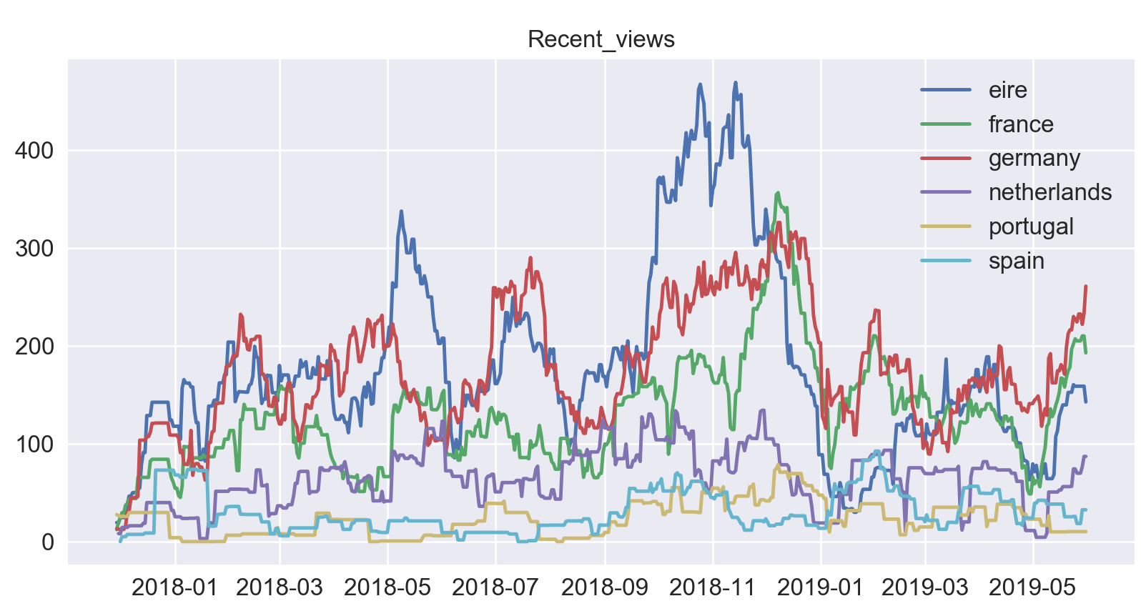
EXPLORATORY DATA ANALYSIS (6): Engineer features dataframe: number of views (excl. United_kingdom)

Slide 11
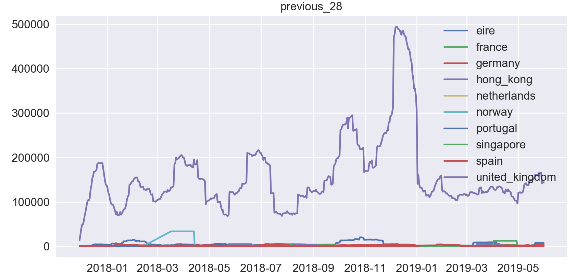
EXPLORATORY DATA ANALYSIS (7): Engineer features dataframe: Previous_28 (incl. United_kingdom)

Slide 12
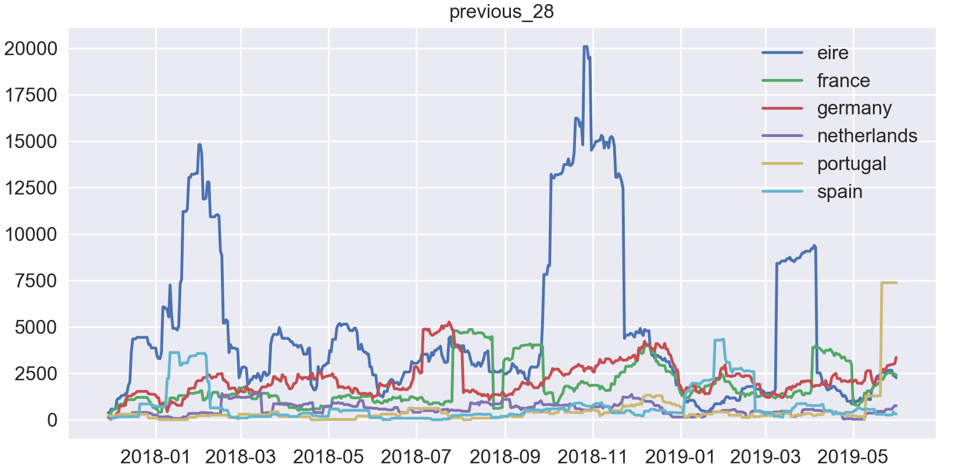
EXPLORATORY DATA ANALYSIS (8): Engineer features dataframe: Previous_28 (incl. United_kingdom)

Slide 13
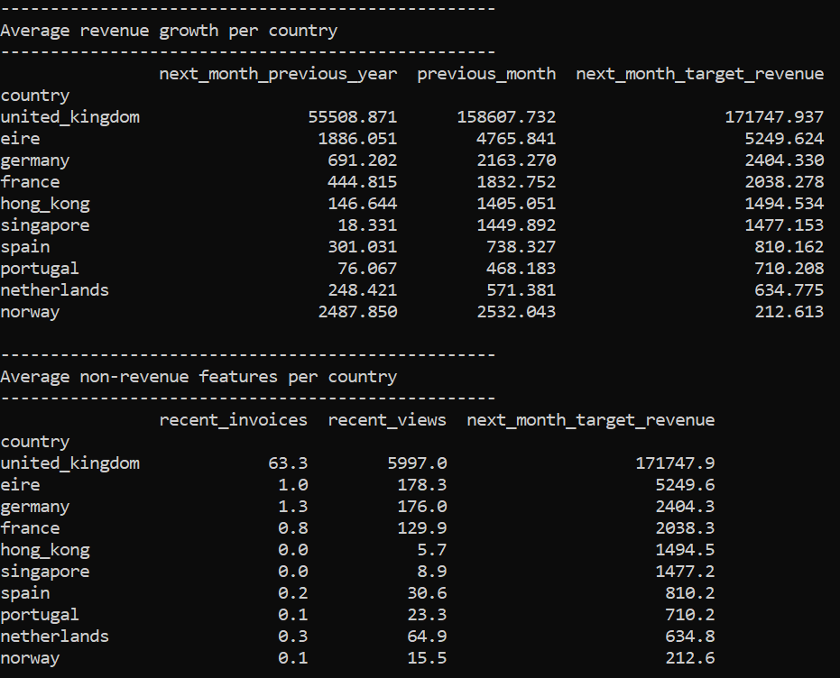
EXPLORATORY DATA ANALYSIS (9): Target and the business metric

Slide 14
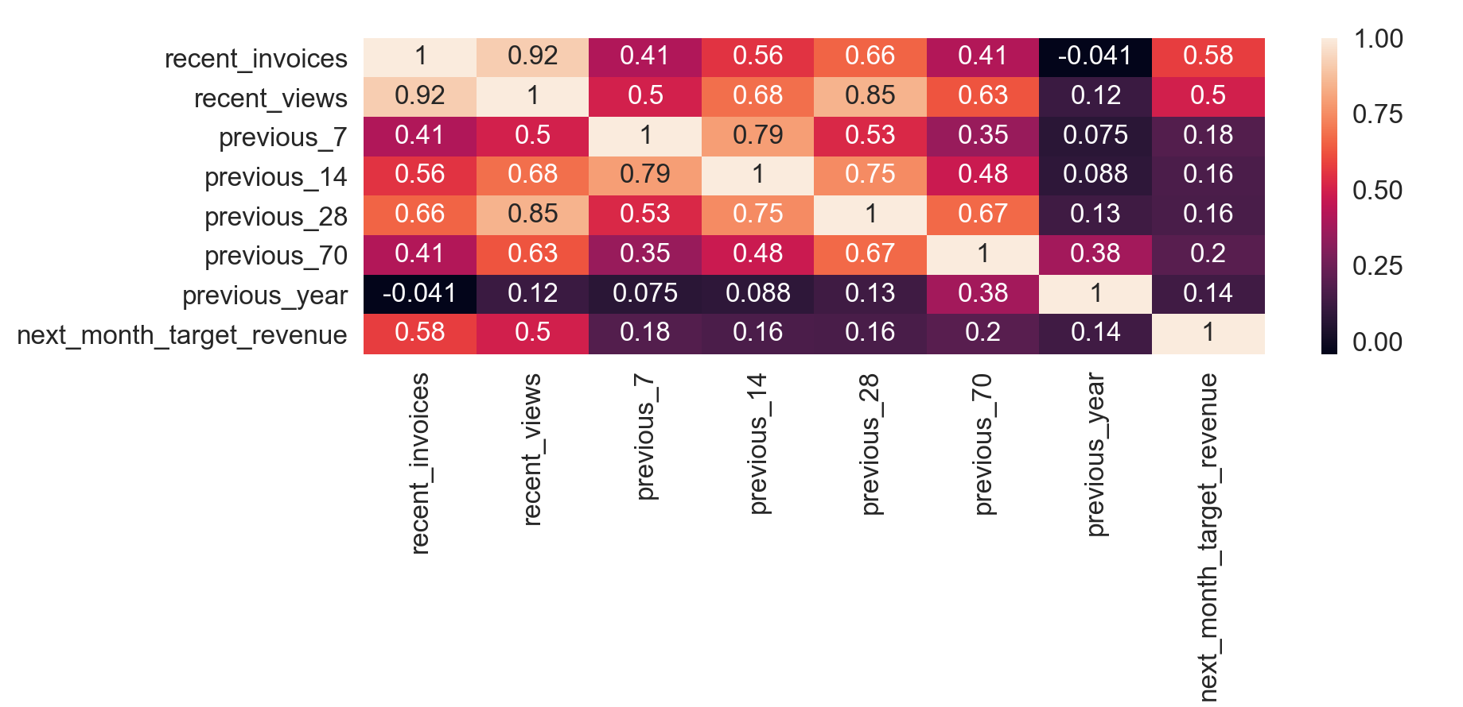
EXPLORATORY DATA ANALYSIS (10): Corelation matrix

Slide 15
EXPLORATORY DATA ANALYSIS (11): Conclusions
Norway, Hong-Kong and Singapore: less data available than for the other 7 other countries
United kingdom is an outlier (as far as views and purchases amount are concerned)
Previous year data not really available
Highest activity: End of the year 2018
Correlation matrix indicates strong correlation between:
recent_invoices / recent_views
Recent_views / previous_28
high degree of correlation with the target revenue is ignored (due to timeseries data auto-correalatoion)

Slide 16
Capstone Part 2: Getting Started (Hands-On)

Slide 17
Modeling approaches compared to address the business opportunity: RANDOM FOREST
Random forest model hyperparameters tested:
'criterion': ['mse','mae’]
'n_estimators': [10,15,20,25]
“A random forest is a meta estimator that fits a number of classifying decision trees on various sub-samples of the dataset and uses averaging to improve the predictive accuracy and control over-fitting.”
n_estimators => Number of trees in the forest.
Criterion => Function to measure the quality of a split. Supported criteria are “mse” for the mean squared error, which is equal to variance reduction as feature selection criterion, and “mae” for the mean absolute error.
Source: https://scikit-learn.org/stable/modules/generated/sklearn.ensemble.RandomForestRegressor.html

Slide 18
Modeling approaches compared to address the business opportunity: BAGGING
Bagging model hyperparameters tested:
'n_estimators': [10,15,20,25]
“A Bagging regressor is an ensemble meta-estimator that fits base regressors each on random subsets of the original dataset and then aggregate their individual predictions to form a final prediction.”
Source: https://scikit-learn.org/stable/modules/generated/sklearn.ensemble.BaggingRegressor.html#sklearn.ensemble.BaggingRegressor

Slide 19
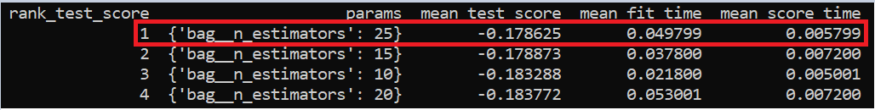
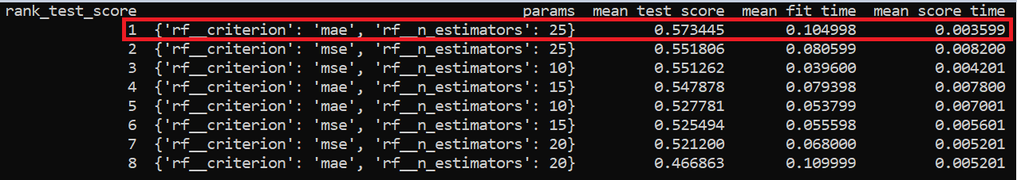
Performance results
Bagging model
Random Forest model

Slide 20
Iterate on your suite of possible models by modifying data transformations, pipeline architectures, hyperparameters and other relevant factors.
Re-train your model on all of the data using the selected approach and prepare it for deployment.
Articulate your findings in a summary report:
Most efficient model ?
Most efficient transformation ? Pipeline architecture ?
Most efficient hyperparameters ?

