Slide 1
PERFORMANCE REPORT
TechVista Solutions
Mar 1, 2026 to Mar 31, 2026
Performance Report
Prepared by SapienBotics Agency

Slide 2
Executive Summary
March 2026 was a breakthrough month for TechVista Solutions following the DataPulse product launch on February 15th. Website sessions surged 34.2% to 45,230, driven primarily by a well-executed Google Ads campaign and strong organic search performance.
The combined paid advertising effort across Meta Ads and Google yielded 1,240 conversions - a 67.5% increase over the previous period. Meta Ads delivered a strong 3.8x ROAS with the retargeting campaign performing exceptionally well at 4.2x ROAS.
SEO efforts are paying dividends, with organic traffic now representing 33.6% of total sessions. The TechCrunch feature on March 12th generated a notable referral traffic spike that contributed to 950 new users.
Key areas requiring attention include the Lookalike Audiences campaign which underperformed at 2.8x ROAS, and the overall bounce rate on mobile devices which remains elevated at 52.1% compared to 38.4% on desktop.
SapienBotics Agency • Confidential • Page 2

Slide 3
Key Performance Indicators
SESSIONS
USERS
CONVERSIONS
45,230
28,450
1,240
+34.2%
+28.7%
+67.5%
AD SPEND
ROAS
COST / CONV.
$8,450
3.8x
$20.12
+12.3%
+22.6%
+14.4%
SapienBotics Agency • Confidential • Page 3

Slide 4
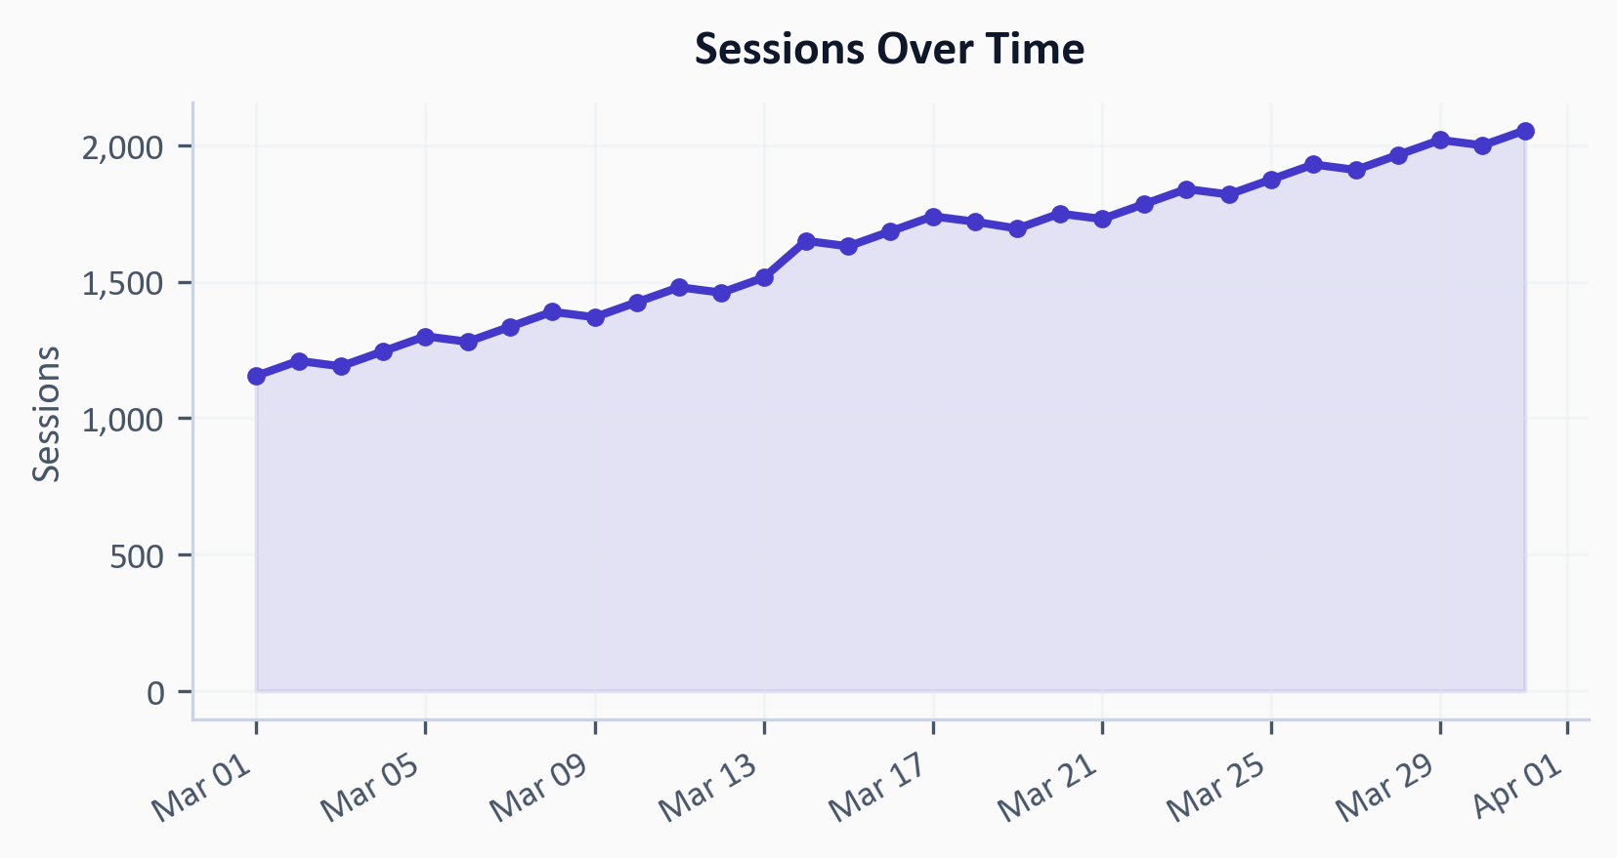
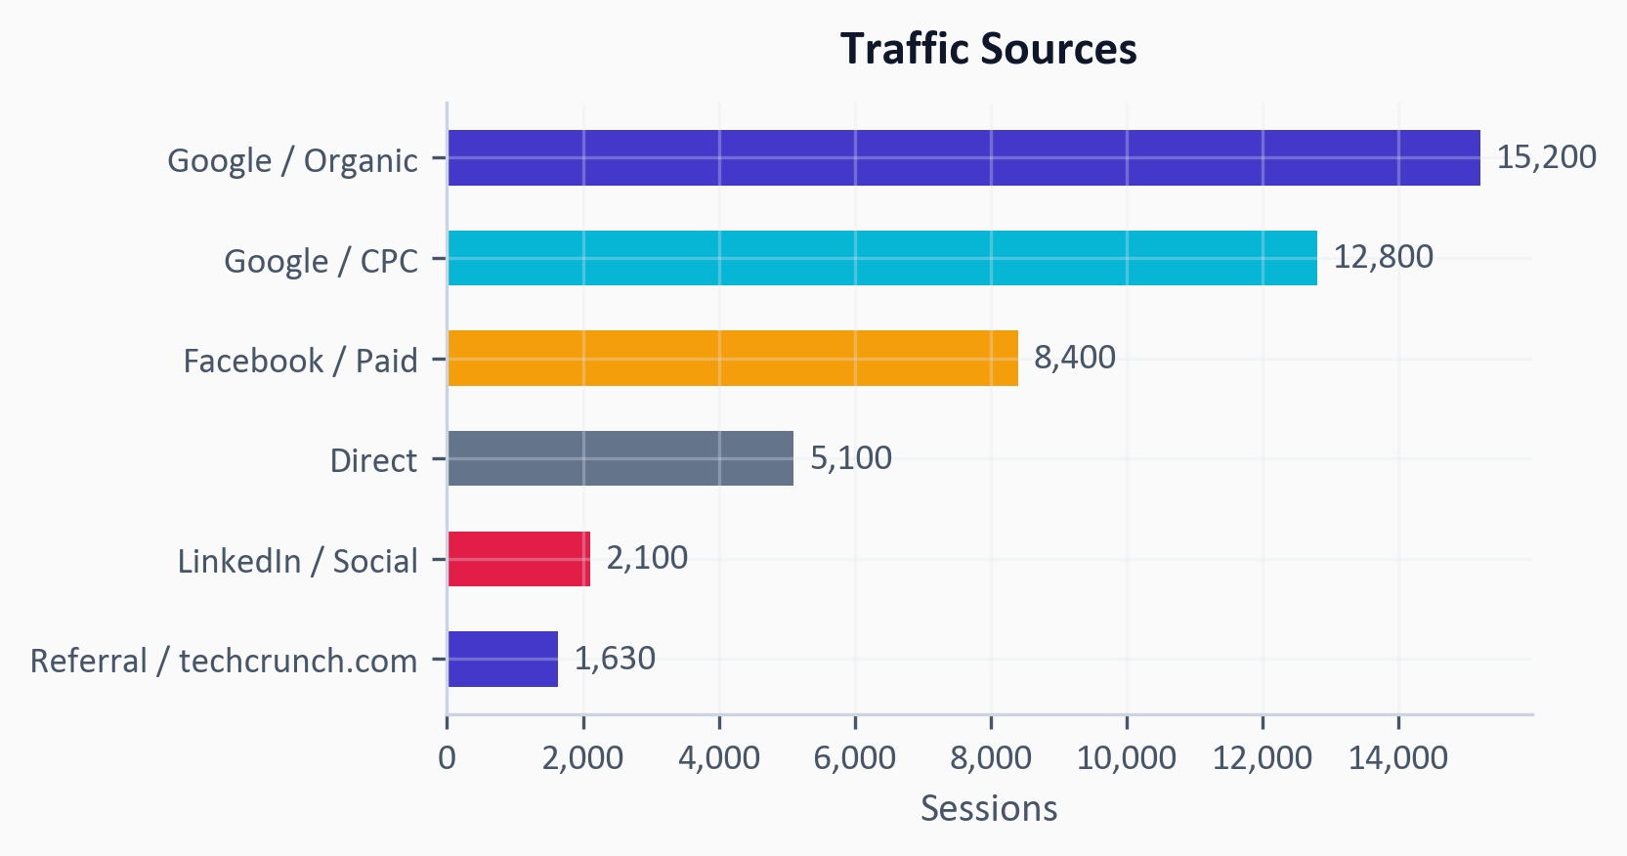
Website Performance
TechVista's website experienced exceptional growth in March, with sessions climbing from 33,705 to 45,230 - a 34.2% increase. The DataPulse launch on February 15th continued to drive interest throughout March, with a visible traffic spike during March 15-18 coinciding with the TechCrunch feature article.
User acquisition was strong with 19,200 new users (67.5% of total users), indicating effective top-of-funnel marketing. Returning users also grew by 18.3%, suggesting the product is generating genuine interest.
The bounce rate improved significantly from 50.4% to 42.3%, a testament to the landing page optimizations implemented in late February. Average session duration of 3 minutes and 5 seconds indicates users are engaging deeply with product content.
Traffic sources showed healthy diversification: organic search (33.6%), paid search (28.3%), paid social (18.6%), direct (11.3%), LinkedIn (4.6%), and referrals (3.6%).
SapienBotics Agency • Confidential • Page 4

Slide 5
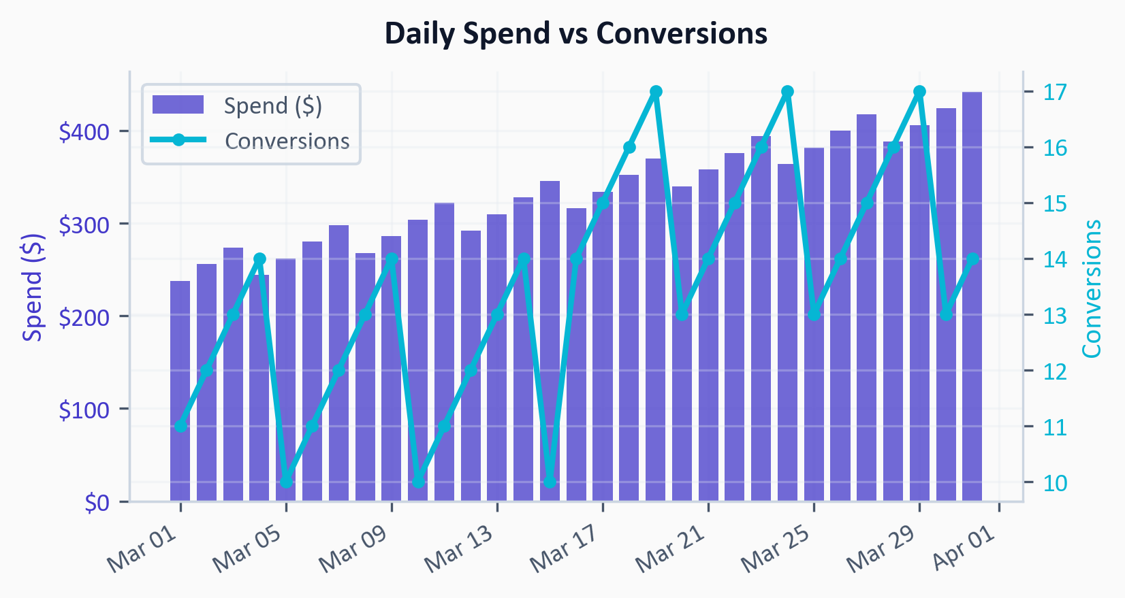
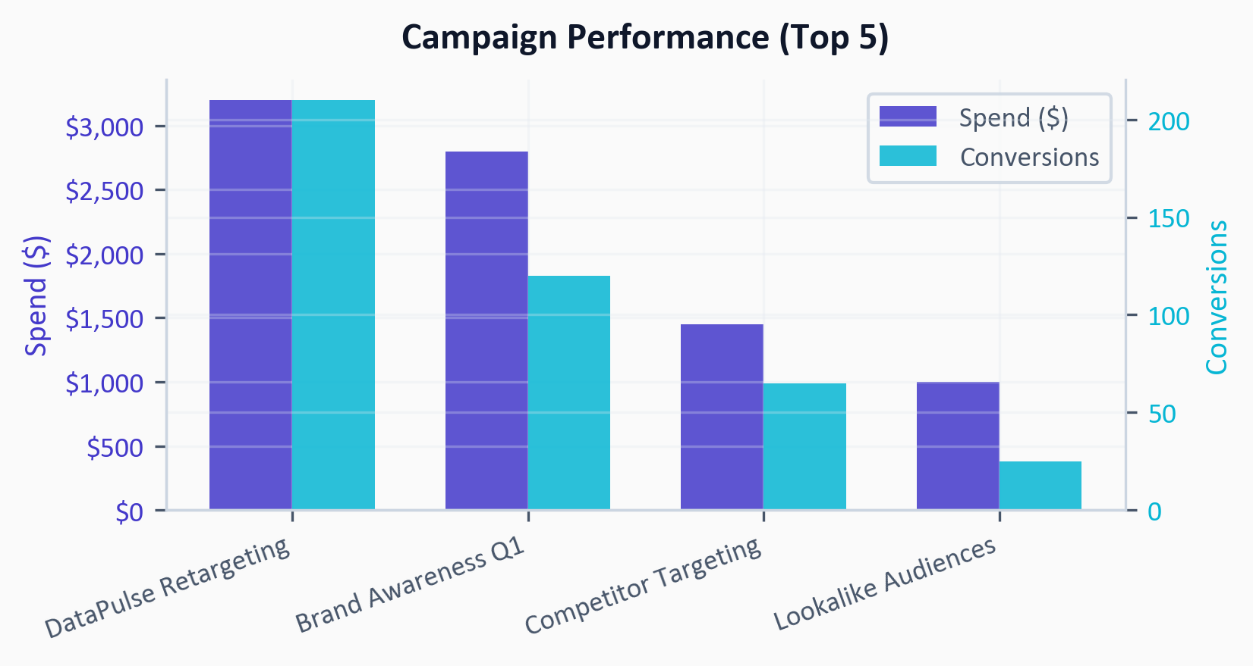
Paid Advertising — Meta Ads
Meta Ads investment of $8,450 delivered 420 conversions at a cost per acquisition of $20.12, generating an overall ROAS of 3.8x. This represents a 45.8% increase in conversions compared to February.
The DataPulse Retargeting campaign was the clear winner, generating 210 conversions at 4.2x ROAS - this campaign alone justified 50% of total conversions at the lowest CPA. The Brand Awareness campaign reached 220,000 impressions and contributed 120 conversions.
The Competitor Targeting campaign showed promising results with a 3.5x ROAS, successfully capturing users researching alternative solutions. However, the Lookalike Audiences campaign underperformed at 2.8x ROAS and warrants creative refresh or audience refinement.
CTR across all campaigns averaged 3.0%, above the industry benchmark of 2.1% for B2B SaaS. CPC remained efficient at $0.54, down from $0.62 in February.
SapienBotics Agency • Confidential • Page 5

Slide 6
Key Wins & Highlights
✓ Sessions surged 34.2% to 45,230, marking the highest traffic month in company history
✓ Conversions jumped 67.5% to 1,240, exceeding the monthly target of 500 trial signups by 148%
✓ Meta Ads retargeting campaign delivered exceptional 4.2x ROAS with 210 conversions
✓ Bounce rate improved from 50.4% to 42.3%, indicating stronger landing page performance
✓ TechCrunch feature generated 950 referral users and boosted brand authority
SapienBotics Agency • Confidential • Page 6

Slide 7
Concerns & Recommendations
⚠ Lookalike Audiences campaign underperforming at 2.8x ROAS - recommend pausing and testing new audience segments based on DataPulse trial signups
⚠ Mobile bounce rate at 52.1% vs 38.4% desktop - the DataPulse landing page needs mobile optimization, particularly the signup form
⚠ LinkedIn organic traffic represents only 4.6% despite B2B audience - recommend increasing LinkedIn content frequency from 2x to 4x weekly
SapienBotics Agency • Confidential • Page 7

Slide 8
Next Steps & Action Items
→ Pause Lookalike Audiences campaign and create new audience based on March trial signups - implement by April 5
→ A/B test mobile landing page with simplified signup form - launch test by April 3
→ Increase Meta retargeting budget by 25% ($800) given strong 4.2x ROAS - effective immediately
→ Develop LinkedIn thought leadership content calendar for April - draft by April 7
→ Schedule Google Ads keyword expansion targeting DataPulse competitor terms - launch April 10
Questions? Reply to this email or schedule a call.
SapienBotics Agency •

