Slide 1
Handle Interruption coming from Multiple Devices

Slide 2
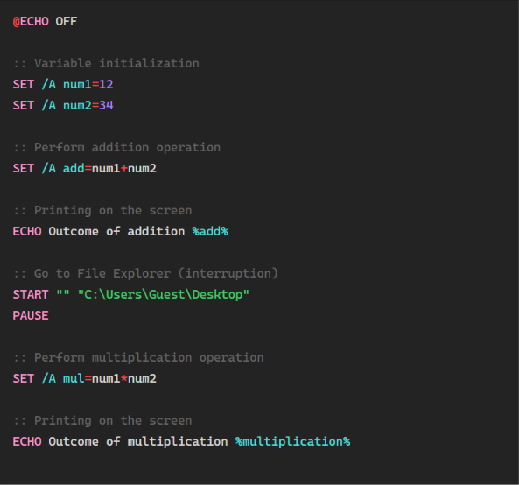
A small example of Software Interruption

Slide 3
Hardware interruption
There are Two types of hardware interruption methods
  Daisy chaining priority interruption
  Parallel priority interruption

Slide 4
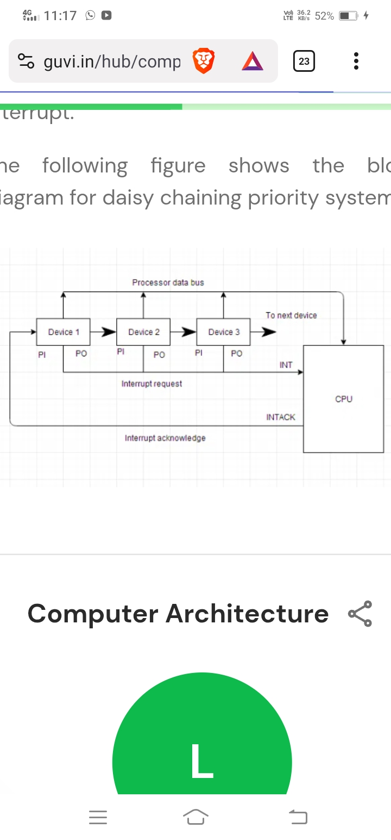
Block Diagram of Daisy chaining priority interruption

Slide 5
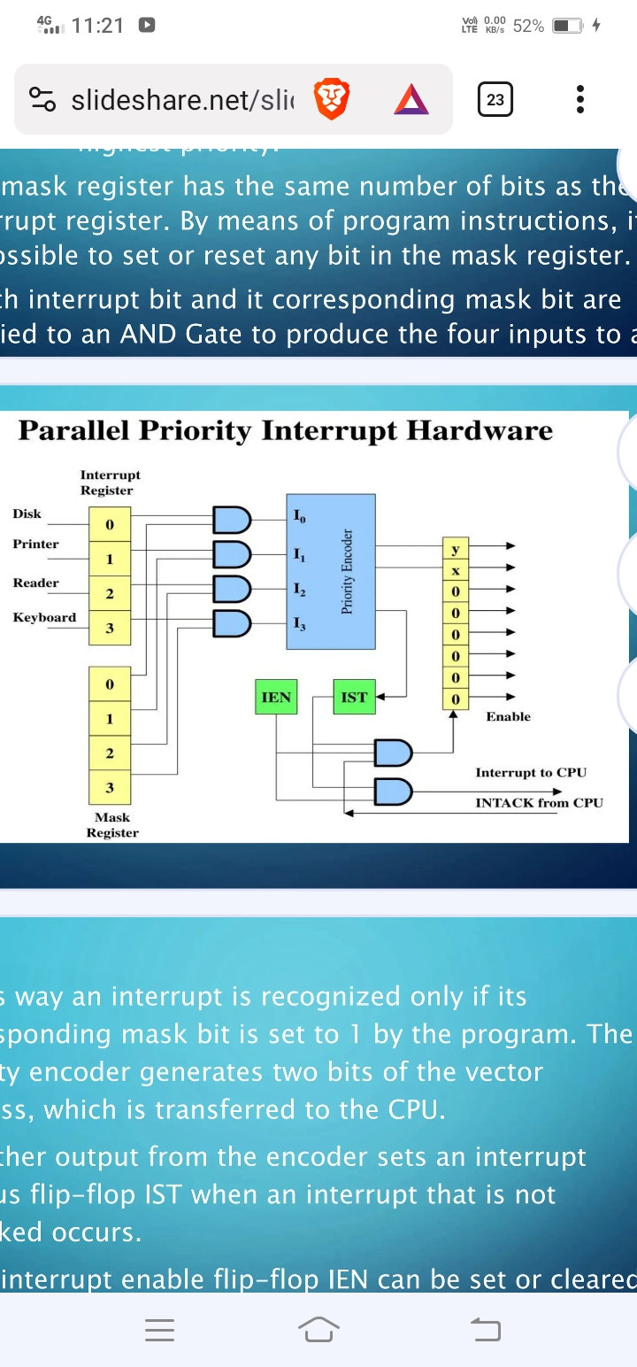
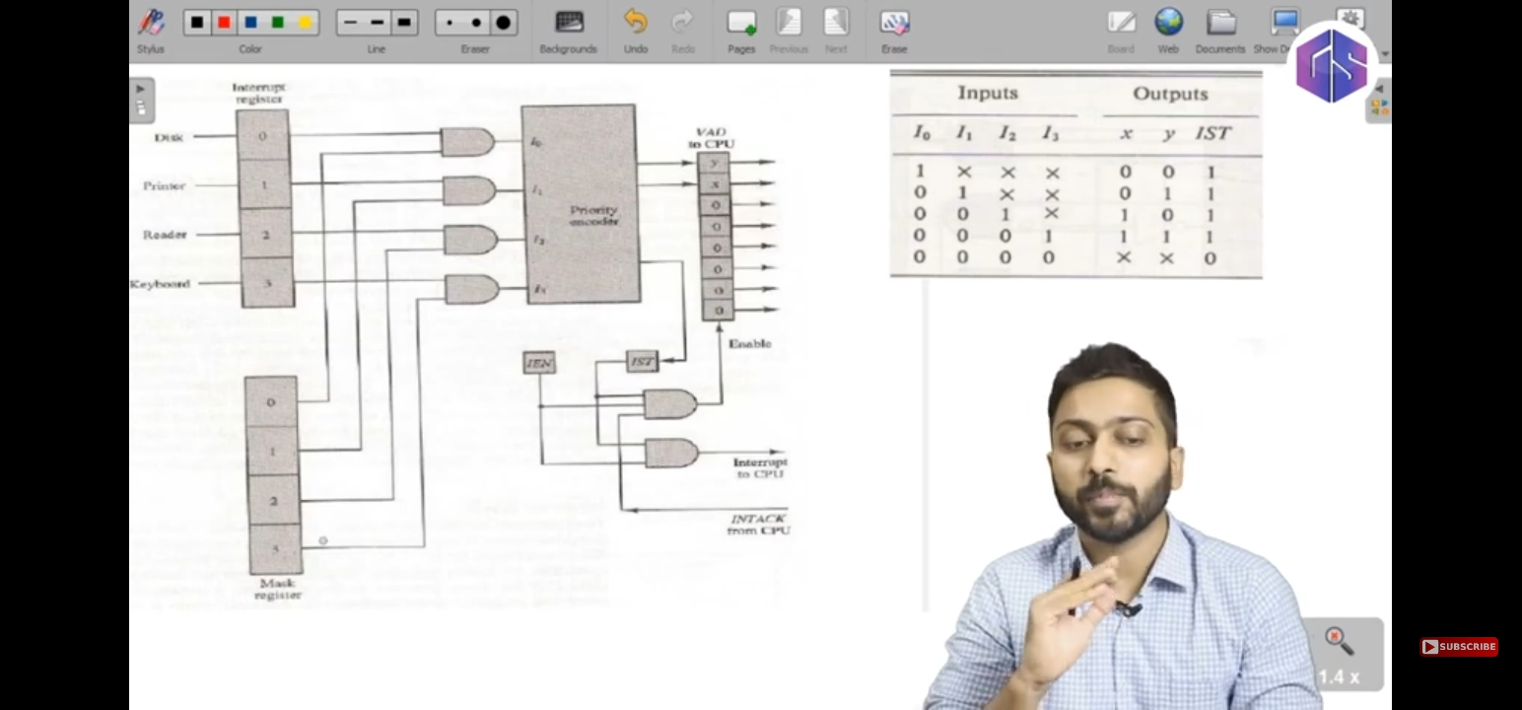
Block Diagram of Parallel priority interruption

