Slide 1
Optimizing wine purchase
James Lee
Olive garden inc.
For Chief Marketing Officer
3/15/2019

Slide 2
Agenda
Objectives of research
Exploratory Data Analysis (EDA)
Unsupervised Learning
Supervised Learning:
  Regression
  Classification

Slide 3
Objectives
Primary Questions:
  Price and Quality: Is more expensive wine necessarily better?
  Review and Quality: What keywords should we look for in identifying good wines?
  Best predictors of quality?
Lesser questions:
  What keywords in review tend to appear together in wine reviews?
  What keywords predict/are associated with the variety?
  What keywords predict/are associated with the origin of sale? (US, EU, Asia)

Slide 4
Exploratory data analysis
Data profile
Data cleaning
Distribution of key variables
Preliminary analysis

Slide 5
Data Profile
Points: the number of points WineEnthusiast rated the wine on a scale of 1-100 (though they say they only post reviews for wines that score >=80)
Variety: the type of grapes used to make the wine (ie Pinot Noir)
Description: a few sentences from a sommelier describing the wine's taste, smell, look, feel, etc.
Country: the country that the wine is from
Province: the province or state that the wine is from
Region 1: the wine growing area in a province or state (ie Napa)
Region 2: sometimes there are more specific regions specified within a wine growing area (ie Rutherford inside the Napa Valley), but this value can sometimes be blank
Winery: the winery that made the wine
Designation: the vineyard within the winery where the grapes that made the wine are from
Price: the cost for a bottle of the wine

Slide 6
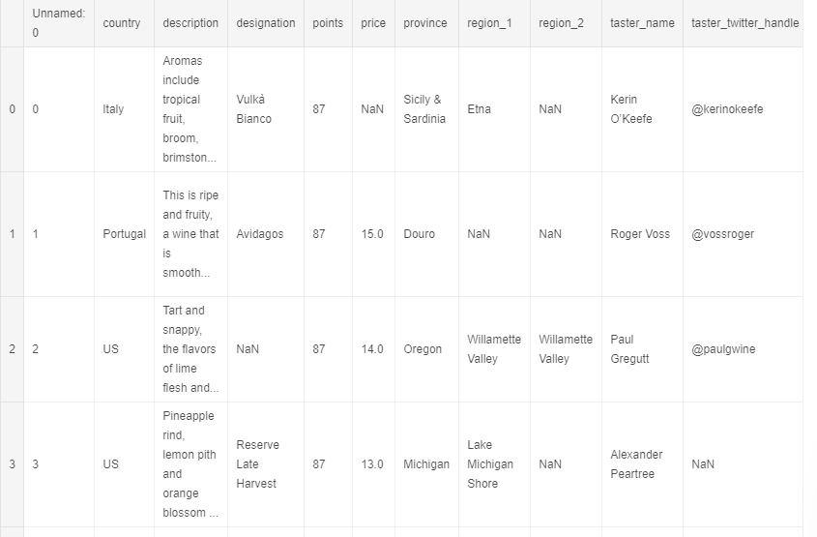
Data Cleaning
Remove unnamed 0 column and other non-relevant ones
Remove rows with NaN for price/description/points
Remove duplicates

Slide 7
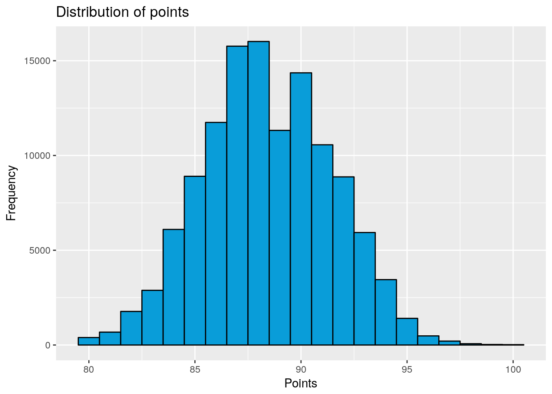
Distribution of Variables
Points (quality) are roughly bimodal but centered at the mean and approximately symmetric
Mode at 88

Slide 8
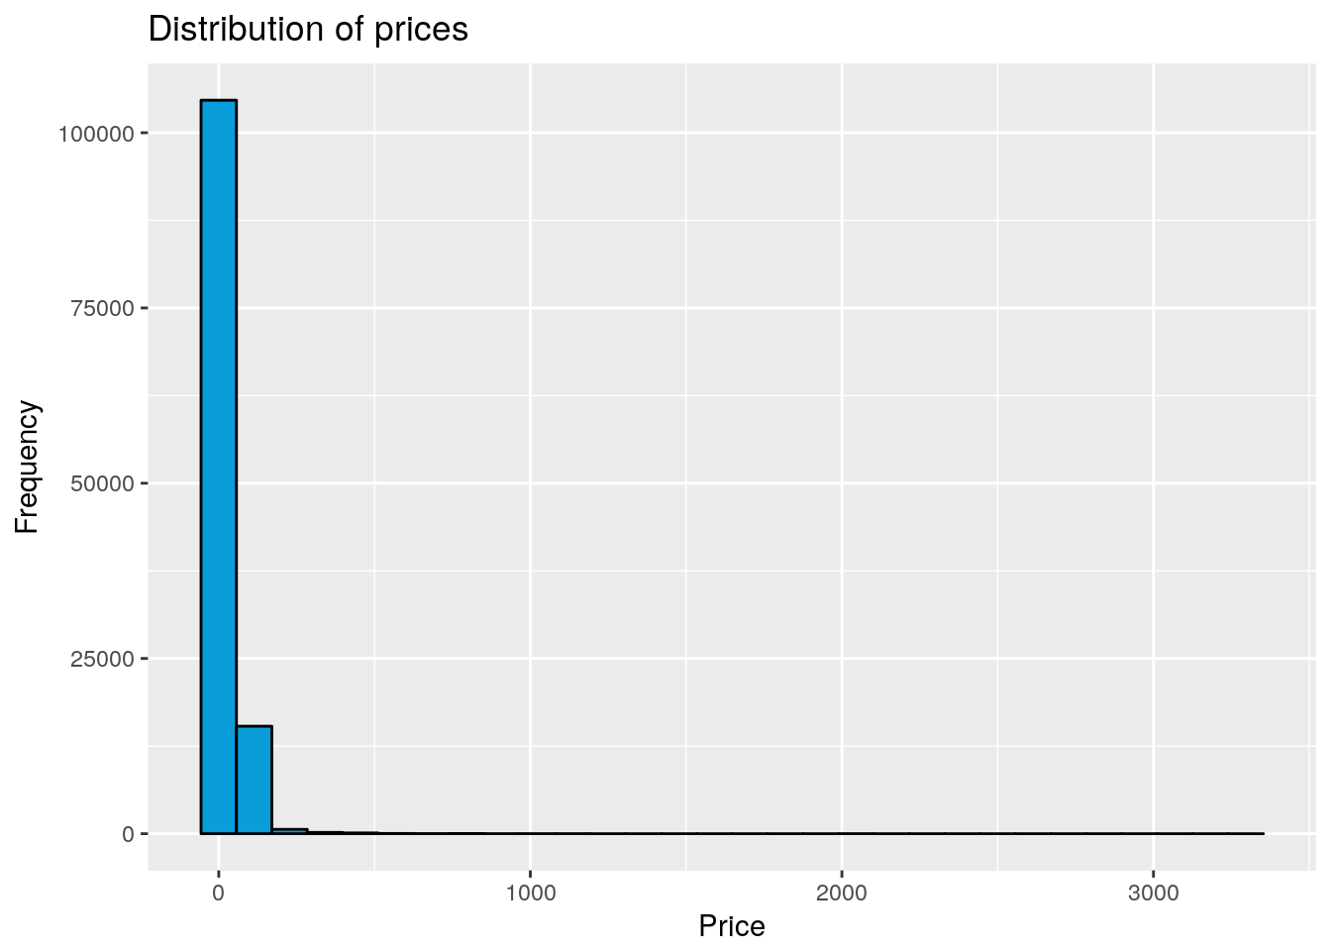
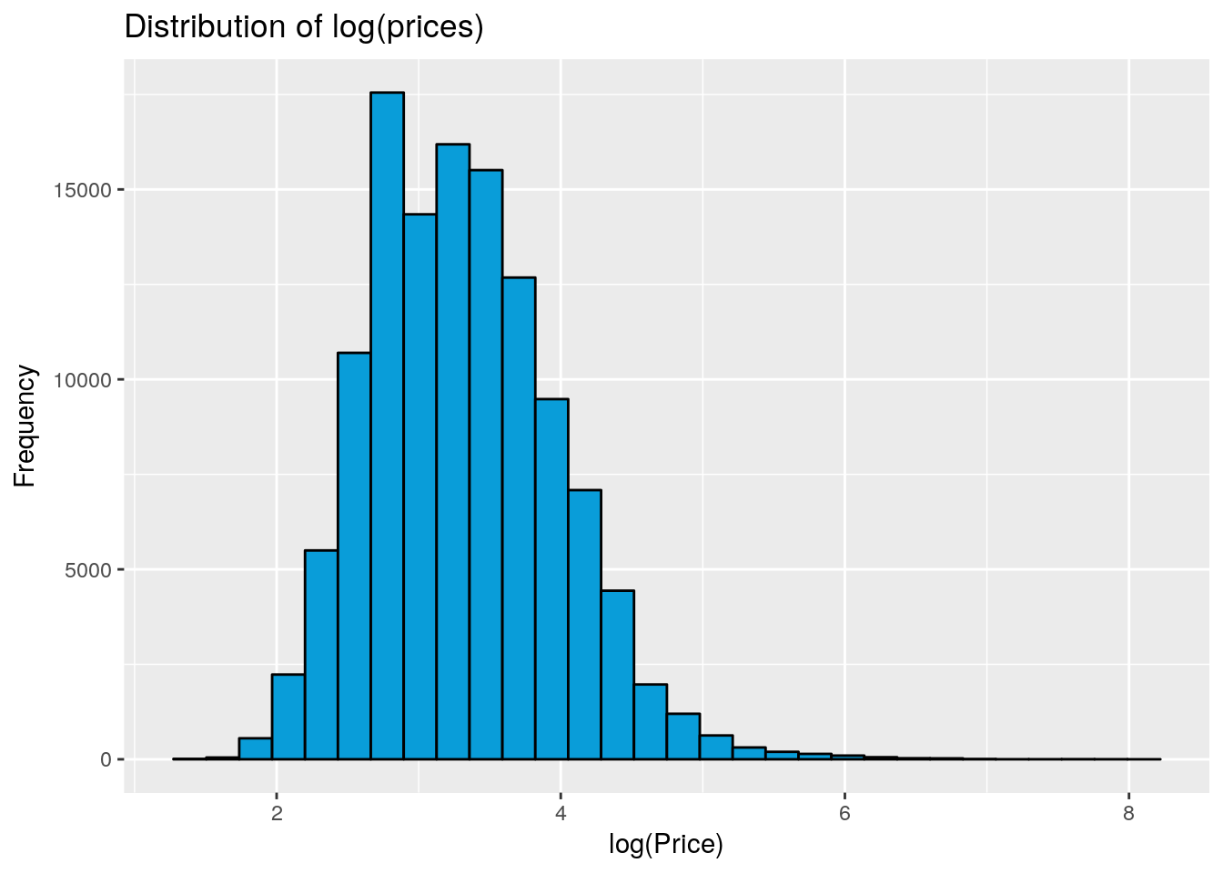
Distribution of variables ii

Slide 9
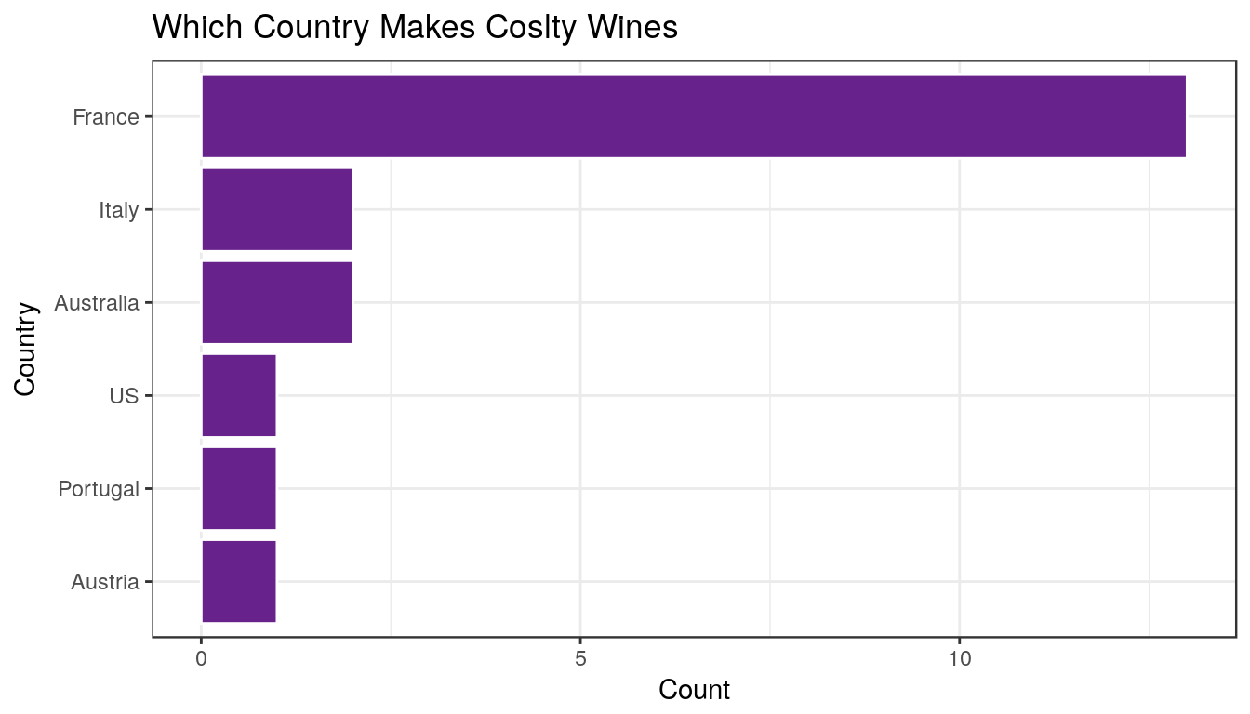
Countries and points
France is on top producing costly wines.

Slide 10
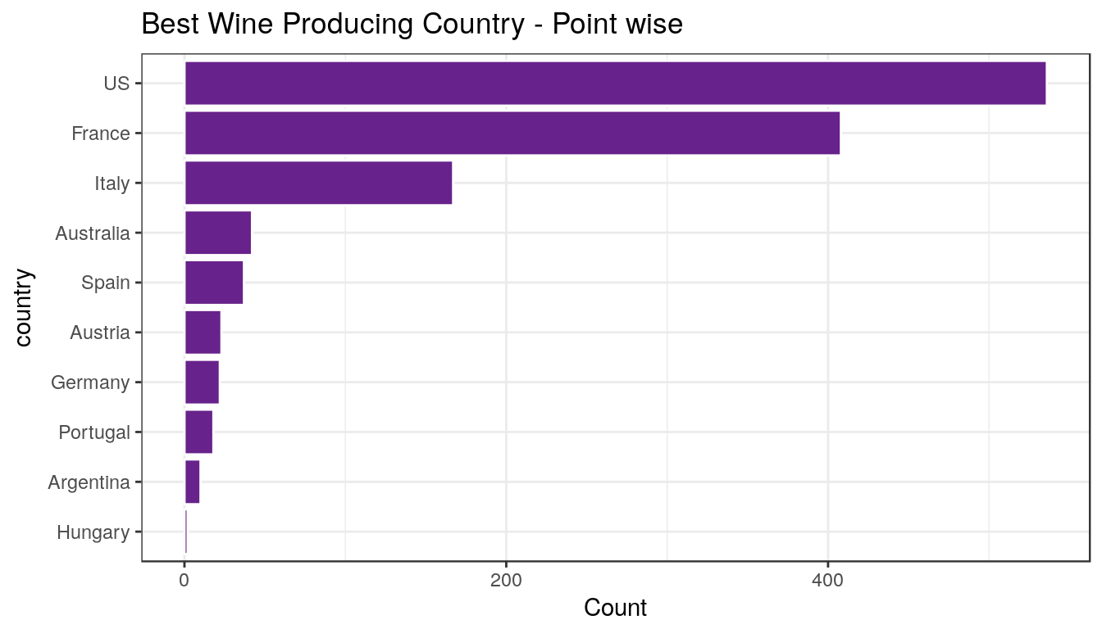
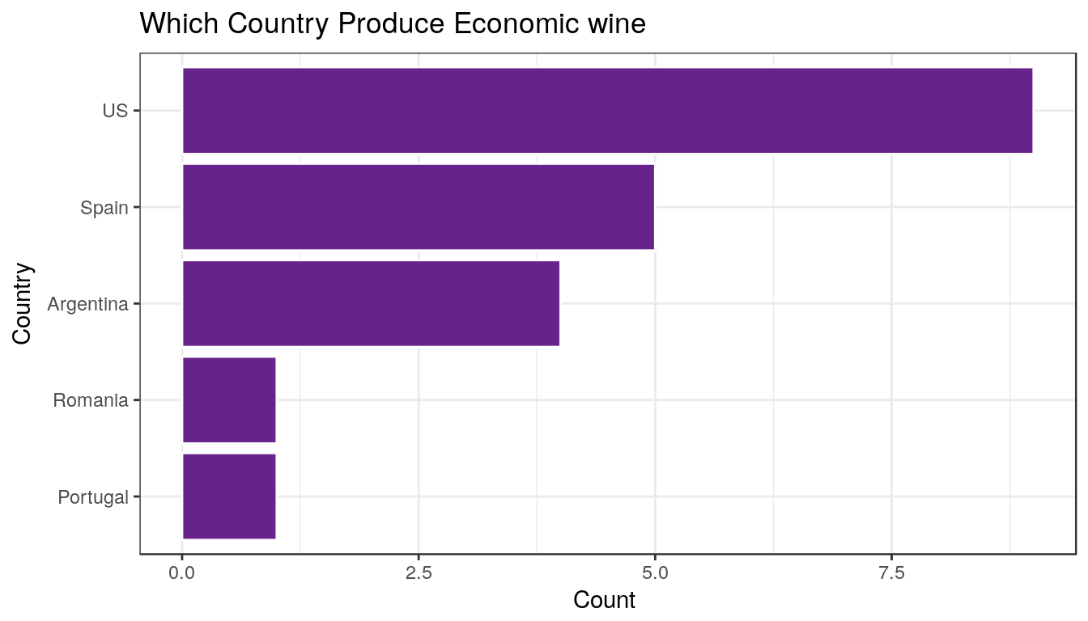
Countries and points ii
US is where there are best winery point vise followed by France, Italy.
US is where least cost wine produced followed by Spain, Argentina( highlighted).

Slide 11
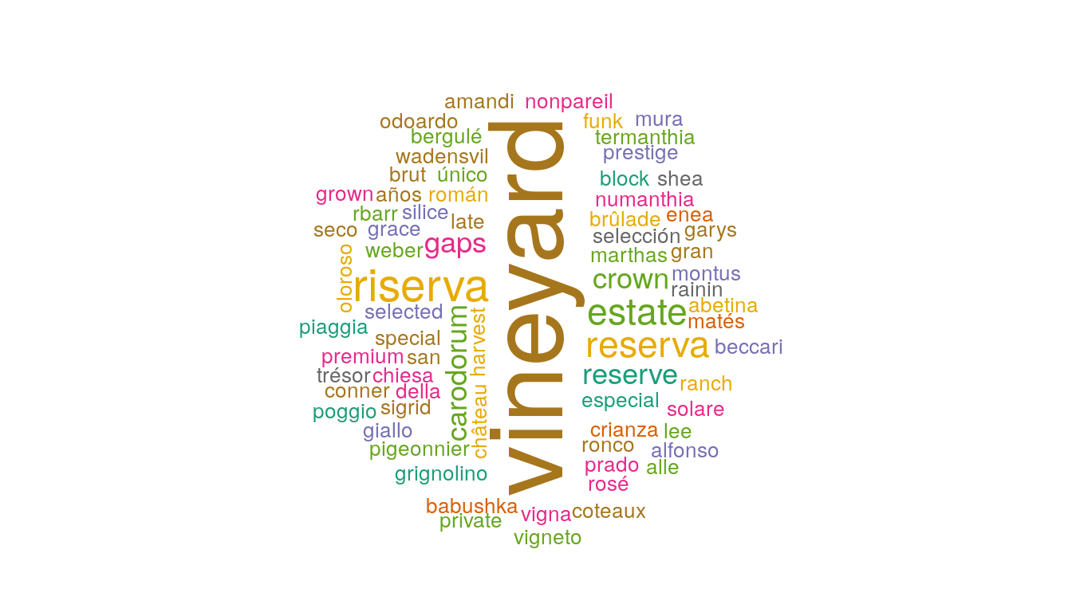
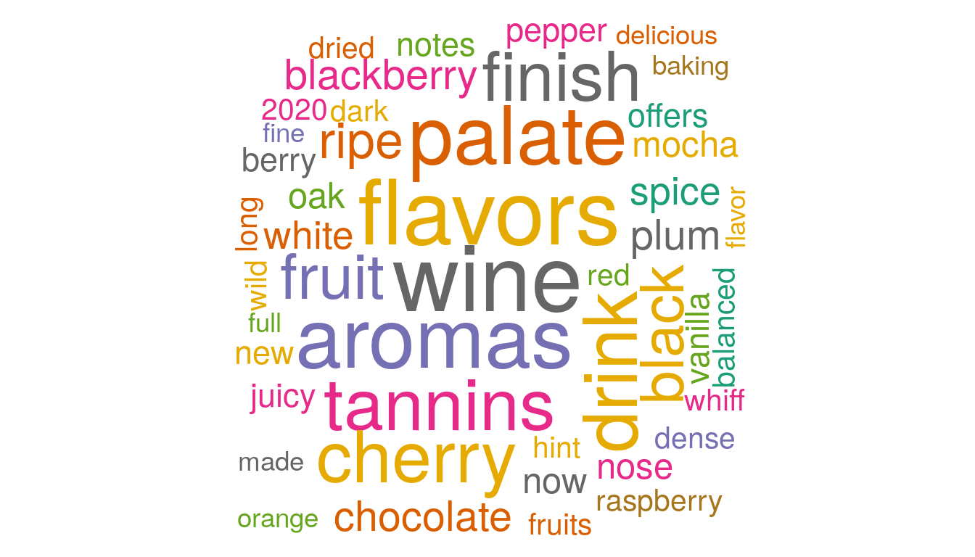
Reviews
Vineyard , reserva, riserva, estate, grapes are most used words to designate a wine.
Flavors, cherry, fruit, drink, chocolate, blackberry, plum, tannins, aromas, palate, black are most common words used to describe a wine.

Slide 12
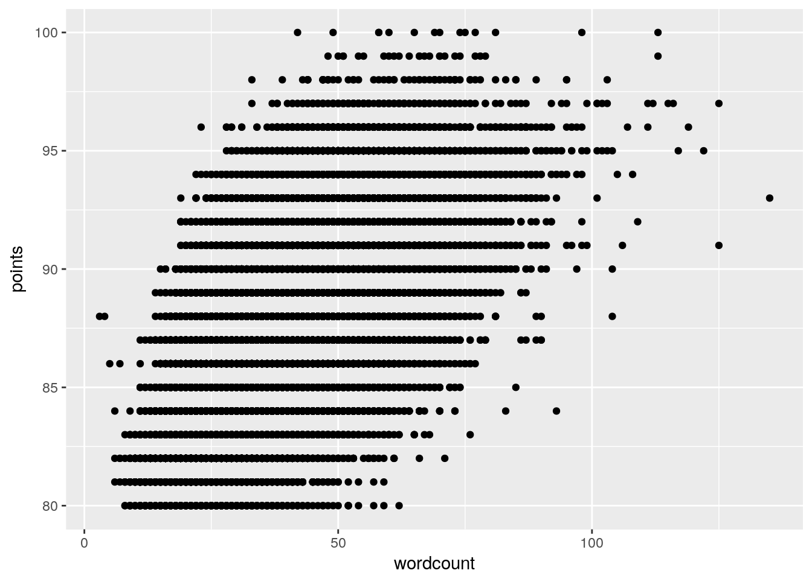
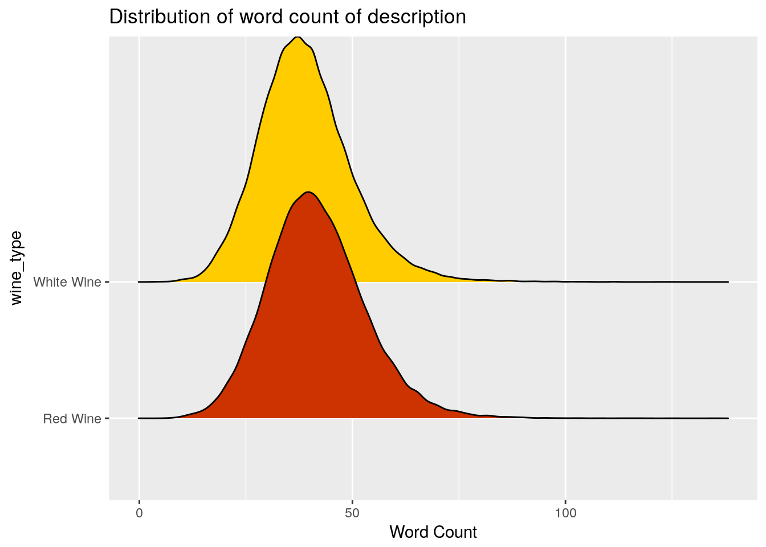
Reviews ii

Slide 13
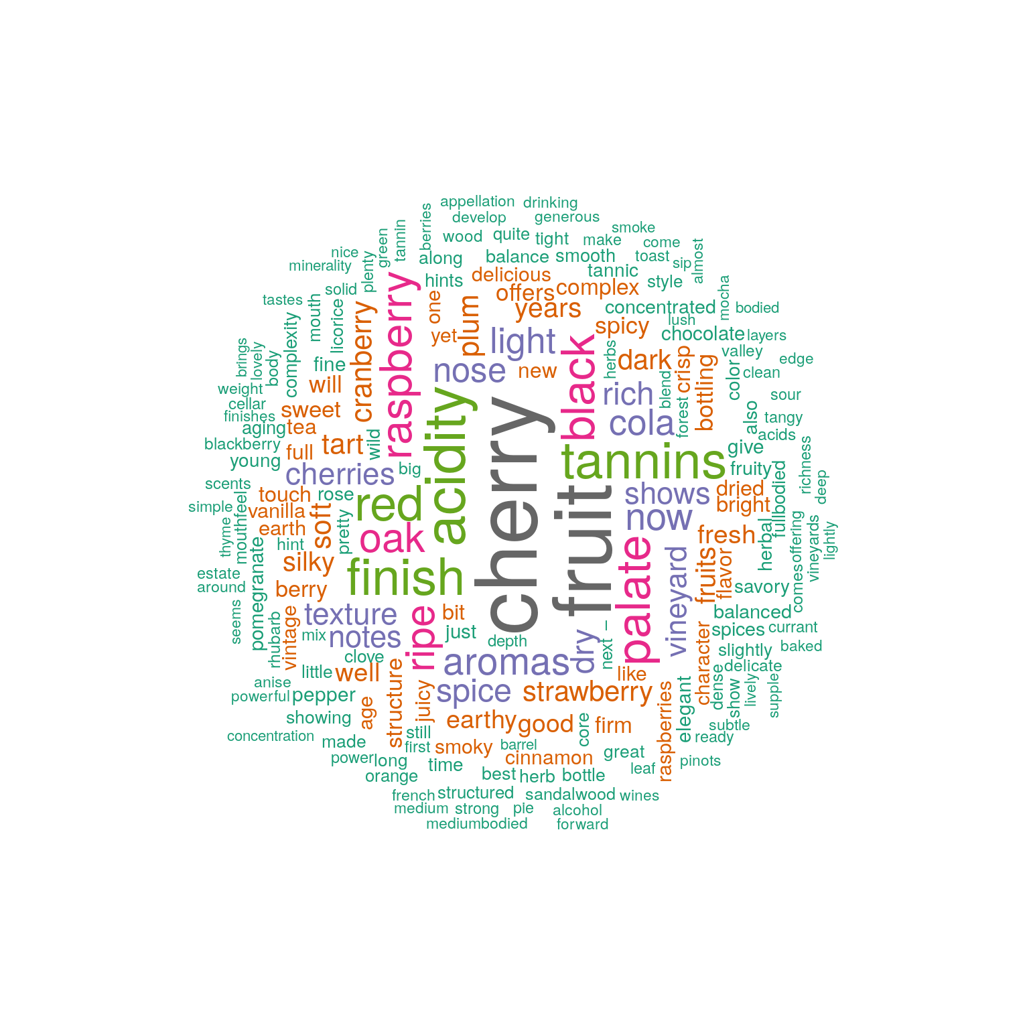
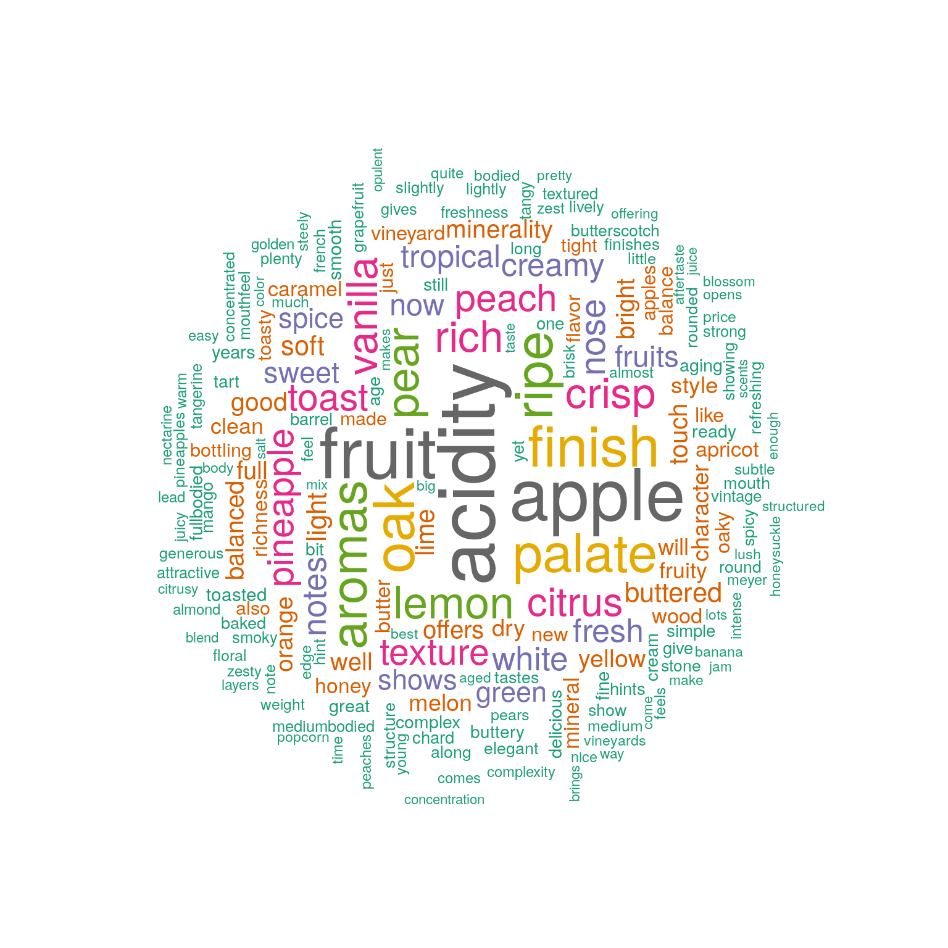
Reviews iii

Slide 14
Unsupervised Learning

Slide 15
Text preprocessing for k-means
Limit to top 3000 words for efficient feature space
Python is very useful for natural language processing:
  Rid of stop words
  Term frequency-inverse document frequency (TF-IDF) vectorizer
  Stem words

Slide 16
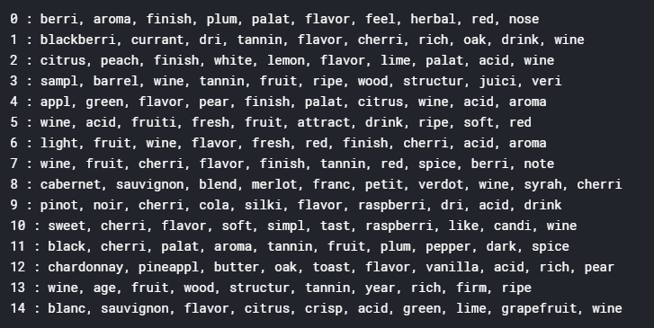
K-means
15 clusters optimal
Words associated with each cluster
What keywords in review tend to appear together in wine reviews?
  These are the keywords to be used toward recommending wines to customers

Slide 17
Supervised Learning

Slide 18
Regression
Tool:
  Cluster Regression
  Categorical Boosting
Questions:
  Price and Quality: Is more expensive wine necessarily better?
  Best predictors of quality

Slide 19
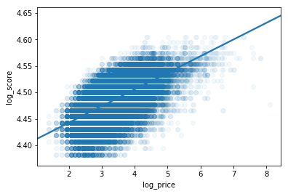
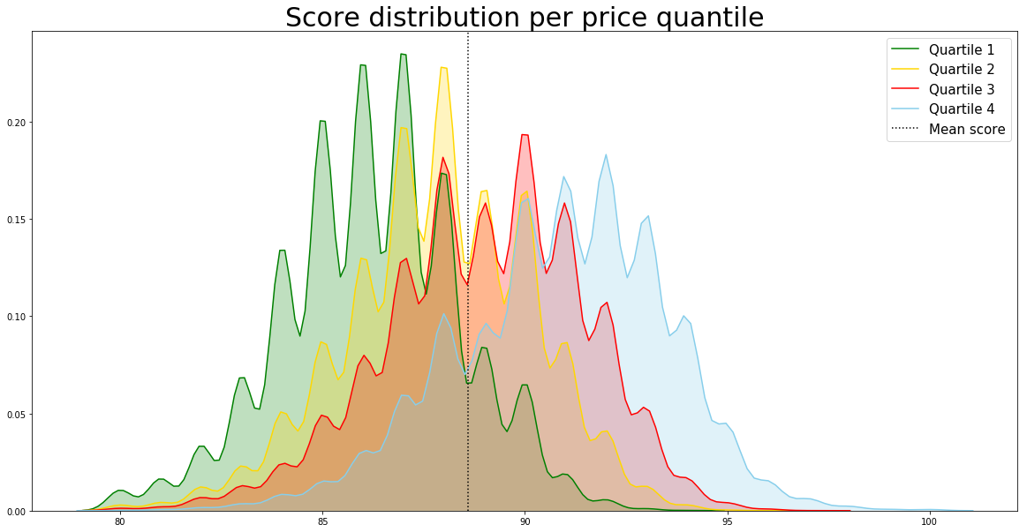
Regression: Quality vs Price
Regress quality on price
Despite the high correlation between price and score, there are plenty of good wine options across all price ranges
Cluster regression on different quantiles
Does good wine have to be expensive?

Slide 20
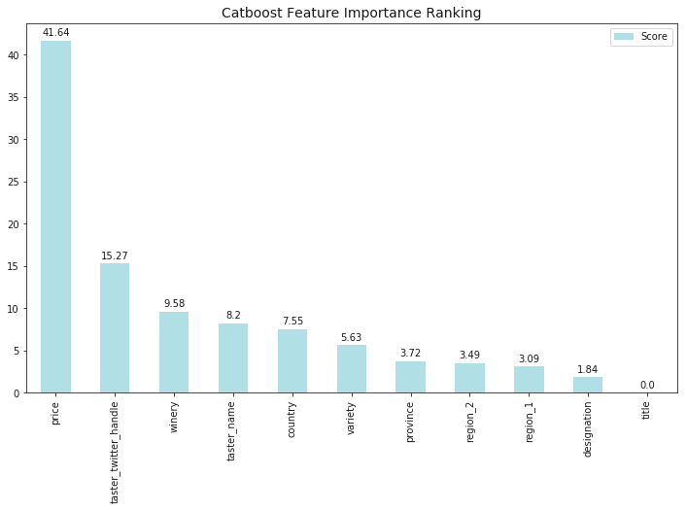
Boosting: predictors of quality
As we can see the most important feature is price. Tester has also big impact for the points score.
Best predictors of quality?
  Best wines tend to be expensive, tester’s judgment, and makers (more important than country or grape)

Slide 21
Classification
Tools
  Naïve Bayes Classifier
  SVM
  Multinomial Regression
Questions
  What keywords should we look for in identifying good wines?
  What keywords predict/are associated with the origin of sale? (US, EU, Asia)
  What keywords predict/are associated with the variety?

Slide 22
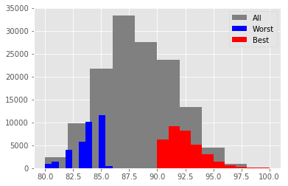

Naïve bayes Classifier
Good wine vs bad wine
Can words predict the quality of wine? A resounding yes
What keywords should we look for in identifying bad/good wines?

Slide 23
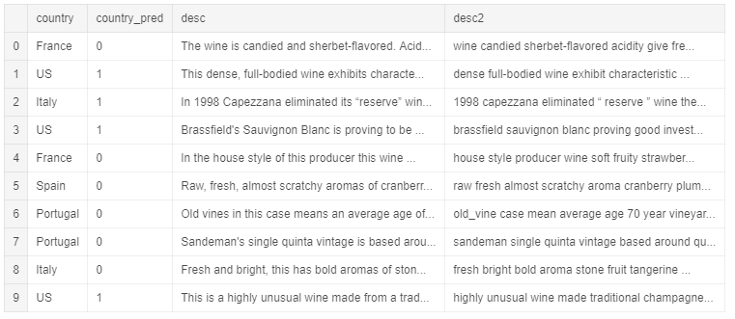
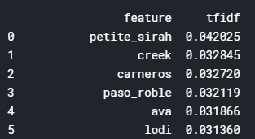
SVM
What keywords predict/are associated with the origin of sale? (US, EU, Asia)?

Slide 24
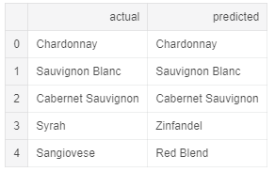
Multinomial Regression
Prune down the varieties to 8 with observations greater than 200; small sample size can bias the coefficients for small observations
53% accuracy – barely better than random guess
Can words and price predict the variety used?

Slide 25
Summary
Questions | Answers | Business Relevance
Is more expensive wine necessarily better? | No, but expensive wines strongly tend to be better | Identify best wines at the affordable price level using database
What keywords should we look for in identifying good wines? | NBC result | Use the set of key words to identify new good, affordable wines
Best predictors of quality? | Price, taster’s subjectivity, and producer | Identify producers who produce the best wines at the cheapest cost
What keywords in review tend to appear together in wine reviews? | K-means result | We can expand keyword database to identify good wines
What keywords predict/are associated with the variety? | Not clear | No result
What keywords predict/are associated with the origin of sale? (US, EU, Asia) | Mostly regional and specific grape name | Uninteresting result

Slide 26
Future work
Reviews from average consumers, not sommelier
Drill down on the questions:
  How much does variety matter to wine rating?
  How much does production origin matter to wine rating?

