Slide 1
MACHINE LEARNING · FINAL PROJECT
Customer Churn
Prediction
Menachem Twersky
Roni Reichbard
Sapir Pirski
7,043 customers · 19 predictive features
3 ML algorithms · 80.70% best test accuracy
Notes:
[Sources]
- CONTRIBUTORS.md
- final_project.ipynb

Slide 2
The task is to identify customers at risk of leaving
PREDICT
INPUT
Churn
Yes or No
• Demographics and tenure
• Subscribed services
• Contract and billing choices
• Monthly and total charges
Application: prioritize retention contact and investigate service patterns. The model estimates risk; it does not prove why a customer leaves.
2
Notes:
[Sources]
- final_project.ipynb — Section 1: The problem

Slide 3
Dataset: 7,043 customers split reproducibly
The source has 20 inputs and one binary target. A stratified split preserves the 26.54% churn rate in both subsets.
7,043
5,634
1,409
customers
training examples
test examples
20 original input features
3
Notes:
[Sources]
- final_project.ipynb — data summary and stratified split outputs

Slide 4
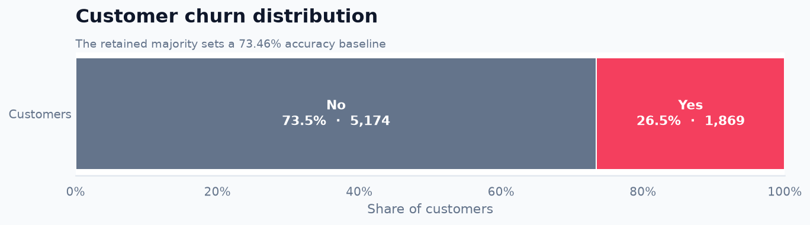
Churn is the minority class, and blanks require a semantic fix
11 blank values
TotalCharges contains blank strings rather than standard nulls. Every affected customer has zero tenure, so the value is set to zero.
The 73.46% retained share defines the majority-class accuracy baseline.
4
Notes:
[Sources]
- final_project.ipynb — label distribution and missing-value analysis

Slide 5
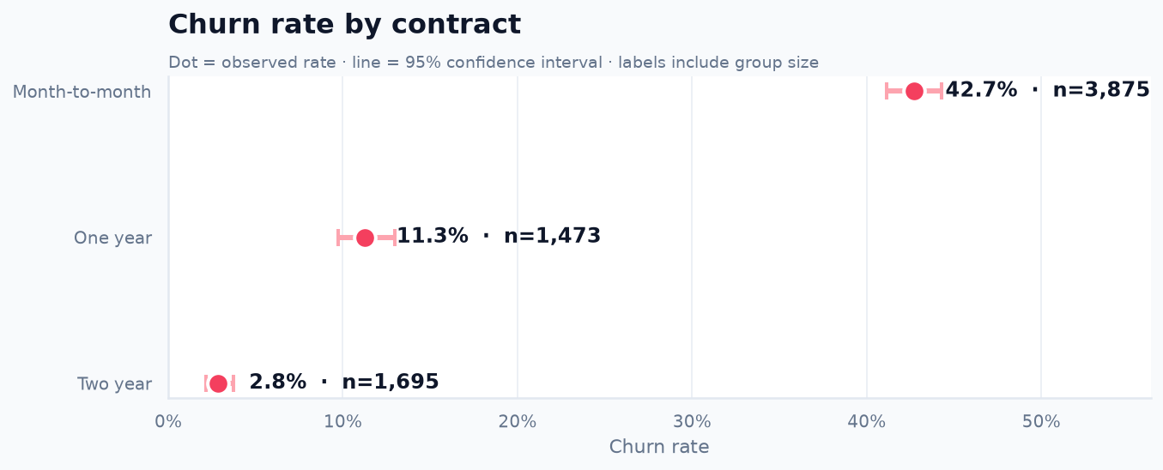
Month-to-month contracts have the highest observed churn
42.7%
month-to-month
churn rate
Association ≠ causation
5
Notes:
[Sources]
- final_project.ipynb — Graph 2: churn rate by contract

Slide 6
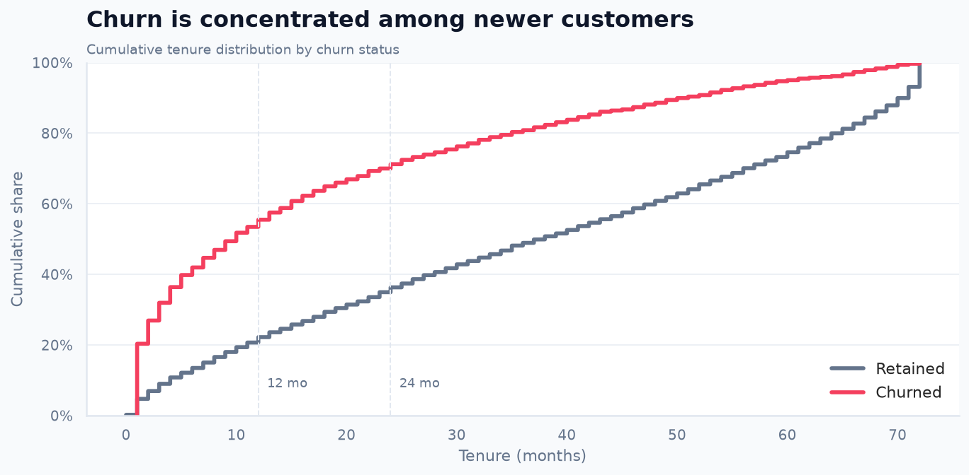
Churn concentrates among newer customers
Why ECDF?
It shows the full cumulative distribution without choosing arbitrary histogram bins.
Implication
Early-lifecycle experience is an important predictive signal.
6
Notes:
[Sources]
- final_project.ipynb — Graph 3: tenure ECDF by churn

Slide 7
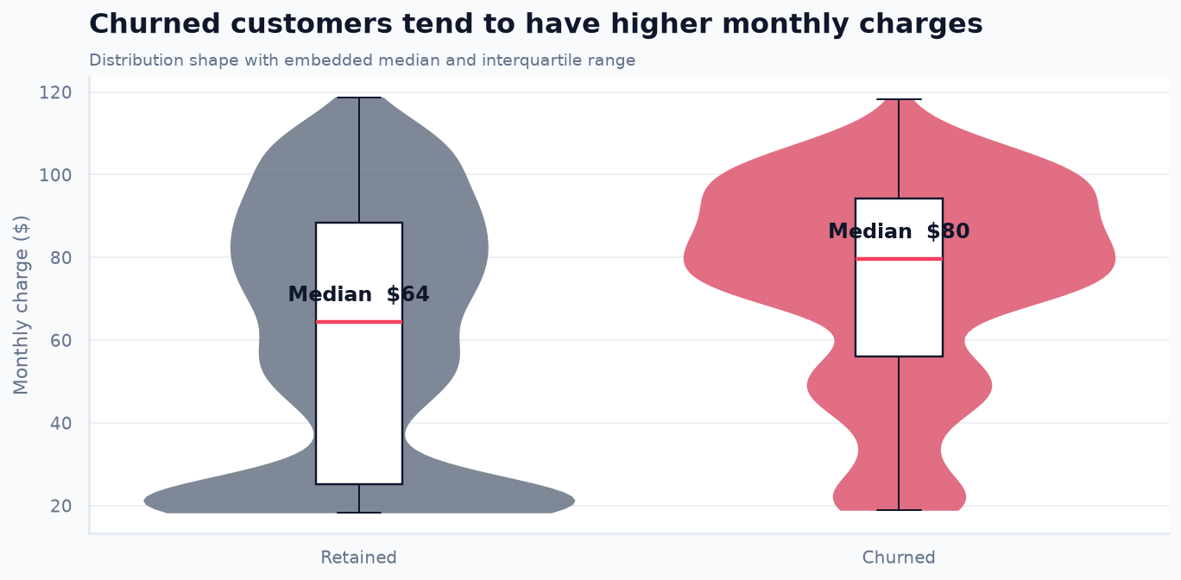
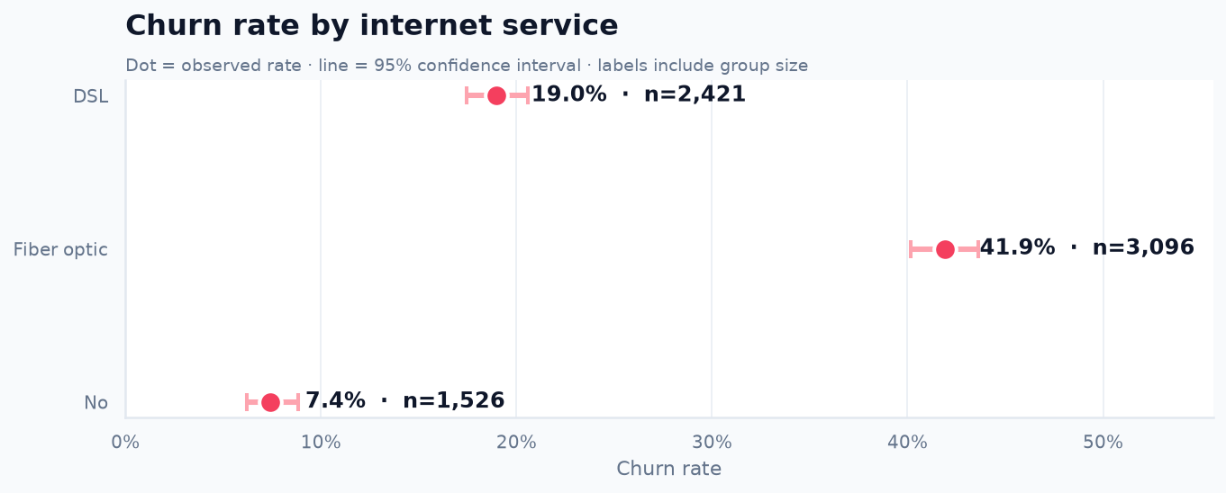
Charges and service type add predictive signal
Churned customers have a higher median monthly charge.
Fiber-optic customers show the highest observed churn.
7
Notes:
[Sources]
- final_project.ipynb — Graph 4: monthly charges
- final_project.ipynb — Graph 5: internet service

Slide 8
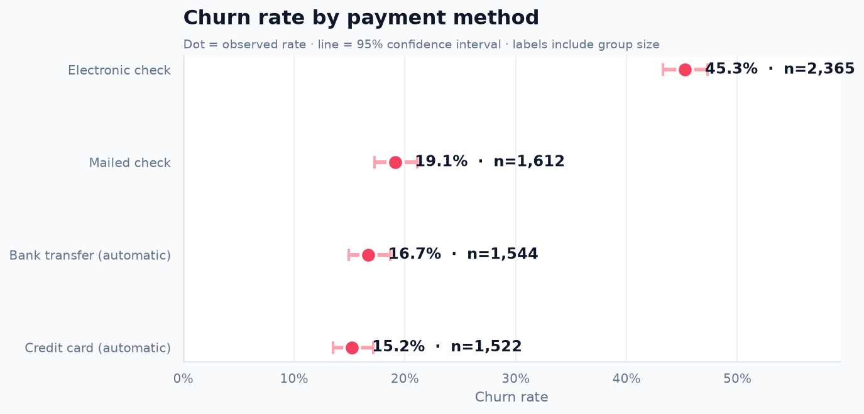
Electronic-check customers show the highest payment-group churn
Interpret carefully
Payment method may reflect convenience, contract structure, or engagement. This chart does not establish a direct causal effect.
8
Notes:
[Sources]
- final_project.ipynb — Graph 6: payment method

Slide 9
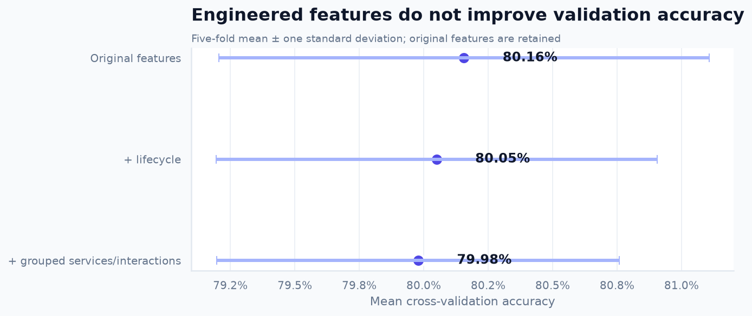
Engineered features did not improve validation
Removed
customerID — unique identifiers do not generalize
Tested
Lifecycle, grouped service counts, automatic payment, and interaction features
Decision
Keep the original 19 predictive features: they validate best.
9
Notes:
[Sources]
- final_project.ipynb — Section 5: data engineering and feature ablation

Slide 10
A training-only selection process protects the final test result
01
02
03
04
Stratified split
Pipeline preprocessing
Five-fold CV
Final evaluation
80% train · 20% test
Fit within each fold
Choose features and parameters
Use untouched test once
Primary selection metric: accuracy · Supporting diagnostics: recall, precision, F1, balanced accuracy, ROC-AUC, PR-AUC and MCC
10
Notes:
[Sources]
- final_project.ipynb — Section 6: evaluation design and baseline

Slide 11
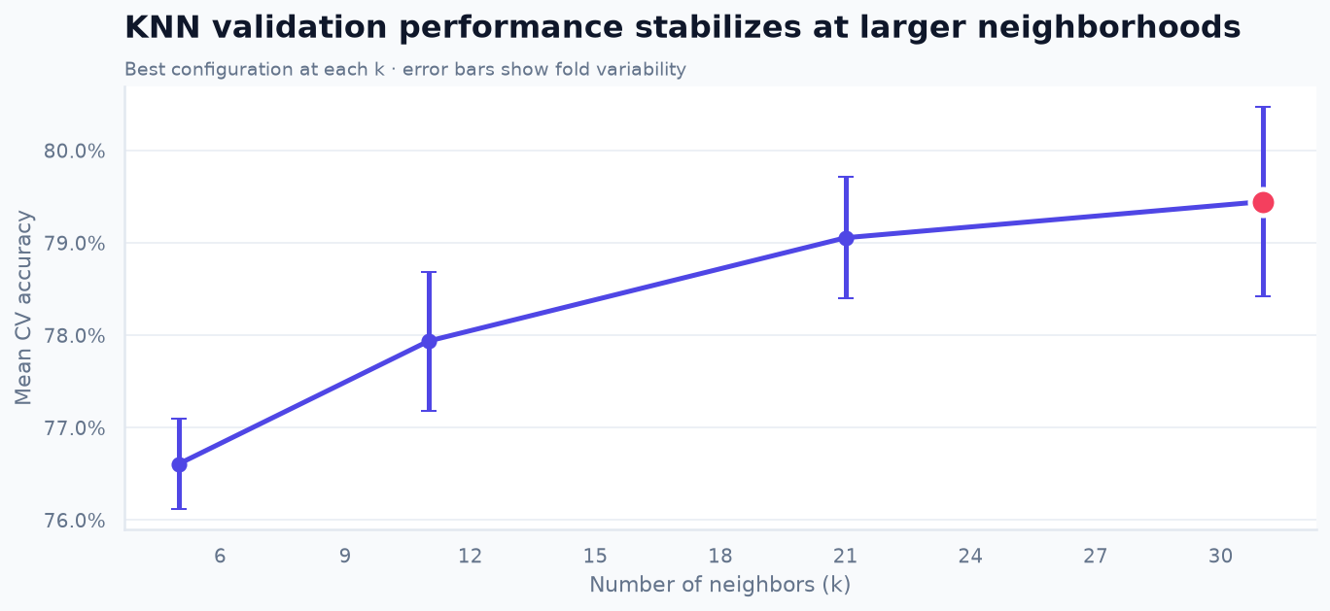
KNN is strongest at k=31
Search
k = 5, 11, 21, 31
uniform / distance
Manhattan / Euclidean
Best CV accuracy
79.45%
11
Notes:
[Sources]
- final_project.ipynb — Section 7: K-nearest neighbors

Slide 12
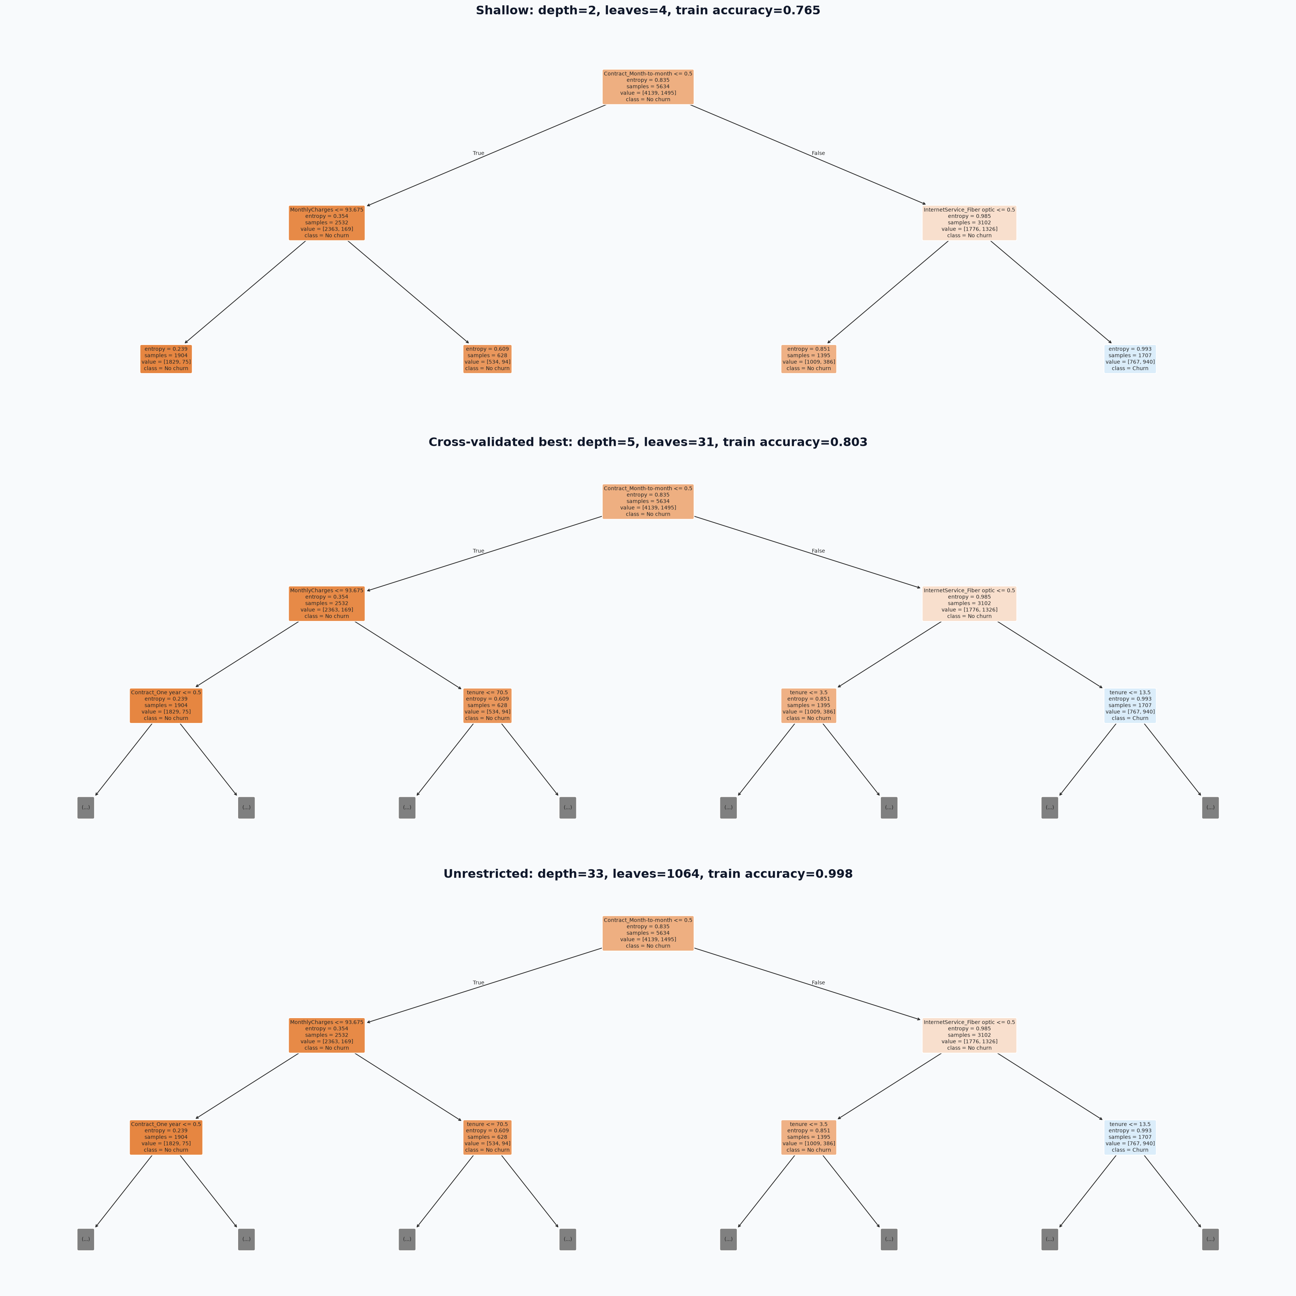
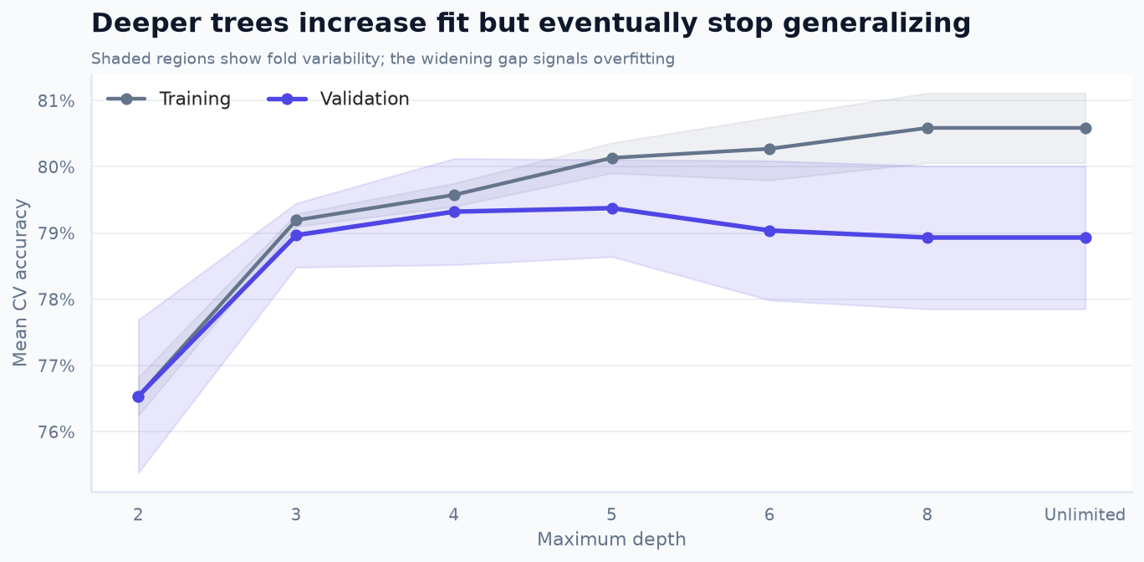
Tree depth exposes the trade-off between readability and overfitting
Selected: entropy · max_depth=5 · min_samples_leaf=5
12
Notes:
[Sources]
- final_project.ipynb — Section 8: decision-tree tuning and artifacts

Slide 13
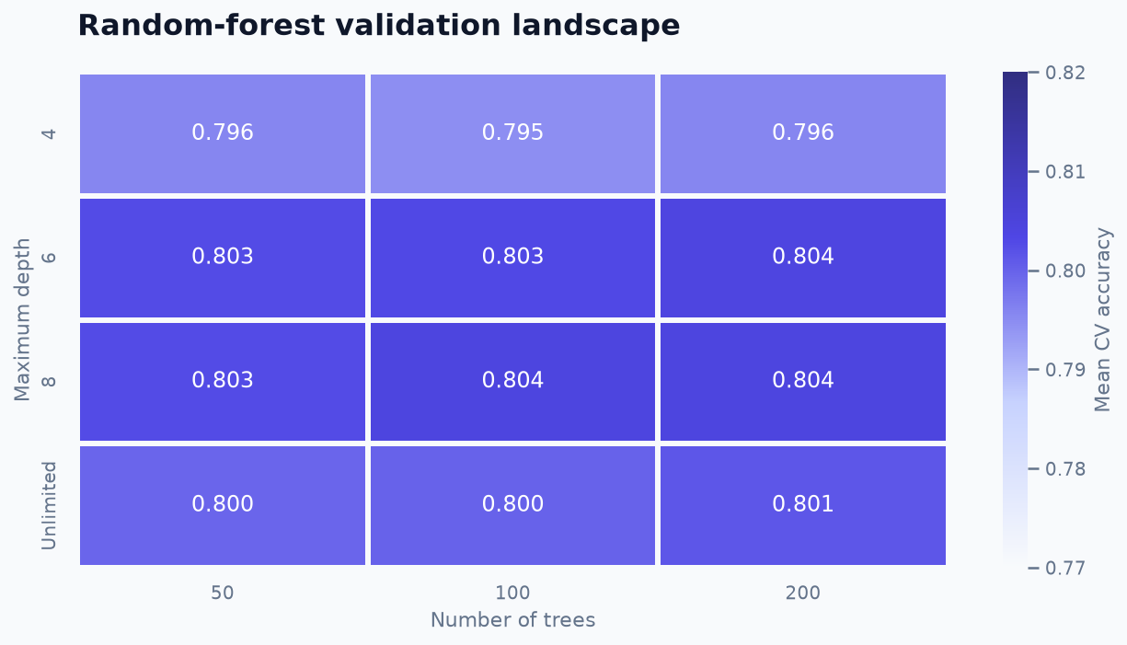
A depth-8 forest performs best in validation
Best configuration
200 estimators
max_depth = 8
max_features = sqrt
min_samples_leaf = 1
Mean CV accuracy
80.42%
13
Notes:
[Sources]
- final_project.ipynb — Section 9: random-forest search

Slide 14
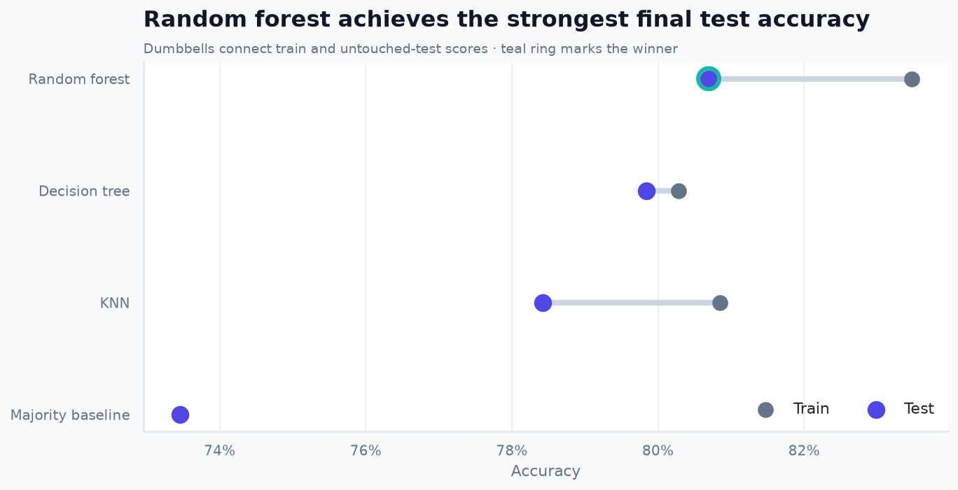
Random forest achieves the best untouched-test accuracy
Model
Train
Test
KNN
80.85%
78.42%
Decision tree
80.28%
79.84%
Random forest
83.48%
80.70%
Accuracy is strongest, but churn recall is 51.07%.
14
Notes:
[Sources]
- final_project.ipynb — Section 10: final untouched-test evaluation

Slide 15
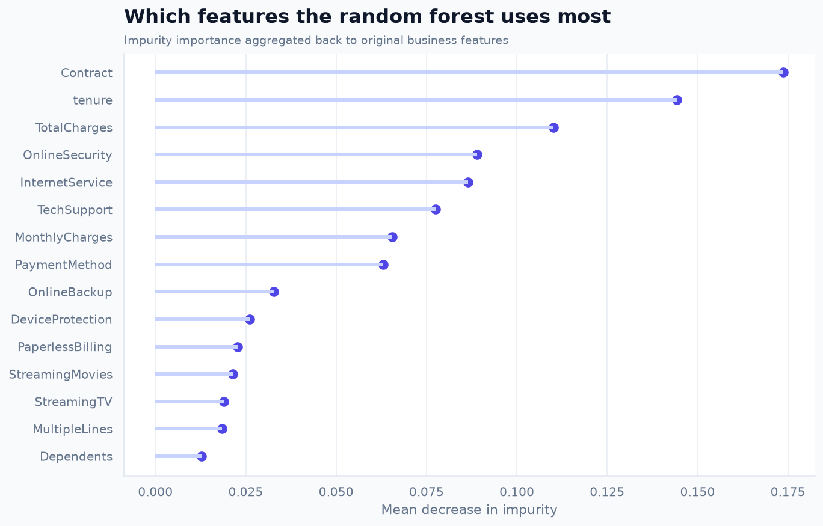
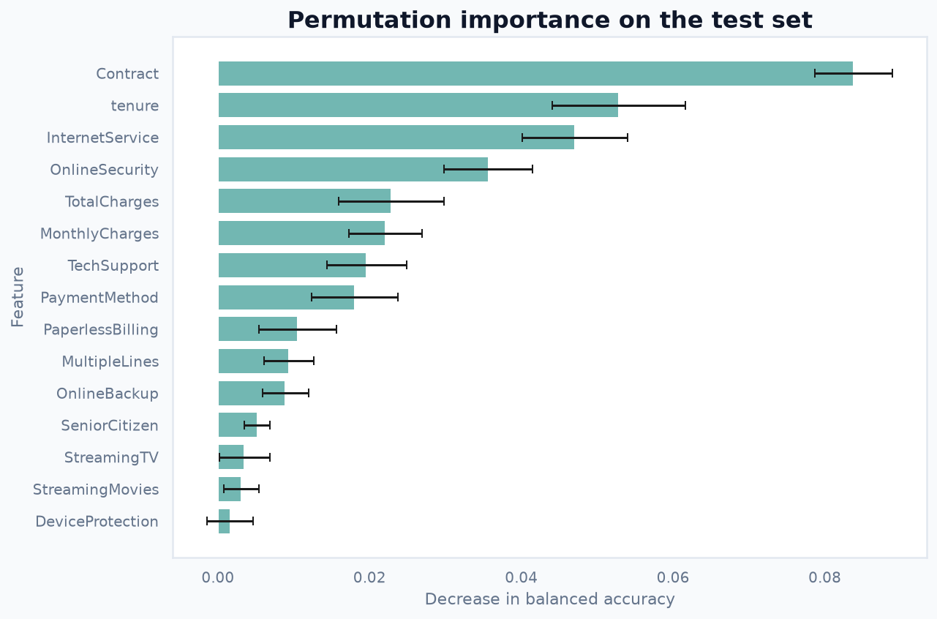
Contract and tenure lead both importance views
Impurity importance
Permutation importance on unseen data
15
Notes:
[Sources]
- final_project.ipynb — random-forest impurity importance
- final_project.ipynb — permutation importance on the untouched test set

Slide 16
Random forest leads, but accuracy is not the whole story
What we learned
80.70%
• Contract and tenure are the strongest predictive signals
• Short tenure and month-to-month contracts identify higher-risk groups
• Importance explains reliance—not causation
• False negatives show why accuracy alone is insufficient
best test accuracy
51.07%
churn recall
Next step: validate on current real-world customer data.
16
Notes:
[Sources]
- final_project.ipynb — Sections 10–13: evaluation, introspection, error analysis, conclusions
- All performance values and plots are reproduced from the executed notebook

