Slide 1


CRYPTOCURRENCY PRICE PREDICTION
Submitted By
S. Madhu Latha
K. Sriram
Nishi Kumari
P. Rajesh
(19P31A1247) (19P31A1218) (19P31A1234) (20P35A1203)
Under the esteemed supervision of
Mrs. J. SAILAJA, M.Tech
Department of Information Technology Aditya College Of Engineering And Technology
Permanently affiliated to JNTUK Kakinada, Approved by AICTE, Accredited by NAAC & NBA
Aditya nagar , ADB Road, Surampalem , Kakinada Dist,533437 2019-2023

Slide 2
Abstract
Cryptocurrencies have emerged as a popular investment option in recent years, with Ethereum being one of the most prominent ones, accurate price prediction of Ethereum can provide valuable insights to investors and traders for making informed decisions.
In this study, we utilized two time series forecasting models, ARIMA and Facebook Prophet, to predict the price of Ethereum.
The evaluation metric used to assess the performance of the models was the Mean Squared Error (MSE).

Slide 3
ARIMA and Facebook Prophet models were then implemented on the preprocessed data to generate Ethereum price forecasts. The models were trained using a time period of historical data and validated using a hold-out set of data.
The findings suggest that Facebook Prophet may be a more accurate model compared to ARIMA for Ethereum price prediction, as evidenced by lower MSE values

Slide 4
Introduction
Cryptocurrencies are digital tokens that can easily replace traditional currency in the future.
Easy access is the reason they are becoming so popular so fast.
Almost anyone can own these coins and are accepted as payment just like traditional currency.
With the rise of cryptocurrencies as a global phenomenon, accurate forecasting of their prices has become a critical task for investors, traders, and researchers.
Ethereum, being one of the leading cryptocurrencies, presents unique challenges and opportunities for price prediction due to its complex and volatile nature.
This study focused on one of the three major cryptocurrencies, named Ethereum, which represent one of the largest share of market capitalization.

Slide 5
In this project, we utilized two popular time series forecasting methods - ARIMA and Facebook Prophet - to forecast the price of Ethereum and compared their performance.
ARIMA, is widely used forecasting method, captures linear dependencies in time series data. On the other hand, Facebook Prophet, is a powerful tool designed specifically for time series data with seasonality, trends, and outliers.
This project presents machine learning model that can be used to estimate the closing price of a coin accurately and with easy to follow implementation.

Slide 6
Machine Learning
Machine learning is programming computers to optimize a performance criterion using example data or past experience.
-- Ethem Alpaydin
The goal of machine learning is to develop methods that can automatically detect patterns in data, and then to use the uncovered patterns to predict future data or other outcomes of interest.
-- Kevin P. Murphy
The field of pattern recognition is concerned with the automatic discovery of regularities in data through the use of computer algorithms and with the use of these regularities to take actions.
-- Christopher M. Bishop

Slide 7
Steps in cryptocurrency price prediction
1. Collecting Dataset
2. Stationarizing the Dataset
3. Implementing ARIMA model
4. Implementing Facebook Prophet model
5. Model Evaluation

Slide 8
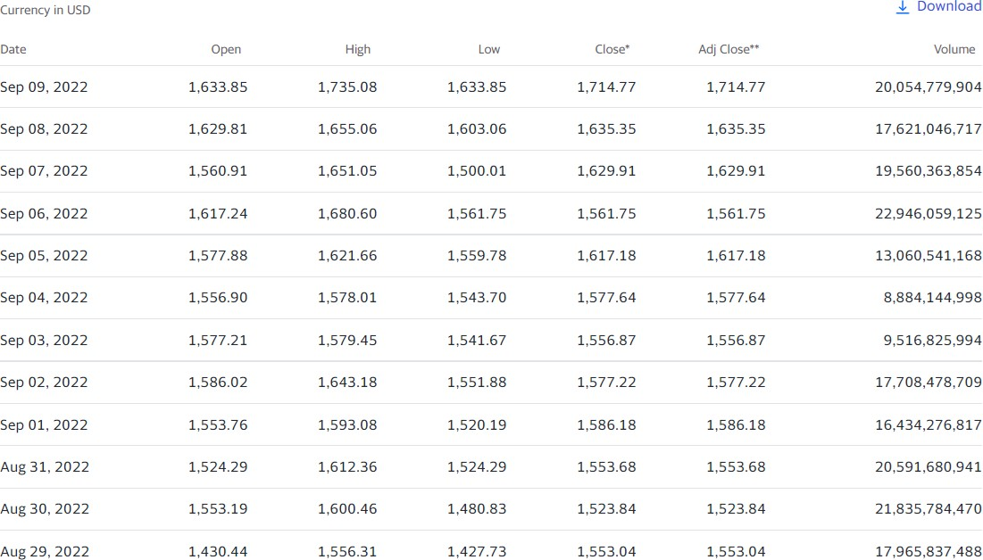
Dataset

Slide 9
Dataset Feature Explanation
Open
Close day.
High Low
The opening price is the price from the first transaction of a business day.
An asset’s closing price is the last price at which it was traded on any given
The high is the highest price at which a stock is traded during a period.
The low is the lowest price of the period.
Adj Close – Adjusted Close is the closing price after adjustments for all applicable splits and dividend distributions.
Volume - Total number of shares that have been bought or sold in a specific period of time or during the trading day.

Slide 10
Stationarizing the Dataset
Now, in order to produce good results from our Statistical ARIMA model, we need to stationarize our dataset.
This data pre-processing work can be done by performing various transforms on our dataset.
Moreover, in order to validate whether our dataset is stationary or not, we can use Dickey–Fuller test.
Dickey–Fuller test tests the null hypothesis that a unit root is present in an autoregressive model.
The alternative hypothesis is different depending on which version of the test is used, but is usually stationarity or trend-stationarity.

Slide 11
Algorithm
Algorithm used in this project is ARIMA
Autoregressive integrated moving average is a statistical model that works on a time series data set to either better comprehend the data or anticipate future trends. To successfully deploy the ARIMA model on a time series dataset, a few requirements must be satisfied.
ARIMA = Auto Regressive Integrated Moving Average
AR : Autoregression. A model that uses the dependent relationship between an observation and some number of lagged observations.
I : Integrated. The use of differencing of raw observations(eg : subtracting an observation from an observation at the previous time step) in order to make the time series stationary.
MA : Moving Average. A model that uses the dependency between an observation and a residual error from a moving average model applied to lagged observations.

Slide 12
Training Arima Model
The statistical ARIMA model, accepts 3 parameters which are defined below,.
Lag Order (p)- Number of lag observations included in the model
Degree Of Differencing (d)- Number of times that the raw observations are differenced
Order Of Moving Average (q)- Size of the moving average window
In order to get the best model for, we will train our model for various values of (p,d,q) and then chosen the model accordingly.

Slide 13
Order Selection
Selecting the appropriate order for the ARIMA model is crucial for accurate forecasting. This can be done by analyzing the Autocorrelation Function (ACF) and Partial Autocorrelation Function (PACF) plots of the time series data.
ACF helps identify the MA order (q), while PACF helps identify the AR order (p).
The order of differencing (d) can be determined by checking if the differenced data is stationary.

Slide 14
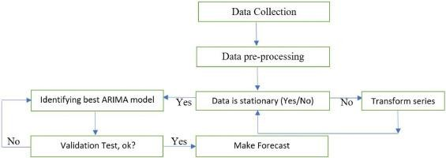
Arima Model

Slide 15
Facebook prophet model:
Introduction:
Facebook Prophet is an open-source time series forecasting model developed by Facebook that is designed to handle time series data with strong seasonality and multiple trends.
It is a powerful tool for forecasting time series data, including cryptocurrency prices like Ethereum.
The key strength of Facebook Prophet lies in its ability to handle seasonality, trends, and outliers in the data.
By utilizing Facebook Prophet for Ethereum price prediction, investors and traders can gain valuable insights into potential price movements, identify trends, and make data-driven decisions.

Slide 16
Model Components:
The Facebook Prophet model consists of several key components:
Trend Component: It captures the overall direction and pattern of the time series data, including any long-term upward or downward trends.
b. Seasonality Component: It models periodic patterns in the data, such as daily, weekly, monthly, or yearly seasonality.
c. Holidays/Events Component: It allows the model to incorporate information about known holidays or events that may impact the time series data.
d. Error Component: It captures the residuals or errors that are not explained by the trend, seasonality, and holidays/components.

Slide 17
Model Fitting :
To use the Facebook Prophet model for Ethereum price prediction, historical price data of Ethereum can be used to train the model.
The data should be formatted into a specific structure that includes a timestamp column and a value column.
The model is then fitted to the data using the Prophet package in Python, specifying the desired parameters, such as seasonality and holidays, and tuning the model accordingly.

Slide 18
Model Forecasting:
Once the model is trained, it can be used to make future price predictions for Ethereum. The forecasts are generated by providing the model with future timestamps and the model will predict the corresponding Ethereum prices.
The forecasts can be evaluated for accuracy using metrics such as MSE and visualized to gain insights into potential future price trends.

Slide 19
Evaluation Metric
Mean Squared Error
Mean squared error (MSE) is a common statistical metric used to evaluate the accuracy of a model's predictions by measuring the average squared difference between predicted values and actual values.

Slide 20
1.1 Purpose of the system:
The purpose of the system in the above project is to utilize machine learning techniques, such as ARIMA and Facebook Prophet, to accurately forecast Ethereum prices. The system aims to capture complex patterns, trends, and seasonality in the historical data, overcome limitations of traditional methods, and provide reliable predictions for informed decision-making in the cryptocurrency market.
1.2 Scope of the System
Data Collection and stationarity check
Model Implementation
Performance Evaluation

Slide 21
2. Existing System: In the existing system we are having the old mechanisms to calculate or forecast price ,so it makes not accurate on the outcome and may vary price from time to time.
3. Proposed System:
The proposed system aims to overcome the limitations of the existing methods by incorporating more advanced machine learning techniques, specifically ARIMA and Facebook Prophet, for Ethereum price prediction. ARIMA is a widely used time series model that can capture linear dependencies in the data, while Facebook Prophet is a Cryptocurrency Price Prediction 4 more advanced model that is designed to handle seasonality, trends, and outliers in time series data.

Slide 22
4. Functional Requirements:
4.1 Software Requirements:
Operating System: - Windows/Linux/MAC OS
IDE – Jupiter
4.2Hardware Requirements:
Processor: intel core i5 and above
Graphic Card: Atleast of 4GB RAM
Free Space: minimum 2 GB

Slide 23
Non-Functional Requirements
5.1 Usability:
Simplified data visualization: The system presents the predictions in a clear and easy-to-understand format, such as graphs or charts.
Customization options: The system allows the users to customize the prediction data they view, such as by selecting specific time period.
Detailed documentation: The system provides detailed documentation on how to use the system and interpret the predictions.
5.2 Reliability:
The system should be reliable, with minimal downtime or errors, to ensure consistent and dependable Ethereum price predictions.

Slide 24
5.3 Performance:
The system is able to predict prices with high accuracy.
The system is able to handle a large volume of data and make predictions in a timely manner.
The system should be able to handle a high number of concurrent users and requests.
5.4 Physical Environment:
It is compatible with any system like a laptop & system.
5.5 Resource Requirements:
Required software is to be installed like python idle, jupyter notebook, and respected libraries are to be installed in our system to execute our project successfully.

Slide 25
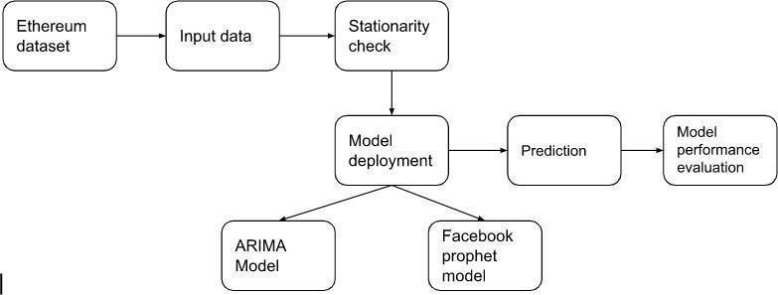
6. System Architecture:
6.1 System Architecture:
A system architecture, sometimes known as a systems architecture, is a conceptual model that describes a system's behaviour, structure, and other aspects.
A description and representation of a system's architecture that is set up to facilitate analysis of a system's behaviour and structure.

Slide 26
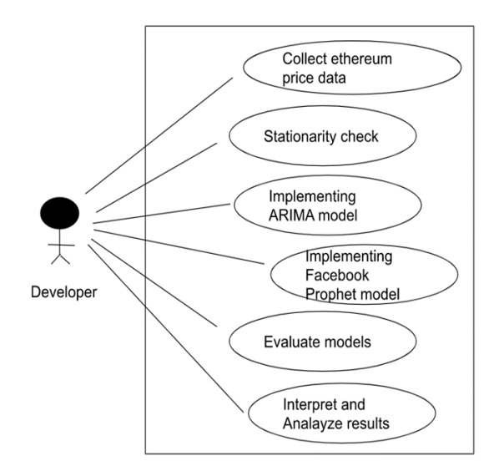
6.2 Use case diagram:
The Usecase diagram is a graphic that is used to define the core elements and processes that make up a system. The key elements are termed as "actors" and the processes are called "actions".
It shows which actors interact with each usecase. Usecase diagrams are created to visualize the relationship between actors and usecases. A usecase is a pattern of behaviour the system exhibits.

Slide 27
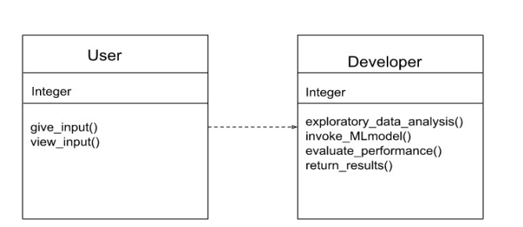
6.3 Class Diagram:
Class diagrams describe the static structure of a system, or how it is structured rather than how it behaves.
Class diagram gives an overview of a system by showing its classes and the relationships among them.
UML class is a rectangle divided into: class name, attributes, and operations.

Slide 28
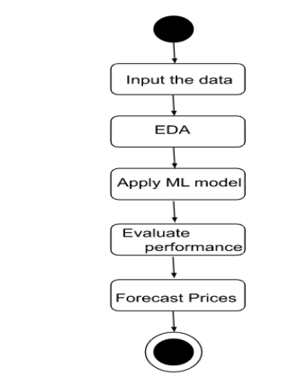
6.3 State Chart Diagram:
An state chart diagram is basically a flowchart to represent the flow from one state to another state.
This flow can be sequential, branched, or concurrent. State chart diagrams deal with all type of flow control by using different elements such as join, etc.

Slide 29
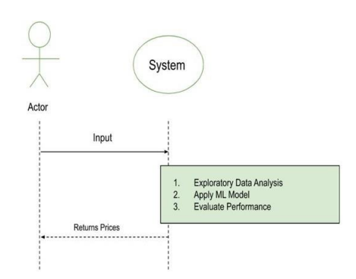
6.4 Sequence diagram:
A sequence diagram is a type of interaction diagram because it describes how and in what order a group of objects works together.
Sequence Diagrams are graphs of relationships which describe how activities are done.

Slide 30
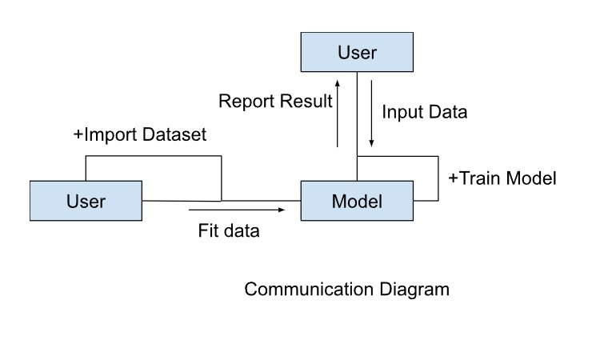
6.5 Communication diagram:
The communication diagram and the sequence diagram are similar. They're semantically equivalent, that is, they present the same information, and you can turn a communication to a sequence diagram and vice versa.
The main distinction between them is that the communication diagram arranges elements according to space, the sequence diagram is according to time.

Slide 31
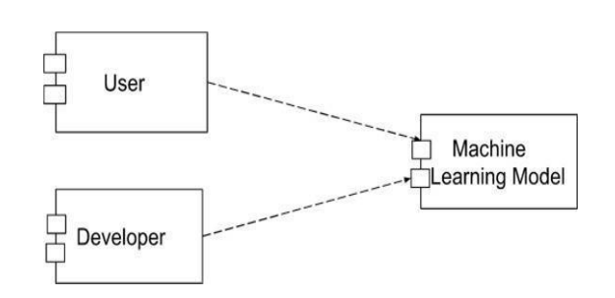
6.6 Component diagram:
Component diagrams are used in modelling the physical aspects of object oriented systems that are used for visualizing, specifying, and documenting component-based systems and also for constructing executable systems through forward and reverse engineering

Slide 32
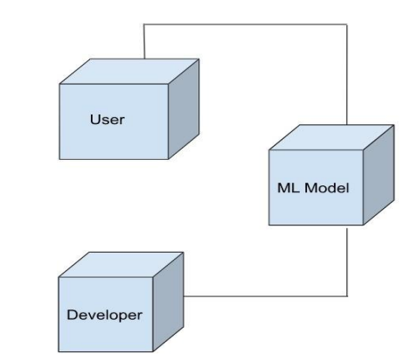
6.7 Deployment diagram:
Deployment diagrams are used to visualize the topology of the physical components of a system, where the software components are deployed. Deployment diagrams are used to describe the static deployment view of a system. Deployment diagrams consist of nodes and their relationship.

Slide 33
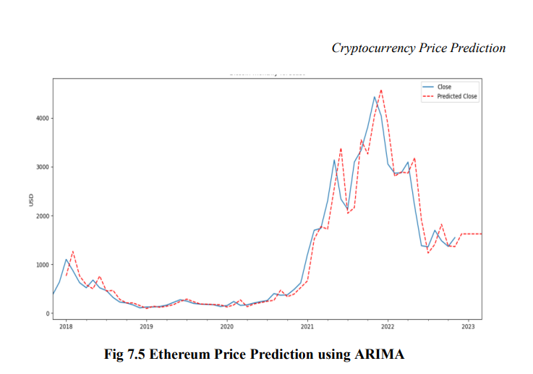
RESULTS:
Ethereum Price Prediction using ARIMA:

Slide 34
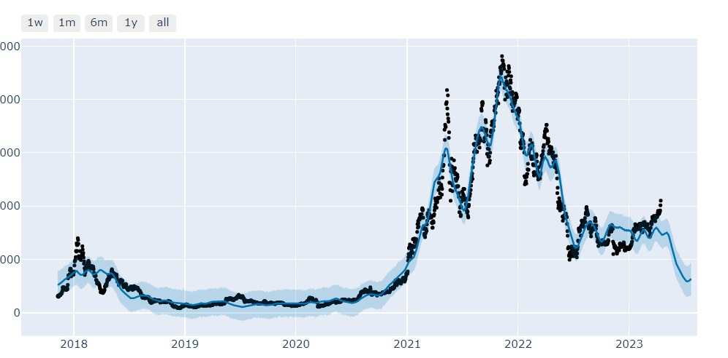
Ethereum Price Prediction Using Facebook Prophet Model:

Slide 35
Conclusion:
In conclusion, the project "Ethereum Price Prediction using ARIMA and Facebook Prophet Models" has utilized two popular time series forecasting methods, ARIMA and Facebook Prophet, to predict Ethereum prices. The evaluation metric used in this project is Mean Squared Error (MSE).
Based on the MSE values obtained, the ARIMA model has yielded an MSE of332.17 ahead Ethereum price prediction, while the Facebook Prophet model has achieved a lower MSE of 196.280897. The lower MSE value for Facebook Prophet suggests that it has performed better in terms of accuracy compared to ARIMA for the given dataset.

Slide 36
References:
Mahir Iqbal, Muhammad Shuaib Iqbal, Fawwad Hassan Jaskani,*, Khurum Iqbal and Ali Hassan. TimeSeries Prediction of Cryptocurrency Market using Machine Learning Techniques. Published on 07 July 2021 EAI Endorsed Transactions.
Xiaolei Sun, Mingxi Liu, Zeqian Sima. A Novel Cryptocurrency Price Trend Forecasting Model Based on LightGBM. December 2018. Research Gate.
Bhanu PRAKASH Kolla, K L University. Predicting Crypto Currency Prices Using Machine Learning and Deep Learning Techniques. September 2020. Research Gate.
Mohammad J. Hamayel and Amani Yousef Owda. A Novel Cryptocurrency Price Prediction Model Using GRU, LSTM and bi-LSTM Machine Learning Algorithms. MDPI

Slide 37

Thank you

