Slide 1
Preliminary Pressure Capsule Results
Using SS316H LAROMANCE material model,
Loading conditions constrained to SS316H model limits

Slide 2
General Assumptions and Model Ranges
Modeling conditions set by application range of the SS316H ROM
Note: SS316H ROM was not developed for this application, but is used as an intermediate step to demonstrate the concepts
Assumed a constant temperature of 801ºC
Assumed initial dislocation densities in range middle:
8.0e12 1/m² mobile dislocation density
7.0e11 1/m² immobile dislocation density
Selected combinations of internal pressure and uniaxial tension to ensure the vonMises Stress remained between 2 – 50 MPa

Slide 3
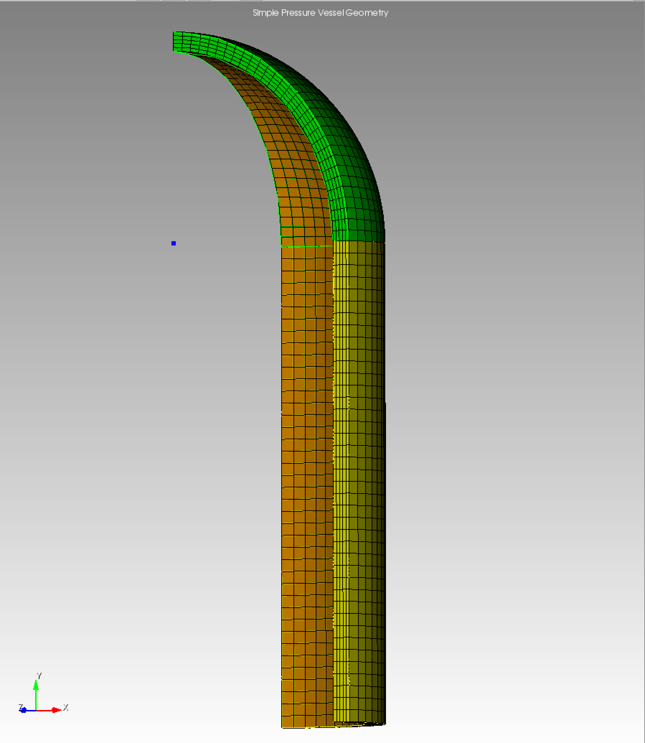
Prolonged Internal Pressure
1/8 symmetry pressure vessel model
5cm cylinder height
2cm cylinder radius
0.2cm wall thickness
Varied the internal pressure
Applied to interior of the 1/8 symmetry pressure capsule (shown in orange)
9 different cases: 0.5, 1.0, 1.5, 2.0, 2.5, 3.0, 3.5, 4.0, and 4.5 MPa
All simulations run for 500s with a constant internal pressure

Slide 4
General Simulation Results Observations
Consistent pattern in stresses, strains, and dislocations across the different internal pressure cases
As expected for this high temperature model, we see the higher pressures produce lower dislocation densities
Hoop stress is just a bit larger than von Mises stress in this configuration, so the ranges allowed by the SS316H ROM limited the range to a max hoop stress of 47 MPa
Highlights the importance of working with a ROM designed for the application
Example simulation results for 4.5MPa case shown

Slide 5
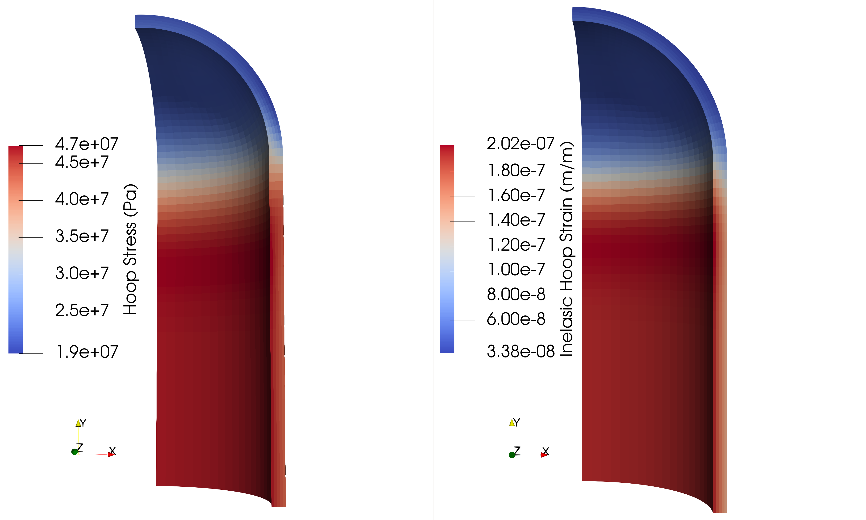
Constant Internal Pressure of 4.5MPa, held for 500s

Slide 6
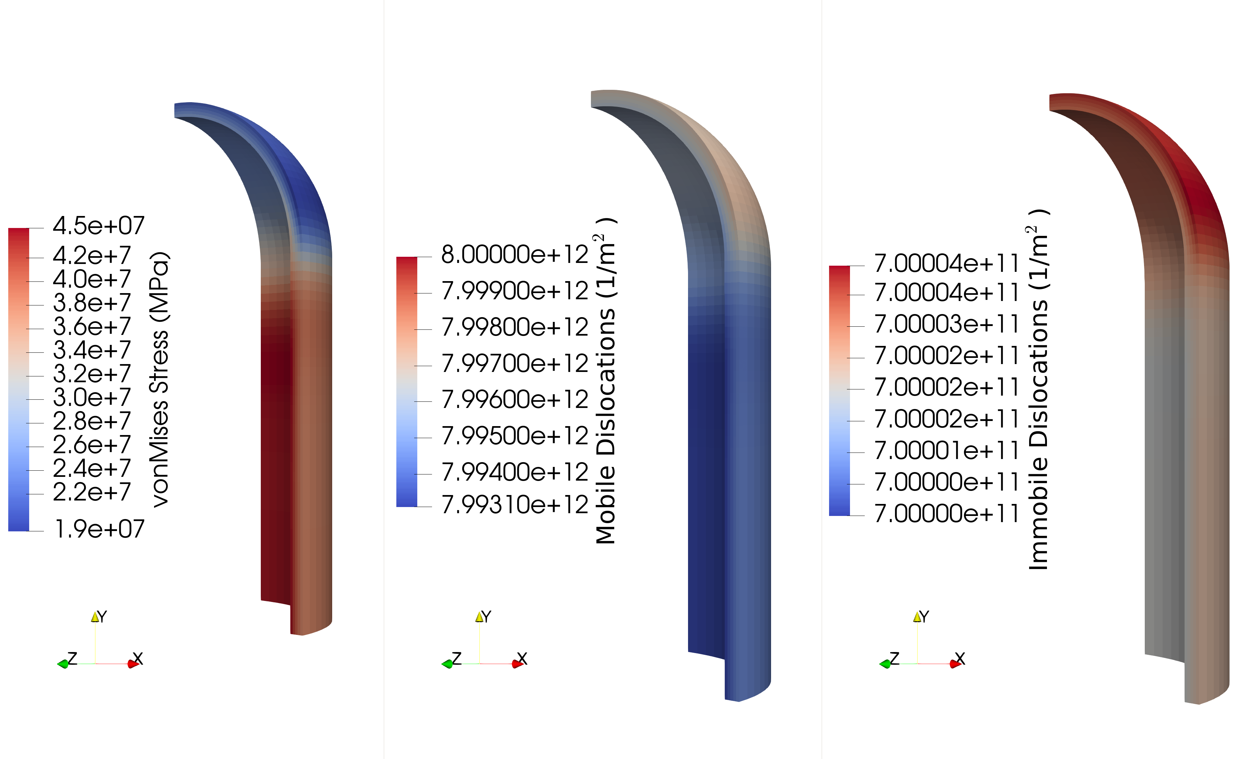
Constant Internal Pressure of 4.5MPa, held for 500s

Slide 7
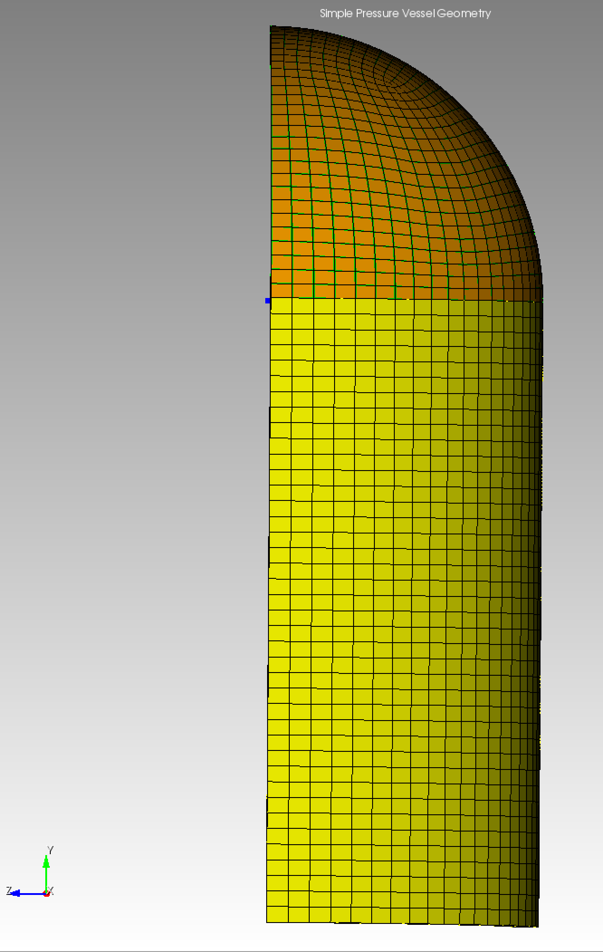
Uniaxial Tension and Pressure Cases
Varied the displacement rate
Applied along the y-axis
Uniform rate to entire end cap outer surface (shown on right in orange)
Rates of 1.64e-5m/s (for 0.372s), 1.64e-6 m/s (for 3.72s), 1.64e-7m/s (for 37.2s), 1.0e-7m/s (for 40s), and 1.64e-8 m/s (for 372s)
Internal pressure value of 1.0 MPa
Simulation time length set to create a final displacement value of 6.5e-6m
Corresponds roughly to a 0.01% strain at mid cap
Excepting the 1.0e-7 m/s case

Slide 8
General Observations: Uniaxial Tension Cases
Consistent pattern and respective values of hoop stress (max 19 MPa) and von Mises stress (max 37 MPa) across all cases
Because the von Mises stress is much higher than the hoop stress, limited in ability to currently model desired hoop stress range
The evolution of the inelastic hoop strain and dislocation densities is strongly dependent on the displacement rate used
Hypothesize that the evolution differences is due more to the simulation length (input parameter for total time) than the applied displacement rate
Will run simulations with an applied displacement rate, followed by a hold period at constant pressure and displacement to test this hypothesis

Slide 9
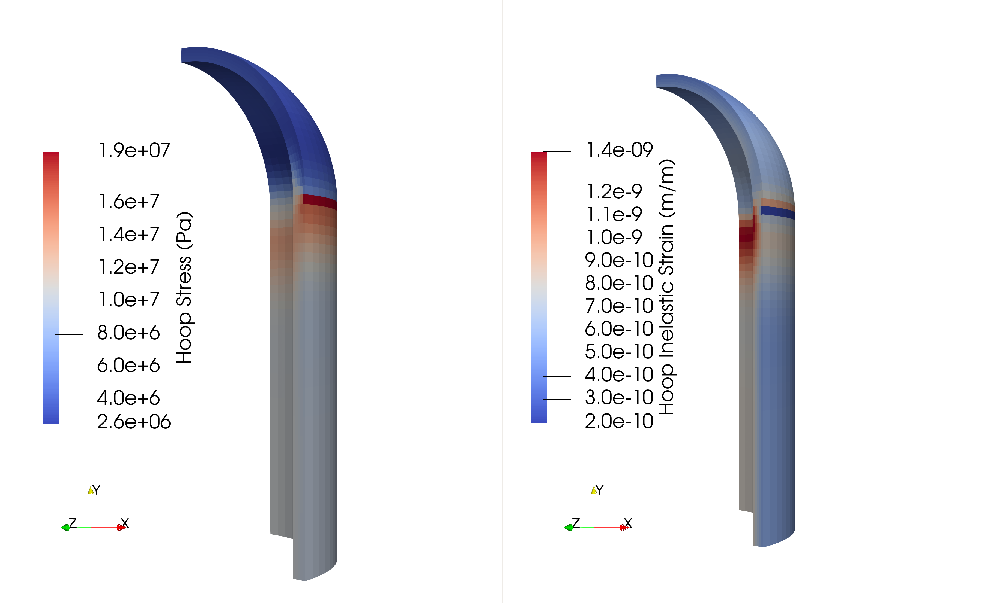
Displacement Rate 1.64e-7 m/s, 1MPa Pressure

Slide 10
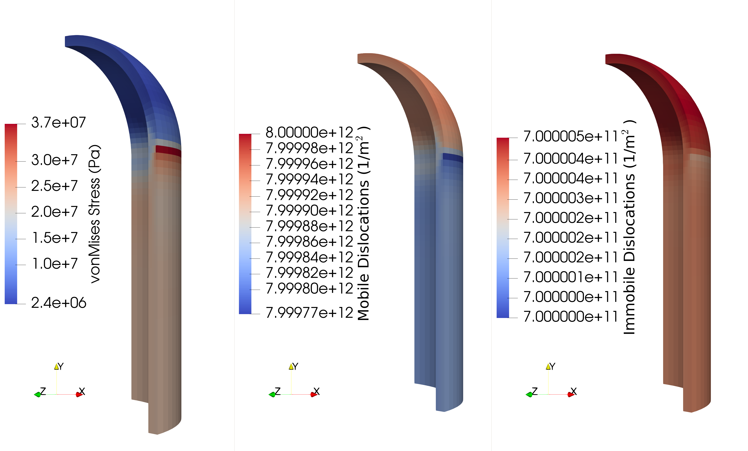
Displacement Rate 1.64e-7 m/s, 1MPa Pressure

