Slide 1
Fods Project Student Profile management system
Presented by: Pratyush Shakya, Nabin Karki, Prashish Sapkota
Date: 15th April, 2025

Slide 2
1)introduction
Purpose: Python-based application to manage student data efficiently.
Functionality: Handles user profiles, academic grades, and extracurricular activities.
User Roles: Provides dashboards for admins (data management, analysis) and students (view personal data).
Storage: Simple text-based file storage.
Analytics: Performance and ECA insights with VDA.
Design: Modular, built with error handling for reliability.

Slide 3
2)objectives
The primary objectives of the Student Management System are:
Centralized Data Management: Store and manage student profiles, grades, and ECAs.
Role-Based Functionality: Implement unique dashboards for admins and students.
Data Security and Authentication: Ensure secure access through user authentication.
Insightful Analytics: Analyze academic performance and ECA participation, aiding institutional decision-making.
User-Friendly Interface: Develop a simple command-line interface for ease of use.
Scalability and Extensibility: Design a modular system that can accommodate additional features.

Slide 4
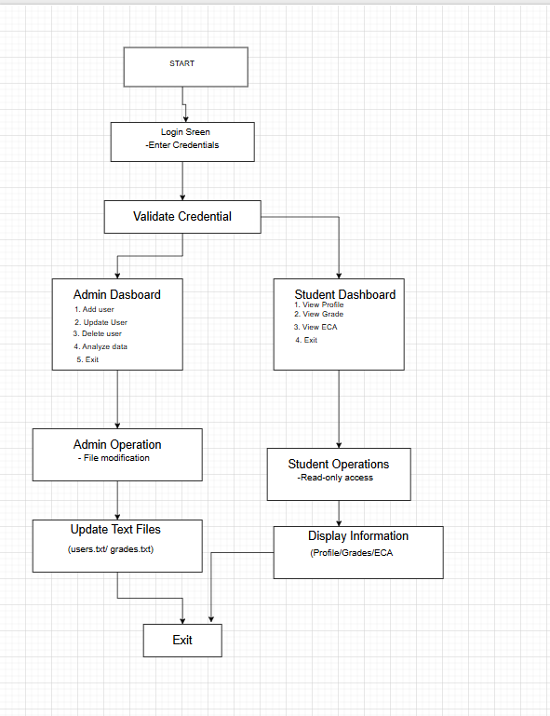
3)System design

Slide 5
4)implementation
[4.1]CODE STRUCTURE
1)User.py: Defines the User base class with initialization and profile viewing.
2)student.py: Implements grade and ECA retrieval for students.
3)admin.py: Handles user management and data analysis.
4) auth.py: Handles authentication.
5) data_analysis.py: Generates visualizations.
6) main.py: Provides the user interface and program flow.

Slide 6
[4.2] Key Functionalities
Admin Operations:
Add, update, and delete users, grades, and ECAs.
Analyze data (bar chart for grades, scatter plot for ECA vs. grades).
Student Operations:
View profile, grades, and ECAs (read-only).
Authentication:
Credential validation, role-based user loading.
Main Interface:
Menu-driven navigation for admin and student dashboards.

Slide 7
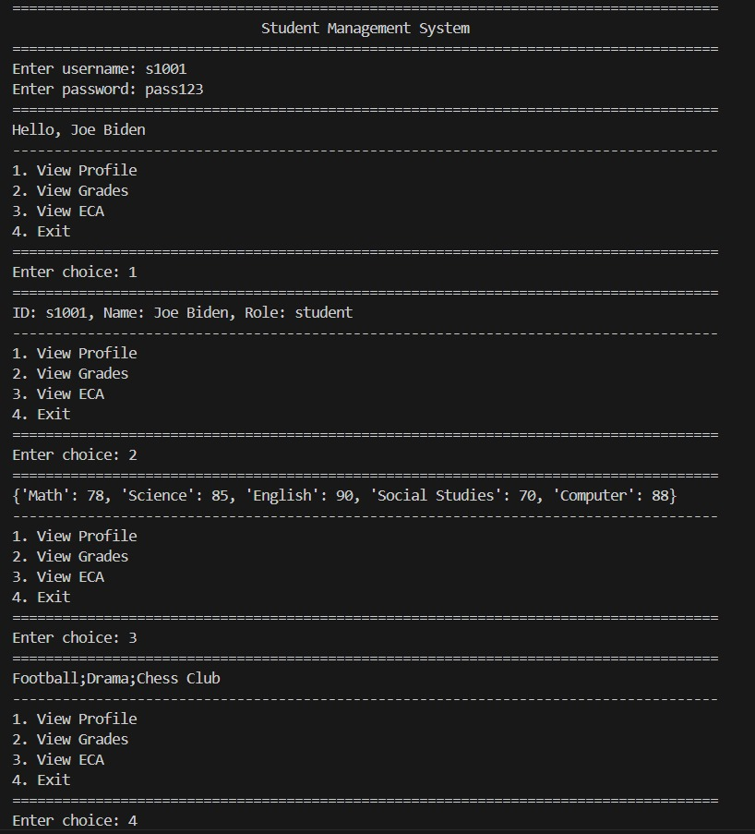
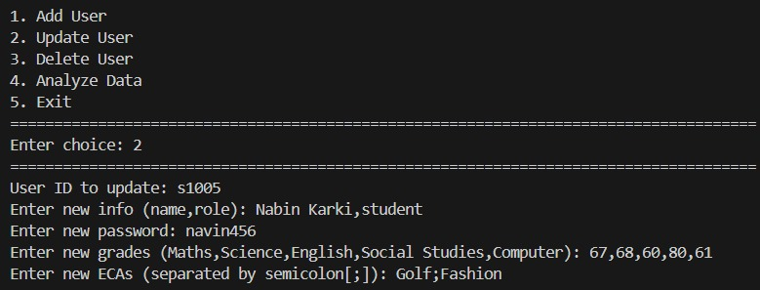
5)SAMPLE OUTPUTS
Admin Dashboard
Student Dashboard

Slide 8
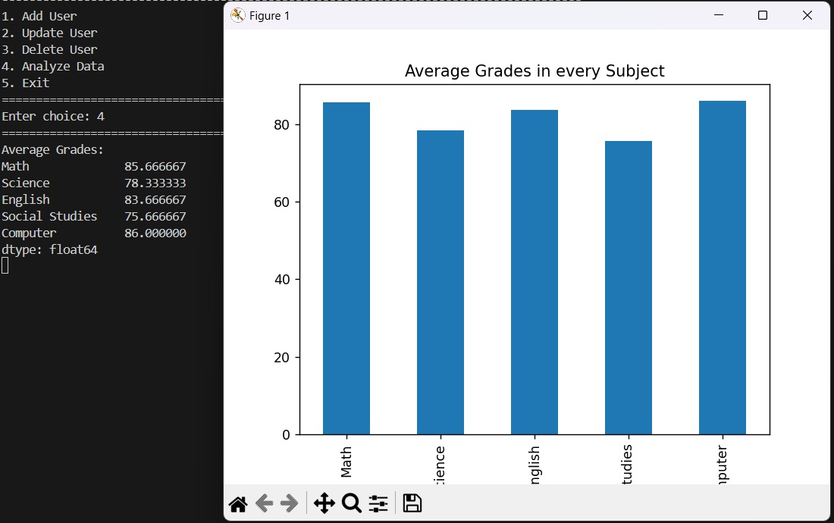
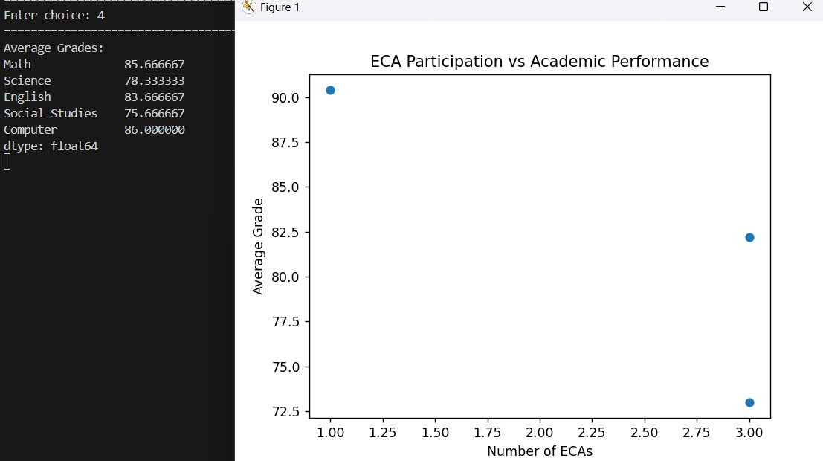
Data Analytics

Slide 9
6)Testing and challenges
Testing:
Unit Testing:
Tested User.viewprofile() to ensure correct formatting (e.g., ID: s1005, Name: Nabin Karki, Role: student).
Verified Student.viewgrades() returns accurate subject-grade mappings.
Checked Student.vieweca() retrieves correct activities.
Integration Testing:
Validated admin operations (add, update, delete) and updated all files consistently.
Ensured login authentication correctly differentiates admin and student roles.
Confirmed data analysis plots are rendered without errors.
User Acceptance Testing:
Simulated admin tasks to add a new student (e.g., s1004, Prashish Sapkota, student) and verified data persistence.
Tested student dashboard for profile, grades, and ECA display.
Validated analysis outputs (bar and scatter plots) for clarity.

Slide 10
Challenges:
File-Based Storage:
Concurrent file access could lead to data corruption.
File I/O errors required robust exception handling.
Data Consistency:
Ensuring updates/deletions synchronized across multiple files (users.txt, grades.txt, etc.) was complex.
Implemented updatefile() and deletefile() to maintain consistency.
Scalability:
Text files are inefficient for large datasets; a database would be ideal for future iterations.
Analysis performance may degrade with many records.
Security:
Plaintext passwords in passwords.txt pose a risk.
Limited input validation could allow malformed data entry.

Slide 11
7)conclusion
Successfully manages student data with role-based access.
Modular design ensures maintainability.
File-based storage is simple but limits scalability.
Future improvements include database integration.
A strong foundation for educational data management.

Slide 12

8)Contribution
Pratyush Shakya: admin.py, data_analysis.py
Prashish Sapkota: auth.py(authentication), main.py
Nabin Karki: student.py, user.py

Slide 13
THANK YOU

