Slide 1
Beginning Technical Writing Dr. Stanton Eng321
PRESENTATION OVER FINAL PROJECT

Slide 2
About me
Gaurab Sapkota
Major: Computer Science
Year: Junior

Slide 3
Project Description
Handbook/ Manual for the secretaries in Physics, Astronomy, and Material Science Department.
Problem
It was difficult to train new employees
Initially employees also found it difficult to do daily tasks.
Hard to maintain contact between the faculty and the employees.
My friend was hired in the summer and complained about it being hard to find where everything was, and not having a good handbook for the job.

Slide 4
Client
Secretaries in Physics, Astronomy and Material Science department.
4 employees from different background.
2 of them are international students
College level education
The person whom I contacted was their supervisor, Adam.

Slide 5
Client Description
At first, was difficult to find a time to meet.
Later had to submit an official proposal and had a meeting.
They let me go to their office, I took some pictures and interviewed the employees.
Easy to work with.
Always replied emails and readily available within the office time.
Happy with the project.

Slide 6
Document
Contents
Mainly the general description of the tasks done on daily basis like how to print, how to use coffee machine, how to process the mail, transfer the call etc.
Document is plain and simple.
Graphics included the pictures, the labels in the pictures, tables.

Slide 7
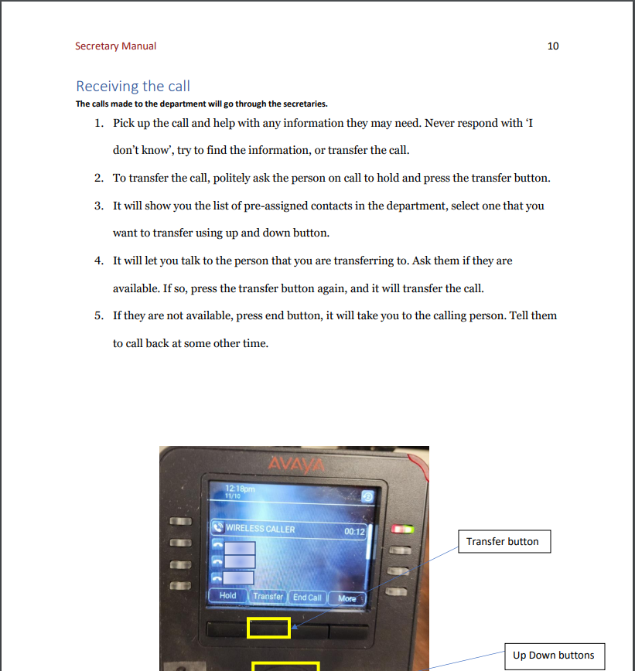

Slide 8
Document
Navigation system
Page numbers and the contents page was used for the navigation
Binding
Submitted a softcopy, laminated by the client themselves.
Front/Back
Front was the cover page and back had the relevant contacts page

Slide 9

Front Page

Slide 10
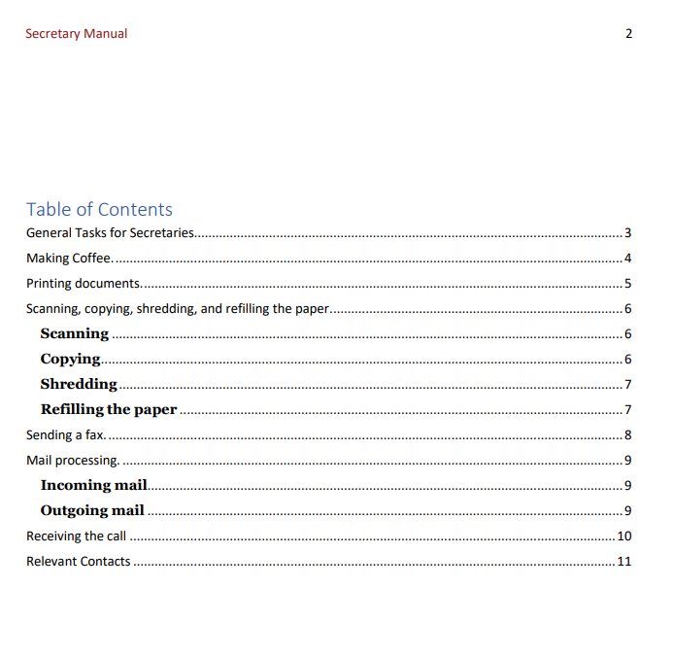
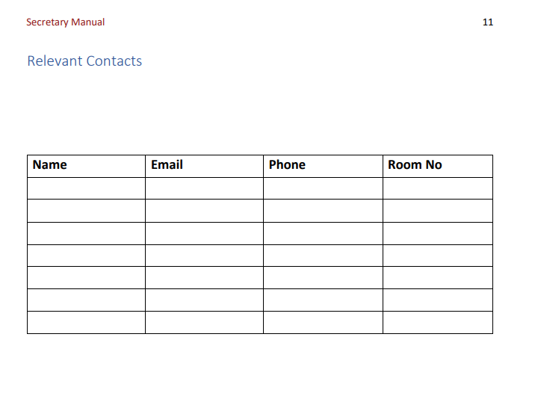
Relevant contacts page
Contents page

Slide 11
What to do differently?
I will try to be more professional when meeting with the clients.
Try to meet soft deadlines.
Take as much information as possible.
Have a good prior planning.

Slide 12
What did I learn
Approach clients
Format documents and pictures
Use Canva
Importance of professionalism
Importance of time management

Slide 13
Future
Software manuals.
Client communication.
Proposals.

Slide 14
Conclusion
It was a great project and great semester. I applied lessons learnt in the class in my document. I learned a great deal from this project.

Slide 15
Thank you.

