Slide 1
Towards a Functional Neuroanatomy of Speech Perception
Authors: Gregory Hickok and David Poeppel
Presenter: Sarah Phuntsok

Slide 2
Argument
Cortical fields in the posterior-superior temporal lobe, bilaterally, constitute the primary substrate for constructing sound-based representations of speech
At least 2 distinct pathways that participate in speech perception in a task-dependent manner, with strong lateralization to the left hemisphere

Slide 3
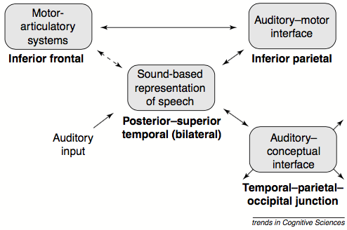
2 Pathways
Left temporal-parietal-occipital junction (auditory-to-meaning)→ access mental lexicon
Left frontal and parietal lobes (auditory-motor) → Access explicit speech segments

Slide 4
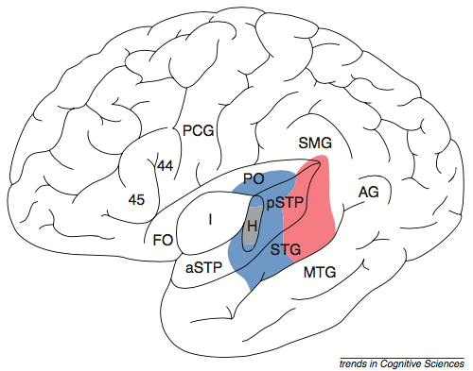
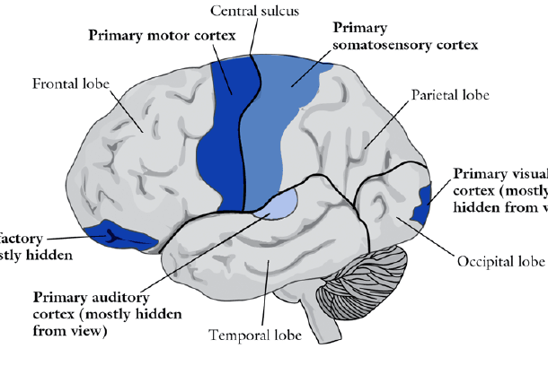

Slide 5
Aphasia
Transcortical Sensory Aphasia (TSA) - Fluent
Associated with damage to TPO junction with most of pSTP/STG spared
Speech perception ability not affected b/c patients were able to repeat the heard speech
Wernicke’s Aphasia - Fluent
Associated with damage to the pSTP/STG, with extension either into MTG or TPO junction or both
Speech perception ability slightly affected/not severe.
Preserved speech perception is due to the right hemisphere’s speech perception ability

Slide 6
Word Deafness
Form of auditory agnosia
They still have the ability to hear but speech perception is impaired.
Bilateral lesion in the superior temporal lobe

Slide 7
The Isolated Right Hemisphere
Split brain patiens and amobarbital injection studies both indicate that is some cases, the isolated right hemisphere has the ability to understand simple speech
There is also evidence of the right hemisphere performing speech discrimination tasks

Slide 8
Electrical interference evidence
Boatman et al. proved involvement of the posterior superior temporal lobe.
Used electrical interference to study the functional anatomy of speech perception in a series of 3 patients undergoing clinical evaluation for surgical treatment of epilepsy.
Found stimulation sites along the left pSTG consistently compromised performance on speech perception tasks (i.e. syllable discrimination/identification and/or auditory comprehension)

Slide 9
Physiological Evidence
fMRI, PET, MEG → all show bilateral activation in the Superior Temporal Lobe
Intraoperative recordings for epilepsy treatment surgery show majority of speech-responsive cells in the STG.

Slide 10
Differing Contributions to Speech Perception by Left and Right Temporal Lobe
Left and Right systems make different contributions to perceptual analysis
In split brain patients, noise adversely affected right hemisphere performance than left
Functional imaging techniques (PET, MEG) show response differences in the 2 hemispheres.

Slide 11
Speech Perception in Tasks Requiring Explicit Attention to Phonetic Structure
Fronto-parietal network predominantly in the left hemisphere, functions to interface auditory and articulatory representations of speech.
Activation in fronto-parital lobes during sub-lexical tasks (i.e. phoneme monitoring)
Ability to repeat pseudowords (where semantic mediation is impossible) = evidence for auditory-motor interface system

Slide 12
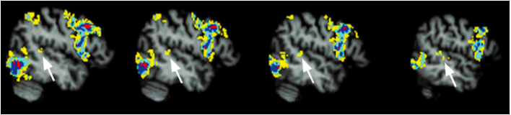
A role for left auditory cortex in speech production
Left auditory cortex (pSTP/pSTG) activated not only in speech perception but also during speech production!
PET, MEG, fMRI

Slide 13
Take Home
The posterior-superior temporal lobe, bilaterally, constitutes the primary substrate for the construction of sound-based representations of speech.
While both hemispheres participate, they make different contributions to speech perception.
Left hemisphere frontal and parietal regions, may be understood in terms of a system that supports auditory-motor interaction (similar to visual-motor interaction)
Auditory cortex in the left pSTP/pSTG participates in aspects of speech production.

