Slide 1
HANA STATEMENT HINTS
KUTO BARAn
HANA Tech Con 2025

Slide 2
HANA STATEMENT HINTS
Content
Short presentation of the company AOK Systems
Introduction to SAP HANA Hints
Determination and use of SAP HANA Hints
Experiences (Examples) with SAP HANA Statements Hints
Takeaways
Links, SAP Notes

Slide 3
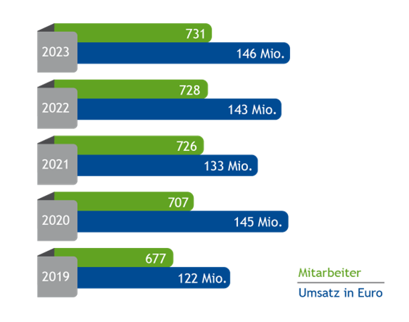
Aok Systems Facts and Figures
About us
Headquartered in Bonn
More than 700 experts throughout Germany
5 locations (Hamburg, Berlin, Frankfurt, Stuttgart, Munich) and various development facilities
Founded in 1999

Slide 4












AOK Systems covers more than 55% of Germany’s SHI market
Customers
SHI data centres:
ARGE AOK data centre
AOK community
BARMER
Hanseatische Krankenkasse (HEK)
Knappschaft-Bahn-See
Mobil Krankenkasse
VIACTIV Krankenkasse
Mobil ISC
National Association of Statutory Health Insurance Funds
ITSG Informationstechnische Servicestelle der gesetzlichen Krankenversicherung
oscare® customers:
Non-oscare®

Slide 5
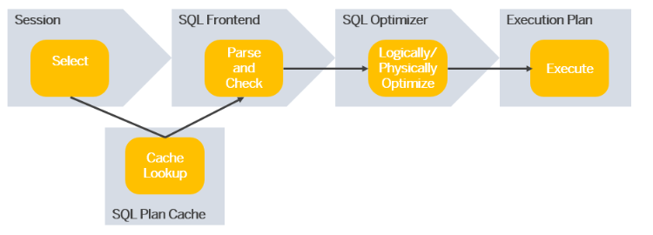
HANA SQL OPTIMIZER
HANA STATEMENT HINTS
Source: openSAP

Slide 6
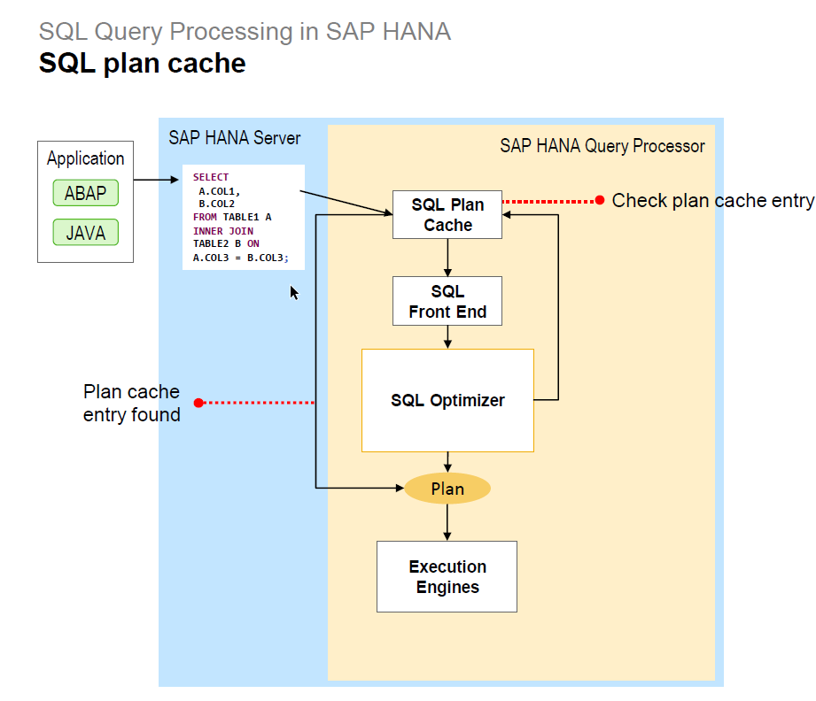
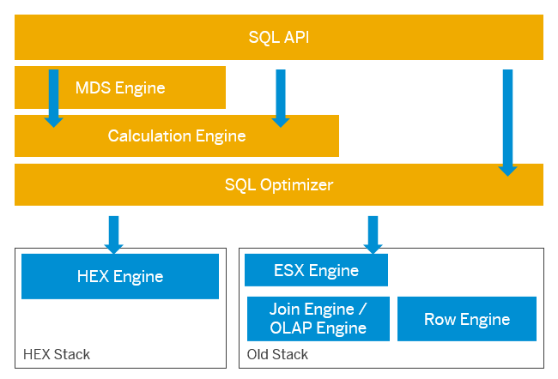
SAP HANA Query Processor components
HANA STATEMENT HINTS
Source: openSAP

Slide 7
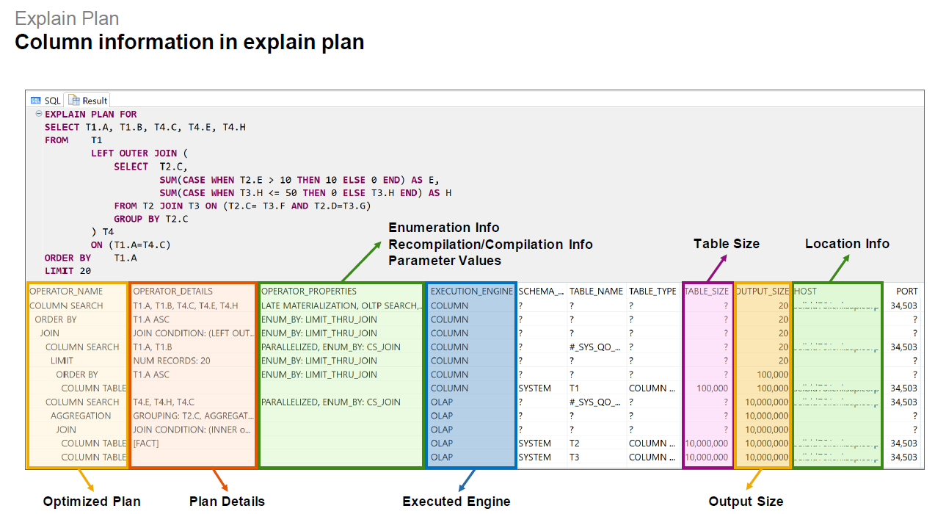
EXECUTION PLAN
HANA STATEMENT HINTS
Source: openSAP

Slide 8
What Are HANA Statement Hints?
HANA STATEMENT HINTS
Hints are instructions for the SAP HANA database server or other components involved in the processing of database requests (e.g. SAP HANA client, SAP ABAP database interface or SAP ABAP DBSL).
Hints can influence how a database request is generated or processed.
influence the SAP HANA optimizer’s behavior during query execution
They do not change the result set of the database requests.
Statement hints allow to globally map SAP HANA hints to a SQL statement without having to adjust the application coding.

Slide 9
Why Use Hints
Introduction to HANA Hints
Improved query performance
Reduced resource consumption
No terminations (as a workaround for bugs that result in terminations)
No crashes (as a workaround for bugs that result in crashes)
Enhanced predictability of query execution plans
Useful in troubleshooting and fine-tuning complex queries
Better control over query execution
temporarily or permanently
Be aware that some hints may be needed on a permanent basis because they stabilize accesses. For example, hints delivered via SAP Note 2700051 are often useful on a permanent basis.

Slide 10
Risks and Recommendations
Introduction to HANA Hints
Possible performance degradation if misused
Use hints only when necessary
It is recommended to keep statement hints implemented as a specific workaround only as long as required.
Once the underlying issue is fixed, the hint should be removed. (e.g. after HANA Upgrades or SAP Upgrades odr adjusting of the application)
HANA Configuration Check ID M1169 ("Total number of implemented statement hints") of the SAP HANA Mini Checks (SAP Note 1999993) is raised as potentially critical if the number of existing statement hints is unusually high.

Slide 11
Types of Hints
Introduction to HANA Hints
Changing an Execution Engine Decision
USE_<engine>_PLAN Hints
NO_USE_<engine>_PLAN Hints:
If a query cannot be executed in the specified engine, the USE_<engine>_PLAN hint does not have any effect.
Hints from the SAP Note 2700051
Changing Query Transformation
NO_<hint>: GROUPING_SIMPLIFICATION
NO_<hint>: NO_GROUPING_SIMPLIFICATION

Slide 12
Types of Hints
Introduction to HANA Hints
Changing Operator Order
<HINT> e.g. AGGR_THRU_JOIN
NO_<HINT> e.g. NO_ AGGR_THRU_JOIN
Choosing Preferred Algorithms
<HINT>: e.g. CS_ORDERBY
NO_<HINT>: e.g. NO_CS_ORDERBY
Hints from the SAP Note 2700051

Slide 13
Execution plans are the key to validating hints
Determination and USE of Hints
Understanding execution plans
Comparison of execution in different systems, if possible
Comparison „bad“ and „good“ execution plan, if possible, because historicization of the plans is still not possible
Maybe „good execution plan“ after removing PLAN-Ids and comparisation with „old bad plan“
experimenting with different execution plans

Slide 14
Determining Useful Hints
Determination and USE of Hints
Check:
ThreadSamples
Memory Allocators
CallStacks
HANA Traces
Experiences from the SAP Notes 2000002, 1999997, 2142945, 2570371, 2100040, 2313619
HANA Configuration MiniCheck: M1114 → SQL with engine performance impact

Slide 15
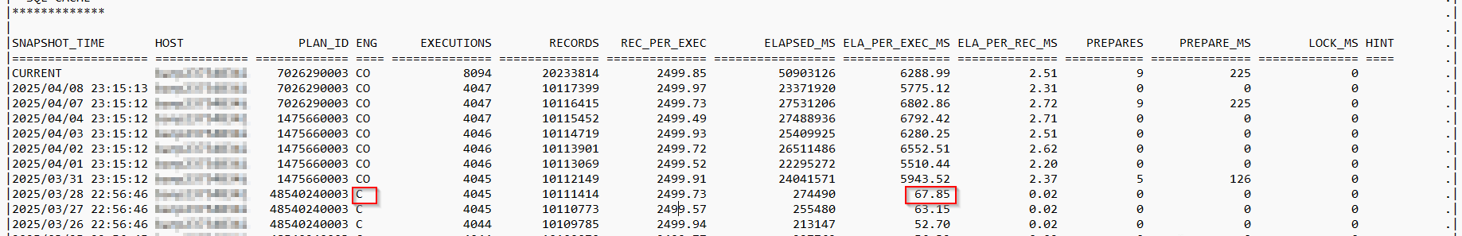
Determination of Hints
Determination and USE of Hints
MiniCheck: |M1114 → SQL with engine performance impact | |374fcb575b1181156204d124f1c5ca94 (CO 6 s vs. C 56 ms)

Slide 16
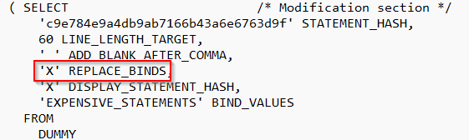
Determination of Hints: TESTS with BIND VARIABLES
Determination and USE of Hints
HANA_SQL_ExpensiveStatements_BindValues
HANA_SQL_StatementHash_DataCollector
HANA_SQL_StatementHash_SQLText
ABAP ST05 Trace

Slide 17
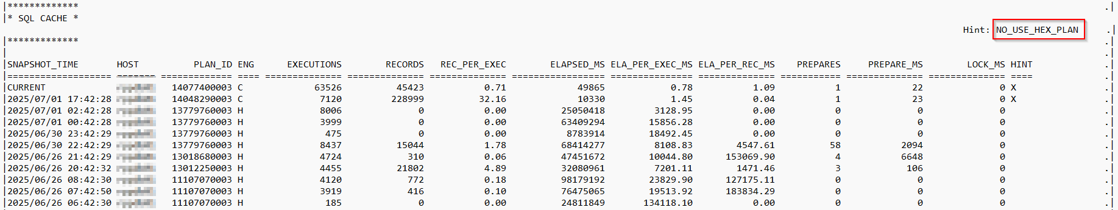
EXAMPLES: Changing an Execution Engine Decision
Experiences with SAP HANA Statements Hints

Slide 18
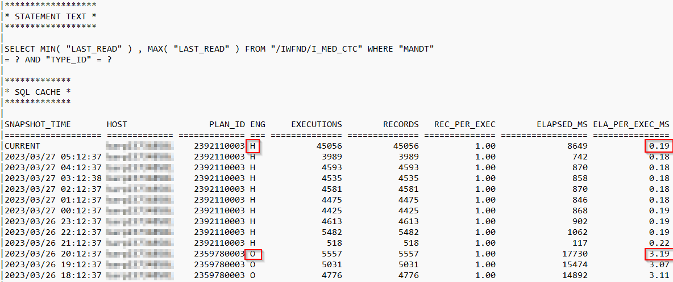
EXAMPLES: Changing an Execution Engine Decision
HANA STATEMENT HINTS
Experiences with SAP HANA Statements Hints

Slide 19
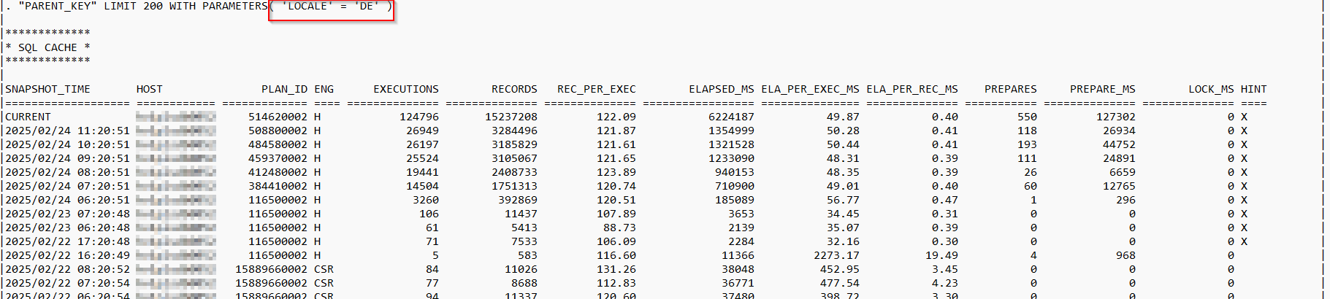
EXAMPLES: Changing an Execution Engine Decision
Experiences with SAP HANA Statements Hints
No LOCALE support: 2570371 - FAQ: SAP HANA Execution Engine (HEX)
indexserver.ini -> [sql] -> hex_enable_with_parameters_locale='true'
USE_HEX_PLAN

Slide 20
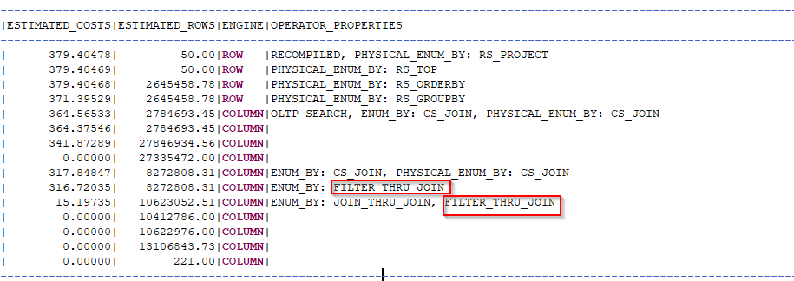
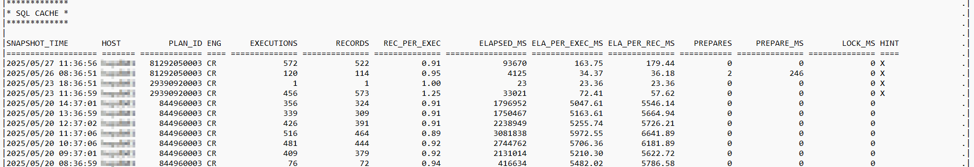
Changing Operator Order
Experiences with SAP HANA Statements Hints
WITH HINT (NO_FILTER_THRU_JOIN)

Slide 21
DOCUMENTING
Experiences with SAP HANA Statements Hints
Keep hints documented for maintainability
ALTER SYSTEM ADD STATEMENT HINT (USE_HEX_PLAN) COMMENT 'SAP HANA TPO Service 2024/07' FOR STATEMENT HASH '39855a2df1cf2e9cb84f6b15d9722a33
ALTER SYSTEM ADD STATEMENT HINT (USE_HEX_PLAN) COMMENT 'SAP HANA 2.0 SPS 07 Upgrade' FOR STATEMENT HASH '39855a2df1cf2e9cb84f6b15d9722a33
SQL: “HANA_SQL_PlanStability_StatementHints” (COMMENTS = ‘%SPS 07%’),
select * from STATEMENT_HINTS where COMMENTS like ‘%SPS%’

Slide 22
TAKEAWAYS
HANA STATEMENT HINTS
Potential performance improvements
influence optimizer behavior
Useful for complex queries
Use with care and testing
Use hints only when necessary
Not a replacement for good query design
Use hints as a last resort after profiling and analysis
Always test performance before and after applying hints
Avoid overusing hints — the optimizer generally makes good decisions
Keep hints documented for maintainability
Possible performance degradation if misused

Slide 23
USEFUL Links AND SAP NOTES
REFERENCES
2142945 - FAQ: SAP HANA Hints
2400006 - FAQ: SAP HANA Statement Hints
2700051 - Delivery of Statement Hints (SAP HANA >= 1.00.122.03)
2717265 - How to add hints on CDS views
1622681 - DBSL Hints für HANA
2799998 - FAQ: SAP HANA Plan Stability
2570371 - FAQ: SAP HANA Execution Engine (HEX)
2599949 - FAQ: SAP HANA Extended SQL Executor (ESX)
SAP HANA SQL Reference Guide for SAP HANA Platform : https://help.sap.com/viewer/4fe29514fd584807ac9f2a04f6754767/2.0.05/en-US/68e2f7a8e06f41cb871276858202c605.html
SQL Processing Components: https://help.sap.com/viewer/9de0171a6027400bb3b9bee385222eff/2.0.05/en-US/27875edb31d7436ea62031d8b167052c.html

Slide 24
USEFUL Links AND SAP NOTES
REFERENCES
2410208 - Collect Explain Plan of a Prepared Statement
2800028 - FAQ: SAP HANA Optimizer Statistics
2124112 - FAQ: SAP HANA Parsing
3326981 - Why HEX Plans fallback to old engines such as Join, OLAP, ESX
2967014 - Large size of memory usage on heap allocators Pool/ESX
SAP HANA Performance Guide for Developers | SAP Help Portal
openSAP Kurs: A First Step Towards SAP HANA Query Optimization
https://open.sap.com/courses/hanasql1/
Blog: SAP HANA Optimizer - the heart of the performance

Slide 25
THANKS
SONSTIGES
"No debt is more urgent than that of giving thanks."
(Marcus Tullius Cicero, 106-43 v.Chr., römischer Philosoph)
HANA CON Community and Jury: Thank you for the opportunity to give me to have a presentation here
Martin Frauendorfer for his SQL Collection and help

Slide 26
Thank you for your
Attention

