Slide 1

SAP HANA Cloud MDS Cubes
Bastian Bremerich, SAP
July 10, 2025

Slide 2
MDS Cube | Introduction
MDS Cube
HANA Cloud only feature
Target Scenarios
SAP Analytics Cloud on HANA Cloud via live connection
SAP Analytics Cloud native models
SAP Analytics Cloud simulation (development in progress)
SAP Analytics Cloud planning (planned)
SAP Analytics Cloud live connectivity (in elaboration)

Slide 3
MDS Cube | Agenda
SAP Analytics Cloud reporting challenges
Technical background & MDS Cube architecture
SAP Analytics Cloud reporting with MDS Cube
Customer instance load test
Demo: MDS Cube lifecycle
Create & use MDS Cube
State of development

Slide 4

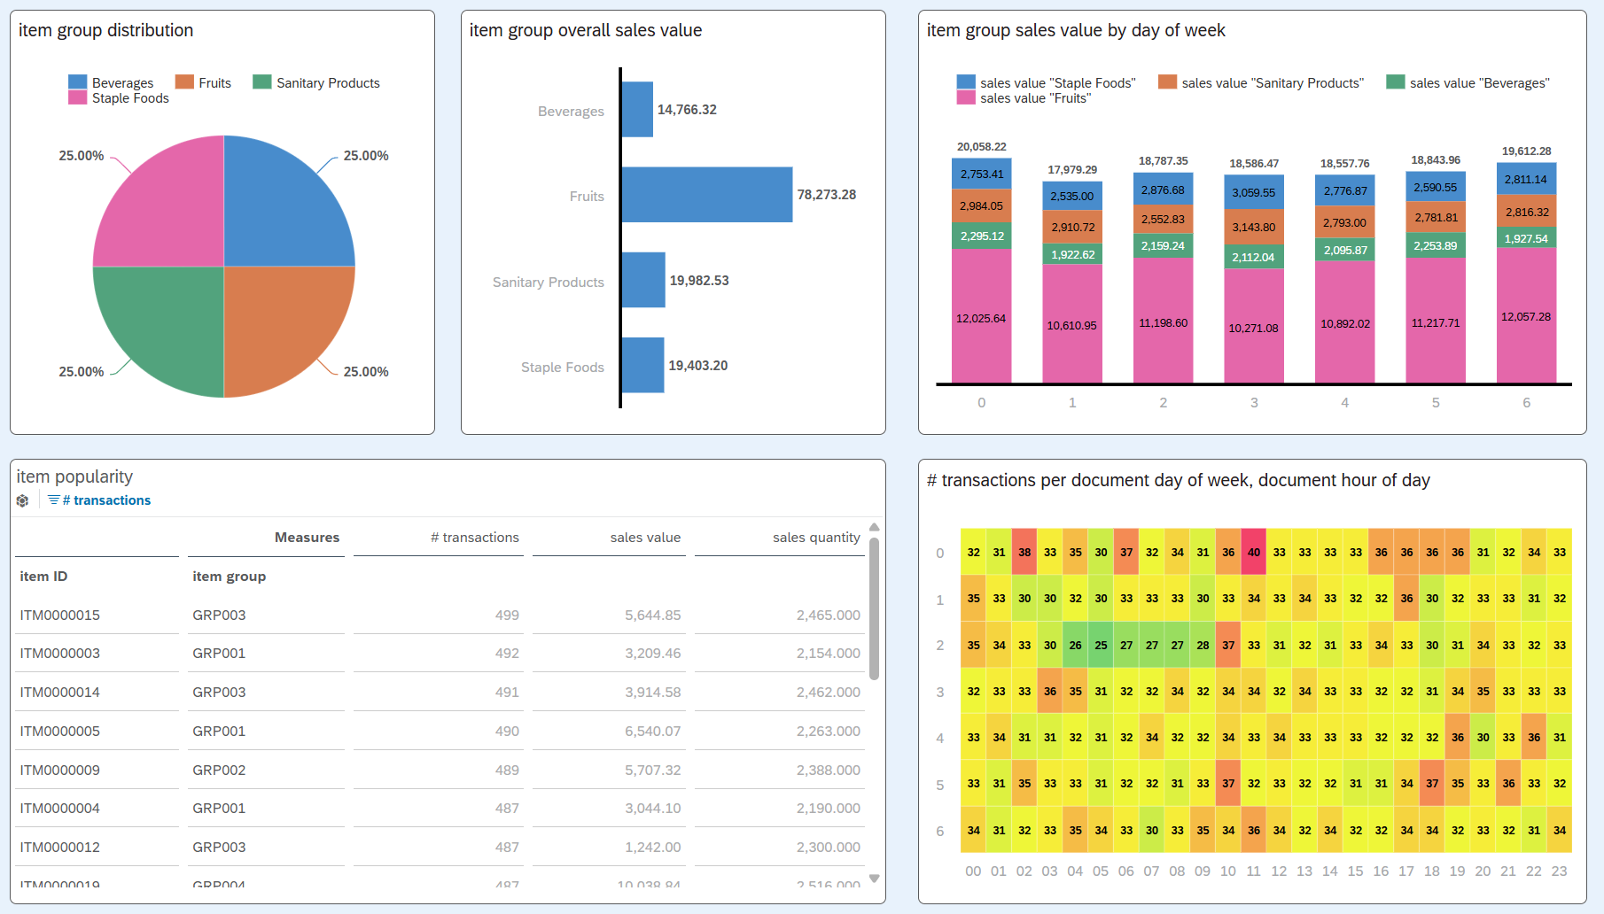
Technical Background | SAC Dashboards

Slide 5
Technical Background | SAC Widget Refresh
SAP Analytics Cloud
Widget
HANA Cloud
MDS Engine
MDS Request
Model Request
Model Request
HANA Execution Engines
Thread
Thread
Thread
Thread
Thread
Thread
Thread
Thread

Slide 6

Technical Background | SAC Dashboard Refresh
SAP Analytics Cloud
Widget
Widget
Widget
Widget
Widget
HANA Cloud
Thread
Thread
Thread
Thread
Thread
Thread
Thread
Thread
CPU resources
Memory resources
Thread
Thread
Thread
Thread
Thread
Thread
Thread
Thread
Thread
Thread
Thread
Thread
Thread
Thread
Thread
Thread
Thread
Thread

Slide 7
MDS Cube | Architecture
MDS Cube
Materialization of Calculation View data
Optimized for multi-dimensional reporting
Computational capabilities on top of materialized data
No expensive processing of HANA model during reporting time
Stored Procedure API for administration
Usable with MDS requests only
MDS Request
MDS Engine
MDS Cube
Load
HANA Model

Slide 8
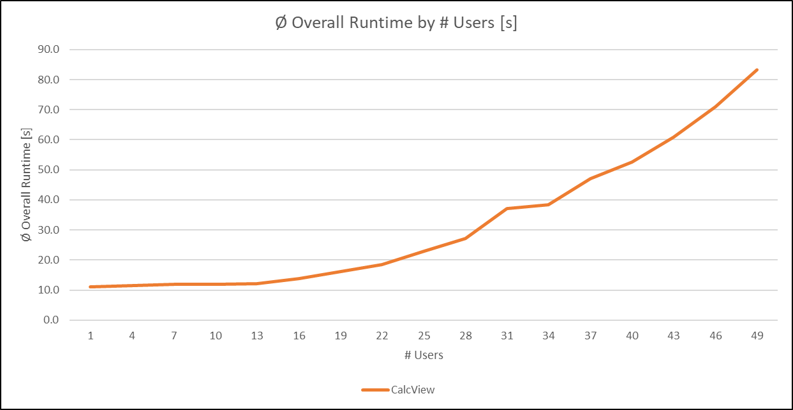
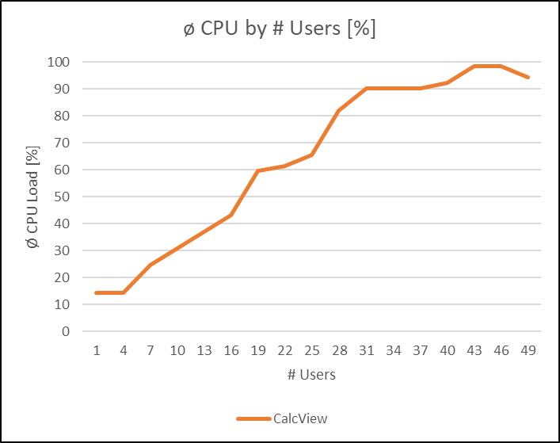
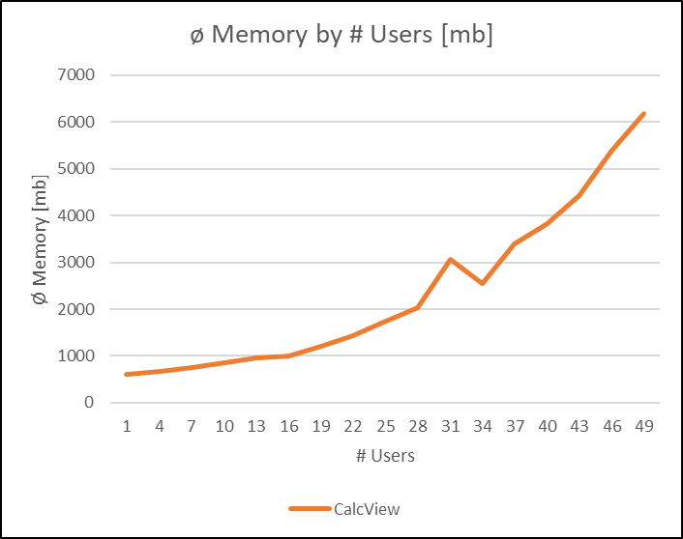
MDS Cube | Customer Scenario
Load test for SAP Analytics Cloud live reporting
Real customer HANA Cloud instance
Real customer model
Real MDS requests
Simulation of increasing amount of end users in fixed time range
Calculation View as source
Increasing CPU load
Increasing end user wait times

Slide 9
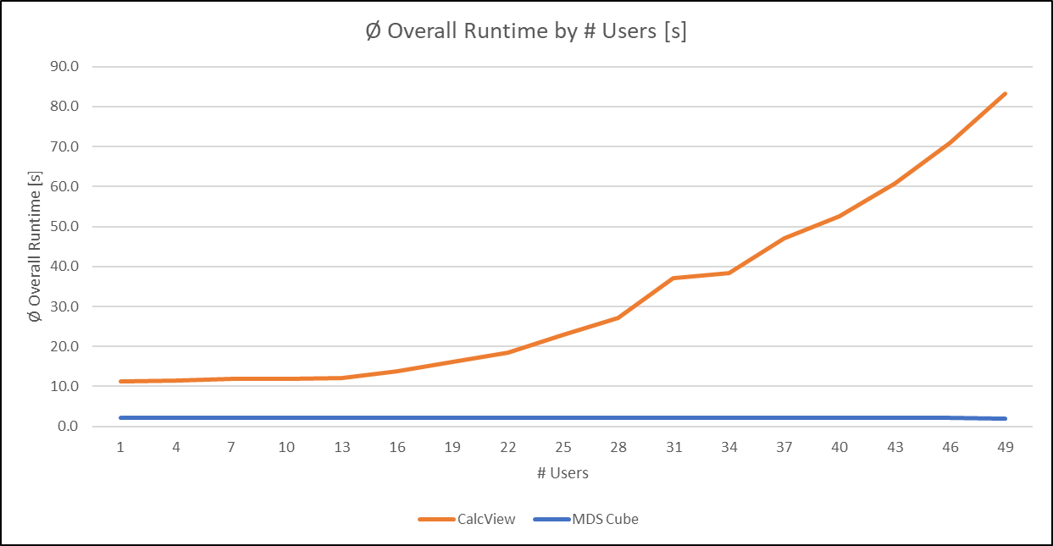
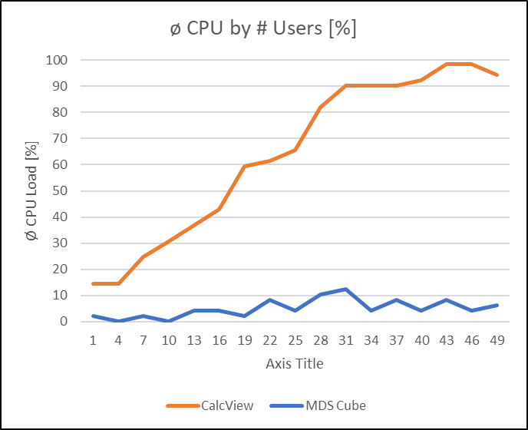
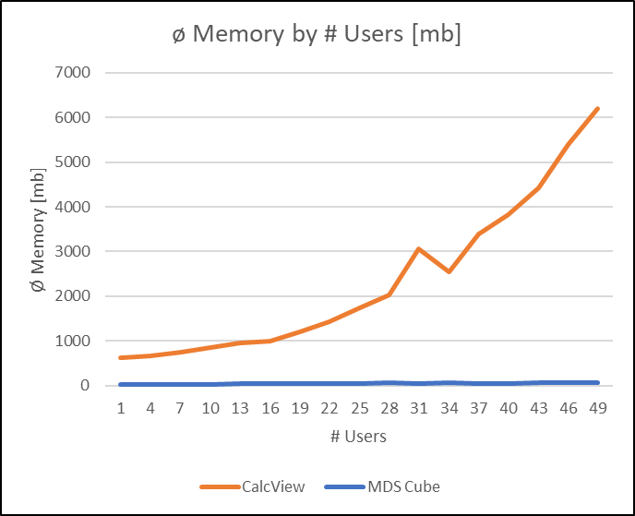
MDS Cube | Customer Scenario
Load test for SAP Analytics Cloud live reporting
Real customer HANA Cloud instance
Real customer model
Real MDS requests
Simulation of increasing amount of end users in fixed time range
Calculation View as source
Increasing CPU load
Increasing end user wait times
MDS Cube as source
Stable CPU load
Stable end user wait times

Slide 10
MDS Cube | Live Demo
MDS Cube modeling
MDS Cube loading (Reload)
MDS Cube monitoring (List)
MDS Cube usage in SAC

Slide 11
MDS Cube | State of Development
Available since HANA Cloud QRC 3/2023
Co-Innovation and Early Adopter Care programs
Collect early customer feedback
Continuous extensions based on customer feedback
Administration & monitoring
Lifecycle management
Calculation View features (in development)
Calculated & Restricted Measures
Input Parameters
Supported Calculation View features
Shared Dimensions (joins & join types)
Analytic Privileges
Hierarchies
Currency Conversion
Unit Conversion (planned QRC 3/2025)
Counters (planned QRC 3/2025)
Suitable scenarios
HANA models with expensive materializable calculations
Remote data access (Virtual Tables)
No requirement for realtime data

Slide 12
MDS Cube | References
SAP Community
Speeding Up Analytics Reporting with the SAP HANA Cloud - analytics accelerator
SAP HANA Cloud Administration Guide
Administration of MDS Cubes
API for Managing MDS Cubes
SAP HANA Cloud Modeling Guide
Define an MDS Cube Based on Elements in a Calculation View
Learning Journey “Develop Data Models with SAP HANA Cloud”
Defining MDS Cubes

Slide 13
Thank you.
Bastian Bremerich
bastian.bremerich@sap.com

Slide 14
Agenda
Agenda item/divider headline
Details
Agenda item/divider headline
Details
Agenda item/divider headline
Details
Agenda item/divider headline
Details

Slide 15
Insert page title (sentence case)
Start typing to add text without a bullet point. To add a bullet point, place the cursor at the start of this line and press tab.
Second level
Third level

Slide 16
Insert page title (sentence case)
Start typing to add text without a bullet point. To add a bullet point, place the cursor at the start of this line and press tab.
Second level
Third level

Slide 17
Color palette
Blue 2 #D1EFFF
Blue 4 #89D1FF
Blue 6 #1B90FF
Blue 7 #0070F2
Blue 10 #002A86
Blue 11 #00144A
Grey 2 #EAECEE
Grey 4 #A9B4BE
Grey 6 #5B738B
Grey 7 #475E75
Grey 10 #1A2733
Grey 11 #12171C
Teal 2 #C2FCEE
Teal 4 #2CE0BF
Teal 6 #049F9A
Teal 7 #07838F
Teal 10 #02414C
Teal 11 #012931
Green 2 #EBF5CB
Green 4 #97DD40
Green 6 #36A41D
Green 7 #188918
Green 10 #164323
Green 11 #0E2B16
Mango 2 #FFF3B8
Mango 4 #FFC933
Mango 6 #E76500
Mango 7 #C35500
Mango 10 #6D1900
Mango 11 #450B00
Red 2 #FFD5EA
Red 4 #FF8CB2
Red 6 #EE3939
Red 7 #D20A0A
Red 10 #5A0404
Red 11 #350000
Raspberry 2 #FFDCE8
Raspberry 4 #FEADC8
Raspberry 6 #FA4F96
Raspberry 7 #DF1278
Raspberry 10 #71014B
Raspberry 11 #510136
Pink 2 #FFDCF3
Pink 4 #FF8AF0
Pink 6 #F31DED
Pink 7 #CC00DC
Pink 10 #510080
Pink 11 #28004A
Indigo 2 #E2D8FF
Indigo 4 #B894FF
Indigo 6 #7858FF
Indigo 7 #5D36FF
Indigo 10 #1C0C6E
Indigo 11 #0E0637

