Slide 1
Expedia Hotel Booking Predictions
Prabha Bhat Sapna Bhat

Slide 2
Introduction
Expedia is one of the largest travel booking websites on the internet
The goal is to predict the booking outcome(hotel reservation) for a user event, based on attributes associated with that user
We can contextualize customer data and predict the likelihood, a user will book a hotel or not
The data used in this project is a random selection from Expedia and is not representative of the overall statistics

Slide 3
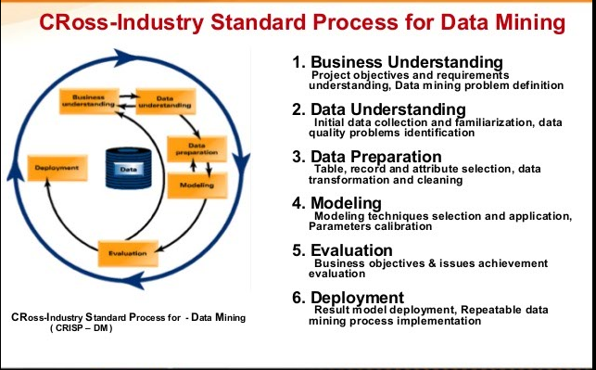
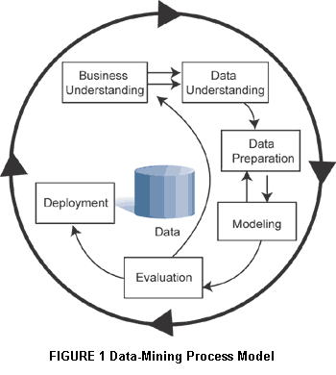
Cross Industry Standard Process (CRISP)

Slide 4
Dataset Description
We have used Expedia dataset from www.kaggle.com repository
The dataset contains 24 attributes and we have chosen 18 of them
date_time, posa_continent, user_location_country, user_location_region, user_location_city, orig_destination_distance, is_mobile, is_package, channel, srch_adults_cnt, srch_children_cnt, srch_rm_cnt, srch_destination_type_id, is_booking, hotel_continent, hotel_country, hotel_market, hotel_cluster

Slide 5
Attribute Description
Column name | Description | Data type
date_time | Timestamp | string
site_name | ID of the Expedia point of sale (i.e. Expedia.com, Expedia.co.uk, Expedia.co.jp, ...) | int
posa_continent | ID of continent associated with site_name | int
user_location_country | The ID of the country the customer is located | int
user_location_region | The ID of the region the customer is located | int
user_location_city | The ID of the city the customer is located | int
orig_destination_distance | Physical distance between a hotel and a customer at the time of search. | double
is_mobile | 1 when a user connected from a mobile device, 0 otherwise | tinyint
is_package | 1 if the click/booking was generated as a part of a package (i.e. combined with a flight), 0 otherwise | int
channel | ID of a marketing channel | int
srch_destination_type_id | Type of destination | int
is_booking | 1 if a booking, 0 if a click | tinyint
hotel_continent | Hotel continent | int
hotel_country | Hotel country | int
hotel_market | Hotel market | int
hotel_cluster | ID of a hotel cluster | int

Slide 6
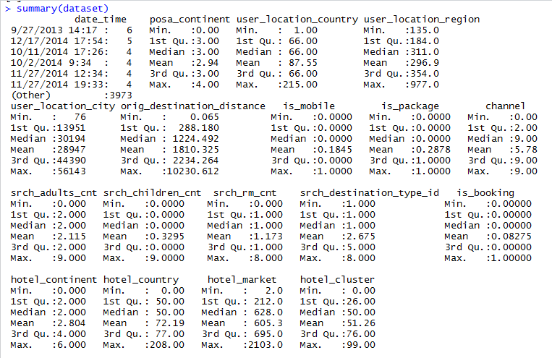
Understanding Data

Slide 7
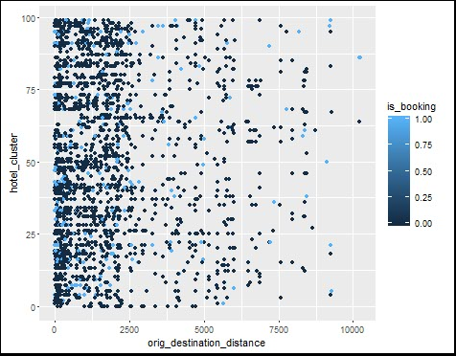
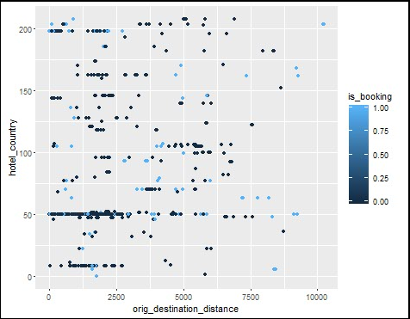
Exploratory Data Analysis

Slide 8
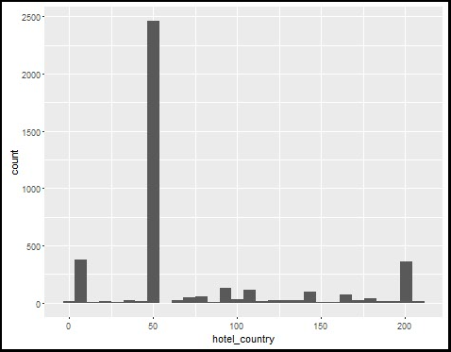
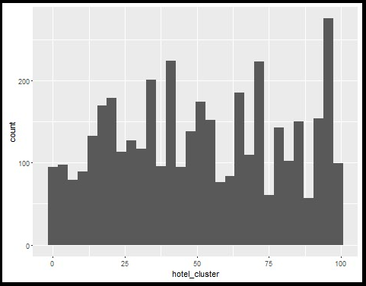
Exploratory Data Analysis Continued..

Slide 9
Algorithms Used
We have used 3 algorithms on the data and derived conclusions on classification of data
Analyzed data to classify or predict a certain result which can help management take decisions
Algorithms used :
K-Nearest Neighbors
CART
C5.0

Slide 10
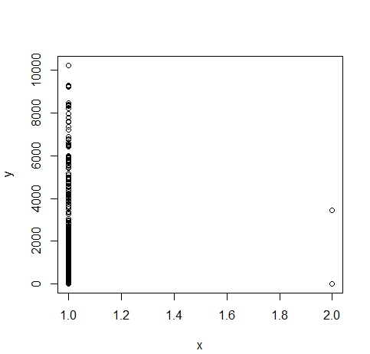
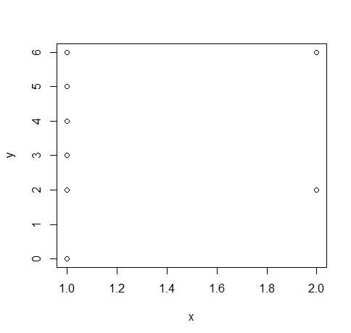
KNN Intermediate Conclusions
is_booking vs origin_destination_distance
is_booking vs hotel_continent

Slide 11
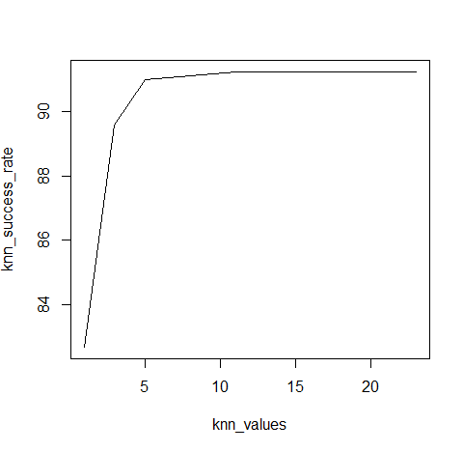
KNN Conclusion and Error Rate
The error rate changes every time since the Training and Test dataset are not static
The average success rate achieved is 89.75%
Hotel Bookings were found to be higher when distance between user and destination was less than 4000 miles
Hotel Bookings were found to be only in continent 2 and 6

Slide 12
CART- Variables used
We created categorical variables for applying CART as listed below:
VARIABLE NAME | CATEGORY
Date | Spring, Summer, Fall, Winter
Destination Distance | 0-5000, 5000-10000, >10000, >12000
is_mobile | ‘YES’, ‘NO’
is_booking | ‘YES’, ‘NO’
hotel_cluster | 2 Star, 3 Star, 4 Star, 5 Star, 6 Star
Notes:
The Decision trees produced by CART are strictly binary containing exactly two branches for each decision node. CART recursively partitions the records in the training data set into subset of records with similar values for the target attribute. The CART algorithm grows the tree by conducting for each decision node, an exhaustive search of all available variable and all splitting values selecting the optimal split.

Slide 13
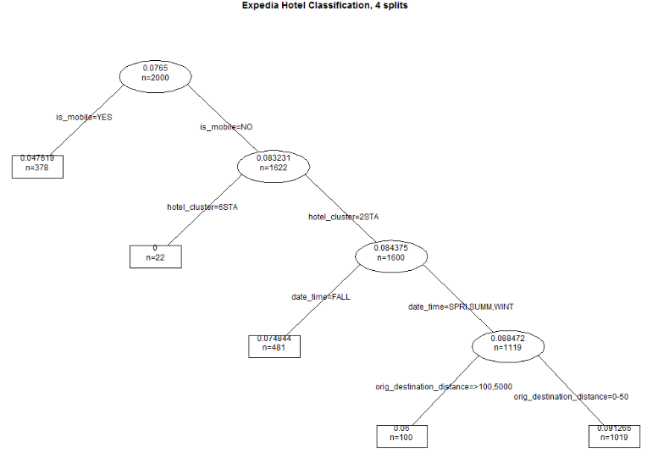
CART: Optimal Tree
Most Important Nodes:
is_mobile
hotel_cluster
date_time
origin_destination_distance
Error rate: 0.089

Slide 14
C5.0- Variables used
We created categorical variables for applying C5.0 as listed below:
VARIABLE NAME | CATEGORY
Date_time | Spring, Summer, Fall, Winter
Destination Distance | 0-5000, 5000-10000, >10000, >12000
is_mobile | ‘YES’, ‘NO’
is_booking | ‘YES’, ‘NO’
posa_continent | C1,C2,C3,C4,C5
hotel_continent | C1,C2,C3,C4,C5,C6,C7
hotel_cluster | 2 Star, 3 Star, 4 Star, 5 Star, 6 Star

Slide 15
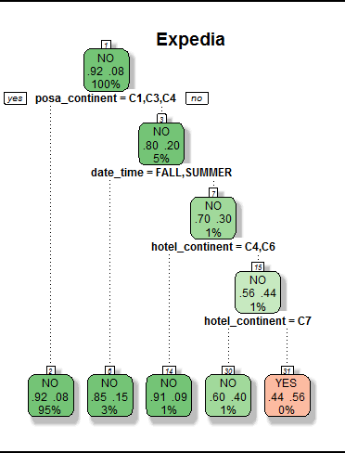
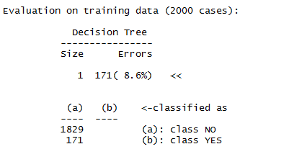
C5.0
Most Important Nodes:
posa_continent
date_time
hotel_continent
Error Rate 0.091
Notes:
C5.0 – C5.0’ predicts a target value of is_booking from the values of the attributes. C5.0 does this by constructing a classifier that makes this prediction. The classifiers are expressed as decision trees .

Slide 16
Evaluation
ALGORITHMS | SUCCESS RATE(%)
KNN | 89.75
CART | 91.1
C5.0 | 90.9

Slide 17
Conclusion
For predicting whether the user is going to book a hotel or not, CART has a better performance compared to KNN and C5.0
is_mobile, hotel_cluster, date_time and origin_destination_distance are the most significant attributes
Most of the bookings are done for 2 Star Hotels
Most of the users who booked the hotel have not done through mobile
Least number of bookings are done in Fall Season

Slide 18
References
https://www.kaggle.com/c/expedia-hotel-recommendations
http://varianceexplained.org/RData/
Discovering Knowledge in Data by Daniel T Larose

Slide 19


