Slide 1
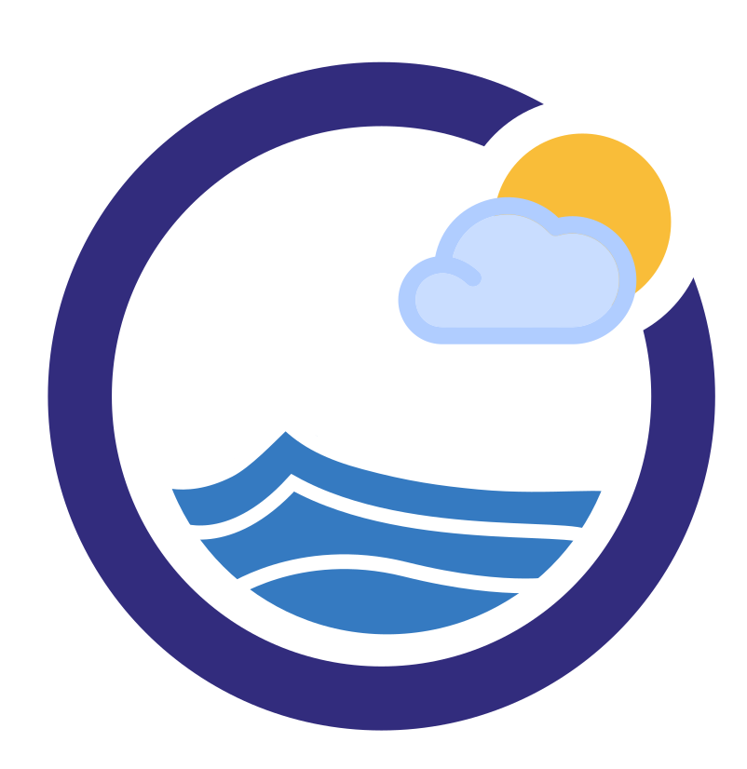

Google Cloud Associate Cloud Engineer
Virtual Networks

Slide 2
Google Cloud Associate Cloud Engineer
When users think about cloud computing, they often think about “virtual machines”.
A “VM” is a set of compute resources that use software instead of a physical computer to run programs and deploy apps.

Slide 3
Google Cloud Associate Cloud Engineer
This allows you to easily configure your ideal VM, for example choosing your own, CPU, RAM or Storage requirements.
Before we dive deeper into VMs and Compute on GCP, it’s important to understand how Google Cloud uses networking through Virtual Networks.

Slide 4
Google Cloud Associate Cloud Engineer
Important Note:
The next section of the course will focus on VMs and their creation.
When creating a new VM you need to provide choices for the Virtual Network information, which is why we cover this topic first!

Slide 5
Google Cloud Associate Cloud Engineer
Section Overview:
Compute Engine
Virtual Private Cloud Networks
VPC Concepts
Networks and Subnetworks
IP Addresses and Routing
Network Designs and Pricing

Slide 6
Google Cloud Associate Cloud Engineer
Let’s get started!

Slide 7
Google Cloud Associate Cloud Engineer
Compute Engine

Slide 8
Google Cloud Associate Cloud Engineer
Before we dive into VPC (Virtual Private Cloud), let’s have a brief overview of Compute Engine to get context of what virtual networks are used for.

Slide 9
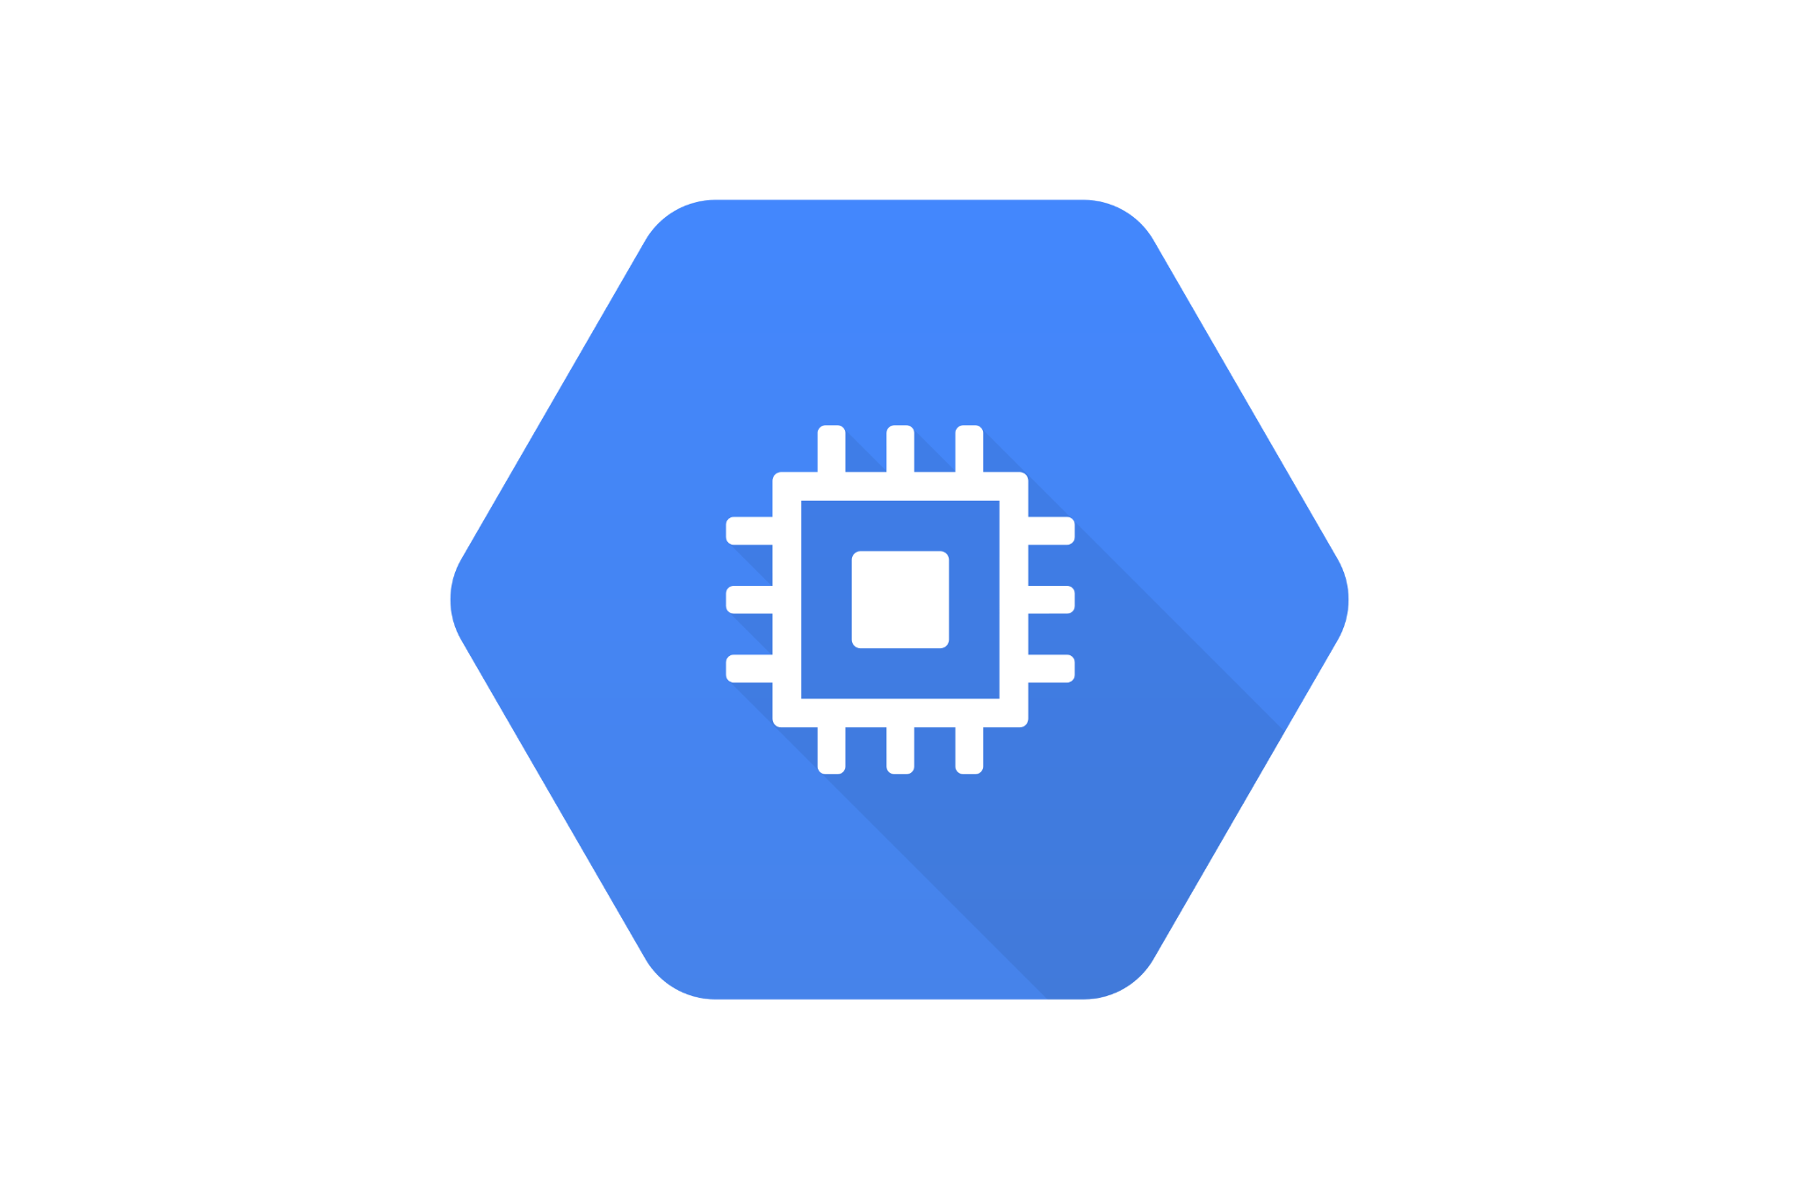
Google Cloud Associate Cloud Engineer
Compute Engine is GCP’s version of a Virtual Machine (VM).

Slide 10
Google Cloud Associate Cloud Engineer
Compute Engine is GCP’s version of a Virtual Machine (VM).
As mentioned in our discussion of cloud computing history, VMs allow us to use software to easily configure compute resources.

Slide 11
Google Cloud Associate Cloud Engineer
We can think of virtual machines as computers with GPU, CPU, RAM, Storage and more that we assemble together through software, rather than needing to purchase a physical machine with our exact specification requirements.

Slide 12
Google Cloud Associate Cloud Engineer
This means when we create a new VM with GCP console or the gcloud command line we get to choose a variety of features.

Slide 13
Google Cloud Associate Cloud Engineer
Compute Engine Disk:
Persistent Disk (Default):
Standard or SSD
Additional local SSD “scratch space” also available for local data that does not need to be permanently stored.

Slide 14
Google Cloud Associate Cloud Engineer
Compute Engine Boot Image:
Linux OS or Windows Server Available
Users can also import their own OS images.
Users can also define a startup scripts to specify VM software configurations from the start.

Slide 15
Google Cloud Associate Cloud Engineer
GCP offers many predefined VMs for common use cases, but you can always create your own custom VM.
The question then becomes:
How large of a compute engine should we choose? If my needs increase, should we go larger now from the start?

Slide 16
Google Cloud Associate Cloud Engineer
GCP offers very large VMs, but it also allows you to connect smaller instances through VPCs.

Slide 17
Google Cloud Associate Cloud Engineer
It’s typically easier and more common to “scale out” rather than “scale up”.

Slide 18
Google Cloud Associate Cloud Engineer
Let’s now explore VPCs for the rest of this section and we’ll go deeper into VMs in the next section!

Slide 19
Google Cloud Associate Cloud Engineer
Review:
We learned the very basics of Compute Engine VMs and that we can connect multiple VMs through a virtual network, rather than relying on a single large VM.

Slide 20
Google Cloud Associate Cloud Engineer
Up Next:
Let’s go through a demonstration of creating a Compute Engine VM!

Slide 21
Google Cloud Associate Cloud Engineer
DEMO:
Creating a VM Instance

Slide 22
Google Cloud Associate Cloud Engineer
In this lecture we’ll create a VM using the Google Cloud console, install nginx on that VM, and then visit our VM on the web!
Important Note:
To install and edit files on the VM we will use the command line with some common Linux commands.

Slide 23
Google Cloud Associate Cloud Engineer
Virtual Private Cloud

Slide 24
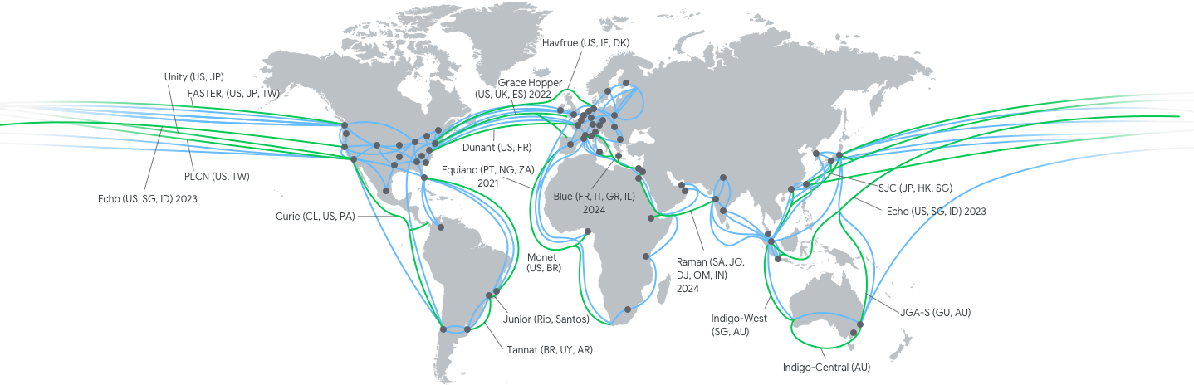
Google Cloud Associate Cloud Engineer
Recall that GCP has a robust network connecting its data centers all over the world.

Slide 25
Google Cloud Associate Cloud Engineer
We can think of this as GCP’s own internal physical network.
Remember when we created our VM in the demo, there were actually two different IP addresses, one internal and one external.

Slide 26
Google Cloud Associate Cloud Engineer
The external network is how we can connect to services on GCP using the internet.
The internal network allows us to connect VMs or other services only within Google Cloud’s own internal network.

Slide 27
Google Cloud Associate Cloud Engineer
The map shown earlier is GCP’s physical network, but just like VMs are machines constructed virtually through software, we can also construct virtual networks using GCP’s Virtual Private Cloud!

Slide 28
Google Cloud Associate Cloud Engineer
Keep in mind that there is some real physical hardware that the VMs are using, it’s just not all constructed together physically in a single unit.
Similarly, VPC networks are created virtually through software (but rely on some underlying physical networks).

Slide 29
Google Cloud Associate Cloud Engineer
The map shown earlier is GCP’s physical network, but just like VMs are machines constructed virtually through software, we can also construct virtual networks using GCP’s Virtual Private Cloud!

Slide 30
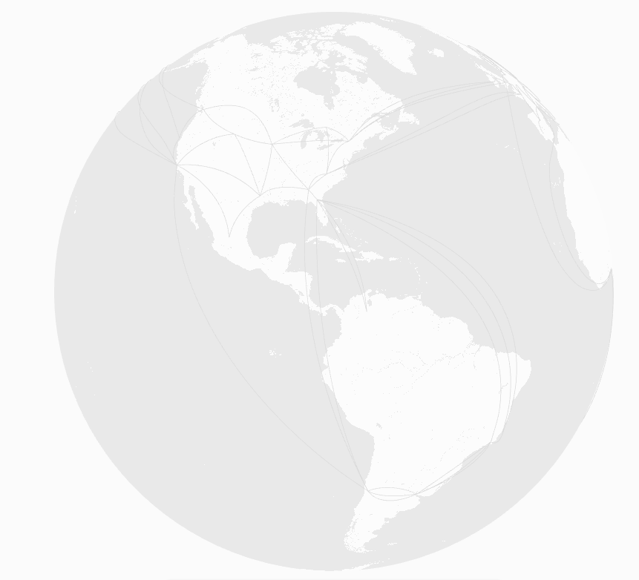
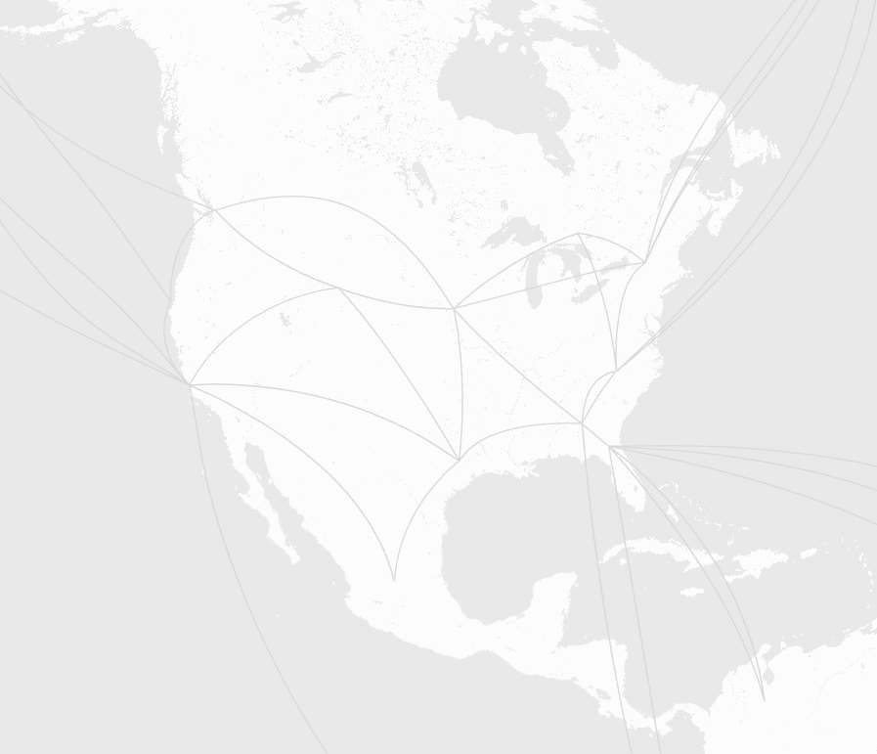
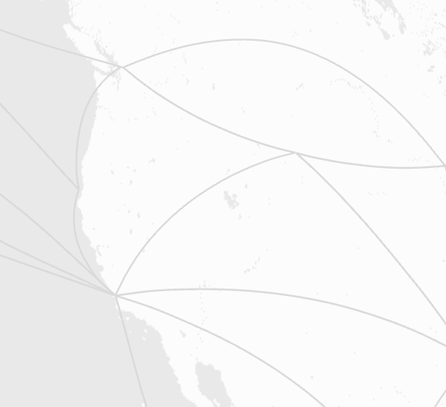
Google Cloud Associate Cloud Engineer
Recall Google Cloud Regions and Zones:
us-west1-a
us-west1-b
us-west1-c
World
Multi-Region
(North America)
Region
(us-west1)
Zones

Slide 31
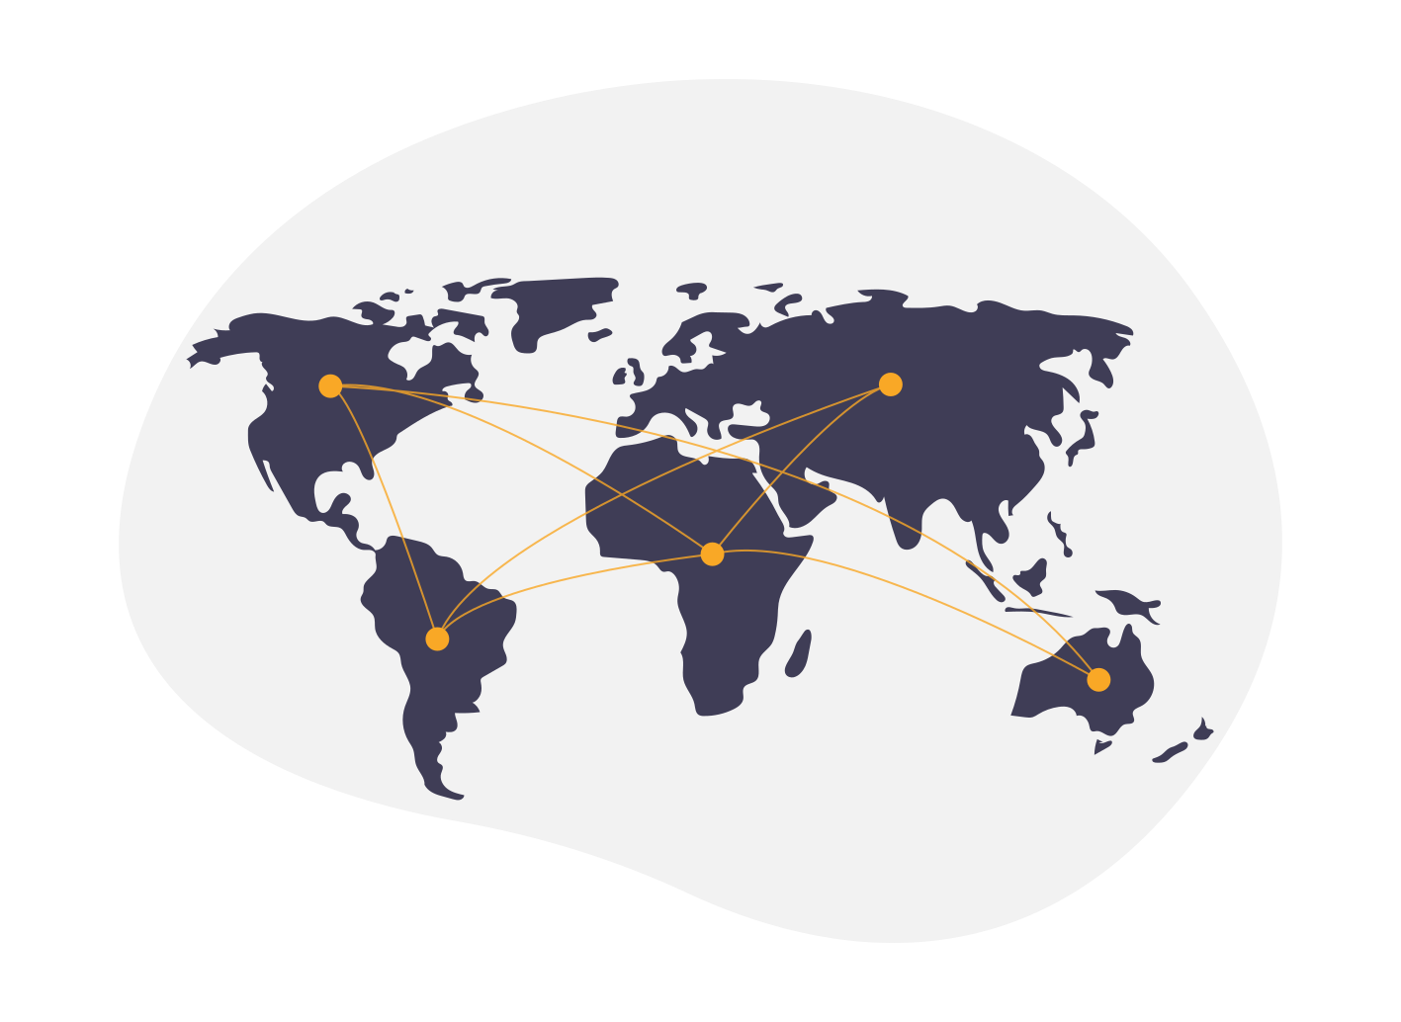
Google Cloud Associate Cloud Engineer
INTERNET

Slide 32
Google Cloud Associate Cloud Engineer
Google Cloud Platform
INTERNET

Slide 33
Google Cloud Associate Cloud Engineer
Google Cloud Platform
Project
INTERNET

Slide 34
Google Cloud Associate Cloud Engineer
Google Cloud Platform
Project
VPC Network
INTERNET

Slide 35
Google Cloud Associate Cloud Engineer
Google Cloud Platform
Project
VPC Network
Region: us-west1
Region: us-east1
INTERNET

Slide 36
Google Cloud Associate Cloud Engineer
Google Cloud Platform
Project
VPC Network
Region: us-west1
Region: us-east1
subnet1
subnet2
INTERNET

Slide 37
Google Cloud Associate Cloud Engineer
Google Cloud Platform
Project
VPC Network
Region: us-west1
Region: us-east1
subnet1
subnet2
Zone: us-west1-a
Zone: us-east1-a
INTERNET

Slide 38
Google Cloud Associate Cloud Engineer
Google Cloud Platform
Project
VPC Network
Region: us-west1
Region: us-east1
subnet1
subnet2
Zone: us-west1-a
Zone: us-east1-a
INTERNET

Slide 39
Google Cloud Associate Cloud Engineer
Google Cloud Platform
Project
VPC Network
Region: us-west1
Region: us-east1
subnet1
subnet2
Zone: us-west1-a
Zone: us-east1-a
INTERNET

Slide 40
Google Cloud Associate Cloud Engineer
Google Cloud Platform
Project
VPC Network
Region: us-west1
Region: us-east1
subnet1
subnet2
Zone: us-west1-a
Zone: us-east1-a
INTERNET

Slide 41
Google Cloud Associate Cloud Engineer
Google Cloud Platform
Project
VPC Network
Region: us-west1
Region: us-east1
subnet1
subnet2
Zone: us-west1-a
Zone: us-east1-a
INTERNET

Slide 42
Google Cloud Associate Cloud Engineer
So what are the components of VPC?
What parts of GCP do we need to learn about to build an understanding of Virtual Private Cloud networks?

Slide 43
Google Cloud Associate Cloud Engineer
VPC Components:
Projects
Projects contain all the services you use on Google Cloud Platform, this includes networks.
You can view this inside the VPC Networks tab on the left hand side of your Google Console.

Slide 44
Google Cloud Associate Cloud Engineer
VPC Components:
Networks
Define how services are connected to each other.
Options include default, auto mode, and custom mode.

Slide 45
Google Cloud Associate Cloud Engineer
VPC Components:
Subnetworks
Allows you to divide or aggregate your GCP services with the Virtual Private Cloud.

Slide 46
Google Cloud Associate Cloud Engineer
VPC Components:
Regions and Zones
As we’ve already discussed, this is how hardware and networks are organized across the world in GCP.

Slide 47
Google Cloud Associate Cloud Engineer
VPC Components:
Virtual Machines (VMs)
This includes Google Kubernetes Engine (GKE) clusters, App Engine flexible environment instances, and other Google Cloud products built on Compute Engine VMs.

Slide 48
Google Cloud Associate Cloud Engineer
VPC Components:
Routing
Google Cloud routes define the paths that network traffic takes from a virtual machine (VM) instance to other destinations.

Slide 49
Google Cloud Associate Cloud Engineer
VPC Components:
Firewalls
Define the accessibility rules to the VMs on the networks.
Lots of flexibility on permissions to communicate or access VMs internally or externally.

Slide 50
Google Cloud Associate Cloud Engineer
Review:
We’ve gotten a high level overview of Virtual Private Cloud on GCP and understand that it is a virtual network inside of Google Cloud.

Slide 51
Google Cloud Associate Cloud Engineer
Up Next:
We’ll spend the rest of the section diving deeper into each of the VPC components we mentioned and get hands-on practice with their respective use cases inside Google Cloud Console.

Slide 52
Google Cloud Associate Cloud Engineer
Networks and
Subnetworks

Slide 53
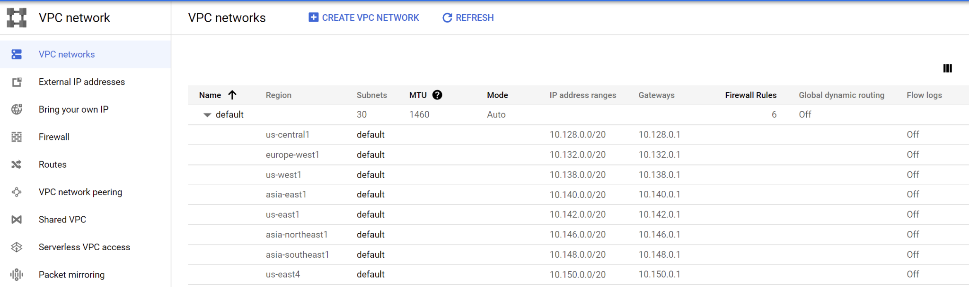
Google Cloud Associate Cloud Engineer
Projects are associated with your GCP services and your billing.
Projects themselves contain networks:

Slide 54
Google Cloud Associate Cloud Engineer
By default, the quota for a new Project is five networks, but you can always request a higher quota using the Google Cloud Console or gcloud command line.

Slide 55
Google Cloud Associate Cloud Engineer
Quick Note:
Google Cloud Documentation uses Subnetwork and Subnet interchangeably, they are referring to the same thing.

Slide 56
Google Cloud Associate Cloud Engineer
These networks are global and can span all available regions.
Let’s go through a few important points on networks and subnetworks…

Slide 57

Google Cloud Associate Cloud Engineer
VPC networks, including their associated routes and firewall rules, are global resources.
They are not associated with any particular region or zone.

Slide 58
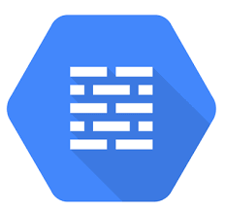
Google Cloud Associate Cloud Engineer
Subnets are regional resources where each subnet defines a range of IPv4 addresses.
Traffic to and from instances can be controlled with network firewall rules.

Slide 59
Google Cloud Associate Cloud Engineer
Rules are implemented on the VMs themselves, so traffic can only be controlled and logged as it leaves or arrives at a VM.

Slide 60
Google Cloud Associate Cloud Engineer
Resources within a VPC network can communicate with one another by using internal IPv4 addresses, subject to applicable network firewall rules.

Slide 61
Google Cloud Associate Cloud Engineer
Each VPC network consists of one or more useful IP range partitions called subnets.
Each subnet is associated with a region.
VPC networks do not have any IP address ranges associated with them.
IP ranges are defined for the subnets.

Slide 62
Google Cloud Associate Cloud Engineer
Recall that we mentioned there are three VPC network types:
Default
Auto Mode
Custom Mode
Let’s explore each in more detail…

Slide 63
Google Cloud Associate Cloud Engineer
Default Networks:
Provided for every project with default firewall rules.
One subnetwork is allocated per region with non-overlapping CIDR blocks.

Slide 64
Google Cloud Associate Cloud Engineer
Auto Mode Networks:
Technically the default network is actually an auto mode network.
One subnetwork is allocated per region.
Use predefined IP ranges with a /20 mask which can be expanded to /16.

Slide 65
Google Cloud Associate Cloud Engineer
Custom Networks:
No default subnetworks are created.
User has full control of the subnetworks and the IP ranges (within the RFC 1918 address space).

Slide 66
Google Cloud Associate Cloud Engineer
Auto mode networks can be converted to custom mode networks if the user needs more control over the IP ranges.
However, this conversion is one way and a custom mode network can’t be turned back into an auto mode network.

Slide 67
Google Cloud Associate Cloud Engineer

Slide 68
Google Cloud Associate Cloud Engineer
Project

Slide 69
Google Cloud Associate Cloud Engineer
Project
Network 1
Network 2
Network 3
Network 4
Network 5

Slide 70
Google Cloud Associate Cloud Engineer
Project
us-east1
Network 1
Network 2
Network 3
Network 4
Network 5

Slide 71
Google Cloud Associate Cloud Engineer
Project
us-east1
us-west1
Network 1
Network 2
Network 3
Network 4
Network 5

Slide 72
Google Cloud Associate Cloud Engineer
Project
us-east1
us-west1
Network 1
Network 2
Network 3
Network 4
Network 5

Slide 73
Google Cloud Associate Cloud Engineer
Project
us-east1
us-west1
asia-east1
Network 1
Network 2
Network 3
Network 4
Network 5

Slide 74
Google Cloud Associate Cloud Engineer
Project
us-east1
us-west1
asia-east1
Network 1
Network 2
Network 3
INTERNET
Network 4
Network 5

Slide 75
Google Cloud Associate Cloud Engineer
Project
us-east1
us-west1
asia-east1
Network 1
Network 2
Network 3
INTERNET
Network 4
Network 5

Slide 76
Google Cloud Associate Cloud Engineer
Project
us-east1
us-west1
asia-east1
Network 1
Network 2
Network 3
These VMs can connect over internal IPs since they’re on the same network.
INTERNET
Network 4
Network 5

Slide 77
Google Cloud Associate Cloud Engineer
Project
us-east1
us-west1
asia-east1
Network 1
Network 2
Network 3
INTERNET
Network 4
Network 5

Slide 78
Google Cloud Associate Cloud Engineer
Project
us-east1
us-west1
asia-east1
Network 1
Network 2
Network 3
INTERNET
Network 4
Network 5

Slide 79
Google Cloud Associate Cloud Engineer
Project
us-east1
us-west1
asia-east1
Network 1
Network 2
Network 3
Must use external IP addresses to connect, due to different networks, even if in same region!
INTERNET
Network 4
Network 5

Slide 80
Google Cloud Associate Cloud Engineer
Project
us-east1
us-west1
asia-east1
Network 1
Network 2
Network 3
Do we actually go through the real world public internet for this communication?
INTERNET
Network 4
Network 5

Slide 81
Google Cloud Associate Cloud Engineer
Project
us-east1
us-west1
asia-east1
Network 1
Network 2
Network 3
Do we actually go through the real world public internet for this communication?
Google Edge Network
Network 4
Network 5

Slide 82
Google Cloud Associate Cloud Engineer
Recall that we mentioned subnetworks are allocated per region and that we have several zones per region.
This means subnetworks can cross zones.

Slide 83
Google Cloud Associate Cloud Engineer
VMs can be on same subnet, even in different zones.
Network

Slide 84
Google Cloud Associate Cloud Engineer
VMs can be on same subnet, even in different zones.
Network
us-east1

Slide 85
Google Cloud Associate Cloud Engineer
VMs can be on same subnet, even in different zones.
Network
us-east1
us-east1-b
us-east1-c

Slide 86
Google Cloud Associate Cloud Engineer
VMs can be on same subnet, even in different zones.
Network
us-east1
us-east1-b
us-east1-c
subnet-1

Slide 87
Google Cloud Associate Cloud Engineer
VMs can be on same subnet, even in different zones.
Network
us-east1
us-east1-b
us-east1-c
subnet-1

Slide 88
Google Cloud Associate Cloud Engineer
The subnetwork is an IP address range.
Network
us-east1
us-east1-b
us-east1-c
10.0.0.0
subnet-1

Slide 89
Google Cloud Associate Cloud Engineer
The 1st and 2nd IP addresses are reserved for the network and the subnet gateway.
Network
us-east1
us-east1-b
us-east1-c
subnet-1
10.0.0.3
10.0.0.2
10.0.0.1
10.0.0.0

Slide 90
Google Cloud Associate Cloud Engineer
Then the VMs have their own IPs with the allowed range.
Network
us-east1
us-east1-b
us-east1-c
subnet-1
10.0.0.3
10.0.0.2
10.0.0.1
10.0.0.0

Slide 91
Google Cloud Associate Cloud Engineer
A single set of firewall rules can be used for both VMs since they share the subnet.
Network
us-east1
us-east1-b
us-east1-c
subnet-1
10.0.0.3
10.0.0.2
10.0.0.1
10.0.0.0

Slide 92
Google Cloud Associate Cloud Engineer
Google Cloud VPCs allow you to increase the IP address space of any subnets.
You can go through this subnet IP address range expansion without any downtime.

Slide 93
Google Cloud Associate Cloud Engineer
Example Subnetworks
PROJECT

Slide 94
Google Cloud Associate Cloud Engineer
Example Subnetworks
PROJECT
Network 1

Slide 95
Google Cloud Associate Cloud Engineer
Example Subnetworks
PROJECT
Network 1
us-east1
us-west1

Slide 96
Google Cloud Associate Cloud Engineer
Example Subnetworks
PROJECT
Network 1
us-east1
us-west1
Subnet
10.321/24

Slide 97
Google Cloud Associate Cloud Engineer
Example Subnetworks
PROJECT
Network 1
us-east1
us-west1
Subnet
10.321/24
Subnet
10.130/16

Slide 98
Google Cloud Associate Cloud Engineer
Subnetwork Key Points:
New subnetworks can not overlap in the same VPC network in any region.
New subnet must be inside the RFC 1918 address space.

Slide 99
Google Cloud Associate Cloud Engineer
Subnetwork Key Points:
You can not undo an expansion of IP range.
Automode subnetworks can be expanded from /20 to /16.
In general avoid very large subnetworks, do not preemptively create a large subnet.

Slide 100
Google Cloud Associate Cloud Engineer
Review:
We learned about Networks and Subnetworks and some key ideas about their use on Google Cloud.

Slide 101
Google Cloud Associate Cloud Engineer
Up Next:
We discussed IP Addresses quite a bit in this lecture, so in the next lecture we’ll take some time to dive deeper into IP addresses in general and on GCP.

Slide 102
Google Cloud Associate Cloud Engineer
IP Addresses

Slide 103
Google Cloud Associate Cloud Engineer
Our discussion of Networks and Subnetworks included topics about IP Addresses.
Let’s cover some quick background information on IP addresses and then dive into specifics for IP addresses on Google Cloud Virtual Machines.

Slide 104
Google Cloud Associate Cloud Engineer
To fully understand an IP address, we need to understand binary notation.
Binary notation simply uses 0s and 1s to represent a number by using the exponents of 2 and positional notation.

Slide 105
Google Cloud Associate Cloud Engineer
Binary Notation:

Slide 106
Google Cloud Associate Cloud Engineer
An Internet Protocol (IP) address is a 32-bit numerical label that uniquely identifies the host device.
IP addresses are normally expressed in dotted-decimal format, with four numbers separated by periods, such as 192.168.123.132.

Slide 107
Google Cloud Associate Cloud Engineer
Let’s revisit our IP Address Example:
The dotted-decimal IP address 192.168.123.132 is (in binary notation) the 32-bit number:
110000000101000111101110000100

Slide 108
Google Cloud Associate Cloud Engineer
Let’s revisit our IP Address Example:
The dotted-decimal IP address 192.168.123.132 is (in binary notation) the 32-bit number:
110000000101000111101110000100
Separate this into 8 bit “octets”:
11000000.10101000.01111011.10000100

Slide 109
Google Cloud Associate Cloud Engineer
An IP address has two parts.
The first part of an IP address is used as a network address, the last part as a host address.

Slide 110
Google Cloud Associate Cloud Engineer
If you take the example 192.168.123.132 and divide it into these two parts, you get:
192.168.123. Network
.132 Host
Can also write it as:
192.168.123.0 - Network Address.
0.0.0.132 - Host Address.

Slide 111
Google Cloud Associate Cloud Engineer
The second item, which is required for IP addresses to work, is the subnet mask.
The subnet mask is used by the TCP/IP protocol to determine whether a host is on the local subnet or on a remote network.

Slide 112
Google Cloud Associate Cloud Engineer
The parts of the IP address that are used as the network and host addresses aren't fixed.
This information is supplied in another 32-bit number called a subnet mask.

Slide 113
Google Cloud Associate Cloud Engineer
The subnet mask is 255.255.255.0 in this example.
255 in binary notation equals 11111111.
The subnet mask is:
11111111.11111111.11111111.00000000

Slide 114
Google Cloud Associate Cloud Engineer
With our example, we then have:
IP Address:
192.168.123.132
Network Address:
192.168.123.0
Host Address:
000.000.000.132
Subnet Mask:
255.255.255.0

Slide 115
Google Cloud Associate Cloud Engineer
This example using a 255.255.255.0 subnet mask, that the network ID is 192.168.123.0, and the host address is 0.0.0.132. When a packet arrives on the 192.168.123.0 subnet (from the local subnet or a remote network), and it has a destination address of 192.168.123.132, the VM will receive it from the network and process it.

Slide 116
Google Cloud Associate Cloud Engineer
Using CIDR (Classless Inter-Domain Routing) rules we can more easily write out Subnet Mask ranges with a prefix.
For example a /16 CIDR prefix corresponds with the 255.255.0.0 subnet mask and has 65,534 usable IP addresses.
Look up CIDR charts only for more info.

Slide 117
Google Cloud Associate Cloud Engineer
It should also be noted that IPv4 is a 32-bit address which creates limits on the number of available IP addresses in the world.
As the internet grows, we can expect to see more IPv6 addresses that are 128-bit addresses.

Slide 118
Google Cloud Associate Cloud Engineer
DHCP (Dynamic Host Configuration Protocol) is a network management protocol used on Internet Protocol (IP) networks for automatically assigning IP addresses and other communication parameters to devices connected to the network using a client–server architecture.

Slide 119
Google Cloud Associate Cloud Engineer
DNS (Domain Name System) is the hierarchical and decentralized naming system used to identify computers, services, and other resources reachable through the Internet or other Internet Protocol (IP) networks.

Slide 120
Google Cloud Associate Cloud Engineer
DNS (Domain Name System) basically serves as the Internet's phone book: every time you visit a website, your computer performs a DNS lookup, translating the domain name into an IP address.

Slide 121
Google Cloud Associate Cloud Engineer
Google Cloud has its own Cloud DNS service for users which we’ll discuss later.
There is a lot more about IP Addresses that is outside the scope of this course.
For now, let’s discuss how IP Addresses relate to GCP VMs.

Slide 122
Google Cloud Associate Cloud Engineer
VM IP Addresses:
VMs can have two IP addresses, one internal and another external.
Let’s review the differences between the internal and external IP addresses of a VM instance.

Slide 123
Google Cloud Associate Cloud Engineer
Internal IP Address:
These addresses are allocated to the VM based on the allowed range on the Subnetwork using DHCP.
DHCP lease is renewed every 24 hours.

Slide 124
Google Cloud Associate Cloud Engineer
Internal IP Address:
If you are communicating between instances in the same VPC network, you can send packets to an instance by specifying the fully qualified DNS name (FQDN) of the target instance.
Google Cloud automatically resolves the name to the internal IP address of the instance.

Slide 125
Google Cloud Associate Cloud Engineer
External IP Address:
External IP Addresses are optional for VMs.
It can be static or ephemeral.

Slide 126
Google Cloud Associate Cloud Engineer
External IP Address:
Static IP Addresses are assigned to a project long term until they are explicitly released from that assignment, and they remain attached to a resource until they are explicitly detached.

Slide 127
Google Cloud Associate Cloud Engineer
External IP Address:
Note that static IP Addresses not assigned to a running VM are billed at a higher rate to dissuade the creation of unused static external IP addresses.

Slide 128
Google Cloud Associate Cloud Engineer
External IP Address:
Ephemeral IP Addresses are available to VM instances and forwarding rules.
Ephemeral external IP addresses remain attached to a VM instance only until the VM is stopped and restarted or the instance is terminated.

Slide 129
Google Cloud Associate Cloud Engineer
External IP Address:
If an instance is stopped, any ephemeral external IP addresses that were assigned to the instance are released back into the general Compute Engine pool and become available for use by other projects.

Slide 130
Google Cloud Associate Cloud Engineer
External IP Address:
It should also be noted that an external IP address is unknown to the OS of the VM.
VPC network maps the external IP address to the internal address using a lookup table.

Slide 131
Google Cloud Associate Cloud Engineer
Let’s also take some time to discuss DNS resolution for internal and external addresses.

Slide 132
Google Cloud Associate Cloud Engineer
Internal IP DNS Resolution:
Each instance has a hostname that can be used to resolve to an internal IP address.
This hostname is the same as the instance name.

Slide 133
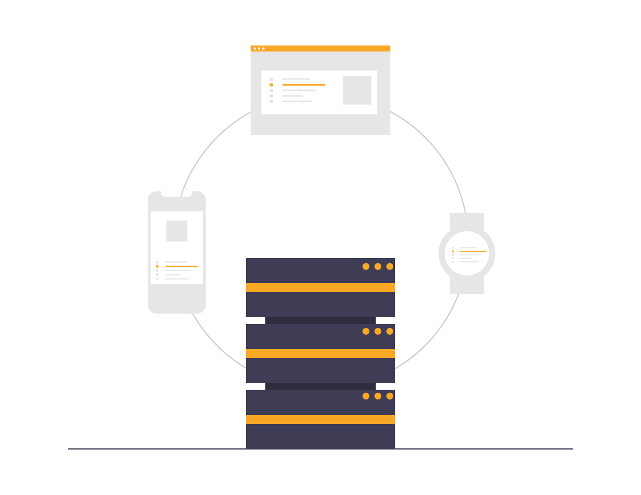
Google Cloud Associate Cloud Engineer
Internal IP DNS Resolution:
The FQDN uses the following format:
[hostname].[zone].c.[projectid].internal

Slide 134
Google Cloud Associate Cloud Engineer
Internal IP DNS Resolution:
Instances that are deleted but then recreated will have a different internal IP address from their original.
This can disrupt connections to other GCP services if they have not obtained the new internal IP address.

Slide 135
Google Cloud Associate Cloud Engineer
Internal IP DNS Resolution:
However, the DNS name always points to a specific instance.
Name resolution is handled by the DNS resolver and is provided as part of Compute Engine.

Slide 136
Google Cloud Associate Cloud Engineer
External IP DNS Resolution:
Instances with an external IP can accept connections to hosts that are outside of the project (outside of the network).
Google Cloud admins can also publish the public DNS records pointing to the instance.

Slide 137
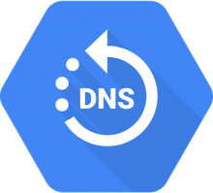
Google Cloud Associate Cloud Engineer
External IP DNS Resolution:
DNS zones can be hosted using GCP’s Cloud DNS service.

Slide 138
Google Cloud Associate Cloud Engineer
Cloud DNS:
GCP’s Cloud DNS service translates domain names into IP addresses with low latency and 100% availability in SLA.

Slide 139
Google Cloud Associate Cloud Engineer
Cloud DNS:
More Information:
https://cloud.google.com/dns

Slide 140
Google Cloud Associate Cloud Engineer
Finally, let’s discuss the ability to create alias IP ranges for your instances.

Slide 141
Google Cloud Associate Cloud Engineer
Alias IP Range:
GCP allows you to assign a range of IP addresses as aliases to a VM’s network interface.

Slide 142
Google Cloud Associate Cloud Engineer
Alias IP Range:
Using IP aliasing, you can configure multiple internal IP addresses, representing containers or applications hosted in a VM, without having to define a separate network interface. You can assign VM alias IP ranges from either the subnet's primary or secondary ranges.

Slide 143
Google Cloud Associate Cloud Engineer
IP Aliases:
A primary CIDR range 10.1.0.0/16 is configured as part of a subnet.
VM
Primary Internal Address:
10.1.0.2
VM Alias IP Range:
10.2.1.0/24
Subnetwork
Primary IP
Address Range
10.1.0.0/16
Secondary IP
Address Range
10.1.0.0/20
Containers

Slide 144
Google Cloud Associate Cloud Engineer
IP Aliases:
A secondary CIDR range 10.2.0.0/20 is configured as part of a subnet.
VM
Primary Internal Address:
10.1.0.2
VM Alias IP Range:
10.2.1.0/24
Subnetwork
Primary IP
Address Range
10.1.0.0/16
Secondary IP
Address Range
10.1.0.0/20
Containers

Slide 145
Google Cloud Associate Cloud Engineer
The VM primary IP 10.1.0.2 is allocated from the primary CIDR range, 10.1.0.0/16, while an alias IP range, 10.2.1.0/24, is allocated in the VM from the secondary CIDR range, 10.2.0.0/20.
VM
Primary Internal Address:
10.1.0.2
VM Alias IP Range:
10.2.1.0/24
Subnetwork
Primary IP
Address Range
10.1.0.0/16
Secondary IP
Address Range
10.1.0.0/20
Containers

Slide 146
Google Cloud Associate Cloud Engineer
The addresses in the alias IP range are used as the IP addresses of the containers hosted in the VM.
VM
Primary Internal Address:
10.1.0.2
VM Alias IP Range:
10.2.1.0/24
Subnetwork
Primary IP
Address Range
10.1.0.0/16
Secondary IP
Address Range
10.1.0.0/20
Containers

Slide 147
Google Cloud Associate Cloud Engineer
Review:
We learned about IP Addresses and how they relate to VM Instances.

Slide 148
Google Cloud Associate Cloud Engineer
Up Next:
We’ll explore routes and firewalls inside Google Cloud.

Slide 149
Google Cloud Associate Cloud Engineer
Routing and
Firewalls

Slide 150
Google Cloud Associate Cloud Engineer
Should anyone be allowed to communicate with our VM Instances?
Clearly the answer is no!
Let’s explore how Google Cloud handles both the routes that packets take and the firewall rules that networks use to allow us to supervise internal and external traffic.

Slide 151
Google Cloud Associate Cloud Engineer
Google Cloud routes define the paths that network traffic takes from a virtual machine (VM) instance to other destinations.
These destinations can be inside your Google Cloud Virtual Private Cloud (VPC) network (for example, in another VM) or outside it.

Slide 152
Google Cloud Associate Cloud Engineer
In a VPC network, a route consists of a single destination prefix in CIDR format and a single next hop.
When an instance in a VPC network sends a packet, Google Cloud delivers the packet to the route's next hop if the packet's destination address is within the route's destination range.

Slide 153
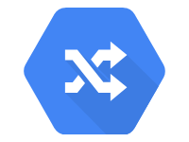
Google Cloud Associate Cloud Engineer
In computer networking, a routing table, or routing information base (RIB), is a data table stored in a router or a network host that lists the routes to particular network destinations.

Slide 154
Google Cloud Associate Cloud Engineer
Every VPC network uses a scalable, distributed virtual routing mechanism.
There is no physical device that's assigned to the network.
Some routes can be applied selectively, but the routing table for a VPC network is defined at the VPC network level.

Slide 155
Google Cloud Associate Cloud Engineer
Each VM instance has a controller that is kept informed of all applicable routes from the network's routing table.
Each packet leaving a VM is delivered to the appropriate next hop of an applicable route based on a routing order.

Slide 156
Google Cloud Associate Cloud Engineer
Default Networks:
Routes for communication traffic directly between instances.
Default routes for packets to destinations outside the network.
Manually created networks won’t have these default routes and firewalls.

Slide 157
Google Cloud Associate Cloud Engineer
Firewall Rules:
VPC network functions as a firewall distributed to the instances and firewall rules are applied to the entire network.
Connections are either allowed or denied at the instance level.

Slide 158
Google Cloud Associate Cloud Engineer
Firewall Rules:
Rules are stateful, meaning bidirectional communication is allowed once a connection is established.
Even without any firewall rules, there is an implied denial of all ingress traffic and implied allowance of egress traffic.

Slide 159
Google Cloud Associate Cloud Engineer
Firewall Rules Parameters:
Direction
Source or Destination
Protocol and Port
Action
Priority
Assignment

Slide 160
Google Cloud Associate Cloud Engineer
Firewall Rules Parameters:
Direction
Inbound connections are matched only against ingress rules.
Outbound connections are matched only against egress rules.

Slide 161
Google Cloud Associate Cloud Engineer
Firewall Rules Parameters:
Sources
Specified as IP Addresses, Source Tags, or Source Service Account.
Destinations
One or more ranges of IP addresses.

Slide 162
Google Cloud Associate Cloud Engineer
Firewall Rules Parameters:
Protocol and Port
Any rule can be restricted to apply to only a specific protocol (e.g. only HTTP traffic) or only a specific port (e.g. only port :80).

Slide 163
Google Cloud Associate Cloud Engineer
Firewall Rules Parameters:
Action
Either allowing or denying the packets based on direction, source/destination, protocol, and port.

Slide 164
Google Cloud Associate Cloud Engineer
Firewall Rules Parameters:
Priority
Defines the order in which rules are evaluated.
The first matching rule is applied.

Slide 165
Google Cloud Associate Cloud Engineer
Firewall Rules Parameters:
Assignment
Rules are applied to all instances, but you can specify that certain rules only apply to certain instances.

Slide 166
Google Cloud Associate Cloud Engineer
External Network
Egress Firewall Rules:
Conditions:
Destination CIDR Ranges
Protocols
Ports
Allow or Deny the egress connection
GCP Virtual Network
Firewall
VM

Slide 167
Google Cloud Associate Cloud Engineer
External Network
Egress Firewall Rules:
Conditions:
Destination CIDR Ranges
Protocols
Ports
Allow or Deny the egress connection
VM
GCP Virtual Network
Firewall
VM

Slide 168
Google Cloud Associate Cloud Engineer
External Network
Firewall
Egress Firewall Rules:
Conditions:
Destination CIDR Ranges
Protocols
Ports
Allow or Deny the egress connection
VM
GCP Virtual Network
Firewall
VM

Slide 169
Google Cloud Associate Cloud Engineer
External Network
Firewall
Ingress Firewall Rules:
Conditions:
Source CIDR Ranges
Protocols
Ports
Allow or Deny the ingress connection
VM
GCP Virtual Network
Firewall
VM

Slide 170
Google Cloud Associate Cloud Engineer
Review:
We learned about routes and firewall rules and how they can apply to VM instances.

Slide 171
Google Cloud Associate Cloud Engineer
Up Next:
We’ll discuss common network design considerations.

Slide 172
Google Cloud Associate Cloud Engineer
Designing
Networks

Slide 173
Google Cloud Associate Cloud Engineer
Let’s go through some key considerations and example of network designs:
Availability
Dependability
Accessibility (Cloud NAT)
Accessibility (Private Google Access)

Slide 174
Google Cloud Associate Cloud Engineer
Multiple Zone Availability
Project
VPC Network
Region: us-west1
subnet1
Zone: us-west1-a
Zone: us-west1-b

Slide 175
Google Cloud Associate Cloud Engineer
Global Dependability with Regions
Project
VPC Network
Region: us-west1
Region: us-east1
subnet1
subnet2
Zone: us-west1-a
Zone: us-east1-a

Slide 176
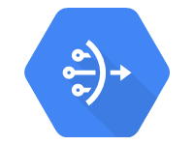
Google Cloud Associate Cloud Engineer
Accessibility with Cloud NAT
VPC Network
Region: us-west1
us-west1-a
us-east1-a
Cloud
NAT

Slide 177
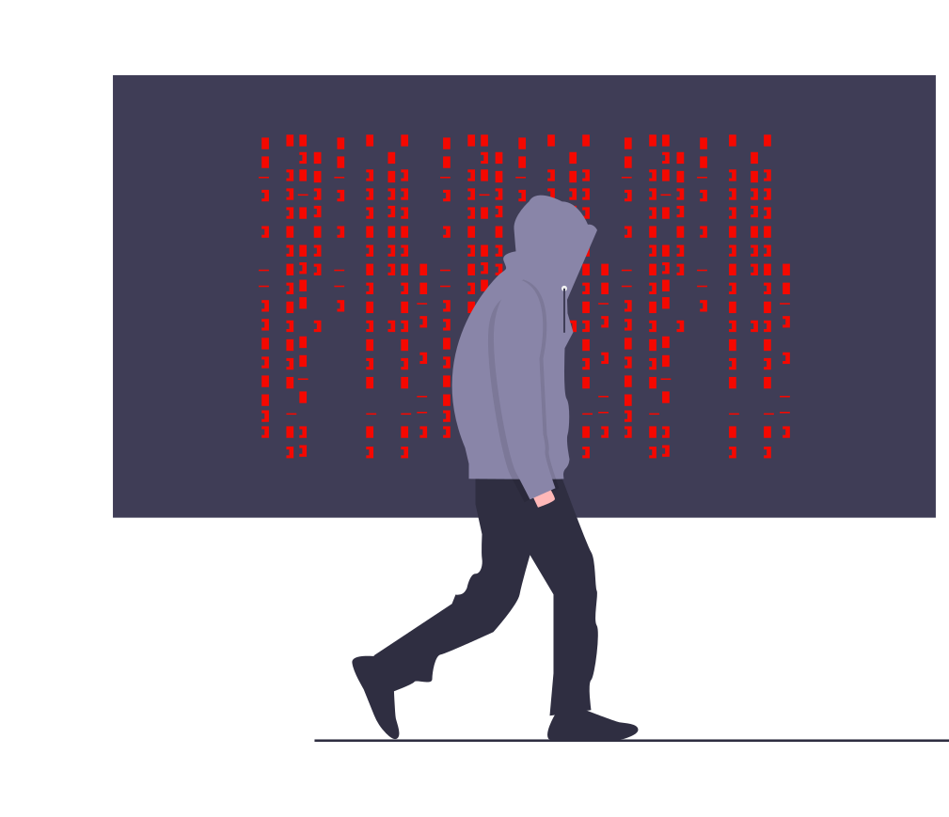
Google Cloud Associate Cloud Engineer
Accessibility with Cloud NAT
VPC Network
Region: us-west1
us-west1-a
us-east1-a
Cloud
NAT

Slide 178
Google Cloud Associate Cloud Engineer
Google Cloud Platform
Project
VPC Network
Region: us-west1
Region: us-east1
INTERNET
Subnet1 - PGA ON
Subnet2 - PGA OFF
Zone: us-west1-a
Zone: us-east1-a
Public IP
Public IP
VPC
ROUTING
INTERNET
GATEWAY
Google API and Services

Slide 179
Google Cloud Associate Cloud Engineer
Google Cloud Platform
Project
VPC Network
Region: us-west1
Region: us-east1
INTERNET
Subnet1 - PGA ON
Subnet2 - PGA OFF
Zone: us-west1-a
Zone: us-east1-a
Public IP
Public IP
VPC
ROUTING
INTERNET
GATEWAY
Google API and Services

Slide 180
Google Cloud Associate Cloud Engineer
Google Cloud Platform
Project
VPC Network
Region: us-west1
Region: us-east1
INTERNET
Subnet1 - PGA ON
Subnet2 - PGA OFF
Zone: us-west1-a
Zone: us-east1-a
Public IP
Public IP
VPC
ROUTING
INTERNET
GATEWAY
Google API and Services

Slide 181
Google Cloud Associate Cloud Engineer
Review:
We discussed some common network considerations and Private Google Access.

Slide 182
Google Cloud Associate Cloud Engineer
Up Next:
We’ll take into account some common pricing considerations for network traffic.

Slide 183
Google Cloud Associate Cloud Engineer
Price
Considerations

Slide 184
Google Cloud Associate Cloud Engineer
Depending on the type of traffic (ingress or egress) and the location of the instances, you may be charged differently for network usage.
Important Note:
The following information is subject to change, refer to the documentation!

Slide 185
Google Cloud Associate Cloud Engineer
Ingress traffic:
Traffic coming in to a Google Cloud resource, such as a VM.
If you send traffic between two VMs, then the traffic is counted as egress traffic as it leaves one VM and counted as ingress traffic as it arrives at the other VM.

Slide 186
Google Cloud Associate Cloud Engineer
Egress traffic:
Traffic leaving a Google Cloud resource, such as a VM, hosted in a Google region.
For egress purposes, a region is a set of buildings operated by Google in a geographic location, such as a data center campus.

Slide 187
Google Cloud Associate Cloud Engineer
Traffic type | Price
Egress to the same Google Cloud zone when using the internal IP addresses of the resources1 | No charge
Egress to a different Google Cloud zone in the same Google Cloud region when using the internal IP addresses (per GB) | $0.01
VM-to-VM egress when both VMs are in the same Google Cloud region, regardless of zone, when using the external IP addresses (per GB) | $0.01
VM-to-VM egress when both VMs are in different regions of the same network using internal or external IP addresses | Pricing depends on regions, check online documentation for full pricing details.

Slide 188
Google Cloud Associate Cloud Engineer
Type (for Iowa us-central1 Region) | Price/Hour (USD)
Static IP address (assigned but unused) | $0.010
Static and ephemeral IP addresses in use on standard VM instances | $0.004
Static and ephemeral IP addresses in use on preemptible VM instances | $0.002
Static and ephemeral IP addresses attached to forwarding rules, used by Cloud NAT, or used as a public IP for a Cloud VPN tunnel. | No charge

Slide 189
Google Cloud Associate Cloud Engineer
While we mentioned some key pricing considerations here, there are a lot more factors depending on the services being used.
Full Details:
cloud.google.com/vpc/network-pricing

Slide 190
Google Cloud Associate Cloud Engineer
Review:
We learned the difference between ingress and egress traffic for pricing and some example traffic pricing per GB.

