Slide 1

PIERIAN CLOUD

Slide 3

Google Cloud Associate Cloud Engineer
DEMO:
VPN Tunnel

Slide 4
Google Cloud Associate Cloud Engineer
Load Balancing and
Autoscaling

Slide 5
Google Cloud Associate Cloud Engineer
Section Overview:
Managed Instance Groups
HTTP(S) Load Balancing
SSL Proxy Load Balancing
TCP Proxy Load Balancing
Network Load Balancing
Internal Load Balancing
Choosing Load Balancing Options

Slide 6
Google Cloud Associate Cloud Engineer
Let’s get started!

Slide 7
Google Cloud Associate Cloud Engineer
Managed Instance Groups

Slide 8
Google Cloud Associate Cloud Engineer
Often you’ll want to create a group of identical VM Instances.
Fortunately, GCP provides managed instance groups that allows you to create multiple identical instances and manage them together as a single group.

Slide 9
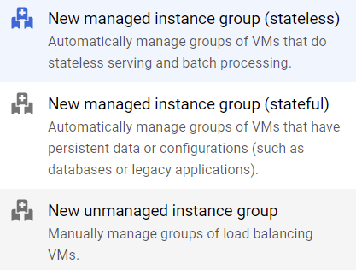
Google Cloud Associate Cloud Engineer
Be aware that there are different types of “instance groups”.
This lecture focuses on managed instance groups.

Slide 10
Google Cloud Associate Cloud Engineer
Managed instance groups (MIGs):
Let you operate apps on multiple identical VMs. You can make your workloads scalable and highly available by taking advantage of automated MIG services, including: autoscaling, autohealing, regional (multiple zone) deployment, and automatic updating.

Slide 11
Google Cloud Associate Cloud Engineer
Unmanaged instance groups:
Let you load balance across a fleet of VMs that you manage yourself.

Slide 12
Google Cloud Associate Cloud Engineer
Managed Instance Groups Use Cases:
Stateless serving workloads, such as a website frontend.
Stateless batch, high-performance, or high-throughput compute workloads, such as image processing from a queue.

Slide 13
Google Cloud Associate Cloud Engineer
Managed Instance Groups Use Cases:
Stateful applications, such as databases, legacy applications, and long-running batch computations with checkpointing.
Compared to stateless MIGs, stateful MIGs let you preserve disks.

Slide 14
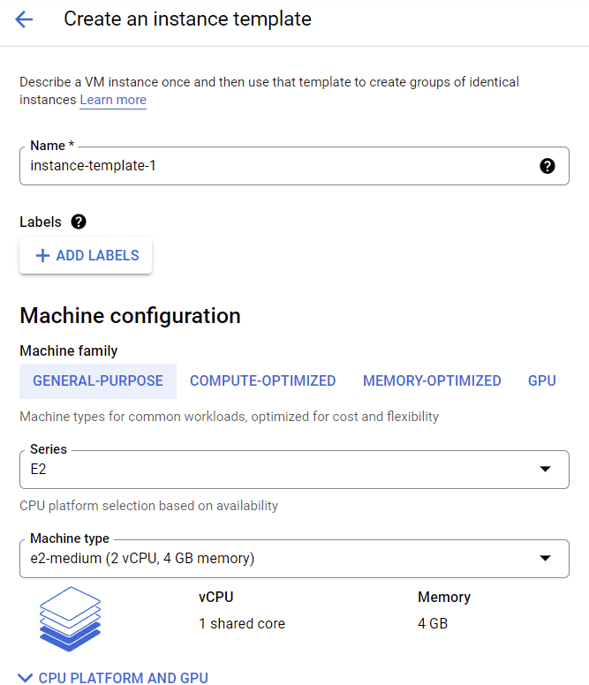
Google Cloud Associate Cloud Engineer
To use MIG we first create Instance Templates to be duplicated N times for the managed instance group.

Slide 15
Google Cloud Associate Cloud Engineer
Notice the template dialog is exactly the same as a normal VM instance creation process, it’s just recorded for future reference.

Slide 16
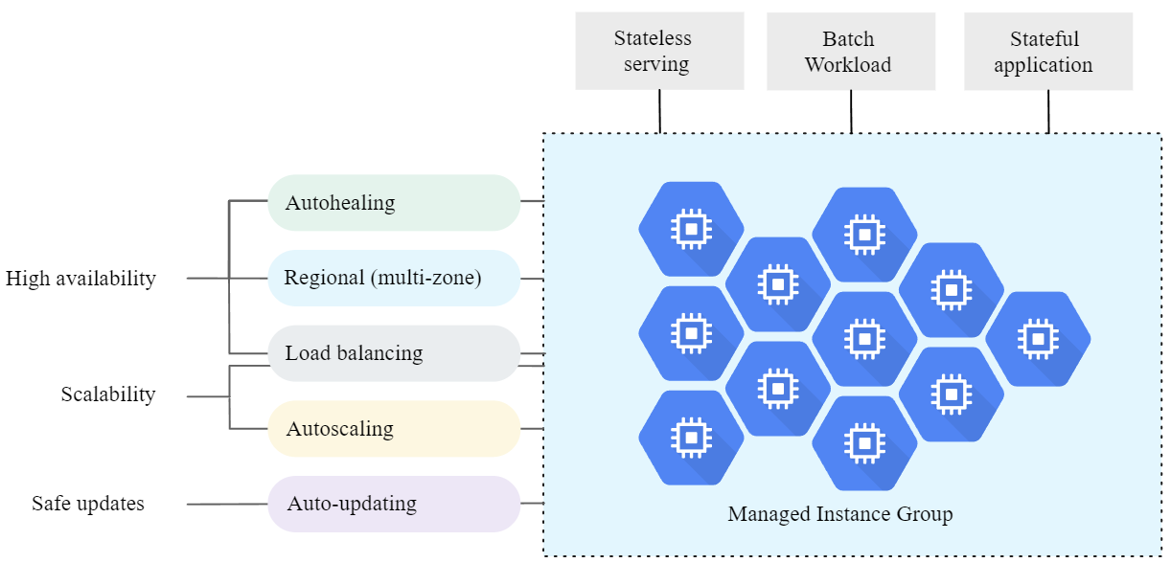
Google Cloud Associate Cloud Engineer
Managed Instance Groups:

Slide 17
Google Cloud Associate Cloud Engineer
Managed Instance Group Features:
High Availability Features
Continuous Run Time
Autohealing
Regional Coverage
Load Balancing

Slide 18
Google Cloud Associate Cloud Engineer
Managed Instance Group Features:
Scalability
Automated Updates
Stateful Support

Slide 19
Google Cloud Associate Cloud Engineer
Regional or Zonal Groups:
You can create two types of MIGs:
A zonal MIG, which deploys instances to a single zone.
A regional MIG, which deploys instances to multiple zones across the same region.

Slide 20
Google Cloud Associate Cloud Engineer
Autoscaling:
MIGs support autoscaling that dynamically adds or removes VM instances from the group in response to increases or decreases in load.

Slide 21
Google Cloud Associate Cloud Engineer
Autoscaling:
You can set one or more signals to scale the group based on:
CPU utilization
Load balancing capacity
Cloud Monitoring metrics
Time Schedules

Slide 22
Google Cloud Associate Cloud Engineer
Autohealing:
Managed instance groups maintain high availability of your applications by proactively keeping your instances available, which means in “RUNNING” state.

Slide 23
Google Cloud Associate Cloud Engineer
Autohealing:
A MIG automatically recreates an instance that is not “RUNNING”.
However, you may want to recreate instances when an application freezes, crashes, or runs out of memory.

Slide 24
Google Cloud Associate Cloud Engineer
Health Check:
MIGs allow you to use application based autohealing using a health check.
If a health check determines that an application has failed on a VM, the group automatically recreates that VM instance.

Slide 25
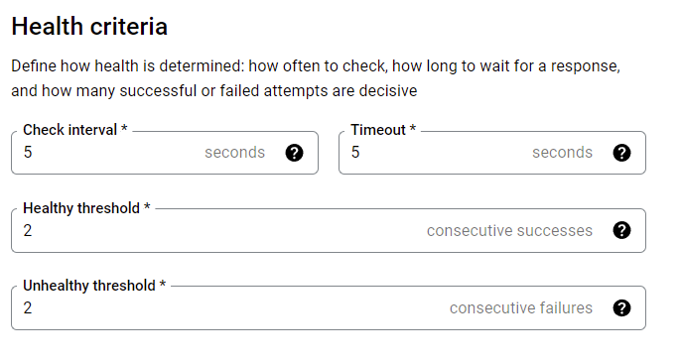
Google Cloud Associate Cloud Engineer
Health Check:

Slide 26
Google Cloud Associate Cloud Engineer
Autohealing:
Be careful not to confuse autohealing with autoscaling.
For the majority of scenarios, use separate health checks for load balancing and for autohealing.

Slide 27
Google Cloud Associate Cloud Engineer
Autohealing:
Health checking for load balancing can and should be more aggressive because these health checks determine whether an instance receives user traffic.

Slide 28
Google Cloud Associate Cloud Engineer
Automatic Updating:
You can easily and safely deploy new versions of software to instances in a MIG.

Slide 29
Google Cloud Associate Cloud Engineer
Automatic Updating:
The rollout of an update happens automatically based on your specifications: you can control the speed and scope of the update rollout in order to minimize disruptions to your application.

Slide 30
Google Cloud Associate Cloud Engineer
For more information on all the useful features provided by Managed Instance groups, check out the docs:
cloud.google.com/compute/docs/ instance-groups

Slide 31
Google Cloud Associate Cloud Engineer
Review:
We learned about Managed Instance Groups and their ability to perform autoscaling and autohealing with health checks.

Slide 32
Google Cloud Associate Cloud Engineer
Up Next:
We’ll begin to learn about Load Balancing.

Slide 33
Google Cloud Associate Cloud Engineer
HTTP(S) Load
Balancing

Slide 34
Google Cloud Associate Cloud Engineer
A load balancer distributes user traffic across multiple instances of your applications.
By spreading the load, load balancing reduces the risk that your applications experience performance issues.

Slide 35




Google Cloud Associate Cloud Engineer
Load Balancing:
Backends
User
Cloud Load
Balancing
Backends
User

Slide 36
Google Cloud Associate Cloud Engineer
Cloud Load Balancing is a fully distributed, software-defined managed service.
It isn't hardware-based, so you don't need to manage a physical load balancing infrastructure.

Slide 37
Google Cloud Associate Cloud Engineer
Cloud Load Balancing is built on the same frontend-serving infrastructure that powers Google.
It supports 1 million+ queries per second with consistent high performance and low latency.

Slide 38
Google Cloud Associate Cloud Engineer
Traffic enters Cloud Load Balancing through 80+ distinct global load balancing locations, optimizing the distance traveled on Google's fast private network backbone.

Slide 39
Google Cloud Associate Cloud Engineer
There are many different types of load balancers to choose from depending on the type of traffic.
For example is the traffic external or internal?
What protocol does the traffic use?
HTTP(S) , TCP, UDP, ESP, ICMP, etc…

Slide 40
Google Cloud Associate Cloud Engineer
The rest of this section focuses on the variety of load balancing options available based on the traffic type.
Let’s now discuss the HTTP(S) Load Balancer with GCP.

Slide 41
Google Cloud Associate Cloud Engineer
External HTTP(S) Load Balancing is a proxy-based Layer 7 load balancer that enables you to run and scale your services behind a single external IP address.

Slide 42
Google Cloud Associate Cloud Engineer
External HTTP(S) Load Balancing distributes HTTP and HTTPS traffic to backends hosted on a variety of Google Cloud platforms (such as Compute Engine, Google Kubernetes Engine (GKE), Cloud Storage, and so on), as well as external backends connected over the internet or via hybrid connectivity.

Slide 43
Google Cloud Associate Cloud Engineer
External HTTP(S) Load Balancing has several modes:
Global External HTTP(S) Load Balancer
Global External HTTP(S) Load Balancer (classic)
Regional external HTTP(S) Load Balancer

Slide 44
Google Cloud Associate Cloud Engineer
Global External HTTP(S) Load Balancer:
This is a global load balancer that is implemented as a managed service on Google Front Ends (GFEs).

Slide 45
Google Cloud Associate Cloud Engineer
Global External HTTP(S) Load Balancer:
It uses the open-source Envoy proxy to support advanced traffic management capabilities such as traffic mirroring, weight-based traffic splitting, request/response-based header transformations, and more.

Slide 46
Google Cloud Associate Cloud Engineer
Global External HTTP(S) Load Balancer:
At time of this filming, this service is technically in “preview”, thus there is also the “classic” version.
Fewer traffic routing figures.

Slide 47
Google Cloud Associate Cloud Engineer
Global External HTTP(S) Load Balancer (classic):
This is the classic external HTTP(S) load balancer that is global in Premium Tier but can be configured to be regional in Standard Tier.

Slide 48
Google Cloud Associate Cloud Engineer
Regional external HTTP(S) Load Balancer
This is a regional load balancer that is implemented as a managed service on the open-source Envoy proxy.

Slide 49
Google Cloud Associate Cloud Engineer
Regional external HTTP(S) Load Balancer
It includes advanced traffic management capabilities such as traffic mirroring, weight-based traffic splitting, request/response-based header transformations, and more.

Slide 50
Google Cloud Associate Cloud Engineer
Regional external HTTP(S) Load Balancer
Was technically still in “preview” at the time of this filming.

Slide 51
Google Cloud Associate Cloud Engineer
HTTP(S) Load Balancing:
Supports global load balancing, allowing for customers to access through a single anycast IP Address.
Anycast allows for multiple servers to share the same IP Address as a single interface.

Slide 52
Google Cloud Associate Cloud Engineer
HTTP(S) Load Balancing:
HTTP load balanced on Port 80 or 8080
HTTPS load balanced on Port 443

Slide 53
Google Cloud Associate Cloud Engineer
HTTP(S) Load Balancing:
Supports IPv4 and IPv6
Supports autoscaling

Slide 54
Google Cloud Associate Cloud Engineer
How does the HTTP(S) work in general?
Let’s go through the steps, starting with a request coming from the public internet to an external IP address.

Slide 55
Google Cloud Associate Cloud Engineer
HTTP(S) Load Balancer Step 1:
An external forwarding rule specifies an external IP address, port, and target HTTP(S) proxy. Clients use the IP address and port to connect to the load balancer.

Slide 56
Google Cloud Associate Cloud Engineer
HTTP(S) Load Balancer Step 2:
A target HTTP(S) proxy receives a request from the client. The HTTP(S) proxy evaluates the request by using the URL map to make traffic routing decisions.

Slide 57
Google Cloud Associate Cloud Engineer
HTTP(S) Load Balancer Step 3:
The HTTP(S) proxy uses a URL map to make a routing determination based on HTTP attributes (such as the request path, cookies, or headers).

Slide 58
Google Cloud Associate Cloud Engineer
HTTP(S) Load Balancer Step 3:
Based on the routing decision, the proxy forwards client requests to specific backend services or backend buckets.

Slide 59
Google Cloud Associate Cloud Engineer
HTTP(S) Load Balancer Step 4:
A backend service distributes requests to healthy backends.
The global external HTTP(S) load balancers also support backend buckets.

Slide 60
Google Cloud Associate Cloud Engineer
HTTP(S) Load Balancer Step 5:
The request is send to the appropriate backend to avoid overloading any instance group.

Slide 61
Google Cloud Associate Cloud Engineer
HTTP(S) Load Balancer:
A health check periodically monitors the readiness of your backends.
Firewall rules for your backends to accept health check probes.

Slide 62
Google Cloud Associate Cloud Engineer
HTTP(S) Load Balancer Architecture
Load Balancer
Internet
Forwarding Rules
Target
Proxy
Forwarding Rules
Backend
Service
SSL Certificate

Slide 63
Google Cloud Associate Cloud Engineer
HTTP(S) Load Balancer Architecture
Load Balancer
Internet
Forwarding Rules
Target
Proxy
Forwarding Rules
Backend
Service
SSL Certificate
Firewall Rules

Slide 64
Google Cloud Associate Cloud Engineer
Backend Services:
Health check is performed to check if the backend is allowed to receive requests.
If health check is not passed, requests are not sent until health check is passed.

Slide 65
Google Cloud Associate Cloud Engineer
Backend Services:
Optional session affinity is allowed to attempt to send all requests from the same client to the same backend instance.
For example, all US based clients always get sent to a US based MIG.

Slide 66
Google Cloud Associate Cloud Engineer
Backend Services:
Time out settings turned on by default.
Balancing Mode can be based on:
CPU Utilization
Requests per Second
Built-in capacity based scaling (scale after CPU % reached).

Slide 67
Google Cloud Associate Cloud Engineer
For the latest information about HTTP(S) check out the official docs:
cloud.google.com/load-balancing/ docs/https

Slide 68
Google Cloud Associate Cloud Engineer
What specifically changes from HTTP load balancing to HTTPS load balancing?

Slide 69
Google Cloud Associate Cloud Engineer
HTTPS Load Balancing:
Target HTTPS Proxy.
Minimum of one signed SSL certificate.
Client SSL Session terminates at the load balancer.
Supports QUIC transport layer protocol.

Slide 70
Google Cloud Associate Cloud Engineer
HTTPS Load Balancing:
SSL Certificates are required for HTTPS
Up to 10 SSL Certificates allowed per target proxy.
Each SSL certificate requires an SSL certificate resource.

Slide 71
Google Cloud Associate Cloud Engineer
Review:
We explored HTTP(S) Load Balancing on GCP.

Slide 72
Google Cloud Associate Cloud Engineer
Up Next:
We’ll continue to discover other load balancer options based on traffic types.

Slide 73
Google Cloud Associate Cloud Engineer
DEMO:
Load Balancing

Slide 74
Google Cloud Associate Cloud Engineer
Let’s go through a demo to explore how load balancing works.
We’ll be using a health check to decide when to begin rerouting traffic to balance an incoming load to our VMs.

Slide 75
Google Cloud Associate Cloud Engineer
Demo Steps:
Create a health check firewall rule
Create a NAT Configuration
Create a custom image
Create an instance template
Configure HTTP Load Balancer
Perform a Load Test

Slide 76
Google Cloud Associate Cloud Engineer
Internal
HTTP(S) Load Balancing

Slide 77
Google Cloud Associate Cloud Engineer
We previously discussed external HTTP(S) load balancing, for external public traffic reaching a single external IP address and then being redirected to the appropriate backend.
GCP also offers internal HTTP(S) load balancing for internal HTTP(S) traffic.

Slide 78
Google Cloud Associate Cloud Engineer
Internal HTTP(S) Load Balancing distributes HTTP and HTTPS traffic to backends hosted on Compute Engine and Google Kubernetes Engine (GKE).
The load balancer is accessible only in the chosen region of your Virtual Private Cloud (VPC) network on an internal IP address.

Slide 79
Google Cloud Associate Cloud Engineer
Internal HTTP(S) Load Balancing is a managed service based on the open source Envoy proxy.
After the load balancer has been configured, it automatically allocates Envoy proxies to meet your traffic needs.

Slide 80
Google Cloud Associate Cloud Engineer
Internal HTTP(S) Load Balancing:
Consists of an internal IP address to which clients send traffic. Only clients that are located in the same region as the load balancer can access this IP address. Internal client requests stay internal to your network and region.

Slide 81
Google Cloud Associate Cloud Engineer
Internal HTTP(S) Load Balancing:
Consists of one or more backend services to which the load balancer forwards traffic. Backends can be Compute Engine VMs, Managed Instance Groups, or GKE nodes. These backends must be located in the same region as the load balancer.

Slide 82
Google Cloud Associate Cloud Engineer
Internal HTTP(S) Load Balancing:
GCP

Slide 83
Google Cloud Associate Cloud Engineer
Internal HTTP(S) Load Balancing:
GCP
Region

Slide 84
Google Cloud Associate Cloud Engineer
Internal HTTP(S) Load Balancing:
GCP
Region
Zone 1
Zone 2
Internal
Client
Internal
Client
Service A Instance
Service B Instance

Slide 85
Google Cloud Associate Cloud Engineer
Internal HTTP(S) Load Balancing:
GCP
Region
Load
Balancer
Zone 1
Zone 2
Internal
Client
Internal
Client
Service A Instance
Service A Instance

Slide 86
Google Cloud Associate Cloud Engineer
Internal HTTP(S) Load Balancing:
GCP
Region
Load
Balancer
Zone 1
Zone 2
Internal
Client
Internal
Client
Service A Instance
Service A Instance

Slide 87
Google Cloud Associate Cloud Engineer
Internal HTTP(S) Load Balancing:
GCP
Region
Load
Balancer
Zone 1
Zone 2
Internal
Client
Internal
Client
Service A Instance
Service A Instance

Slide 88
Google Cloud Associate Cloud Engineer
Review:
We briefly discussed GCP’s Internal Load Balancing options for HTTP(S) traffic.

Slide 89
Google Cloud Associate Cloud Engineer
Up Next:
We’ll continue to discover other load balancer options based on traffic types.

Slide 90
Google Cloud Associate Cloud Engineer
SSL Proxy
Load Balancing

Slide 91
Google Cloud Associate Cloud Engineer
SSL Proxy Load Balancing is a reverse proxy load balancer that distributes SSL traffic coming from the internet to virtual machine (VM) instances in your Google Cloud VPC network.

Slide 92
Google Cloud Associate Cloud Engineer
When using SSL Proxy Load Balancing for your SSL traffic, user SSL (TLS) connections are terminated at the load balancing layer, and then proxied to the closest available backend instances by using either SSL (recommended) or TCP.

Slide 93
Google Cloud Associate Cloud Engineer
With the Premium Tier, SSL Proxy Load Balancing can be configured as a global load balancing service.
With Standard Tier, the SSL proxy load balancer handles load balancing regionally.

Slide 94
Google Cloud Associate Cloud Engineer
Let’s see a diagram example of an SSL Proxy Load Balancer.

Slide 95
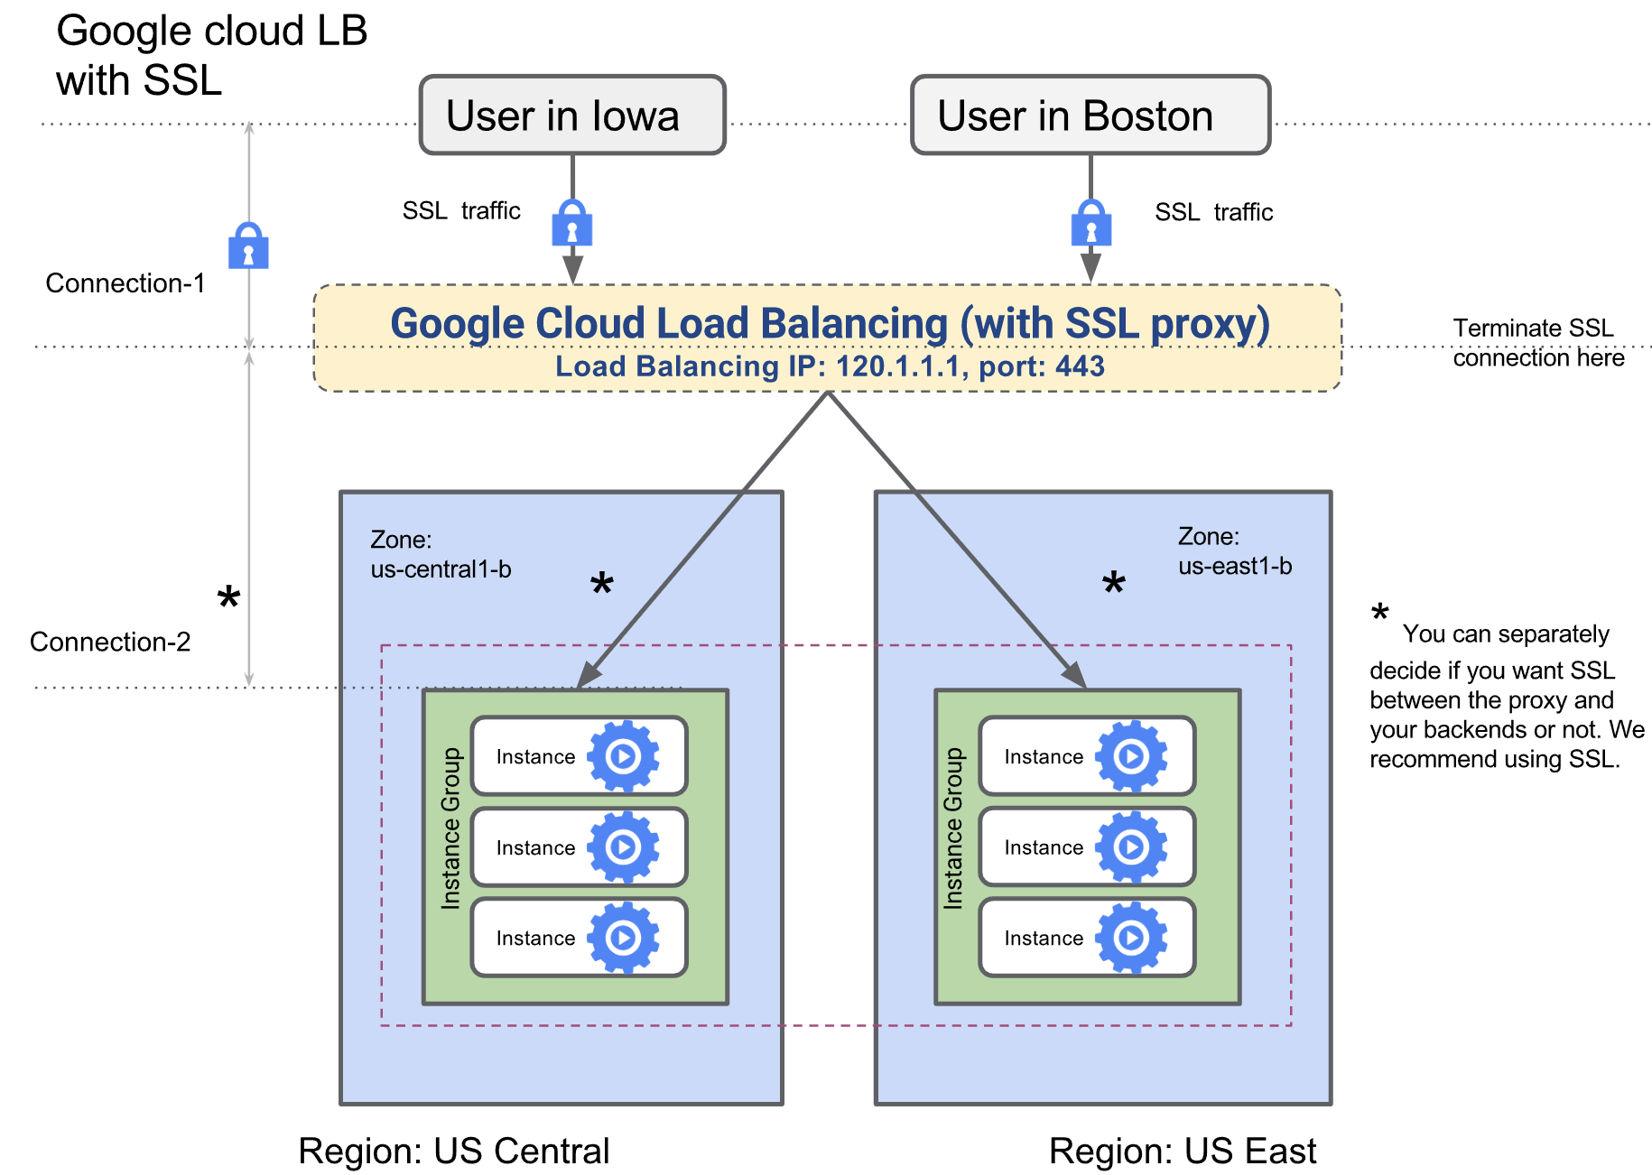
Google Cloud Associate Cloud Engineer

Slide 96
Google Cloud Associate Cloud Engineer
SSL Proxy Load Balancing Features:
IPv6 termination:
SSL Proxy Load Balancing supports both IPv4 and IPv6 addresses for client traffic. Client IPv6 requests are terminated at the load balancing layer, and then proxied over IPv4 to your VMs.

Slide 97
Google Cloud Associate Cloud Engineer
SSL Proxy Load Balancing Features:
Intelligent Routing:
The load balancer can route requests to backend locations where there is capacity. In contrast, an L3/L4 load balancer must route to regional backends without considering capacity.

Slide 98
Google Cloud Associate Cloud Engineer
SSL Proxy Load Balancing Features:
Better utilization of backends:
SSL processing can be very CPU-intensive if the ciphers used are not CPU efficient.

Slide 99
Google Cloud Associate Cloud Engineer
SSL Proxy Load Balancing Features:
Certificate Management:
Your customer-facing SSL certificates can be either certificates that you obtain and manage or certificates that Google obtains and manages for you.
Google-managed SSL certificates each support up to 100 domains.

Slide 100
Google Cloud Associate Cloud Engineer
SSL Proxy Load Balancing Features:
Security Patching:
If vulnerabilities arise in the SSL or TCP stack, Google will apply patches at the load balancer automatically to keep your VMs safe.

Slide 101
Google Cloud Associate Cloud Engineer
Review:
We learned about SSL Proxy Load Balancing.

Slide 102
Google Cloud Associate Cloud Engineer
Up Next:
We’ll learn about TCP Proxy Load Balancing.

Slide 103
Google Cloud Associate Cloud Engineer
TCP Proxy Load Balancing

Slide 104
Google Cloud Associate Cloud Engineer
TCP Proxy Load Balancing is a reverse proxy load balancer that distributes TCP traffic coming from the internet to virtual machine (VM) instances in your Google Cloud VPC network.

Slide 105
Google Cloud Associate Cloud Engineer
When using TCP Proxy Load Balancing, traffic coming over a TCP connection is terminated at the load balancing layer, and then forwarded to the closest available backend using TCP or SSL.

Slide 106
Google Cloud Associate Cloud Engineer
TCP Proxy Load Balancing lets you use a single IP address for all users worldwide. The TCP proxy load balancer automatically routes traffic to the backends that are closest to the user.

Slide 107
Google Cloud Associate Cloud Engineer
With Premium Tier, TCP Proxy Load Balancing can be configured as a global load balancing service.
With Standard Tier, the TCP proxy load balancer handles load balancing regionally.

Slide 108
Google Cloud Associate Cloud Engineer
TCP Proxy Load Balancing Features:
IPv6 termination
Intelligent Routing
Security Patching
Support for well-known TCP Ports

Slide 109
Google Cloud Associate Cloud Engineer
Let’s explore an example of TCP Proxy Load Balancing.

Slide 110
Google Cloud Associate Cloud Engineer
US Region
TCP connection 1b
Instance Group
TCP connection 1a
Instance
NYC User
Instance
TCP Proxy Load Balancer
TCP connection 2a
EU Region
Instance Group
Paris User
Instance
TCP connection 2b
Instance

Slide 111
Google Cloud Associate Cloud Engineer
Review:
We learned about TCP Proxy Load Balancing.

Slide 112
Google Cloud Associate Cloud Engineer
Up Next:
We’ll discuss network load balancing.

Slide 113
Google Cloud Associate Cloud Engineer
External TCP/UDP Network Load
Balancing

Slide 114
Google Cloud Associate Cloud Engineer
Note, since its most commonly used with TCP or UDP, you often see it referred to as External TCP/UDP Network Load Balancing although you will later see this shortened to just Network Load Balancing.

Slide 115
Google Cloud Associate Cloud Engineer
A Network Load Balancer balances traffic originating from the internet.
Network Load Balancing is a regional, non-proxied load balancing service.
This means it can only balance for instances within the same region (non-global).

Slide 116
Google Cloud Associate Cloud Engineer
Network Load Balancing supports the following traffic types:
TCP
UDP
EDP
ICMP

Slide 117
Google Cloud Associate Cloud Engineer
A network load balancer can receive traffic from:
Any client on the internet
Google Cloud VMs with external IPs
Google Cloud VMs that have internet access through Cloud NAT or instance-based NAT

Slide 118
Google Cloud Associate Cloud Engineer
Network Load Balancing is a managed service.
Network Load Balancing is implemented by using Andromeda virtual networking and Google Maglev.

Slide 119
Google Cloud Associate Cloud Engineer
Network load balancers are not proxies.
Load-balanced packets are received by backend VMs with the packet's source and destination IP addresses, protocol, and, if the protocol is port-based, the source and destination ports unchanged.

Slide 120
Google Cloud Associate Cloud Engineer
Network load balancers are not proxies.
Load-balanced connections are terminated by the backend VMs.

Slide 121
Google Cloud Associate Cloud Engineer
Network load balancers are not proxies.
Responses from the backend VMs go directly to the clients, not back through the load balancer.
The industry term for this is direct server return.

Slide 122
Google Cloud Associate Cloud Engineer
Let’s review the network load balancer architecture…

Slide 123
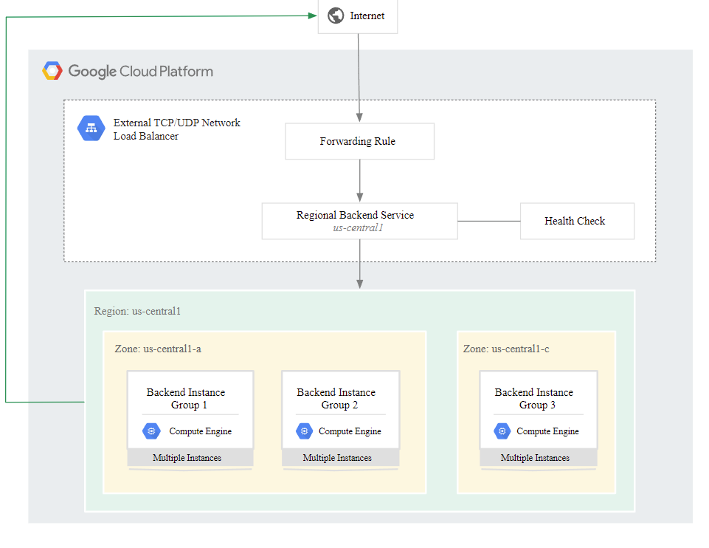
Google Cloud Associate Cloud Engineer
Direct Server
Return (DSR)

Slide 124
Google Cloud Associate Cloud Engineer
Let’s see a diagram example of the network load balancer usage.

Slide 125
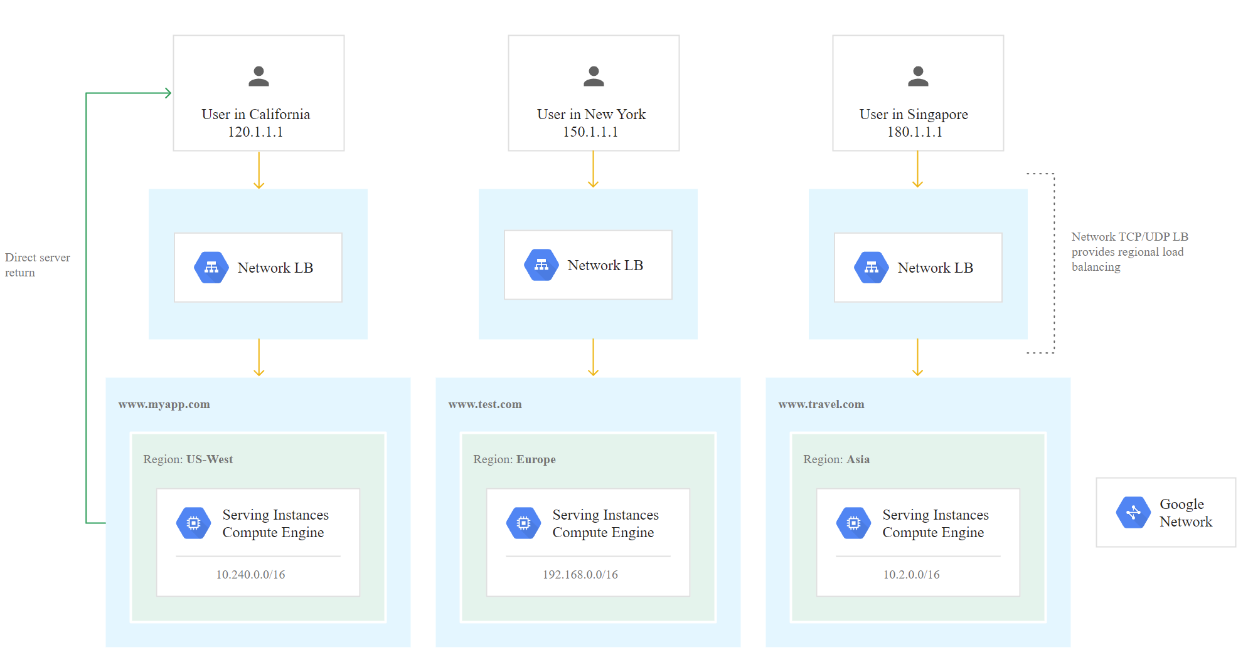
Google Cloud Associate Cloud Engineer

Slide 126
Google Cloud Associate Cloud Engineer
Network Load Balancing Use Cases:
You need to load balance non-TCP traffic, or you need to load balance a TCP port that isn't supported by other load balancers.

Slide 127
Google Cloud Associate Cloud Engineer
Network Load Balancing Use Cases:
It is acceptable to have SSL traffic decrypted by your backends instead of by the load balancer. The network load balancer cannot perform this task. When the backends decrypt SSL traffic, there is a greater CPU burden on the VMs.

Slide 128
Google Cloud Associate Cloud Engineer
Network Load Balancing Use Cases:
Self-managing the backend VM's SSL certificates is acceptable to you. Google-managed SSL certificates are only available for HTTP(S) Load Balancing and SSL Proxy Load Balancing.

Slide 129
Google Cloud Associate Cloud Engineer
Network Load Balancing Use Cases:
You need to forward the original packets unproxied. For example, if you need the client source IP to be preserved.

Slide 130
Google Cloud Associate Cloud Engineer
Network Load Balancing Use Cases:
You have an existing setup that uses a pass-through load balancer, and you want to migrate it without changes.

Slide 131
Google Cloud Associate Cloud Engineer
Review:
We discussed network load balancing.

Slide 132
Google Cloud Associate Cloud Engineer
Up Next:
We’ll review how to choose a load balancer.

Slide 133
Google Cloud Associate Cloud Engineer
Load Balancing
Options

Slide 134
Google Cloud Associate Cloud Engineer
Clearly we’ve covered lots of load balancer options.
Now let’s discuss how to choose a load balancer.

Slide 135
Google Cloud Associate Cloud Engineer
Feature Considerations:
External vs. Internal Load Balancing
Global vs. Regional Load Balancing
Premium vs. Standard Network Tiers
Proxy versus pass-through Load Balancing
Traffic Type and DDoS Protections

Slide 136
Google Cloud Associate Cloud Engineer
Internal or external IP address | Regional or global | Premium or Standard network tier | Proxy or pass-through | Traffic type | Load balancer type
Internal | Regional | Premium only | Pass-through | TCP or UDP | Internal TCP/UDP load balancer
 |  |  | Proxy | HTTP or HTTPS | Internal HTTP(S) load balancer
External | Global | Premium only | Proxy | HTTP or HTTPS | Global external HTTP(S) load balancer (Preview)
 | Global in Premium Tier Effectively regional in Standard Tier | Premium or Standard | Proxy | HTTP or HTTPS | Global external HTTP(S) load balancer (classic)
 |  |  |  | SSL | SSL proxy load balancer
 |  |  |  | TCP | TCP proxy load balancer
 | Regional | Premium or Standard | Pass-through | TCP, UDP, ESP, or ICMP | External TCP/UDP Network load balancer
 |  | Standard only | Proxy | HTTP or HTTPS | Regional external HTTP(S) load balancer (Preview)

Slide 137
Google Cloud Associate Cloud Engineer
Internal or external IP address | Regional or global | Premium or Standard network tier | Proxy or pass-through | Traffic type | Load balancer type
Internal | Regional | Premium only | Pass-through | TCP or UDP | Internal TCP/UDP load balancer
 |  |  | Proxy | HTTP or HTTPS | Internal HTTP(S) load balancer
External | Global | Premium only | Proxy | HTTP or HTTPS | Global external HTTP(S) load balancer (Preview)
 | Global in Premium Tier Effectively regional in Standard Tier | Premium or Standard | Proxy | HTTP or HTTPS | Global external HTTP(S) load balancer (classic)
 |  |  |  | SSL | SSL proxy load balancer
 |  |  |  | TCP | TCP proxy load balancer
 | Regional | Premium or Standard | Pass-through | TCP, UDP, ESP, or ICMP | External TCP/UDP Network load balancer
 |  | Standard only | Proxy | HTTP or HTTPS | Regional external HTTP(S) load balancer (Preview)

Slide 138
Google Cloud Associate Cloud Engineer
Internal or external IP address | Regional or global | Premium or Standard network tier | Proxy or pass-through | Traffic type | Load balancer type
Internal | Regional | Premium only | Pass-through | TCP or UDP | Internal TCP/UDP load balancer
 |  |  | Proxy | HTTP or HTTPS | Internal HTTP(S) load balancer
External | Global | Premium only | Proxy | HTTP or HTTPS | Global external HTTP(S) load balancer (Preview)
 | Global in Premium Tier Effectively regional in Standard Tier | Premium or Standard | Proxy | HTTP or HTTPS | Global external HTTP(S) load balancer (classic)
 |  |  |  | SSL | SSL proxy load balancer
 |  |  |  | TCP | TCP proxy load balancer
 | Regional | Premium or Standard | Pass-through | TCP, UDP, ESP, or ICMP | External TCP/UDP Network load balancer
 |  | Standard only | Proxy | HTTP or HTTPS | Regional external HTTP(S) load balancer (Preview)

Slide 139
Google Cloud Associate Cloud Engineer
Internal or external IP address | Regional or global | Premium or Standard network tier | Proxy or pass-through | Traffic type | Load balancer type
Internal | Regional | Premium only | Pass-through | TCP or UDP | Internal TCP/UDP load balancer
 |  |  | Proxy | HTTP or HTTPS | Internal HTTP(S) load balancer
External | Global | Premium only | Proxy | HTTP or HTTPS | Global external HTTP(S) load balancer (Preview)
 | Global in Premium Tier Effectively regional in Standard Tier | Premium or Standard | Proxy | HTTP or HTTPS | Global external HTTP(S) load balancer (classic)
 |  |  |  | SSL | SSL proxy load balancer
 |  |  |  | TCP | TCP proxy load balancer
 | Regional | Premium or Standard | Pass-through | TCP, UDP, ESP, or ICMP | External TCP/UDP Network load balancer
 |  | Standard only | Proxy | HTTP or HTTPS | Regional external HTTP(S) load balancer (Preview)

Slide 140
Google Cloud Associate Cloud Engineer
Internal or external IP address | Regional or global | Premium or Standard network tier | Proxy or pass-through | Traffic type | Load balancer type
Internal | Regional | Premium only | Pass-through | TCP or UDP | Internal TCP/UDP load balancer
 |  |  | Proxy | HTTP or HTTPS | Internal HTTP(S) load balancer
External | Global | Premium only | Proxy | HTTP or HTTPS | Global external HTTP(S) load balancer (Preview)
 | Global in Premium Tier Effectively regional in Standard Tier | Premium or Standard | Proxy | HTTP or HTTPS | Global external HTTP(S) load balancer (classic)
 |  |  |  | SSL | SSL proxy load balancer
 |  |  |  | TCP | TCP proxy load balancer
 | Regional | Premium or Standard | Pass-through | TCP, UDP, ESP, or ICMP | External TCP/UDP Network load balancer
 |  | Standard only | Proxy | HTTP or HTTPS | Regional external HTTP(S) load balancer (Preview)

Slide 141
Google Cloud Associate Cloud Engineer
Internal or external IP address | Regional or global | Premium or Standard network tier | Proxy or pass-through | Traffic type | Load balancer type
Internal | Regional | Premium only | Pass-through | TCP or UDP | Internal TCP/UDP load balancer
 |  |  | Proxy | HTTP or HTTPS | Internal HTTP(S) load balancer
External | Global | Premium only | Proxy | HTTP or HTTPS | Global external HTTP(S) load balancer (Preview)
 | Global in Premium Tier Effectively regional in Standard Tier | Premium or Standard | Proxy | HTTP or HTTPS | Global external HTTP(S) load balancer (classic)
 |  |  |  | SSL | SSL proxy load balancer
 |  |  |  | TCP | TCP proxy load balancer
 | Regional | Premium or Standard | Pass-through | TCP, UDP, ESP, or ICMP | External TCP/UDP Network load balancer
 |  | Standard only | Proxy | HTTP or HTTPS | Regional external HTTP(S) load balancer (Preview)

Slide 142
Google Cloud Associate Cloud Engineer
Let’s review a decision tree format to choose a Load Balancer.

Slide 143
Google Cloud Associate Cloud Engineer
Internal or External
Load Balancing?

Slide 144
Google Cloud Associate Cloud Engineer
Internal
Load Balancing
TCP Traffic
UDP Traffic
HTTP(S) Traffic

Slide 145
Google Cloud Associate Cloud Engineer
Internal
Load Balancing
TCP Traffic
UDP Traffic
HTTP(S) Traffic
Internal TCP/UDP
Load Balancing
Internal HTTP(S)
Load Balancing

Slide 146
Google Cloud Associate Cloud Engineer
External Load Balancer
IPv4 and IPv6

Slide 147
Google Cloud Associate Cloud Engineer
External Load Balancer
IPv4 and IPv6
HTTP(S) Traffic
TCP Traffic
UDP Traffic
ESP or ICMP Traffic

Slide 148
Google Cloud Associate Cloud Engineer
External Load Balancer
IPv4 and IPv6
HTTP(S) Traffic
TCP Traffic
UDP Traffic
ESP or ICMP Traffic
Regional?
Regional External HTTP(S) Load Balancer
Global External HTTP(S) Load Balancer

Slide 149
Google Cloud Associate Cloud Engineer
External Load Balancer
IPv4 and IPv6
HTTP(S) Traffic
TCP Traffic
UDP Traffic
ESP or ICMP Traffic
Regional?
SSL Offload?
Regional External HTTP(S) Load Balancer
Global External HTTP(S) Load Balancer
SSL Proxy
Load Balancer

Slide 150
Google Cloud Associate Cloud Engineer
External Load Balancer
IPv4 and IPv6
HTTP(S) Traffic
TCP Traffic
UDP Traffic
ESP or ICMP Traffic
Regional?
SSL Offload?
Global LB or IPv6?
Regional External HTTP(S) Load Balancer
Global External HTTP(S) Load Balancer
SSL Proxy
Load Balancer
TCP Proxy
Load Balancer

Slide 151
Google Cloud Associate Cloud Engineer
External Load Balancer
IPv4 and IPv6
HTTP(S) Traffic
TCP Traffic
UDP Traffic
ESP or ICMP Traffic
Regional?
SSL Offload?
Global LB or IPv6?
Preserve Client IPs?
Regional External HTTP(S) Load Balancer
Global External HTTP(S) Load Balancer
SSL Proxy
Load Balancer
TCP Proxy
Load Balancer
External Network
Load Balancer

Slide 152
Google Cloud Associate Cloud Engineer
External Load Balancer
IPv4 and IPv6
HTTP(S) Traffic
TCP Traffic
UDP Traffic
ESP or ICMP Traffic
Regional?
SSL Offload?
Global LB or IPv6?
Preserve Client IPs?
Regional External HTTP(S) Load Balancer
Global External HTTP(S) Load Balancer
SSL Proxy
Load Balancer
TCP Proxy
Load Balancer
External Network
Load Balancer

Slide 153
Google Cloud Associate Cloud Engineer
Review:
We discussed how to choose a Load Balancer.

