Slide 1

PIERIAN CLOUD

Slide 3

Google Cloud Associate Cloud Engineer
Kubernetes

Slide 4
Google Cloud Associate Cloud Engineer
Section Overview:
Kubernetes Basic Concepts Lectures:
Kubernetes Basic Overview
Understanding Containers
Understanding Nodes and Control Plane
Understanding Kubernetes API

Slide 5
Google Cloud Associate Cloud Engineer
Section Overview:
Practical Kubernetes:
Container Images
DEMO: Cloud Build
Google Kubernetes Engine
Kubernetes Object Management
DEMO: Google Kubernetes

Slide 6
Google Cloud Associate Cloud Engineer
Let’s get started!

Slide 7
Google Cloud Associate Cloud Engineer
Kubernetes
Basic Overview

Slide 8
Google Cloud Associate Cloud Engineer
Let’s start with a formal definition of Kubernetes and then break it down into some key ideas and concepts.

Slide 9
Google Cloud Associate Cloud Engineer
Kubernetes:
A portable, extensible, open-source platform for managing containerized workloads and services, that facilitates both declarative configuration and automation allowing users to run resilient distributed systems at scale.

Slide 10
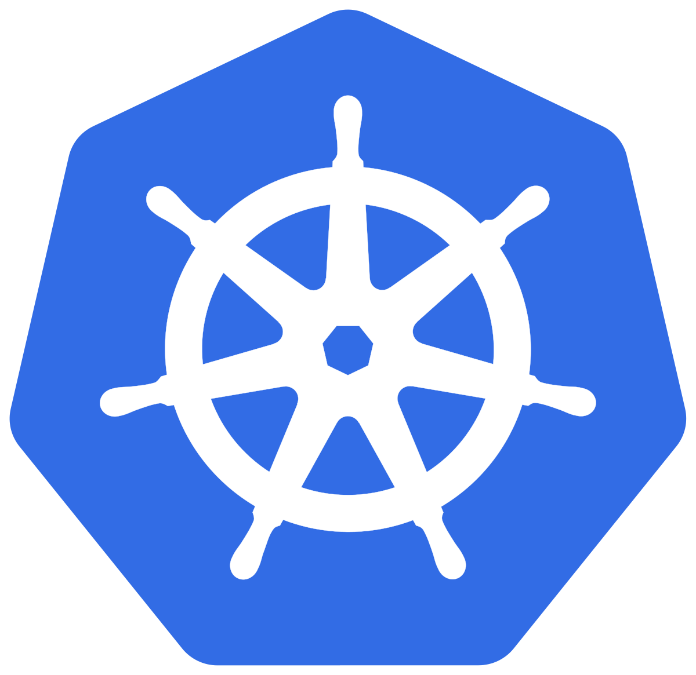
Google Cloud Associate Cloud Engineer
Kubernetes:
Google originally designed Kubernetes, but the Cloud Native Computing Foundation now maintains the project.
Kubernetes 1.0 was released in 2015

Slide 11
Google Cloud Associate Cloud Engineer
Kubernetes:
Put simply, it’s a container orchestrator making sure containers are running as they should in the correct location and can communicate with each other.

Slide 12
Google Cloud Associate Cloud Engineer
Before we dive into Kubernetes components and key ideas, let’s take a step back and understand the motivation behind creating Kubernetes.

Slide 13
Google Cloud Associate Cloud Engineer
Many applications take the structure of “monoliths” where the variety of functional components are all integrated into a single deployable artifact.

Slide 14
Google Cloud Associate Cloud Engineer
Monoliths are common but can run into issues at scale.
main()
module
module
module
Database
File System

Slide 15
Google Cloud Associate Cloud Engineer
Deployments can be slow since the entire monolith as to be rolled out all together.
main()
module
module
module
Database
File System

Slide 16
Google Cloud Associate Cloud Engineer
Different functionalities can be developed by different teams, adding complexity to rollouts of new versions.
main()
module
module
module
Database
File System

Slide 17
Google Cloud Associate Cloud Engineer
Scaling means resources need to scale for the entire monolith, regardless of what module has increased load.
main()
main()
module
module
module
module
module
module
Database
File System

Slide 18
Google Cloud Associate Cloud Engineer
A solution to monoliths is the concept of microservices.
Each piece of functionality lives as its own individually deployable artifact, meaning only a particular microservice needs to be updated rather than the entire monolith.

Slide 19
Google Cloud Associate Cloud Engineer
Microservices then communicate with each other as separate components which make up the larger application.
Service A
Service B
Service C
Service D
Database
File System

Slide 20
Google Cloud Associate Cloud Engineer
Individual microservices can then be added or replaced easily.
Service A
Service B
Service C
Service D
Database
File System

Slide 21
Google Cloud Associate Cloud Engineer
Scaling can then happen at a microservice level depending on the demand on certain functionalities.
Service A
Service B
Service C
Service B
Service B
Service D
Database
File System

Slide 22
Google Cloud Associate Cloud Engineer
While microservices can solve many of the issues of a monolith, it would be too resource intensive to run a VM instance for every single individual microservice.
This issue can be solved through containerized applications.

Slide 23
Google Cloud Associate Cloud Engineer
Containers allow for an even higher level of abstraction, with multiple microservices or applications connected to the same VM Instance and the same host operating system.

Slide 24
Google Cloud Associate Cloud Engineer
App A
App B
App C

Slide 25
Google Cloud Associate Cloud Engineer
App A
App B
App C
Containerized Applications

Slide 26
Google Cloud Associate Cloud Engineer
App A
App B
App C
Docker
Host Operating System
Infrastructure

Slide 27
Google Cloud Associate Cloud Engineer
App A
App B
App C
Docker
Host Operating System
Infrastructure

Slide 28
Google Cloud Associate Cloud Engineer
App A
App B
Ver 2.0
App C
Docker
Host Operating System
Infrastructure

Slide 29
Google Cloud Associate Cloud Engineer
There are still issues to be solved, such as not having downtime when containerized applications are replaced or updated.
Also how do we allow these containerized microservice applications to communicate with each other?

Slide 30
Google Cloud Associate Cloud Engineer
Kubernetes was created to help solve these issues and manage these containers on virtual machines.

Slide 31
Google Cloud Associate Cloud Engineer
Kubernetes API
Node
Node
Node
POD 1
POD 2
POD 4
POD 3

Slide 32
Google Cloud Associate Cloud Engineer
Review:
We learned about microservices, containers, and the motivations behind Kubernetes.

Slide 33
Google Cloud Associate Cloud Engineer
Up Next:
We’ll take a deeper dive into understanding containers and how they operate using Kubernetes.

Slide 34
Google Cloud Associate Cloud Engineer
Understanding Containers

Slide 35
Google Cloud Associate Cloud Engineer
We previously learned that Kubernetes was a container orchestrator and we also saw that containers were used to package up services.
Containers allow us to deploy smaller services with isolation and consistency.

Slide 36
Google Cloud Associate Cloud Engineer
Containers are based on two key concepts from the Linux Kernel:
Namespaces
Control what a process can see.
Cgroups
Control what a process can use.

Slide 37
Google Cloud Associate Cloud Engineer
Namespaces:
PID
Mount
Network
UTS
User
Cgroup

Slide 38
Google Cloud Associate Cloud Engineer
Cgroups:
Memory
CPU
Blkio
Cpuacct
Cpuset
Devices
Net_prio
Freezer

Slide 39
Google Cloud Associate Cloud Engineer
You may be thinking:
“This virtual separation of components sounds a lot like Virtual Machines, so what’s the difference between VMs and Containers?”

Slide 40
Google Cloud Associate Cloud Engineer
Virtual Machines
Application Code
Dependencies
Kernel
Hardware + Hypervisor

Slide 41
Google Cloud Associate Cloud Engineer
Virtual Machines
Container
Application Code
Application Code
Dependencies
Dependencies
Kernel
Kernel + Container Runtime
Hardware + Hypervisor
Hardware

Slide 42
Google Cloud Associate Cloud Engineer
Virtual Machines:
Hypervisor Specific
Low Isolation for Applications
Tied to OS Kernel
Containers:
Decoupled from OS Kernel
Portable and Efficient

Slide 43
Google Cloud Associate Cloud Engineer
Most applications don’t actually need their own OS Kernel.
Developers can also no longer be concerned about hard-coded PATHs linked to the OS.

Slide 44
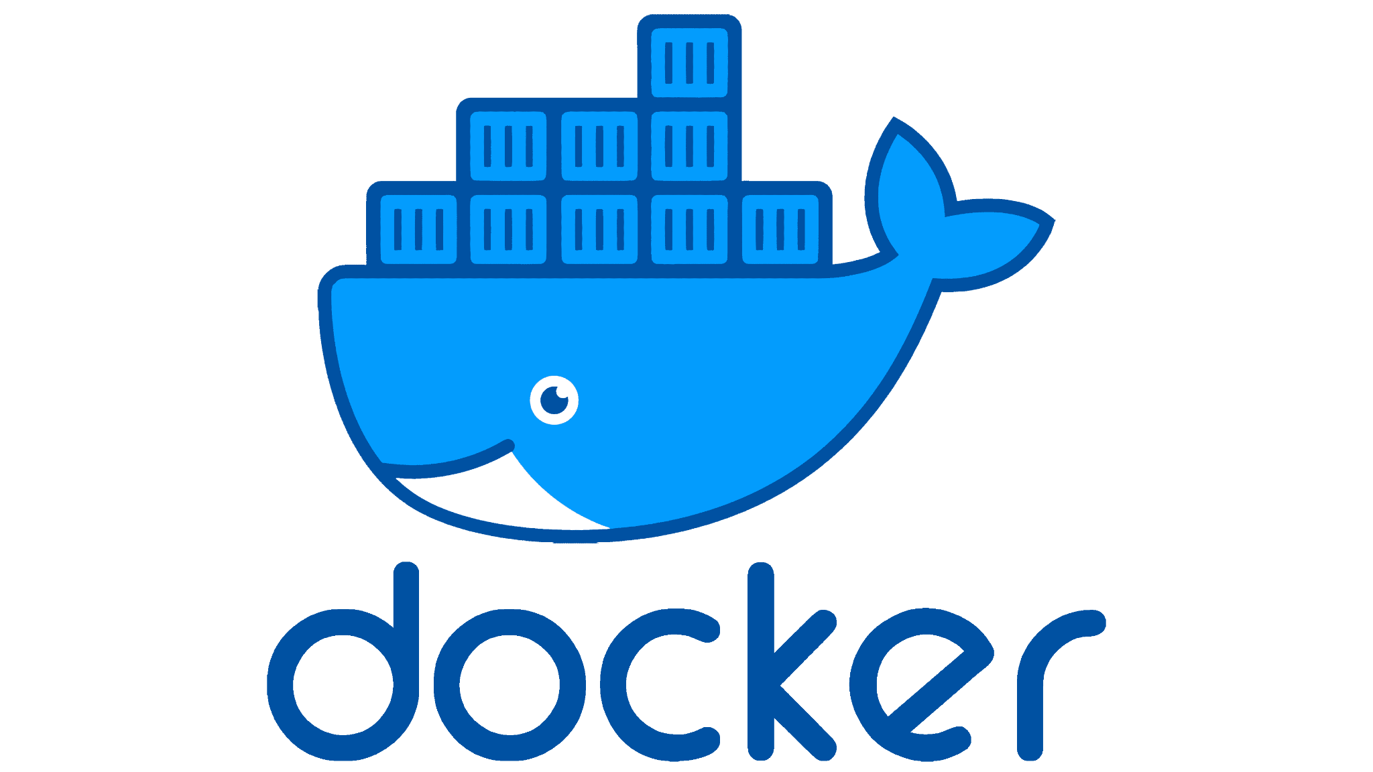
Google Cloud Associate Cloud Engineer
There are many options for container runtimes.
One of the most popular is Docker.

Slide 45
Google Cloud Associate Cloud Engineer
Docker created an API that helps developers build containers, regardless of what machine its being run on.

Slide 46
Google Cloud Associate Cloud Engineer
To do this, developers create a docker file.
Let’s take a look at an example file…

Slide 47
Google Cloud Associate Cloud Engineer
$cat Dockerfile
FROM ubuntu:18.04.6
RUN apt update && apt install python -y
RUN app install python-pip -y
RUN pip install flask
COPY app.py /opt/app.py
ENTRYPOINT FLASK_APP=/opt/app.py flask run –host=0.0.0.0

Slide 48
Google Cloud Associate Cloud Engineer
$cat Dockerfile
FROM ubuntu:18.04.6
RUN apt update && apt install python -y
RUN app install python-pip -y
RUN pip install flask
COPY app.py /opt/app.py
ENTRYPOINT FLASK_APP=/opt/app.py flask run –host=0.0.0.0

Slide 49
Google Cloud Associate Cloud Engineer
$cat Dockerfile
FROM ubuntu:18.04.6
RUN apt update && apt install python -y
RUN app install python-pip -y
RUN pip install flask
COPY app.py /opt/app.py
ENTRYPOINT FLASK_APP=/opt/app.py flask run –host=0.0.0.0

Slide 50
Google Cloud Associate Cloud Engineer
$cat Dockerfile
FROM ubuntu:18.04.6
RUN apt update && apt install python -y
RUN app install python-pip -y
RUN pip install flask
COPY app.py /opt/app.py
ENTRYPOINT FLASK_APP=/opt/app.py flask run –host=0.0.0.0

Slide 51
Google Cloud Associate Cloud Engineer
$cat Dockerfile
FROM ubuntu:18.04.6
RUN apt update && apt install python -y
RUN app install python-pip -y
RUN pip install flask
COPY app.py /opt/app.py
ENTRYPOINT FLASK_APP=/opt/app.py flask run –host=0.0.0.0

Slide 52
Google Cloud Associate Cloud Engineer
This dockerfile has now allowed us to create a container in just a few lines of code.
But with only this file, we would still need to manually deploy the container, manage it, and be concerned with uptime or update rollouts.

Slide 53
Google Cloud Associate Cloud Engineer
Fortunately as we’ve discussed, Kubernetes can help with this exact issue.
Kubernetes helps manage your containers through a control plane and making sure the current state matches the desired state.

Slide 54
Google Cloud Associate Cloud Engineer
Dockerfiles tell your container what to do, Kubernetes tells your entire cluster what to do.
Let’s take a look at the topology of Kubernetes…

Slide 55
Google Cloud Associate Cloud Engineer
Kubernetes API
Control Plane
Node 1
Node 1
POD 1
POD 3
POD 2
POD 4

Slide 56
Google Cloud Associate Cloud Engineer
A kubernetes cluster consists of nodes which themselves have pods.
Pods are collections of multiple containers.
Let’s explore our flask application container and what it would look like as a pod.

Slide 57
Google Cloud Associate Cloud Engineer
apiVersion: v1
kind: Pod
metadata:
name: static-web
labels:
role: myrole
spec:
containers:
- name: web
image: nginx
ports:
- name: web
containerPort: 80
protocol: TCP

Slide 58
Google Cloud Associate Cloud Engineer
apiVersion: v1
kind: Pod
metadata:
name: static-web
labels:
role: myrole
spec:
containers:
- name: web
image: nginx
ports:
- name: web
containerPort: 80
protocol: TCP

Slide 59
Google Cloud Associate Cloud Engineer
apiVersion: v1
kind: Pod
metadata:
name: static-web
labels:
role: myrole
spec:
containers:
- name: web
image: nginx
ports:
- name: web
containerPort: 80
protocol: TCP

Slide 60
Google Cloud Associate Cloud Engineer
Once this configuration is put into a Kubernetes cluster, Kubernetes understands what you want it to achieve, and will keep checking to see if the current state matches your desired state.

Slide 61
Google Cloud Associate Cloud Engineer
Review:
We took a closer look at how containers works in conjunction with Kubernetes.

Slide 62
Google Cloud Associate Cloud Engineer
Up Next:
We’ll take a deeper dive into how Kubernetes works with Nodes and the Control Plane.

Slide 63
Google Cloud Associate Cloud Engineer
Understanding Nodes and Control Plane

Slide 64
Google Cloud Associate Cloud Engineer
Let’s take a closer look at the organization of Kubernetes to begin to build an understanding of how Kubernetes API can communicate with Nodes to understand the state of Pods (in order to later update everything to the desired state).

Slide 65
Google Cloud Associate Cloud Engineer
We can think of a node as a virtual (or physical) machine we run our workloads on.
A cluster is a group of one or more worker nodes.

Slide 66
Google Cloud Associate Cloud Engineer
Kubernetes API
Control Plane
Node 1
Node 1
POD 1
POD 3
POD 2
POD 4

Slide 67
Google Cloud Associate Cloud Engineer
Kubernetes API
Control Plane
Node 1
Node 1
POD 1
POD 3
POD 2
POD 4
CLUSTER

Slide 68
Google Cloud Associate Cloud Engineer
Each node contains all the services necessary to run pods:
Container Runtime:
Ability to run containers

Slide 69
Google Cloud Associate Cloud Engineer
Each node contains all the services necessary to run pods:
Kubelet
Confirms that all operations that should be running are actually running.

Slide 70
Google Cloud Associate Cloud Engineer
Each node contains all the services necessary to run pods:
Kube-proxy
Handles networking, allowing for the Kubernetes API to keep track of nodes, pods and networking.

Slide 71
Google Cloud Associate Cloud Engineer
Even with the organization that Nodes and Pods gives us, it’s still not possible for a human to manage all the pods and nodes in a cluster.
Kubernetes manages this for us through the control plane.

Slide 72
Google Cloud Associate Cloud Engineer
Kubernetes API
Control Plane
Node 1
Node 1
POD 1
POD 3
POD 2
POD 4

Slide 73
Google Cloud Associate Cloud Engineer
Kubernetes API
Control Plane

Slide 74
Google Cloud Associate Cloud Engineer
Kubernetes API
API Server
Control Plane

Slide 75
Google Cloud Associate Cloud Engineer
Kubernetes API
API Server
etcd
Control Plane

Slide 76
Google Cloud Associate Cloud Engineer
Kubernetes API
Scheduler
API Server
etcd
Control Plane

Slide 77
Google Cloud Associate Cloud Engineer
Kubernetes API
Scheduler
API Server
etcd
Controller
Manager
Control Plane

Slide 78
Google Cloud Associate Cloud Engineer
Kubernetes API
Scheduler
API Server
etcd
Cloud
Controller
Controller
Manager
Control Plane

Slide 79
Google Cloud Associate Cloud Engineer
This gives the user an abstraction to communicate with using the Kubernetes API.
To deploy a container, a pod is created for the container and that pod can exist on a node.

Slide 80
Google Cloud Associate Cloud Engineer
Review:
We discussed a high level overview of nodes, the control plane, and its components.

Slide 81
Google Cloud Associate Cloud Engineer
Up Next:
We’ll take a closer look at the Kubernetes API.

Slide 82
Google Cloud Associate Cloud Engineer
Understanding Kubernetes API

Slide 83
Google Cloud Associate Cloud Engineer
Before we get started exploring the Kubernetes API, take note that this walkthrough example shows us using the API imperatively, meaning we manually type out commands.

Slide 84
Google Cloud Associate Cloud Engineer
Typically we want to work with the Kubernetes API declaratively, meaning we create a simple file that Kubernetes API reads to understand the desired state and then attempt to achieve that state from the current state.

Slide 85
Google Cloud Associate Cloud Engineer
To understand the Kubernetes API, let’s go through a very simple example of deploying a hello world application.
Imagine we’ve created a containerized application that simply echos “Hello World” when its pinged on its local IP on Port 8080.

Slide 86
Google Cloud Associate Cloud Engineer
$ gcloud container clusters create hello-world-cluster

Slide 87
Google Cloud Associate Cloud Engineer
$ gcloud container clusters create hello-world-cluster
Node
Node
Node
CLUSTER

Slide 88
Google Cloud Associate Cloud Engineer
$ kubectl run dbs –image myapp/example-db:1.0.0 –record
Node
Node
Node
CLUSTER

Slide 89
Google Cloud Associate Cloud Engineer
$ kubectl run dbs –image myapp/example-db:1.0.0 –record
Node
Node
Node
Pod
hello-world
CLUSTER

Slide 90
Google Cloud Associate Cloud Engineer
app: hello
replicas: 1
Node
Node
Node
Pod
hello-world
CLUSTER

Slide 91
Google Cloud Associate Cloud Engineer
app: hello
replicas: 2
Node
Node
Node
Pod
hello-world
CLUSTER

Slide 92
Google Cloud Associate Cloud Engineer
app: hello
replicas: 2
Node
Node
Node
Pod
Pod
hello-world
hello-world
CLUSTER

Slide 93
Google Cloud Associate Cloud Engineer
app: hello
replicas: 2
Node
Node
Node
Pod
Pod
hello-world
hello-world
CLUSTER

Slide 94
Google Cloud Associate Cloud Engineer
app: hello
replicas: 2
Node
Node
Node
Pod
Pod
Pod
hello-world
hello-world
hello-world
CLUSTER

Slide 95
Google Cloud Associate Cloud Engineer
To access our application, we’ll need to create a service.
If we have multiple instances of our application, this service will need to be able to communicate with them across nodes.

Slide 96
Google Cloud Associate Cloud Engineer
$ kubectl expose deployment dbs --port 80 --type LoadBalancer

Slide 97
Google Cloud Associate Cloud Engineer
$ kubectl expose deployment dbs --port 80 --type LoadBalancer
Node
Node
Pod
Pod
hello-world
hello-world
CLUSTER

Slide 98
Google Cloud Associate Cloud Engineer
$ kubectl expose deployment dbs --port 80 --type LoadBalancer
10.1.0.1
10.1.0.2
Node
Node
Pod
Pod
hello-world
hello-world
CLUSTER

Slide 99
Google Cloud Associate Cloud Engineer
$ kubectl expose deployment dbs --port 80 --type LoadBalancer
Service
10.8.244.100
10.1.0.1
10.1.0.2
Node
Node
Pod
Pod
hello-world
hello-world
CLUSTER

Slide 100
Google Cloud Associate Cloud Engineer
$ kubectl expose deployment dbs --port 80 --type LoadBalancer
Service
10.8.244.100
10.1.0.1
10.1.0.2
Node
Node
Node
10.1.0.3
Pod
Pod
Pod
hello-world
hello-world
hello-world
CLUSTER

Slide 101
Google Cloud Associate Cloud Engineer
With services offering an abstraction and allowing a single point of contact for all replicated containerized applications, we can easily roll out new deployed updates across our nodes and the service will automatically update itself.

Slide 102
Google Cloud Associate Cloud Engineer
$ kubectl edit deployment dbd
Service
10.8.244.100
Node
Node
Pod
Pod
app1
app1
CLUSTER

Slide 103
Google Cloud Associate Cloud Engineer
$ kubectl edit deployment dbd
Service
10.8.244.100
Node
Node
Pod
Pod
Pod
app1
app1
app2
CLUSTER

Slide 104
Google Cloud Associate Cloud Engineer
$ kubectl edit deployment dbd
Service
10.8.244.100
Node
Node
Pod
Pod
Pod
app1
app1
app2
CLUSTER

Slide 105
Google Cloud Associate Cloud Engineer
$ kubectl edit deployment dbd
Service
10.8.244.100
Node
Node
Pod
Pod
app1
app2
CLUSTER

Slide 106
Google Cloud Associate Cloud Engineer
$ kubectl edit deployment dbd
Service
10.8.244.100
Node
Node
Pod
Pod
Pod
app1
app2
app2
CLUSTER

Slide 107
Google Cloud Associate Cloud Engineer
$ kubectl edit deployment dbd
Service
10.8.244.100
Node
Node
Pod
Pod
Pod
app1
app2
app2
CLUSTER

Slide 108
Google Cloud Associate Cloud Engineer
Review:
We explored an example of how to use the Kubernetes API imperatively to deploy a simple containerized application.

Slide 109
Google Cloud Associate Cloud Engineer
Up Next:
We’ll switch over to our “practical” Kubernetes lectures, focusing on demos inside of Google Cloud.

Slide 110
Google Cloud Associate Cloud Engineer
Container Images

Slide 111
Google Cloud Associate Cloud Engineer
Recall that the use of containers allows a further abstraction from virtual machines, allowing us to place containerized applications to sit on top of the OS Kernel.

Slide 112
Google Cloud Associate Cloud Engineer
Dedicated Server
Application Code
Dependencies
Kernel
Hardware

Slide 113
Google Cloud Associate Cloud Engineer
Virtual Machines
Application Code
Dependencies
Kernel
Hardware + Hypervisor

Slide 114
Google Cloud Associate Cloud Engineer
Container
Application Code
Dependencies
Container Runtime
Kernel
Hardware + Hypervisor

Slide 115
Google Cloud Associate Cloud Engineer
Container
Container
Application Code
Application Code
Dependencies
Dependencies
Container Runtime
Kernel
Hardware + Hypervisor

Slide 116
Google Cloud Associate Cloud Engineer
As we mentioned, we can use Docker formatted container images to construct our containers.
Let’s take a closer look at how this is structured…

Slide 117
Google Cloud Associate Cloud Engineer
Ephemeral
Read/Write Layer
Thin R/W Layer (Container Layer)
Ubuntu: 20.04
34f68egb2319 0B
Read-only
Layers
g472819ds32 2.13 KB
f43324c7823 197.1 KB
d4b1gf33s8a 180.1MB

Slide 118
Google Cloud Associate Cloud Engineer
Docker File

Slide 119
Google Cloud Associate Cloud Engineer
Docker File
FROM ubuntu:20.04
Ubuntu: 20.04
d4b1gf33s8a 180.1MB

Slide 120
Google Cloud Associate Cloud Engineer
Docker File
FROM ubuntu:20.04
COPY ./app
Ubuntu: 20.04
f43324c7823 197.1 KB
d4b1gf33s8a 180.1MB

Slide 121
Google Cloud Associate Cloud Engineer
Docker File
FROM ubuntu:20.04
COPY ./app
RUN make /app
Ubuntu: 20.04
g472819ds32 2.13 KB
f43324c7823 197.1 KB
d4b1gf33s8a 180.1MB

Slide 122
Google Cloud Associate Cloud Engineer
Docker File
FROM ubuntu:20.04
COPY ./app
RUN make /app
CMD python /app/app.py
Ubuntu: 20.04
34f68egb2319 0B
g472819ds32 2.13 KB
f43324c7823 197.1 KB
d4b1gf33s8a 180.1MB

Slide 123
Google Cloud Associate Cloud Engineer
Thin R/W Layer (Container Layer)
Docker File
FROM ubuntu:20.04
COPY ./app
RUN make /app
CMD python /app/app.py
Ubuntu: 20.04
34f68egb2319 0B
g472819ds32 2.13 KB
f43324c7823 197.1 KB
d4b1gf33s8a 180.1MB

Slide 124
Google Cloud Associate Cloud Engineer
Container
Container
Container
R/W Layer
R/W Layer
R/W Layer
Ubuntu: 20.04
34f68egb2319 0B
Read-only
Layers
g472819ds32 2.13 KB
f43324c7823 197.1 KB
d4b1gf33s8a 180.1MB

Slide 125
Google Cloud Associate Cloud Engineer
It is very common to use publicly available open-source container images which we can download from a container registry such as gcr.io.
This is Google’s own container registry with publicly available images (and the ability to store private container images).

Slide 126
Google Cloud Associate Cloud Engineer
Google provides a managed service called Cloud Build for building containers, which is an alternative to docker and provides direct integration to GCP and Cloud IAM.

Slide 127
Google Cloud Associate Cloud Engineer
Cloud Build can retrieve container images from Cloud Storage, Cloud Source Repositories, or git repositories.
Cloud Build can be configured to follow set-up build steps and then it will deliver these containers to GCP compute options, such as Kubernetes, App Engine, and Cloud Functions.

Slide 128
Google Cloud Associate Cloud Engineer
Review:
We explored the more practical components of Containers and their construction.

Slide 129
Google Cloud Associate Cloud Engineer
Up Next:
We’ll explore how to use Cloud Build on GCP!

Slide 130
Google Cloud Associate Cloud Engineer
DEMO: Cloud Build

Slide 131
Google Cloud Associate Cloud Engineer
Now that we understand Containers and Cloud Build, let’s explore how we can use the Cloud Build service and Google Container Registry to save our container using Google Cloud Platform.

Slide 132
Google Cloud Associate Cloud Engineer
In this demo we’ll do the following:
Set up Cloud Build.
Set up Google Container Registry.
Use Cloud Shell to create a shell script.
Create a Dockerfile to run our shell script.
Build the container image with GCR.
Update the container and view history.

Slide 133
Google Cloud Associate Cloud Engineer
Google Kubernetes
Engine (GKE)

Slide 134
Google Cloud Associate Cloud Engineer
We already know that Kubernetes is a powerful, open-source tool for deploying and managing containerized applications.
But what about deploying and managing Kubernetes itself?
Kubernetes can quickly become complex infrastructure to maintain!

Slide 135
Google Cloud Associate Cloud Engineer
Google Kubernetes Engine is a managed Kubernetes service on GCP.
GKE helps you to deploy, manage, and scale Kubernetes environments for your containerized applications on Google Cloud.

Slide 136
Google Cloud Associate Cloud Engineer
Beginners often confuse Kubernetes with Google Kubernetes Engine, which is understandable, since Kubernetes itself came out of Google.
But remember, Kubernetes helps manage and deploy containerized apps, GKE helps you manage Kubernetes.

Slide 137
Google Cloud Associate Cloud Engineer
When you use GKE, you start by directing the service to instantiate a Kubernetes system for you.
GKE is fully managed, which means you don’t have to provision the underlying resources.

Slide 138
Google Cloud Associate Cloud Engineer
GKE Features:
Fully Managed
Container-optimized OS
Automatic Upgrades
IAM Integration
Automatic Repairs
Cloud Console
Auto Cluster Scaling

Slide 139
Google Cloud Associate Cloud Engineer
GKE now offers two modes of operations: Standard and Autopilot.
Let’s talk about the difference between them…

Slide 140
Google Cloud Associate Cloud Engineer
Standard is the initial experience Google has been building since the launch of GKE, giving users full control over the nodes with the ability to fine tune and run custom administrative workloads.

Slide 141
Google Cloud Associate Cloud Engineer
The newer Autopilot mode is a hands-off, fully managed solution that manages the entire cluster’s infrastructure without worrying about configuring and monitoring that comes with per-pod billing.

Slide 142
Google Cloud Associate Cloud Engineer
Autopilot ensures you pay only for your running pods, not system components, operating system overhead, or unallocated capacity.

Slide 143
Google Cloud Associate Cloud Engineer
You can learn a lot more about the features provided by GKE in the official documentation:
cloud.google.com/kubernetes-engine

Slide 144
Google Cloud Associate Cloud Engineer
Review:
We learned the basics about GKE and its features.

Slide 145
Google Cloud Associate Cloud Engineer
Up Next:
We’ll take a deeper dive into some of the details of Kubernetes Architecture to prepare to use GKE ourselves!

Slide 146
Google Cloud Associate Cloud Engineer
Kubernetes
Architecture

Slide 147
Google Cloud Associate Cloud Engineer
Let’s take a deeper look at some of the key aspects of Kubernetes architecture.
We’ll also take a look at what is managed for you when you decide to use Google Kubernetes Engine.

Slide 148
Google Cloud Associate Cloud Engineer
Kubernetes Architecture:
Control Plane
Nodes
Objects
Namespaces

Slide 149
Google Cloud Associate Cloud Engineer
CLUSTER

Slide 150
Google Cloud Associate Cloud Engineer
CLUSTER
kubectl

Slide 151
Google Cloud Associate Cloud Engineer
CLUSTER
Control Plane
kube-
APIserver
kubectl
etcd
kube-
scheduler
kube-
cloud-
manager
kube-
controller-
manager

Slide 152
Google Cloud Associate Cloud Engineer
CLUSTER
Control Plane
Node
Node
Node
kube-
APIserver
kubectl
Kubelet
Kubelet
Kubelet
etcd
kube-
scheduler
Kube-
proxy
Kube-
proxy
Kube-
proxy
kube-
cloud-
manager
kube-
controller-
manager

Slide 153
Google Cloud Associate Cloud Engineer
Using GKE we can also set-up Region clusters instead of single zone clusters.
Let’s take a look at what this topology offers…

Slide 154
Google Cloud Associate Cloud Engineer
CLUSTER
Control Plane
Node
Node
Node

Slide 155
Google Cloud Associate Cloud Engineer
ZONE
CLUSTER
Control Plane
Node
Node
Node

Slide 156
Google Cloud Associate Cloud Engineer
CLUSTER
REGION
ZONE
ZONE
ZONE
CLUSTER
Control Plane
Control Plane
Control Plane
Node
Node
Node
Node
Node
Node
Node
Node
Node

Slide 157
Google Cloud Associate Cloud Engineer
Let’s now explore object management in Kubernetes.
We can define objects within a YAML file for Kubernetes.
Let’s take a look at an example YAML file for Kubernetes.

Slide 158
Google Cloud Associate Cloud Engineer
apiVersion: v1
kind: Pod
metadata:
name: nginx
labels:
app: nginx
spec:
containers:
- name: nginx
image: nginx:latest

Slide 159
Google Cloud Associate Cloud Engineer
Labels are key-value pairs with which you tag your objects during or after their creation.
Labels help you identify and organize objects and subsets of objects.

Slide 160
Google Cloud Associate Cloud Engineer
apiVersion: v1
kind: Pod
metadata:
name: nginx
labels:
app: nginx
env: test
spec:
containers:
- name: nginx
image: nginx:latest

Slide 161
Google Cloud Associate Cloud Engineer
A workload is spread evenly across available nodes by default.
It should also be noted that Pods themselves have a life cycle:
Created
Running
Broken → Dead

Slide 162
Google Cloud Associate Cloud Engineer
A Deployment ensures that a defined set of Pods is running at any given time.
You can specify (spec) the desired number of replicas , which Kubernetes will automatically seek to match by comparing the current state to the desired state.

Slide 163
Google Cloud Associate Cloud Engineer
Kubernetes allows you to abstract a single physical cluster into multiple virtual clusters known as namespaces.
Namespaces provide scope for naming resources such as Pods, Deployments, and controllers.

Slide 164
Google Cloud Associate Cloud Engineer
CLUSTER
Node
Node
Node
Default
Pods
Deployments
ConfigMap
Controllers
Kube-system
Secrets
Deployments
Kube-public

Slide 165
Google Cloud Associate Cloud Engineer
Review:
We learned about the architecture behind Kubernetes.

Slide 166
Google Cloud Associate Cloud Engineer
Up Next:
We’ll explore how to use the Google Kubernetes Engine!

Slide 167
Google Cloud Associate Cloud Engineer
DEMO: Google Kubernetes Engine

Slide 168
Google Cloud Associate Cloud Engineer
GKE Demo:
Create a new project.
Setup gcloud CLI.
Create a GKE Cluster.
Deploy an application to the cluster.
Expose the application and connect via HTTP on the internet.

Slide 169
Google Cloud Associate Cloud Engineer
Demo Container:
https://console.cloud.google.com/artifacts/docker/google-samples/us/containers/gke%2Fhello-app

