Slide 1

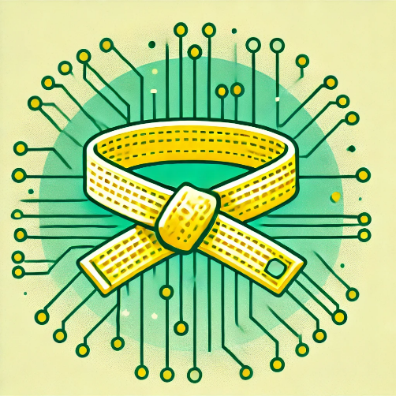
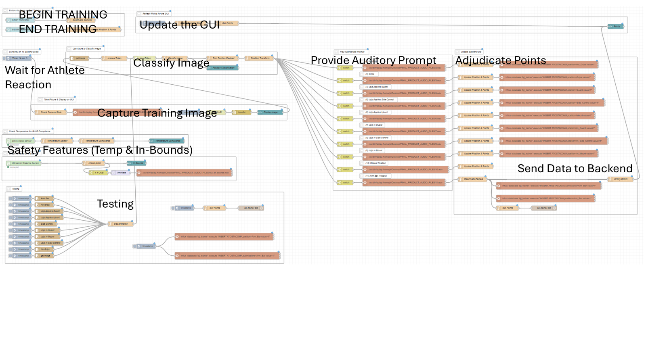




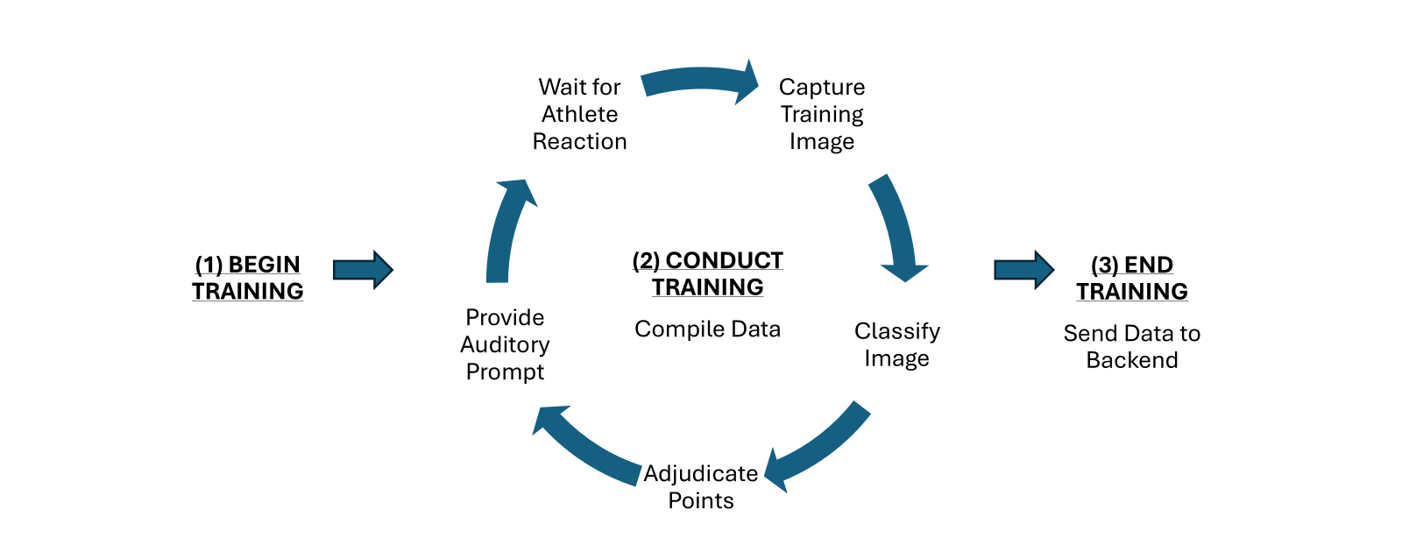




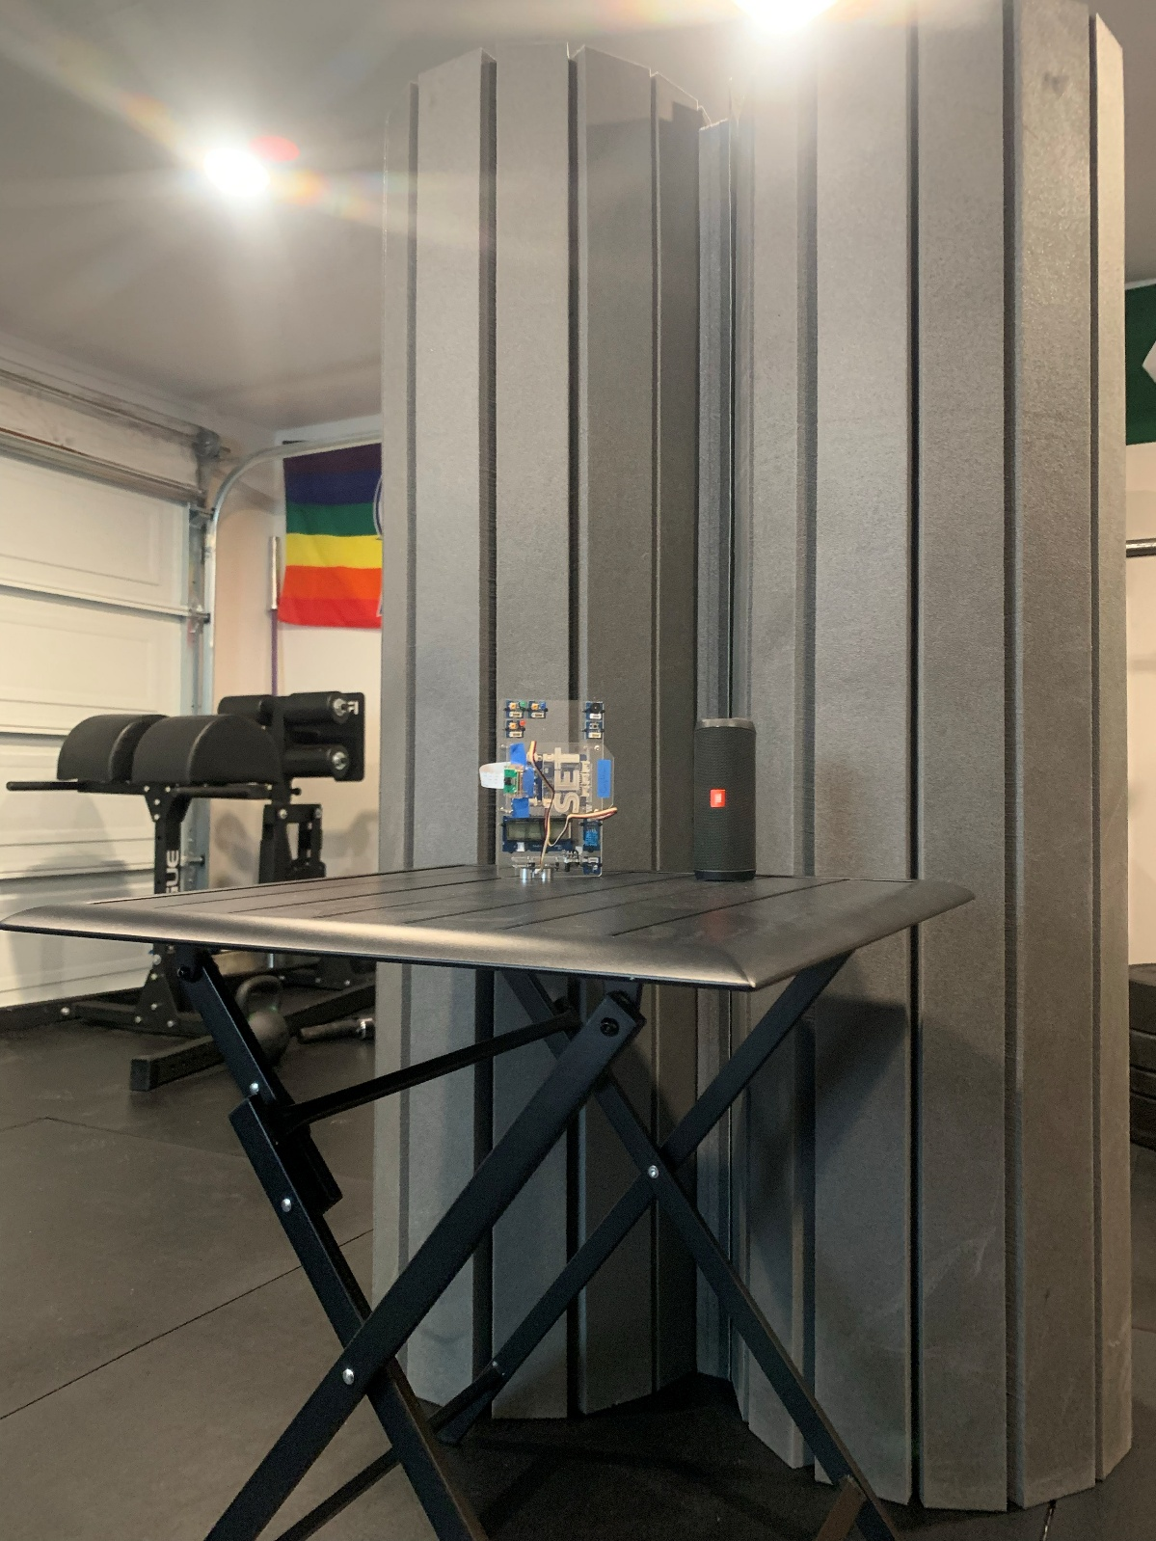
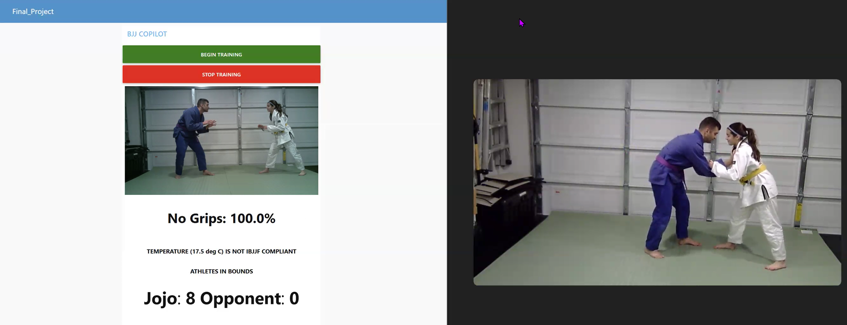
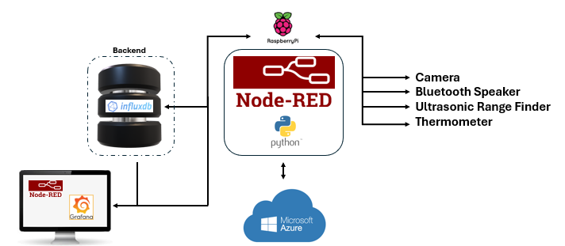
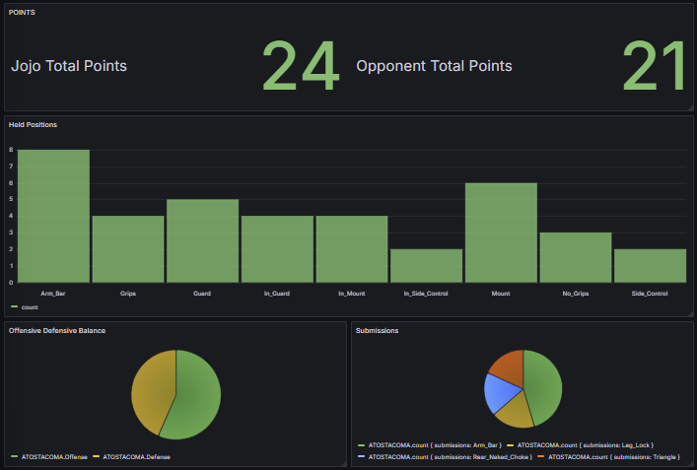
BJJ COPILOT
David Coughran
University of Washington
Project Idea
Technologies Employed
Node-RED Flows
Problem Identification: Brazilian Jiu-Jitzu (BJJ) is a martial art and combat sport focusing on ground fighting and grappling techniques. Studying BJJ has an incredibly high transaction cost. There are thousands of positions, maneuvers, techniques, sweeps, and key concepts, meaning new students can easily become overwhelmed. Anecdotally, instructors who run BJJ schools estimate that 90% of beginners will quit within the first six months. Students can feel “out of place” in an environment where they are learning a new skill, but mistakes are openly visible to everyone.
Challenges: The key technical challenge is replicating the presence of an instructor who can identify a body position, generate the appropriate coaching cues, and deliver the necessary auditory instructions. Additionally, how do we replicate the ancillary functions of a coach who can maintain safety, apply a rule set, score points, and give feedback over the long term? How do we blend existing technologies to simulate the presence of an instructor so BJJ practitioners can train in a private setting and at a time of their choosing?
Proposed Solution: THE BJJ COPILOT is a training application that allows the user to recreate the effect of a private BJJ instructor every time they train. BJJ Copilot incorporates edge and cloud solutions, using Raspberry Pi functions including image capture, temperature sensing, ultrasonic range finder, and speakers. The system is loaded with skill appropriate prompts that will give the user auditory clues during a drilling session or a live sparring match. BJJ Copilot comes loaded with the rule set of the International Brazilian Jiu Jitzu Federation (IBJJF), meaning training sessions can be actively scored with data loaded to a backend for long term analysis and feedback.
Raspberry Pi Features:
Image capture and caching
Temperature sensor for IBJJF competition-conditions adherence
Ultrasonic range detector to determine out-of-bounds
Bluetooth speaker to play coaching prompts
Node-RED for main process programming and to store the IBJJF Ruleset
Node-RED custom dashboard on Frontend
Data Storage:
Influx Database as Backend to store positions held, submissions, and points scored
Calculates the user’s balance of offense and defense in training
Statistical comparison of various movements and strategies
Various data visualizations using Grafana
Cloud Interaction:
Azure Custom Vision for position classification
High Level Overview (Architecture)
Project Outcomes
Prototype
On the Edge Layer, a Raspberry Pi runs Node-RED flows as the primary architecture for program commands and logic. The device captures observational data through the camera, ultrasonic range finder, and thermometer. Its sole actuator is a speaker configured for Bluetooth. A Python Flask script (Final_Image_Capture.py) allows images to be displayed on a Node-RED dashboard. We store information on an Influx database, allowing visualizations of the collected data through Grafana. On the Cloud Layer, we interact with Microsoft Azure services for position classification.
The BJJ Copilot:
Creates a private training environment anywhere the user has room for a mat, a Raspberry Pi, and a drilling/sparring partner
Provides focused repetition, repetition, repetition with coaching cues and prompts
Simulates match officiating and keeps track of points
Allows for long term analysis of skill proficiency and weaknesses in technique/strategy

