Slide 1


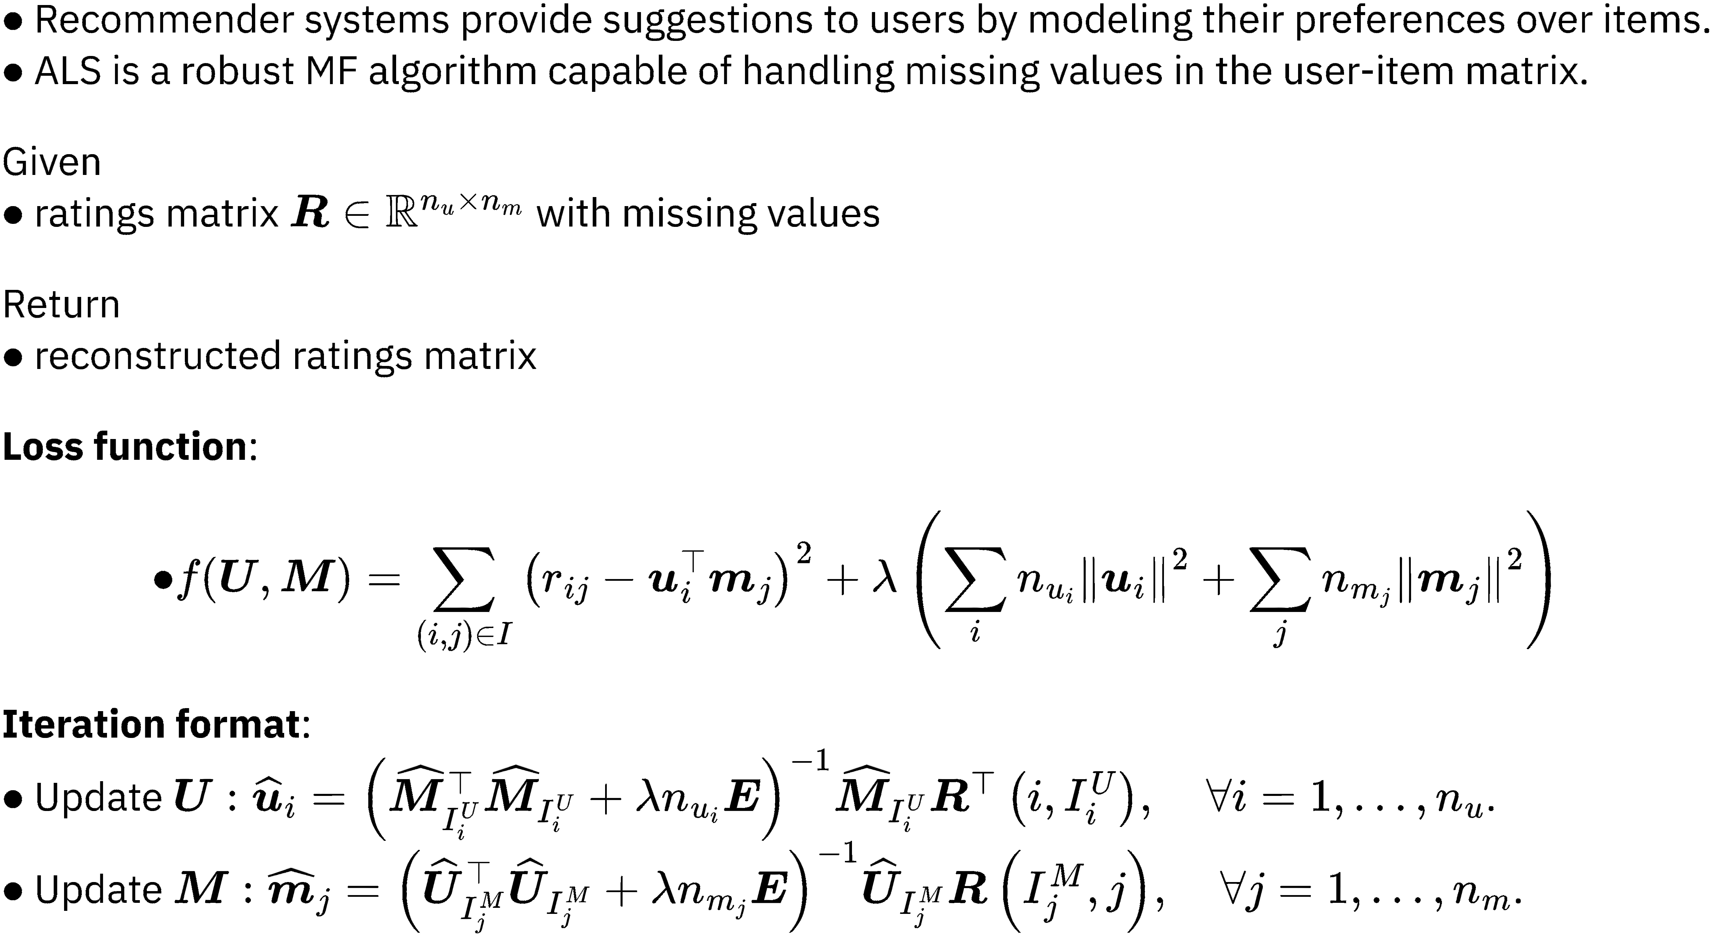
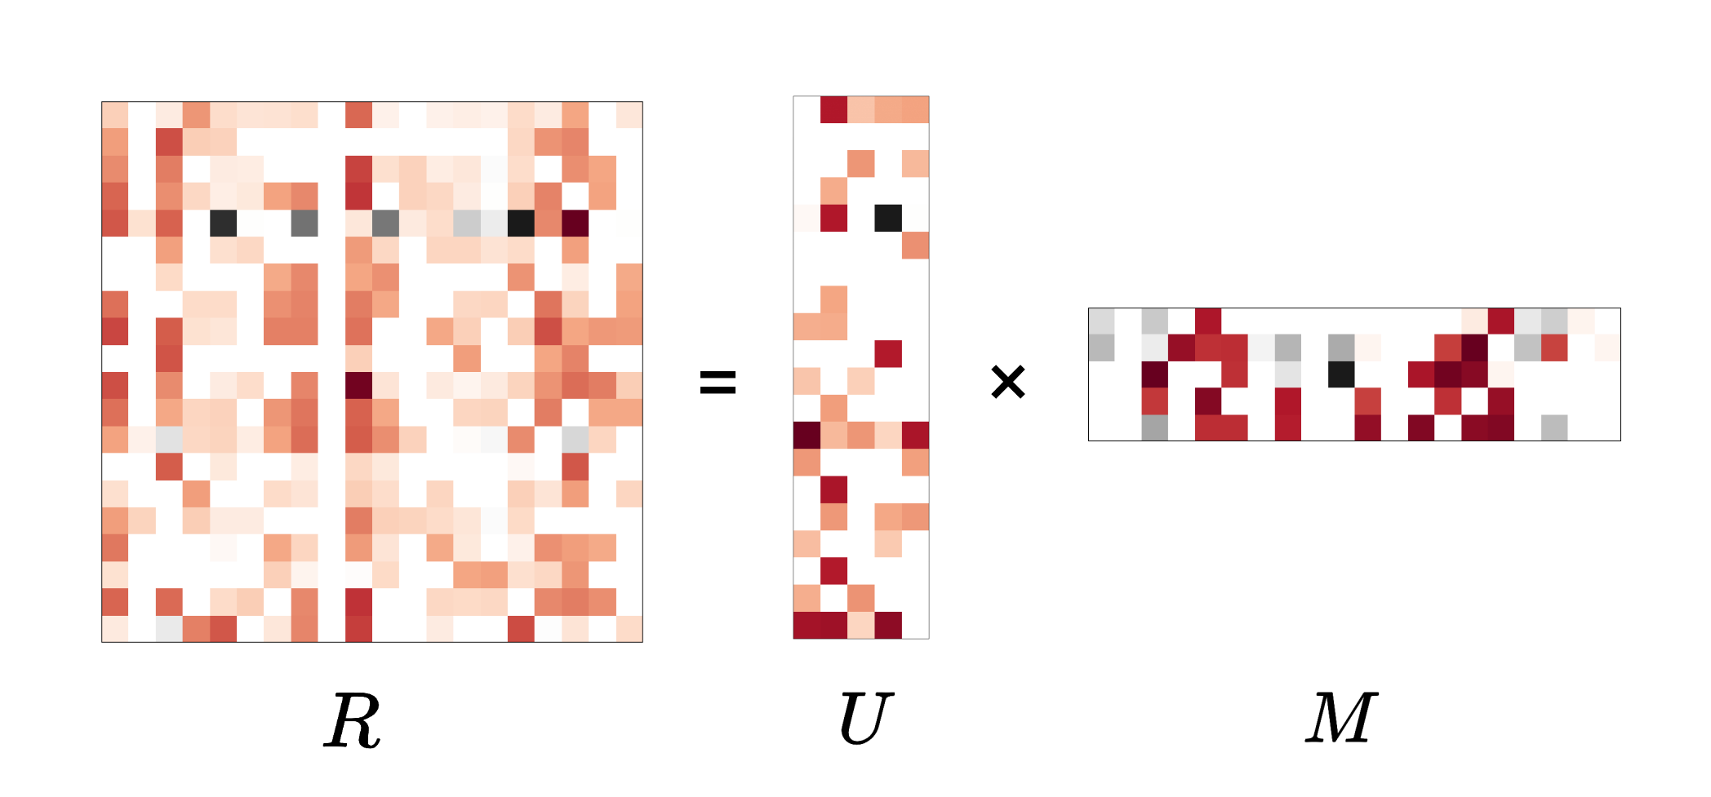
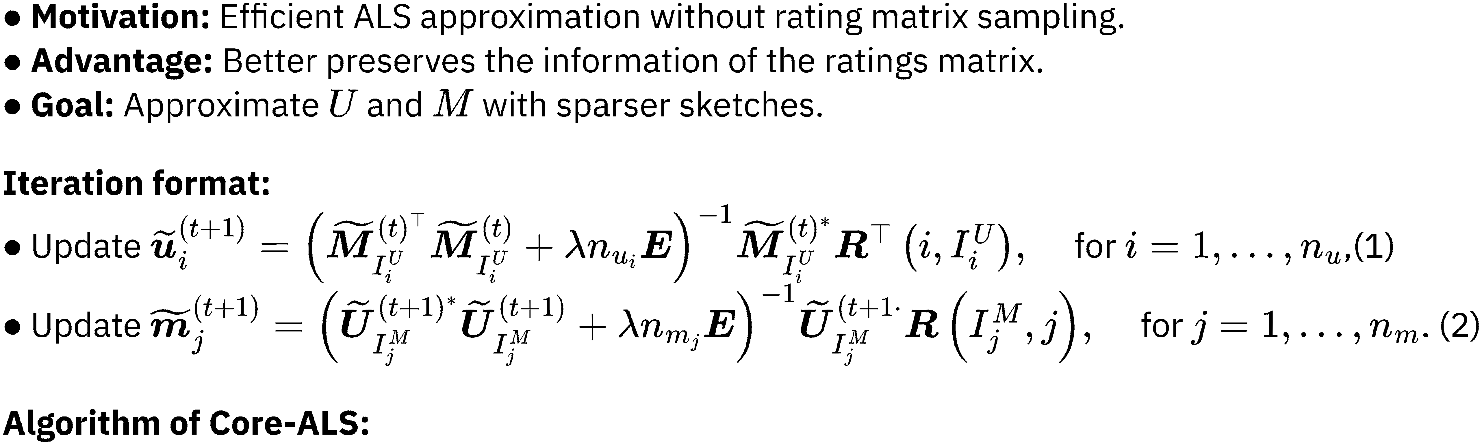
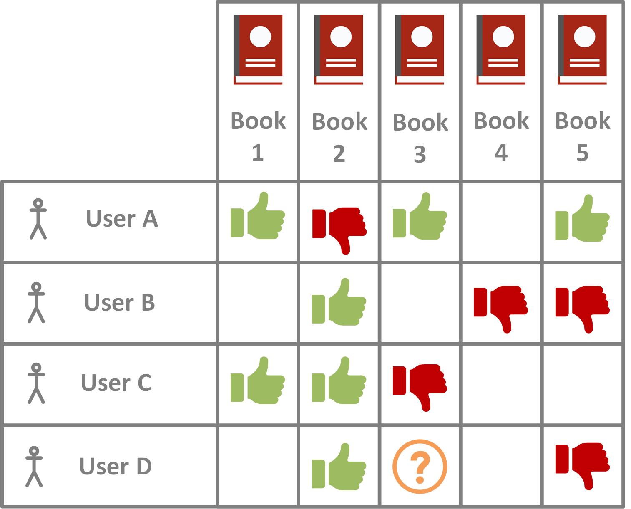
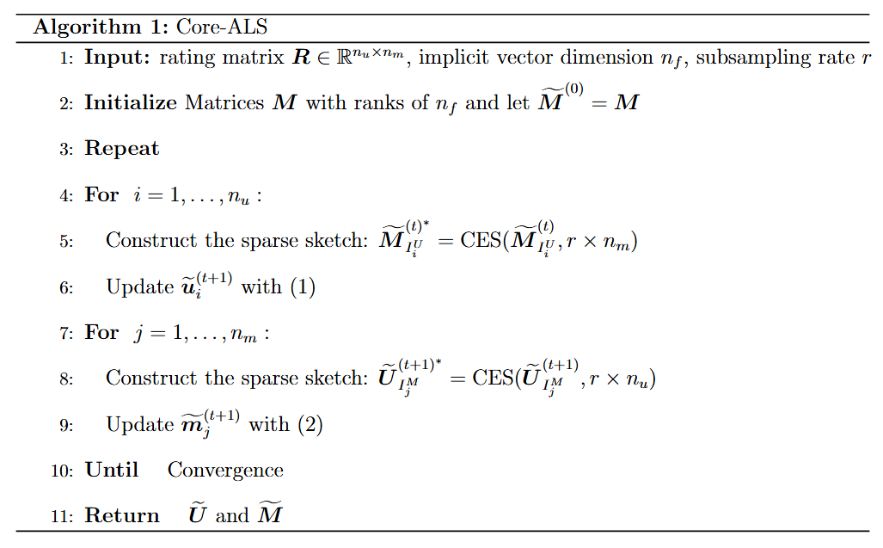
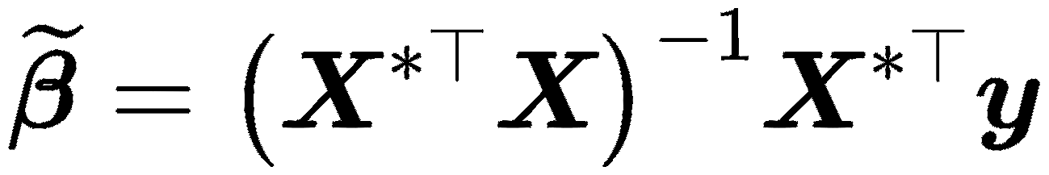
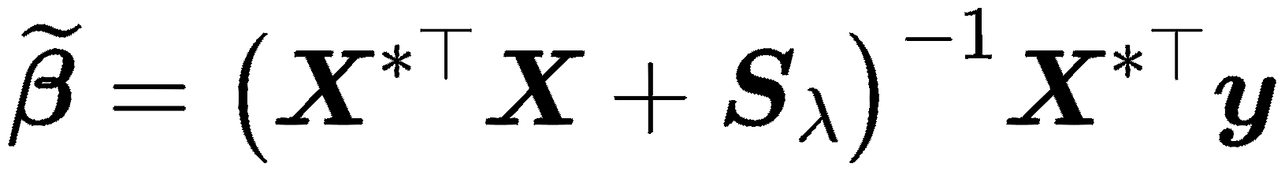

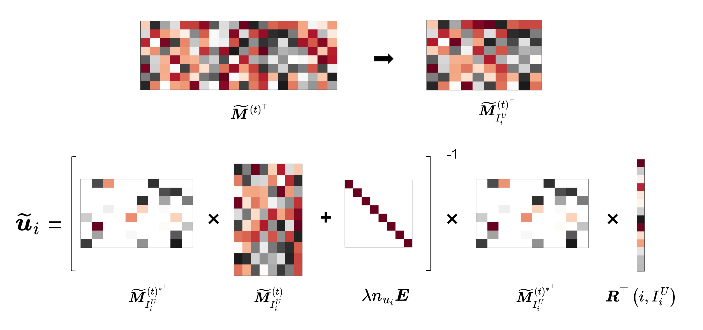
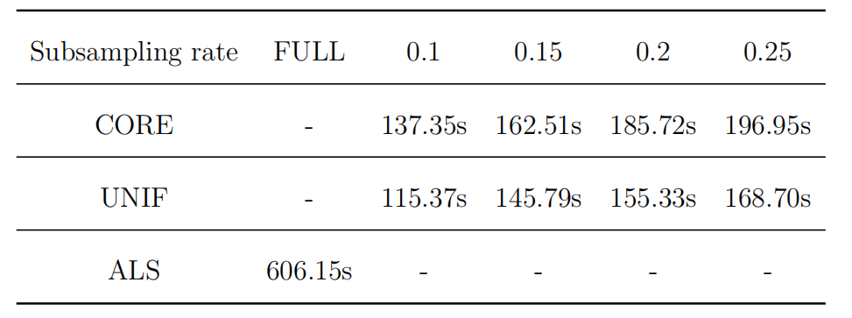
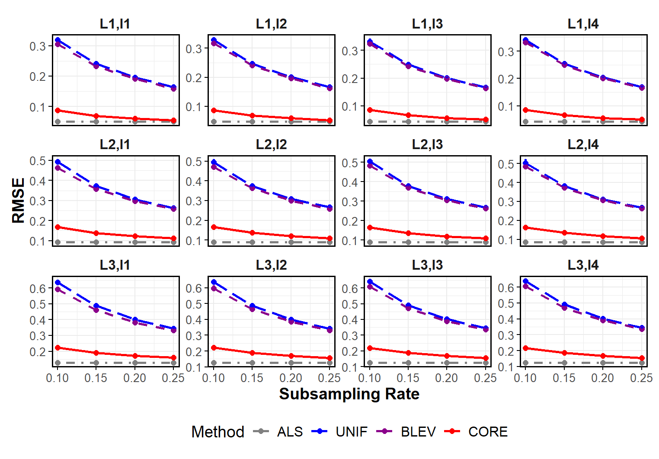
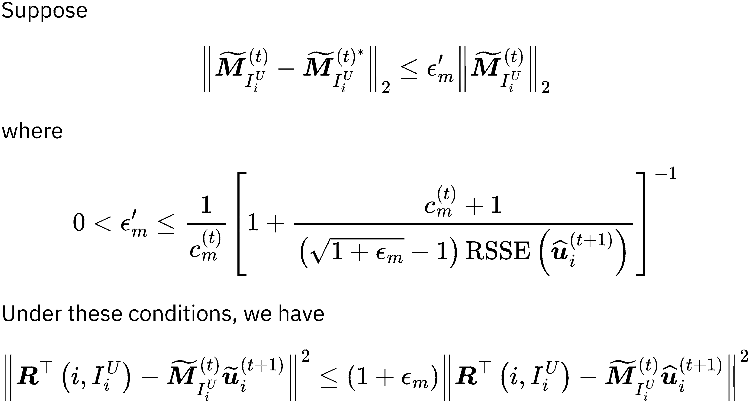
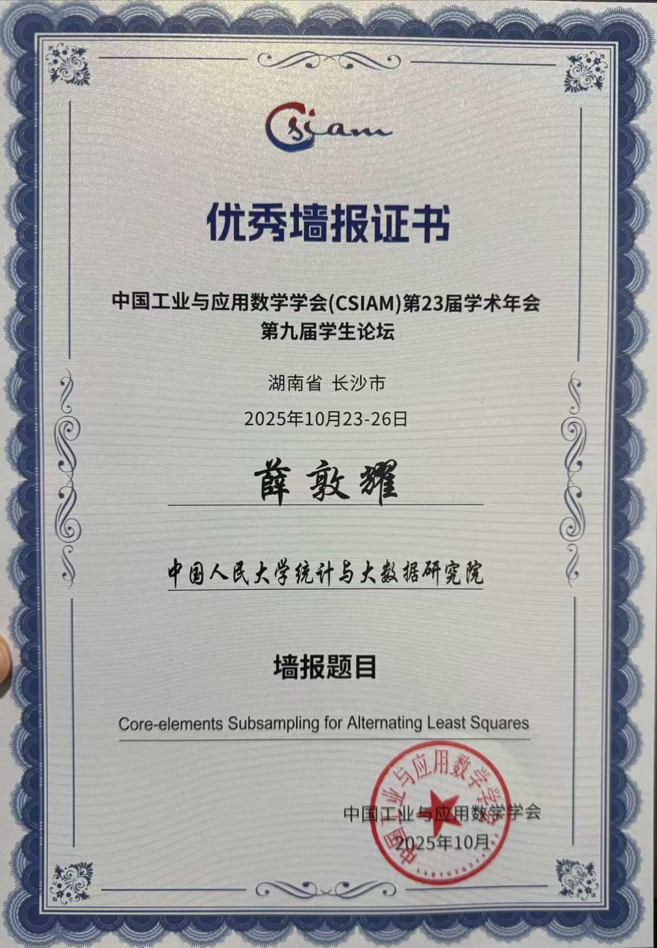
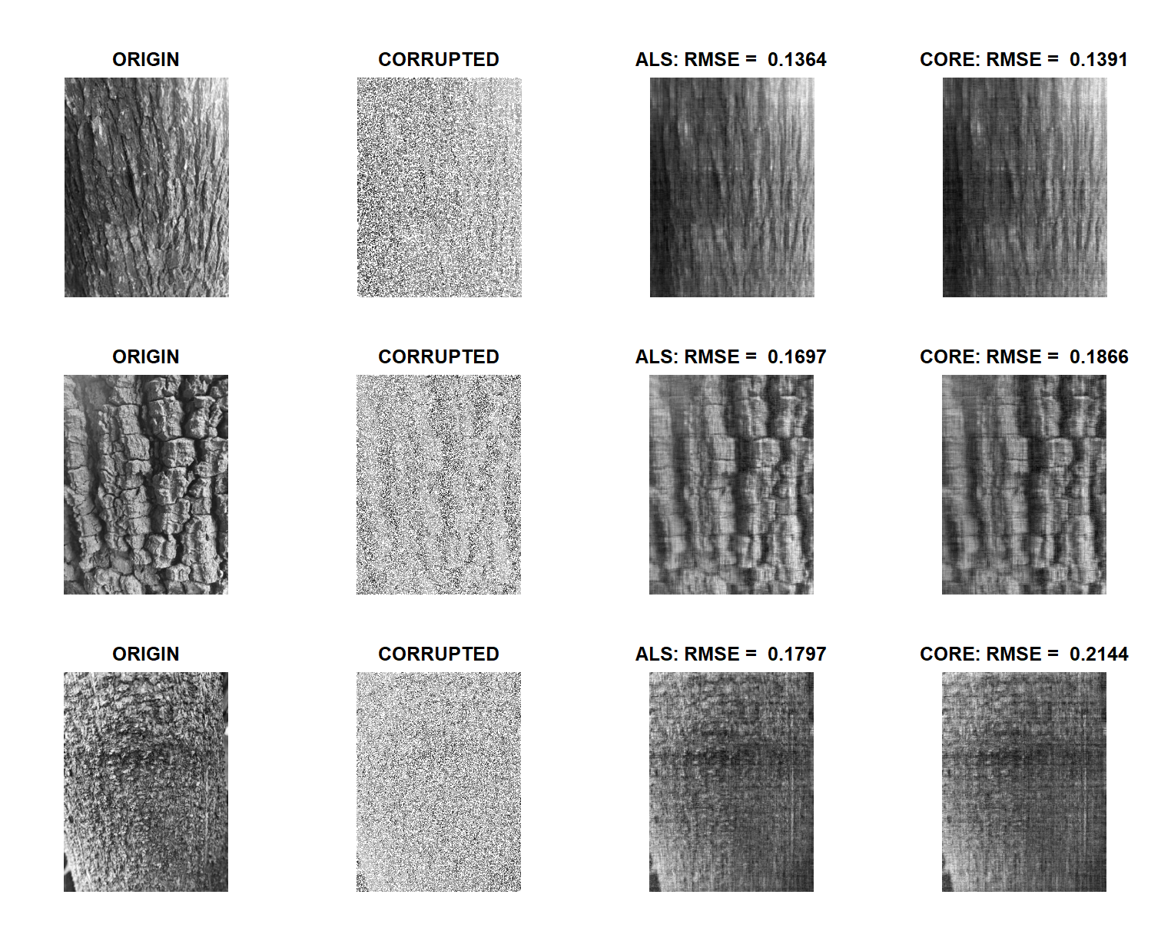

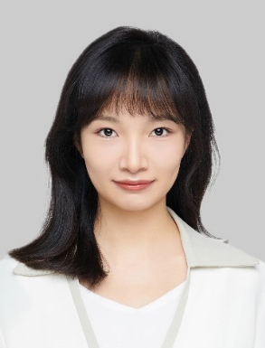
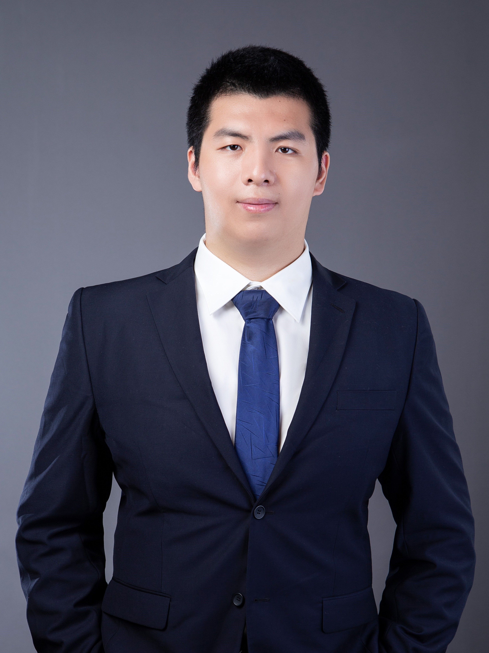

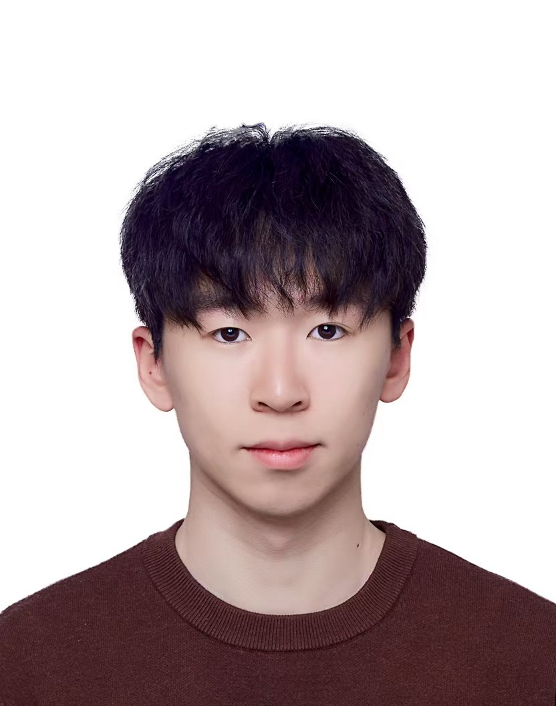

Core-elements Subsampling for Alternating Least Squares
Efficient Algorithms for Large-Scale Recommendation Systems
Dunyao XUE¹(Presenter), Mengyu LI³ , Jingyi ZHANG² , Cheng MENG¹
¹Renmin University of China, ²Beijing University of Posts and Telecommunications,³Tsinghua University
JCGS 2026
Contributions
Introduction
Method
Alternating least squares
Core-elements subsampling method
Netflix competition data
Bark texture image data
Core-elements estimation for ALS
Approximation guarantee
$$O(n_{f}(nnz(R)∗rn_{f}+n_{f}^{2}n_{m}))$$
$$O(n_{f}(nnz(R)∗rn_{f}+)n_{f}^{2}n_{u}))$$
Real Data Analysis
Awards
CSAYS Poster and CSIAM Outstanding Poster
References
Acknowledgments (in alphabetical order)
Contact
Follow Our Lab
Li, M., J. Yu, T. Li, and C. Meng (2024). Core-elements for large-scale least squares estimation. Statistics and Computing 34(6), 1-16.
Li, M., J. Zhang, and C. Meng (2024). Nonparametric additive models for billion observations. Journal of Computational and Graphical Statistics, 1-23.
Meng, C., R. Xie, A. Mandal, X. Zhang, W. Zhong, and P. Ma (2021). Lowcon: A designbased subsampling approach in a misspecified linear model. Journal of Computational and Graphical Statistics 30, 694-708.
Meng, C., X. Zhang, J. Zhang, W. Zhong, and P. Ma (2020). More efficient approximation of smoothing splines via space-filling basis selection. Biometrika .
Zhou, Y., D. Wilkinson, R. Schreiber, and R. Pan (2008). Large-scale parallel collaborative filtering for the netflix prize. In Proceedings of the fourth AAIM Conference, pp. 337-348.
Dunyao XUE
Renmin University of China
Email: xuedunyao1202@ruc.edu.cn
Phone: (+86) 15851243359
Mengyu LI
THU
Cheng MENG
RUC
Jingyi ZHANG
BUPT

