Slide 1





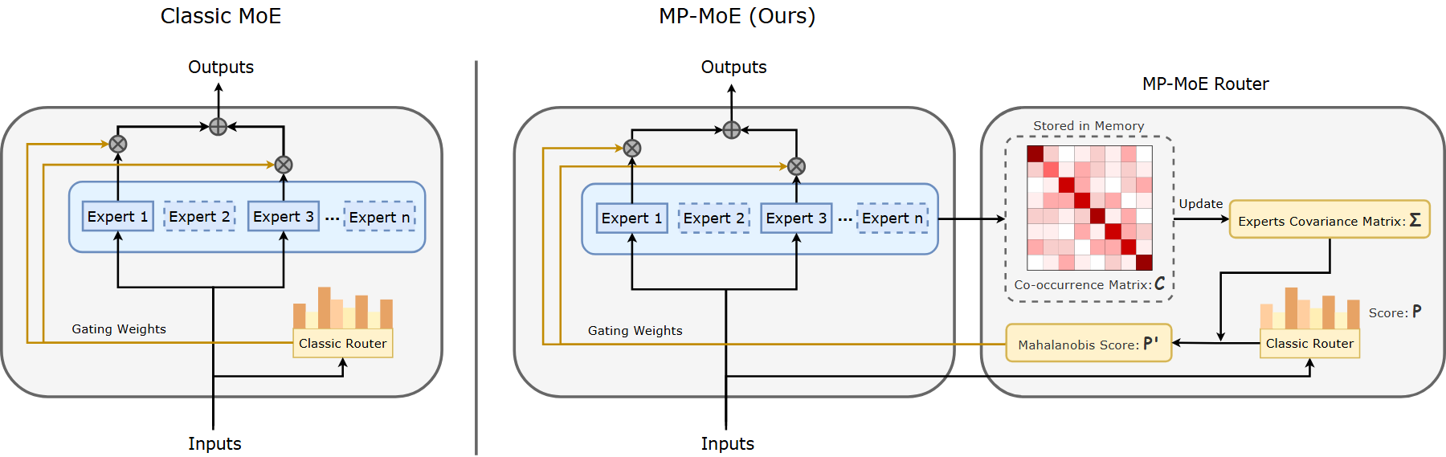
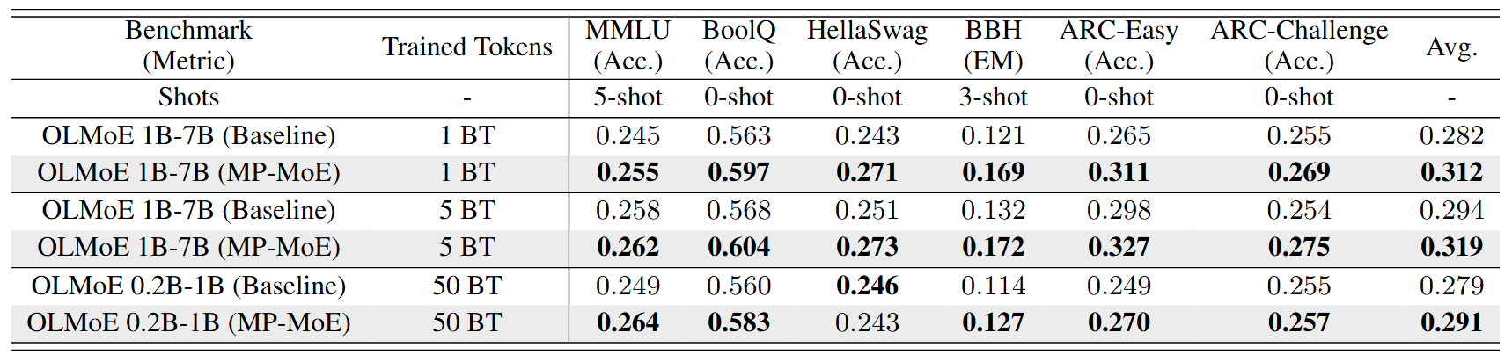
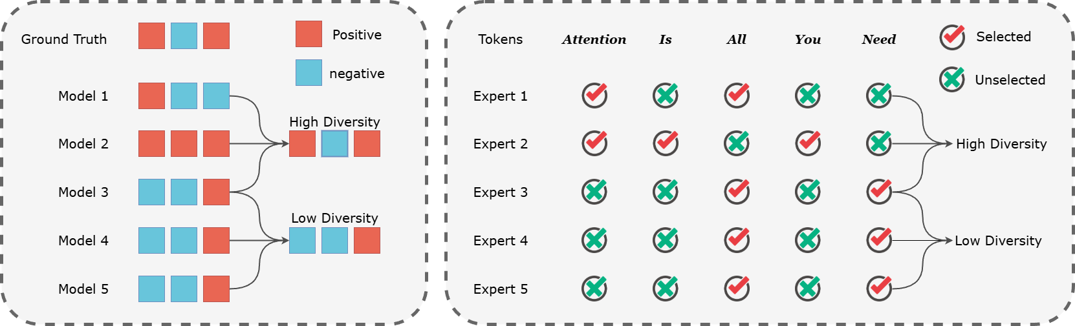
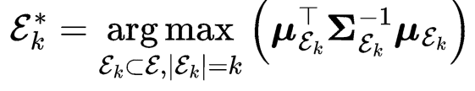
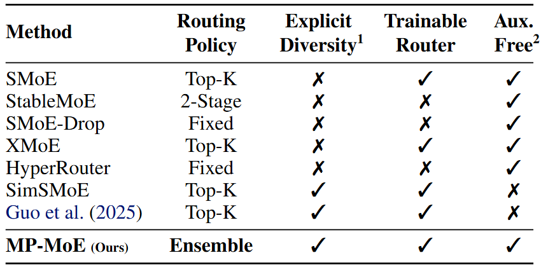
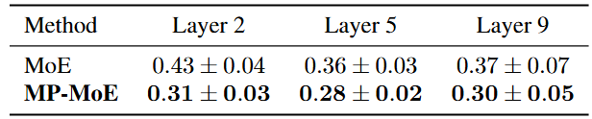
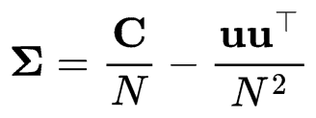
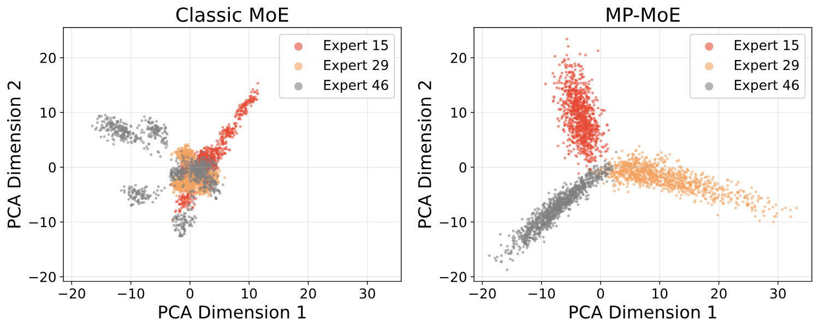
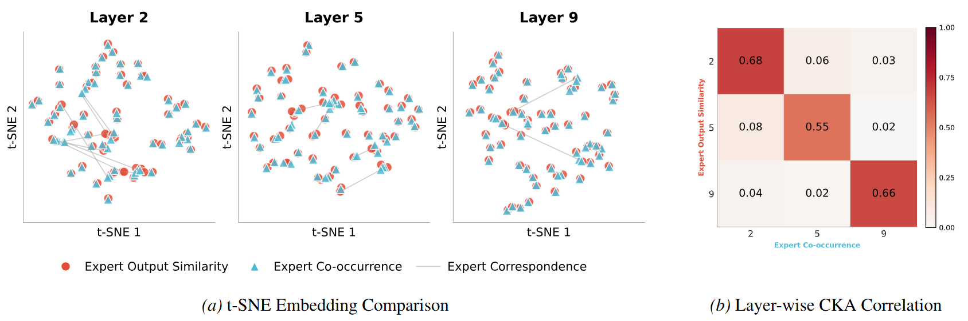
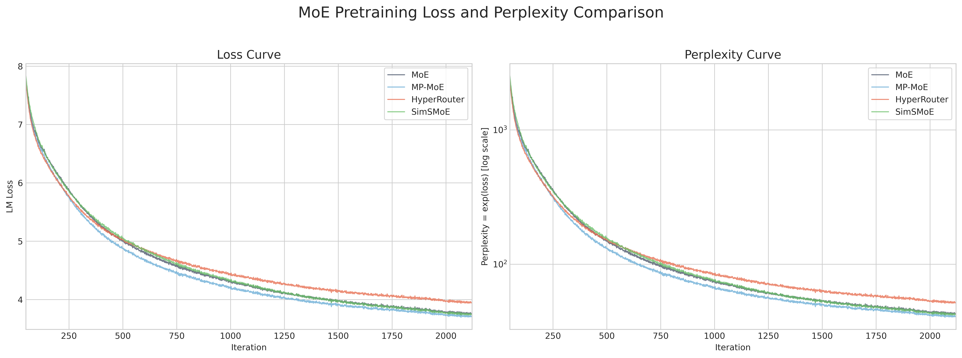
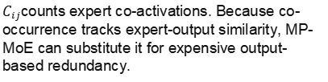

Breaking the Echo Chamber:
A Dynamic Ensemble Pruning Perspective on MoE
Xinlai Kang^{1,2}*, Dunyao Xue¹*, Zhengbo Wang¹, Chengshuo Du¹, Hang Zhou³, Xinghao Chen², Hanting Chen²†, Cheng Meng¹†
¹ Institute of Statistics and Big Data, Renmin University of China, Beijing, China^{; 2} Huawei Foundation Model Lab, Beijing, China ³TJUNLP Lab, School of Computer Science and Technology, Tianjin University, Tianjin, China
Code
Paper
Motivation
Method: MP-MoE
Experiments
Why does traditional MoE routing create an echo chamber?
Benchmark Comparison between Classic MoE and MP-MoE on OLMoE
Traditional top-k MoE routing repeatedly co-selects high-score experts. Over training, these experts process overlapping token distributions and reinforce similar representations instead of specializing.
Ensemble-learning inspiration: accuracy needs diverse votes
Ensemble view:
Good routing should prune a small expert team that is confident and complementary.
Mahalanobis Ensemble Routing
MP-MoE improves average accuracy by 1-3 points with only about 3% extra pretraining time and no additional inference cost
Existing routers leave a diversity gap
A high routing score still matters, but correlated experts are down weighted. The selected subset maximizes collective confidence and diversity.
Expert Diversification: Reduced Similarity and Improved Separation
1 . Routing policy
Top-k/fixed choices remain score- or rule-dominated.
Co-occurrence proxy
We model the selection status of the $i$-th expert for a given token as a Bernoulli random variable $I_{i}\sim \{0,1\}$
2 . Explicit diversity
Most baselines do not directly penalize redundancy.
$C_{ij}$counts expert co-activations. Because co-occurrence tracks expert-output similarity, MP-MoE can substitute it for expensive output-based redundancy.
3 . Aux. free
MP-MoE without additional auxiliary loss.
Co-occurrence aligns with expert similarity
Main Contributions
Ensemble-pruning router
Leverages Mahalanobis distance to select a high-confidence, diversity-aware expert subset during pretraining.
Co-occurrence proxy
PCA shows MP-MoE separates expert representations more clearly than classic MoE.
Flame-MoE PPL:
MP-MoE -4.71%;
SimSMoE -1.31%;
HyperRouter +20.62%.
Models the selection status of the experts as Bernoulli random variables, then uses it for covariance estimation.
Theoretical guarantees
Training Dynamics and Inference Efficiency
Greedy solver with guarantees
Approximation guarantee.
Uses greedy marginal gains and incremental Cholesky updates, with approximation guarantees for the selected subset.
The greedy subset rule admits a provable approximation to the optimal Mahalanobis-pruned ensemble under the paper's conditions.
Efficient empirical gains
Incremental Cholesky decomposition.
No inference overhead: standard top-k routing is retained at serving time.
Improves benchmarks by 1-3 pts with about 3% training overhead and no additional inference latency.
Cholesky factors are updated as experts are added, avoiding repeated $Σ_{S,S}^{−1}$ inversions and keeping training overhead small.

