Slide 1




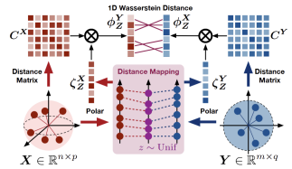
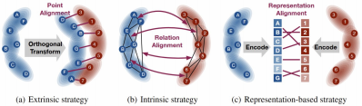
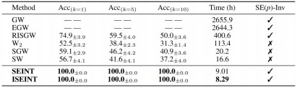
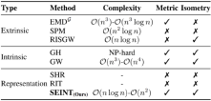
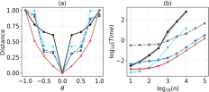
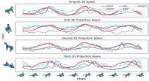
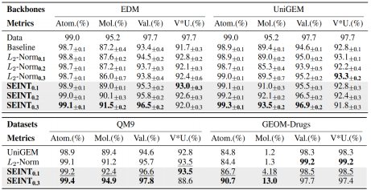
ERS/r
O
Z
1 937
/ 民
SEINT: An Efficient SE(卩)-Invariant Transport Metric Driven by
Polar Transport Discrepancy-based Representation
Junyi Lin^{1*} , Dunyao Xue^{1*} , Jun Yu² , Hongteng Xu^{1忄}, Cheng Meng^{1忄}. ¹ Renmin University of China, ² Beijing Institute of Technology Paper
Motivation
Method: SEINT
Experiments
How can one construct an SE(p)-invariant metric? Are current SE(p)-invariant methods adequate?
 | 2 3 | complexity here is evaluated un- der the assumption n ≥ p. Metric indicates whether the method is a well-defined metric. Isometry indicates whether the method's applicability extends to comparing general isometry classes.
The existing strategies , whether extrinsic, intrinsic, or representation-based , fail to simul- taneously optimize for computational efficiency, rigorous metric properties, and general applicability across isometry classes.
· polar Transport Discrepancy (PTD) . x z (r)= lIlx : l d z* (3) . R · Distance-convoluted polar Transport Discrepancy (DCPTD) . · SE(p)-Invariant Transport (SEINT) Distance. EINT X, Y, μX , μY) inf sup E meII μx , μy ) uz epx , Y (R) |  |  | P
(a) SE(p)-lnvariance. | ASA DISTANCE METRIC
(b) capability on High-Dimensional Data. (c) cross-space capability·
ASA REGULARIZATION TERM Acheive SOTA results in 3D Molecular Generation.
Main Contributions
X , Z , Z
Y
New representations PTD and DCPTD Provide training-free , isometry-invariant 1 D representations for distribu- tions in arbitrary-dimensional spaces. New metric SEINT is built via 1 D T alignment and is rigorously proved to be a metric on isometry classes of normed spaces. Efficiency SEINT achieves nearly linear complexity in commonly used normed spaces. Cross-space comparison SEINT Compares distributions beyond rotation and translation , enabling comparisons across arbitrary isometry classes. Extensibility SEINT is broadly applicable in normed spaces and can be further extended to general metric spaces.
Theoretical guarantees
· Metric property. SEINT defines a valid metric on isometry classes of metric measure spaces , satisfying nonnegativity, symmetry, and the tri- angle inequality. · SE(p) invariance. SEINT is invariant under rigid transformations , includ- ing rotations and translations , and therefore provides a geometry-aware comparison of distributions. · Discrete guarantee. In the discrete setting , SEINT also remains a well- defined metric under mild assumptions , extending the theoretical guaran- tee beyond continuous distributions. · convexity. In the discrete case , SEINT admits a convex formulation with respect to the reference measure, which guarantees the interchangeabil- ity ofthe infimum and supremum in practical optimization.

