Slide 1
Aditi
InterCorp Women Hackathon Team
Navya Gatla
Saritha Rani Yellanki
Swathi Appikatla
Sumithra Poreddy

Slide 2

Need of the Application
Births attended at Health center is at nearly 37% in rural and 67% in urban India
Fear of expenses involved.
Inadequate nutrition during pregnancy leading to
58% infant mortality rate
Unaware of existing central and state government schemes
High rate of under 5yrs mortality

Slide 3
Why this application?
Connects women and government.
Empowering women to take care of herself and her child.
Bring awareness to urban and rural women about the available government schemes
Maintain her health profile and plan a safe and secured pre-natal and post-natal stage and child care.
End Users :
Women (Public profile)
Government
Government can register patients attended

Slide 4
Solution
Educate women to take care of herself and her family
Bring awareness to urban and rural women about the available government schemes
Maintain her health profile
Feel safe and secured during pre-natal and post-natal stage
Government can also use this application to track the patients attended
Being aware of the schemes and policies , the mother can plan safe and secured pregnancy and child care.

Slide 5
Features of the application
Maintain Health profile
Alerts on medical visits and intake of medicines
Map the person to the related Anganwadi centers and provide details of the activities at the centre
Information related to health care
Available state and central government schemes

Slide 6
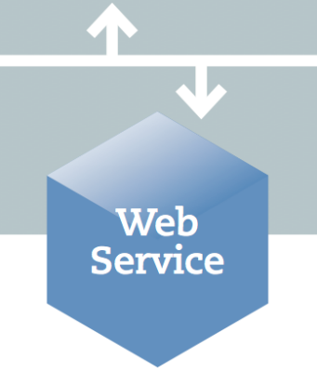
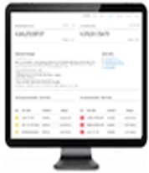



Architecture
(LAE)
JSON Request →
← JSON Response
Technology Stack
UI : Angular 7
Middle Layer : Java with Spring Boot framework
Database : MongoDB
* ART(Access Request Tool) is for admin subscription

Slide 7
Thank you !!

