Slide 1
Java Database Connectivity

Slide 2
Concept
Java Database Connectivity (JDBC) is the set of Java Classes and the interfaces.
Use JDBC feature within our java program to access almost all available RDBMS (Oracle, MS-Access, MS-SQL Sybase).
JDBC is the part of java.sql package.
JDBC consist of 7 interfaces and two classes.
Seven Interfaces are:
    Driver interface
    Connection interface
    Statement interface
    PreparedStatement interface
    CollableStatement interface
    ResulSet interface
    ResulSetMetaData interface
And two abstract classes are
    DriverManager class
    DriverPropertyInfo class

Slide 3
ESTABLISHING A CONNECTION :
First we need to do is to load the Driver class into the JVM for specified JDBC – ODBC driver and then make a connection to the RDBMS.
To loading of JDBC Driver class registered itself with DriverManager. following method is used for this purpose (i.e. Class.forName).
    Class.forName(“com.mysql.cj.jdbc.Driver”);
forName() method will automatically create an instance of the JDBC-ODBC driver and register it with the DriverManager.
We shall establish the connection to a RDBMS by using following line of code
Connection con = DriverManager.getConnection("jdbc:mysql://localhost:3306/SOCS12",
"root","root123");
Note : This connection object is used to create the JDBC Statement that passes the SQL statement to the DBMS System.

Slide 4
How we will be create table Explain with MYSQL Database
How we will submitting the CREATE TABLE , DELETE TABLE , UPDATE TABLE , INSERT (sql query) command from Java program to the RDBMS.
For That we need to use Connection Object.
Connection Interface having some of the methods declared that are-
    createStatement();
    prepareStatement();
    prepareCall();
    setAutoCommit();
    commit();
    rollback();
    setReadOnly();
Then We need to call any one of the above method (e.g. createStatement()) from the connection Object con in order to create an object of a class that implements the Statement interface.
Statement stat=con.createStatement();

Slide 5
Important methods declared in the Statement class are
Method | Purpose
executeQuery() | 1. Invoke this method to submit a SQL SELECT command 2. It Returns the ResultSet object , ResulSet consists of row returned by the select statement
executeUpdate() | 1. Invoke this method to submit a SQL INSERT or UPDATE or DELETE command. 2. It returns an integer value , which specifies no. of rows affected. 3. This statement also use to creating , altering and deleting tables
close() | 1. Invoke this method to immediately release a statement’s resources.
execute(String sql) | 1. This statement can be used in place of executeUpdate or executeQuery().

Slide 6
Note :
The retrieved contents of the table with the help of SQL Query are stored in the ResultSet Object.
e.g.
ResultSet rs = stat.executeQuery("select * from Studentdetails");

Slide 7
How do we create DATABASE , Tables and Insert recorords into Tables :
MySQL Create Database
A database is used to store the collection of records in an organized form. It allows us to hold the data into tables, rows, columns, and indexes to find the relevant information frequently. We can access and manage the records through the database very easily.
MySQL a database as a directory that stores all files in the form of a table. It allows us to create a database mainly in two ways:
  MySQL Command Line Client
  MySQL Workbench

Slide 8
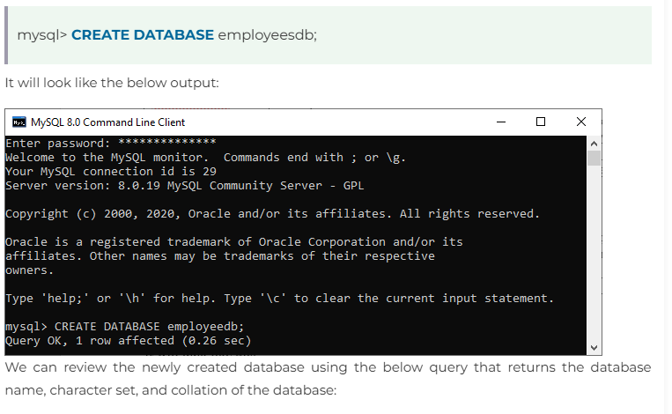
MySQL Command Line Client

Slide 9
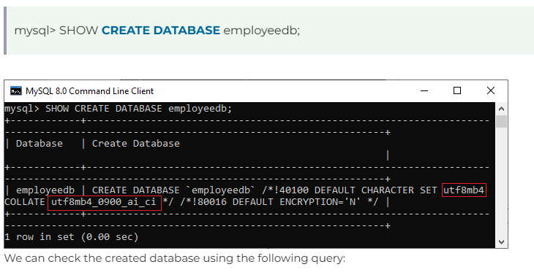
MySQL Command Line Client

Slide 10
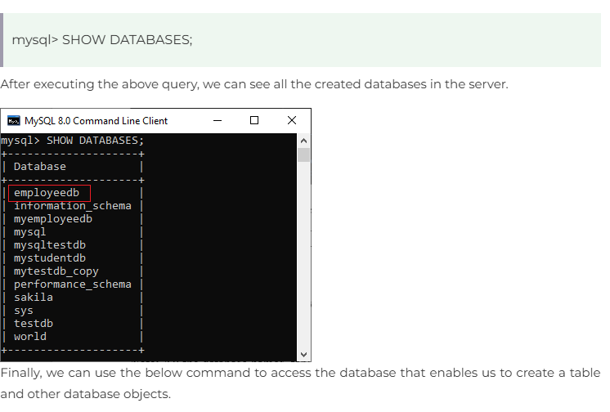
MySQL Command Line Client

Slide 11
MySQL Workbench
It is a visual database designing or GUI tool used to work with database architects, developers, and Database Administrators. This visual tool supports SQL development, data modeling, data migration, and comprehensive administration tools for server configuration, user administration, backup, and many more. It allows us to create new physical data models, E-R diagrams, and SQL development (run queries, etc.).
To create a new database using this tool, we first need to launch the MySQL Workbench and log in using the username and password that you want. It will show the following screen:

Slide 12
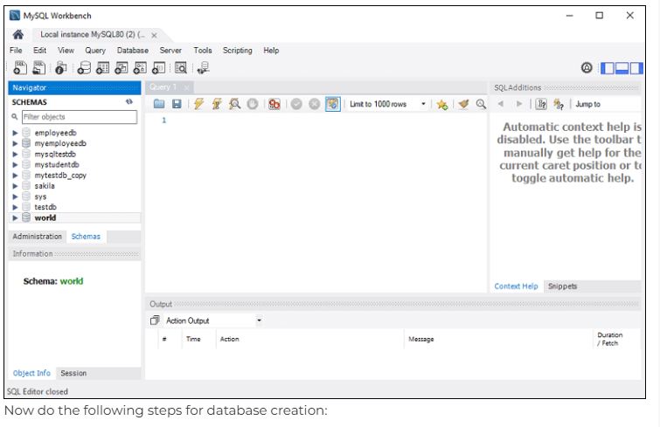
MySQL Workbench

Slide 13
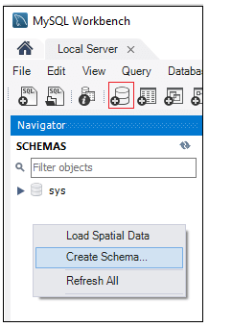
MySQL Workbench
Step- 1: Go to the Navigation tab and click on the Schema menu. Here, we can see all the previously created databases. If we want to create a new database, right-click under the Schema menu and select Create Schema or click the database icon (red rectangle), as shown in the following screen.

Slide 14
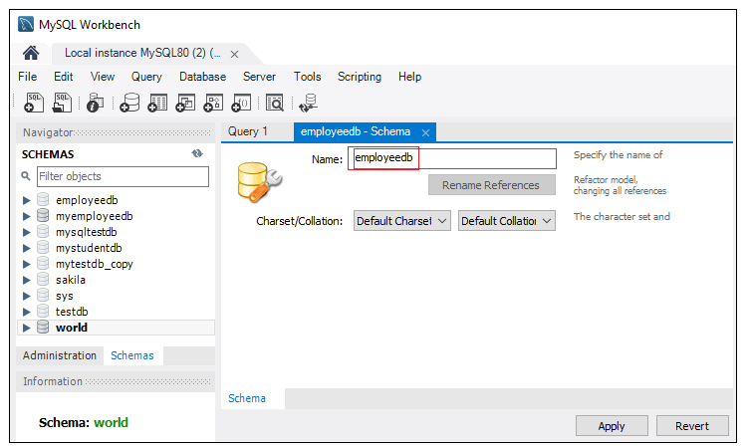
MySQL Workbench
Step- 2: The new Schema window screen open. Enter the new database name (for example, employeedb) and use default character set and collation. Now, click on the Apply button as shown in the screen below:.

Slide 15
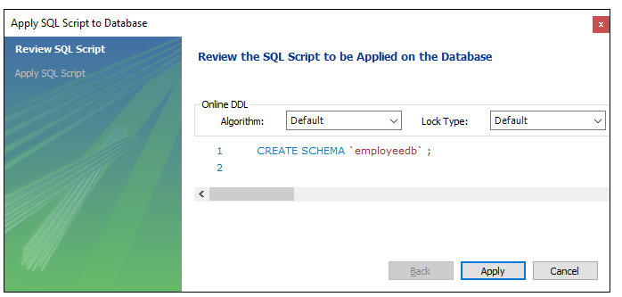
MySQL Workbench
Step- 3: A new popup window appears. Click on the Apply button

Slide 16
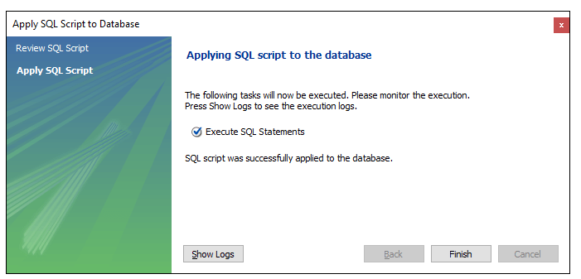
MySQL Workbench
Step- 4: A new popup screen appears. Click on the Finish button to complete the database creation.

Slide 17
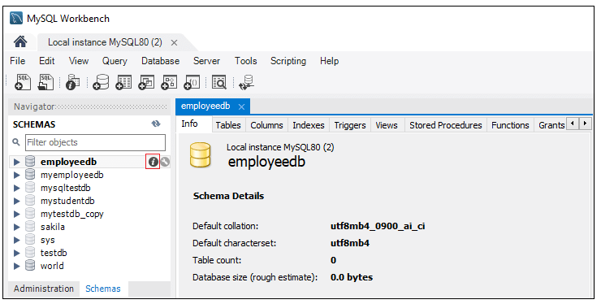
MySQL Workbench
Step- 5: After successful database creation, we can see new databases in the Schema menu. If we do not see this, click on the refresh icon into the Schema menu
Step- 6: We can see more information about the database by selecting the database and click on the 'i' icon. The information window displays several options, like Table, Triggers, Indexes, Users, and many more

Slide 18
MySQL Workbench
Step- 7: MySQL Workbench does not provide an option to rename the database name, but we can create, update, and delete the table and data rows from the database.
MySQL SELECT Database
SELECT Database is used in MySQL to select a particular database to work with. This query is used when multiple databases are available with MySQL Server.
You can use SQL command USE to select a particular database.
Syntax:
USE database_name;

Slide 19
MySQL Select Database
SELECT Database is used in MySQL to select a particular database to work with. This query is used when multiple databases are available with MySQL Server.
You can use SQL command USE to select a particular database.
Syntax:
USE database_name;

Slide 20
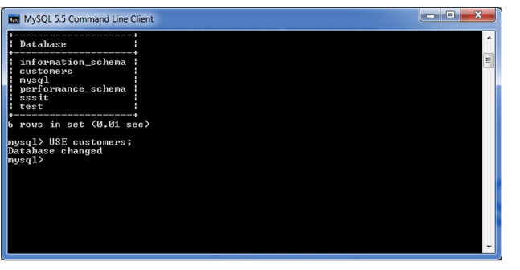
MySQL Select Database
Let's take an example to use a database name "customers".
USE customers;
It will look like this:

Slide 21
MySQL Show/List Databases
When we work with the MySQL server, it is a common task to show or list the databases, displaying the table from a particular database, and information of user accounts and their privileges that reside on the server. In this article, we are going to focus on how to list databases in the MySQL server.
We can list all the databases available on the MySQL server host using the following command, as shown below:
mysql> SHOW DATABASES;

Slide 22
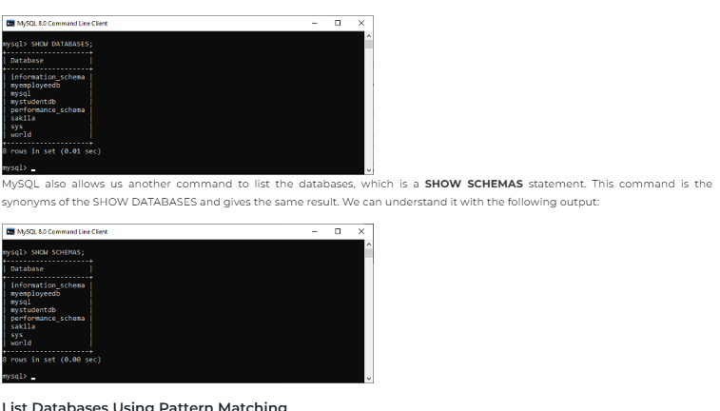

Slide 23
Creation of Java Project OR Mavin Project in Eclipse:
Integration or Installation of MySQL Dependencies through jar file
Download jar file and save in a particular folder using the following link
Link : https://repo1.maven.org/maven2/com/mysql/mysql-connector-j/9.1.0/

Slide 24
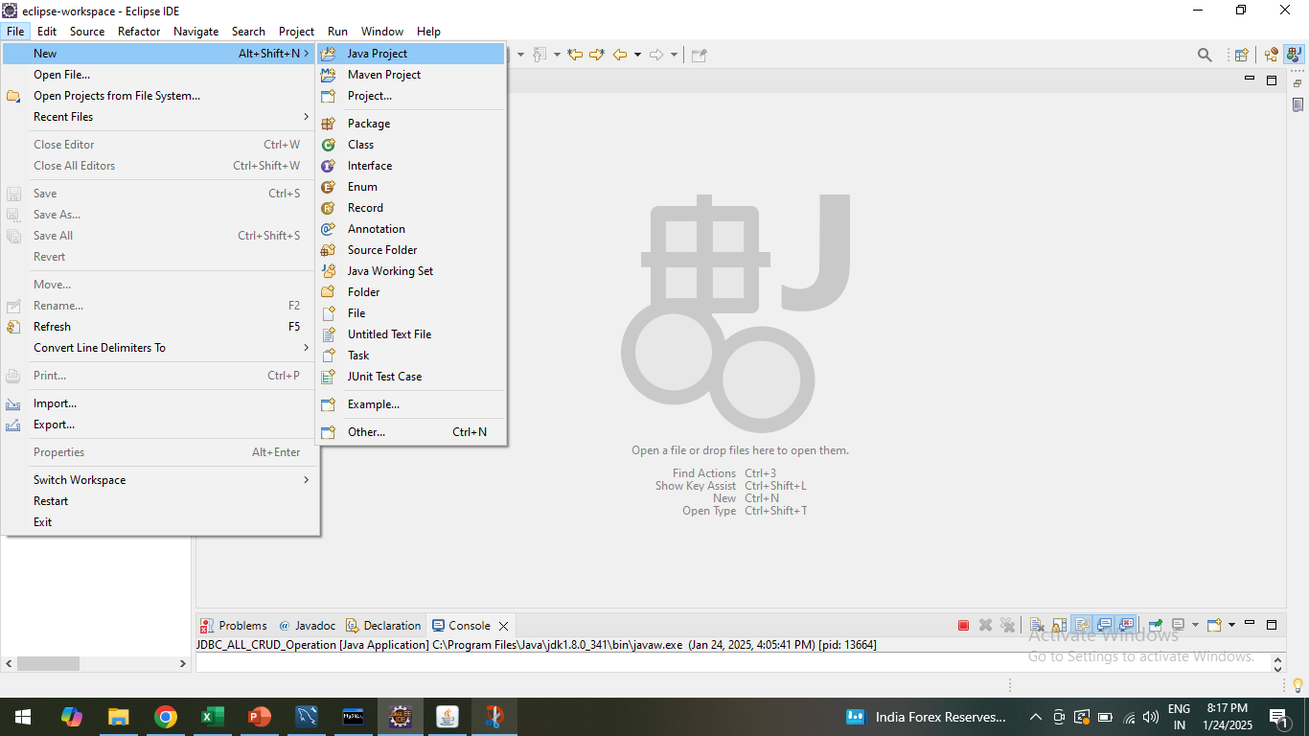
Creation of Java Project Or Maven Project:
Step-I: Creation of Java Project

Slide 25
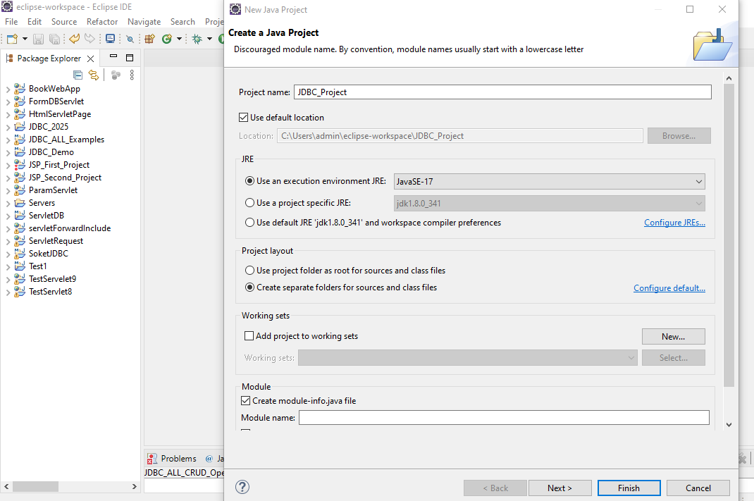
Creation of Java Project Or Maven Project:
Step-II: Assign the name to Java Project and Click on next

Slide 26
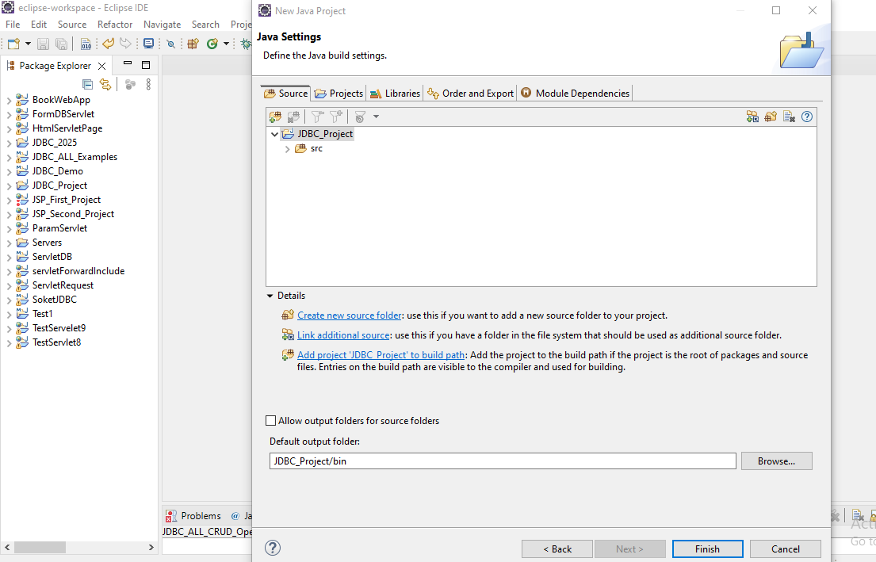
Creation of Java Project Or Maven Project:
Step-III: JDBC _Project is created

Slide 27
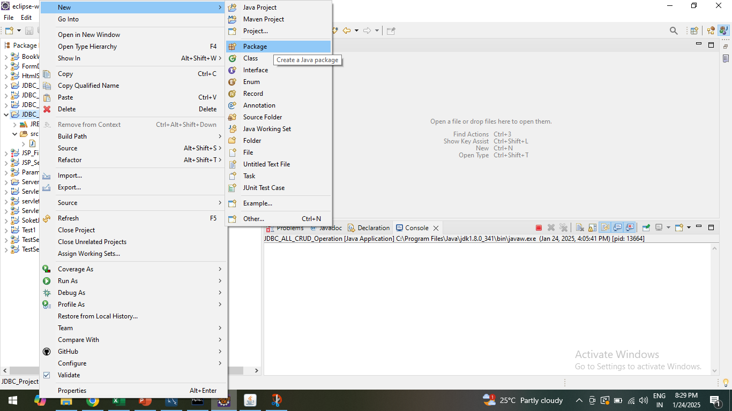
Creation of Java Project Or Maven Project:
Step-IV: Create / Add the Package (jdbc_2025_demo) in to created JDBC _Project

Slide 28
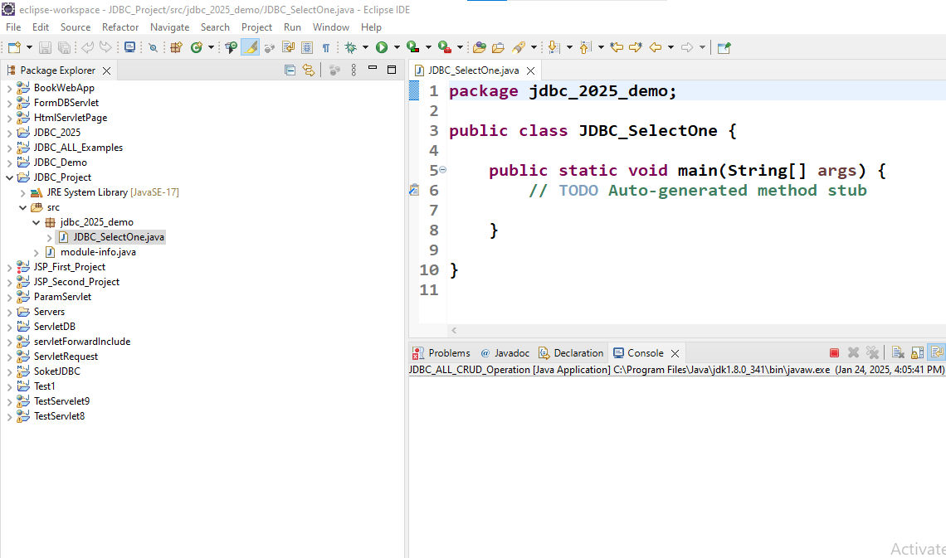
Creation of Java Project Or Maven Project:
Step-V: Create / Add the Class in package created (e.g.class JDBC_SelectOne ) is created Under Package (e.g. jdbc_2025_demo) Under Java Project (e.g. JDBC _Project)

Slide 29
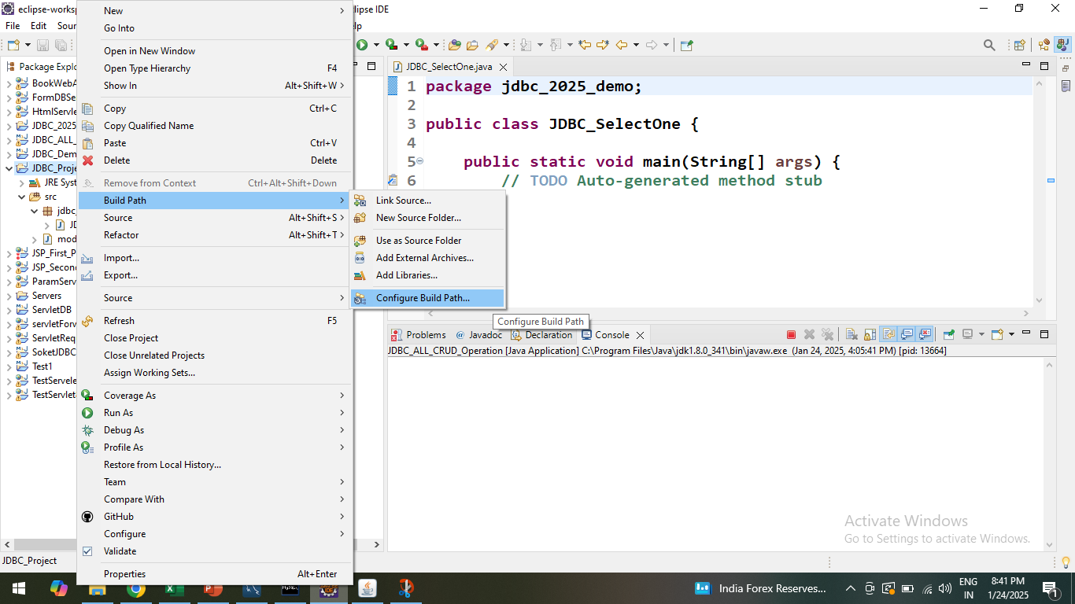
Incorporation or Inclusion of .jar file connector in to Java Project which we created:
Step-I: Write Click on Project we created → Buld Path → ConfigureBuildPath

Slide 30
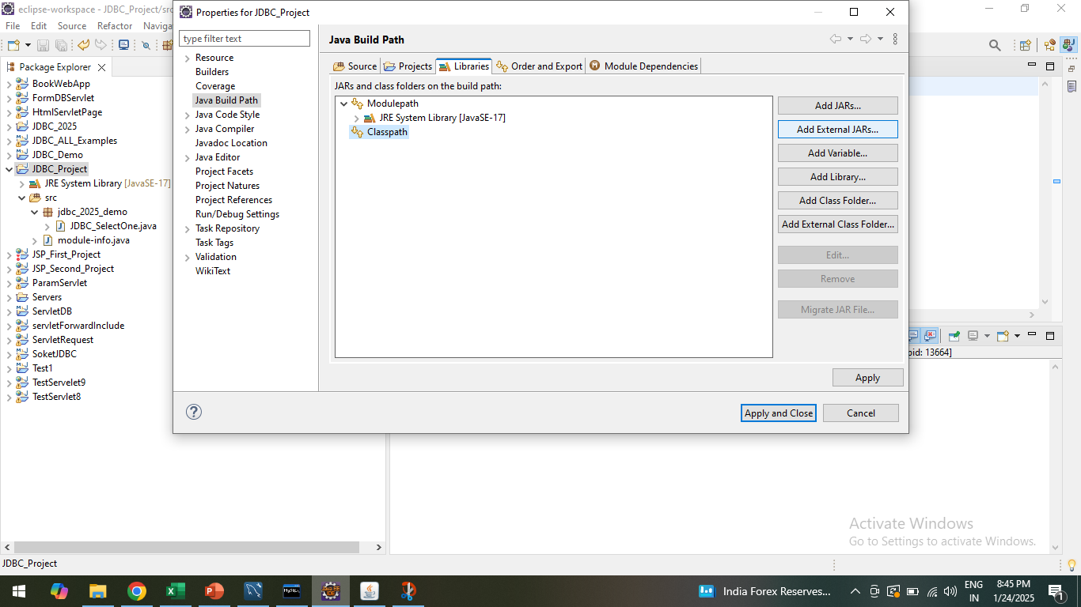
Incorporation or Inclusion of .jar file connector into Java Project which we created:
Step-II: Select Libraries tab → Click on Classpath → Add External Jars

Slide 31
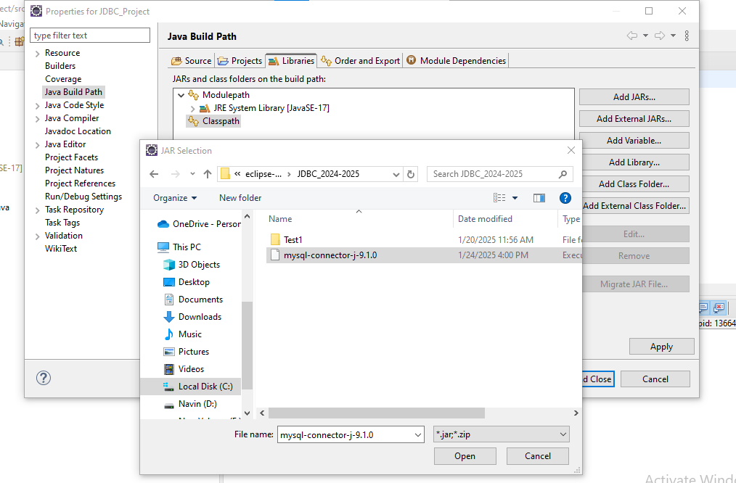
Incorporation or Inclusion of .jar file connector into Java Project which we created:
Step-III: Select the folder where you saved the downloaded mysql-connector-j-9.1.0 file

Slide 32
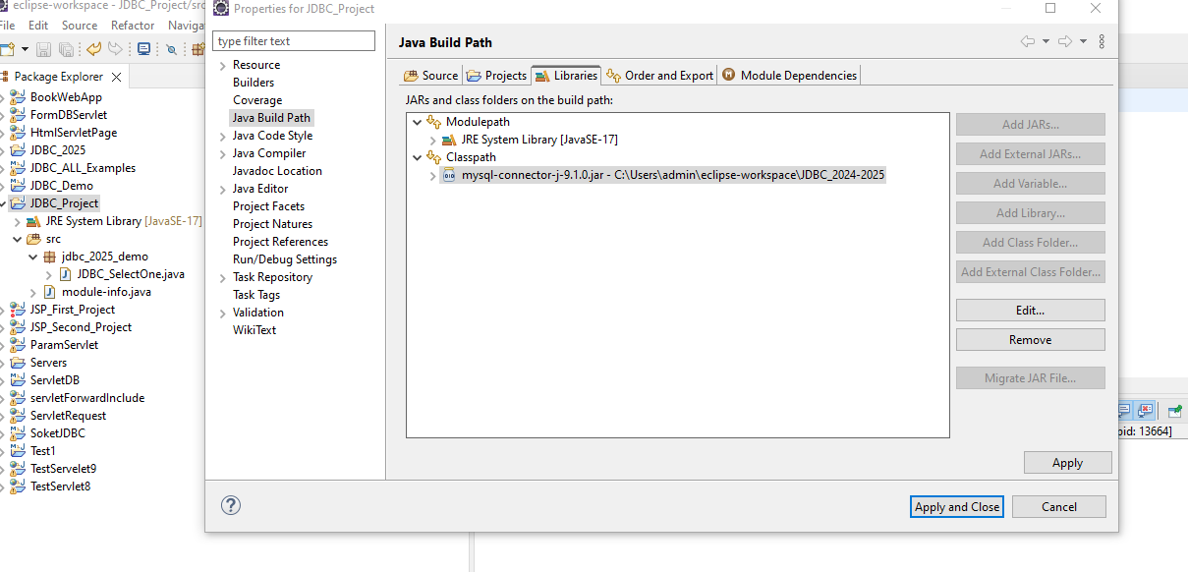
Incorporation or Inclusion of .jar file connector into Java Project which we created:
Step-IV: Click on Open now external mysql-connector-j-9.1.0 file added into Java Project which we created → Click on Apply → Click on Apply and Close

Slide 33
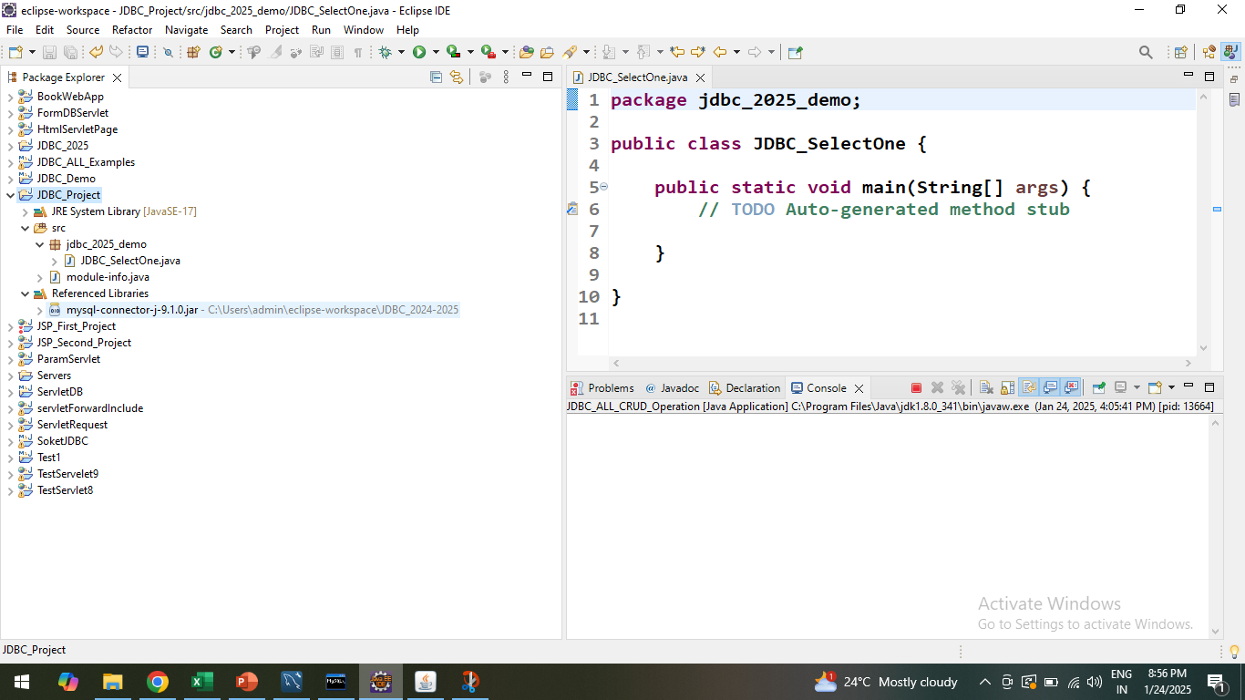
Incorporation or Inclusion of .jar file connector into Java Project which we created:
Step-IV: Check the file is present or not under the Project we created → Reference Library→ mysql-connector-j-9.1.0.jar - C:\Users\admin\eclipse-workspace\JDBC_2024-2025\mysql-connector-j-9.1.0.jar

Slide 34
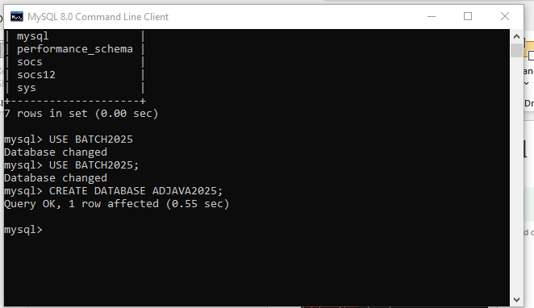
Creation of Database / Table in Mysql – Remember Mysql Username and Password
Step-I : Click on Start → Open → Mysql 8.0 command Line Clint
Wrtie → CREATE DATABASE ADJAVA2025;
Database ADJAVA2025 is created

Slide 35
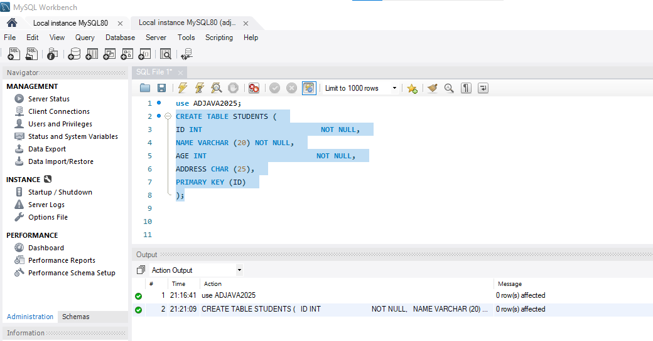
Creation of Database / Table in Mysql – Remember Mysql Username and Password
Step-II : Create a Table into Database → e.g Student_Info
CREATE TABLE STUDENTS (
ID INT NOT NULL,
NAME VARCHAR (20) NOT NULL,
AGE INT NOT NULL,
ADDRESS CHAR (25),
PRIMARY KEY (ID)
);

Slide 36
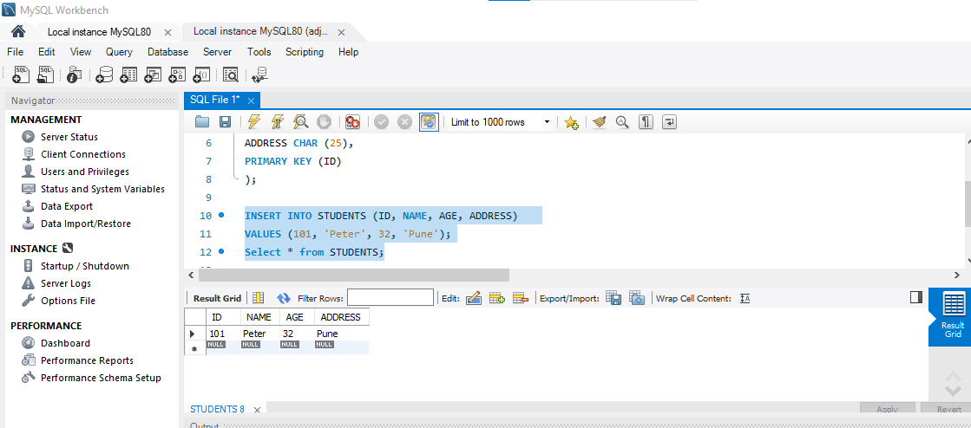
Creation of Database / Table in Mysql – Remember Mysql Username and Password
Step-III: Insertion and Selection of Records in the STUDENTS Table
INSERT INTO STUDENTS (ID, NAME, AGE, ADDRESS) VALUES (101, 'Peter', 32, 'Pune’);
Select * from STUDENTS;

Slide 37
(SELECT) Viewing of this Inserted record in STUDENTS Table from .java file Or Java Project we created from → JDBC_SelectOne. Java class as we created earlier
package jdbc_2025_demo;
import java.sql.Connection;
import java.sql.DriverManager;
import java.sql.ResultSet;
import java.sql.Statement;
public class JDBC_SelectOne {
public static void main(String[] args) {
// TODO Auto-generated method stub
try
{
Class.forName("com.mysql.cj.jdbc.Driver"); // To loading MYsql JDBC Driver
Connection con=DriverManager.getConnection("jdbc:mysql://localhost:3306/ADJAVA2025","root","root123");

Slide 38
(SELECT) Viewing of this Inserted record in STUDENTS Table from .java file Or Java Project we created from → JDBC_SelectOne. Java class as we created earlier
// Establishing the Connection: here SOCS is database name, root is username and password is root123
Statement stmt=con.createStatement(); // To execute sql statement creating object of statement
ResultSet rs=stmt.executeQuery("select * from STUDENTS");
while(rs.next())
System.out.println(rs.getInt(1)+" "+rs.getString(2)+" "+rs.getInt(3)+" "+rs.getString(4));
con.close();
}
catch(Exception e)
{
System.out.println(e);
}
}
}

Slide 39
// Selecting records present in the Table present in database
package DB_Basics;
import java.sql.*;
public class DBConnection
{
public static void main(String[] args)
{
// TODO Auto-generated method stub
try
{
Class.forName("com.mysql.jdbc.Driver");
Connection con=DriverManager.getConnection("jdbc:mysql://localhost:3306/ SOCS","root","root123");
//here SOCS is database namse, root is username and password
Statement stmt=con.createStatement();
ResultSet rs=stmt.executeQuery("select * from emp");
while(rs.next())
System.out.println(rs.getInt(1)+" "+rs.getString(2)+" "+rs.getString(3));
con.close();
}

Slide 40
catch(Exception e)
{
System.out.println(e);
}
}
}

Slide 41
// Creating Table in database from .java file
package JDBC4;
import java.sql.Connection;
import java.sql.DriverManager;
import java.sql.ResultSet;
import java.sql.SQLException;
import java.sql.Statement;
public class DB_InsertData {
public static void main(String[] args)
{
// TODO Auto-generated method stub
Connection con;
Statement stmt;
String CreateString;
CreateString = "create table TEATABLE1 (TEA_NAME VARCHAR(30),SUPP_ID INT ,PRICE INT ,SALES INT ,TOTAL INT)";
//"CREATE TABLE TEATABLE (TEA_NAME VARCHAR2(30),SUPP_ID NUMBER(6),PRICE NUMBER(6,2),SALES NUMBER(6,2),TOTAL NUMBER(6,2))";

Slide 42
try
{
Class.forName("com.mysql.cj.jdbc.Driver"); // To loading MYsql JDBC Driver
}
catch (java.lang.ClassNotFoundException e1)
{
System.out.println(e1.getMessage());
}
try
{
con=DriverManager.getConnection("jdbc:mysql://localhost:3306/ SOCS12","root","root123");
stmt=con.createStatement();
stmt.executeUpdate(CreateString); of Resulset
stmt.close();
con.close();
}
catch(SQLException ex)
{
System.out.println("Sql Exeception Error"+ ex.getMessage());
}
}
}

Slide 43
// Inserting the records in table and Retrieving records from Table
package JDBC_ALL_DEMO;
import java.io.BufferedReader;
import java.io.IOException;
import java.io.InputStreamReader;
import java.sql.Connection;
import java.sql.DriverManager;
import java.sql.ResultSet;
import java.sql.SQLException;
import java.sql.Statement;
class Insert_JDBC_Demo
{
public static void main(String[] args) throws ClassNotFoundException, SQLException, IOException
{
BufferedReader br=new BufferedReader(new InputStreamReader(System.in));
Class.forName("com.mysql.cj.jdbc.Driver");
Connection con=DriverManager.getConnection("jdbc:mysql://localhost:3306/SOC S","root","root123");
Statement stmt=con.createStatement();

Slide 44
System.out.print("Enter Query For update : ");
String str1=br.readLine();
int up=stmt.executeUpdate(str1);
System.out.println("No of recored updated = "+up);
System.out.print("Fired the query : ");
String str=br.readLine();
ResultSet rs=stmt.executeQuery(str);
System.out.println("\tId\tName\t\tAge\n");
while(rs.next())
{
System.out.print("\t"+rs.getInt(1));
System.out.print("\t"+rs.getString(2));
System.out.print("\t"+rs.getInt(3));
System.out.println("\n");
}
}
}

Slide 45
// Inserting the records in table and Retrieving records from Table Using GUI: AWT/ Swing
package AWT_JDBC_Ex;
import java.awt.*;
import java.awt.event.*;
import java.sql.*;
public class Jdbc_View_Record
{
public static void main(String[] args)
{
// TODO Auto-generated method stub
frm f=new frm();
f.setSize(500,500);
f.setVisible(true);
}
}

Slide 46
class frm extends Frame implements ActionListener
{
Label l1,l2,l3;
Button b1;
TextField tf1,tf2,tf3;
Connection cn;
PreparedStatement ps;
ResultSet rs;
public frm()
{
setLayout(null);
l1=new Label("EmpID");
l1.setBounds(50,50,50,50);
l2=new Label("Empname");
l2.setBounds(50,250,50,50);
l3=new Label("Age");
l3.setBounds(50,350,50,50);
b1=new Button("View_Record");

Slide 47
tf1=new TextField(10);
tf1.setBounds(50,150,150,150);
tf2=new TextField(10);
tf2.setBounds(50,250,150,150);
tf3=new TextField(10);
tf3.setBounds(50,350,150,150);
add(l1);
add(l2);
add(l3);
add(b1);
add(tf1);
add(tf2);
add(tf3);
b1.addActionListener(this);
setLayout(new FlowLayout());
try
{ Class.forName("com.mysql.cj.jdbc.Driver"); cn=DriverManager.getConnection("jdbc:mysql://localhost:3306/SOCS","root","root123");
}

Slide 48
catch(Exception e){
System.out.println(e);
}}
public void actionPerformed(ActionEvent ae){
if(ae.getSource()==b1)
{
try{
ps=cn.prepareStatement("select * from emp where id=?");
ps.setString(1,tf1.getText());
rs=ps.executeQuery();
while(rs.next()){
tf2.setText(rs.getString(2));
tf3.setText(rs.getString(3));
}
}
catch(Exception e){
System.out.println(e);
}
}
}
}

Slide 49
// Updating the records in table
package JDBC_ALL_DEMO;
import java.sql.Connection;
import java.sql.DriverManager;
import java.sql.ResultSet;
import java.sql.SQLException;
import java.sql.Statement;
public class JDBC_Update
{
// TODO Auto-generated method stub
public static void main(String[] args) throws SQLException
{
Connection con;
Statement stmt = null;
try
{
Class.forName("com.mysql.cj.jdbc.Driver"); // To loading MYsql JDBC Driver
}
catch (java.lang.ClassNotFoundException e1)
{
System.out.println(e1.getMessage());
}

Slide 50
try
{
con=DriverManager.getConnection("jdbc:mysql://localhost:3306/SOCS12","root","root123");
stmt=con.createStatement();
ResultSet r1 = stmt.executeQuery("Select TEA_NAME,PRICE from teatable");
while(r1.next())
{
String s= r1.getString("TEA_NAME");
float f= r1.getFloat("PRICE");
System.out.println(s +" "+ f);
}
}
catch(SQLException ex)
{
System.out.println("Sql Exeception Error"+ ex.getMessage());
}

Slide 51
try {
stmt.executeUpdate("UPDATE teatable SET PRICE=34 WHERE TEA_NAME='ThreeRoseTea'");
}
catch(Exception e)
{
System.out.println(e.getMessage());
}
ResultSet rs = stmt.executeQuery("Select TEA_NAME,PRICE from teatable");
while(rs.next())
{
String s1= rs.getString("TEA_NAME");
float p= rs.getFloat("PRICE");
System.out.println(s1+" "+p);
}
}
}

Slide 52
Use of PreparedStatement
Features | Statement | PreparedSatement
Parameters | Cannot accept parameters at runtime; values must be concatenated into the SQL string. | Accepts dynamic input parameters using placeholders (?).
Preperformance | Slower for repeated execution because the SQL query is compiled/parsed by the database every time it runs. | Faster for repeated execution of the same query structure because it is precompiled once and the execution plan is cached on the database server.
Usage | Suitable for static queries, typically Data Definition Language (DDL) statements like CREATE, ALTER, or DROP. | Ideal for Data Manipulation Language (DML) statements like SELECT, INSERT, UPDATE, and DELETE, especially when executed multiple times with different data.

Slide 53
Use of PreparedStatement
Security | Highly vulnerable to SQL injection attacks if user input is not carefully validated/escaped. | Prevents SQL injection by automatically escaping parameter values, treating all user input as data, not executable code.
Summary : In modern Java development, it is a best practice to almost always use PreparedStatement due to its superior security and performance benefits. The only time Statement might be used is for truly static SQL statements, such as DDL commands, that do not require any input parameters

Slide 54
OBTAINING METADATA USING ResultSetMetaData interface
. Sometimes we doesn't know about structure of table.
- In this situation we use methods of ResulMetaData interface for retrieving the vital data about a data table
- getColumnCount() = returns number of columns
- getColumnName()
- getColumnType()
- getColumnDisplaySize()
- isPricision()= returns number of decimal digits
-getTableName()

Slide 55
(INSERT) record in STUDENTS Table from .java file Or Java Project we created from → JDBC_SelectOne. Java class as we created earlier

Slide 56
(INSERT) record in STUDENTS Table from .java file Or Java Project we created from → JDBC_SelectOne. Java class as we created earlier

Slide 57
(UPDATE) record in STUDENTS Table from .java file Or Java Project we created from → JDBC_SelectOne. Java class as we created earlier

Slide 58
(UPDATE) record in STUDENTS Table from .java file Or Java Project we created from → JDBC_SelectOne. Java class as we created earlier

Slide 59
(DELETE) record in STUDENTS Table from .java file Or Java Project we created from → JDBC_SelectOne. Java class as we created earlier

Slide 60
(DELETE) record in STUDENTS Table from .java file Or Java Project we created from → JDBC_SelectOne. Java class as we created earlier

Slide 61
(ALL CRUDE SQL OPERATION WITH GUI ) record in STUDENTS Table from .java file Or Java Project we created from → JDBC_SelectOne. Java class as we created earlier

Slide 62
Creation of Java Project Or Maven Project:
Step-VI: Assign the name for creted class and start writing java database connectivity code

Slide 63
package DB_Basics;
import java.sql.*;
public class DBConnection
{
public static void main(String[] args)
{
// TODO Auto-generated method stub
try
{
Class.forName("com.mysql.jdbc.Driver");
Connection con=DriverManager.getConnection("jdbc:mysql://localhost:3306/ SOCS","root","root123");
//here SOCS is database namse, root is username and password
Statement stmt=con.createStatement();
ResultSet rs=stmt.executeQuery("select * from emp");
while(rs.next())
System.out.println(rs.getInt(1)+" "+rs.getString(2)+" "+rs.getString(3));
con.close();
}

Slide 64
catch(Exception e)
{
System.out.println(e);
}
}
}

Slide 65
package JDBC4;
import java.sql.Connection;
import java.sql.DriverManager;
import java.sql.ResultSet;
import java.sql.SQLException;
import java.sql.Statement;
public class DB_InsertData {
public static void main(String[] args)
{
// TODO Auto-generated method stub
Connection con;
Statement stmt;
String CreateString;
CreateString = "create table TEATABLE1 (TEA_NAME VARCHAR(30),SUPP_ID INT ,PRICE INT ,SALES INT ,TOTAL INT)";
//"CREATE TABLE TEATABLE (TEA_NAME VARCHAR2(30),SUPP_ID NUMBER(6),PRICE NUMBER(6,2),SALES NUMBER(6,2),TOTAL NUMBER(6,2))";

Slide 66
try
{
Class.forName("com.mysql.cj.jdbc.Driver"); // To loading MYsql JDBC Driver
}
catch (java.lang.ClassNotFoundException e1)
{
System.out.println(e1.getMessage());
}
try
{
con=DriverManager.getConnection("jdbc:mysql://localhost:3306/ SOCS12","root","root123");
stmt=con.createStatement();
stmt.executeUpdate(CreateString); of Resulset
stmt.close();
con.close();
}
catch(SQLException ex)
{
System.out.println("Sql Exeception Error"+ ex.getMessage());
}
}
}

Slide 67
Byte Stream sub classes are –

Slide 68
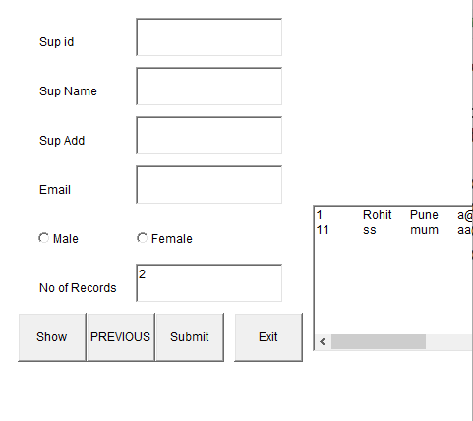
Example – Supplier Information Form

Slide 69
package JDBC4;
import java.sql.Connection;
import java.sql.DriverManager;
import java.sql.ResultSet;
import java.sql.SQLException;
import java.sql.Statement;
public class jdbcsup
{
public static void main(String[] args)
{
// TODO Auto-generated method stub
frmrecord f = new frmrecord();
f.setSize(500,500);
f.setVisible(true);
}
}

Slide 70
class frmrecord extends Frame implements ActionListener
{
private static final long serialVersionUID = 1L;
Label l1,l2,l3,l4,l5;
TextField tf1,tf2,tf3,tf4,tf5;
CheckboxGroup chb;
Checkbox ch1,ch2;
TextArea ta;
Button b1,b2,b3,b4,b5;
Connection cn;
PreparedStatement ps;
Statement st;
ResultSet rs;
String s="";
String str="";

Slide 71
public frmrecord()
{
setLayout(null);
l1=new Label("Sup id");
l1.setBounds(50,50,100,50);
l2=new Label("Sup Name");
l2.setBounds(50,100,100,50);
l3=new Label("Sup Add");
l3.setBounds(50,150,100,50);
l4=new Label("Email");
l4.setBounds(50,200,100,50);
l5=new Label("No of Records");
l5.setBounds(50,300,100,50);

Slide 72
chb=new CheckboxGroup();
ch1=new Checkbox("Male",chb,false);
ch2=new Checkbox("Female",chb,false);
ch1.setBounds(50,250,75,50);
ch2.setBounds(150,250,75,50);
tf1=new TextField(10);
tf1.setBounds(150,50,150,40);
tf2=new TextField(10);
tf2.setBounds(150,100,150,40);
tf3=new TextField(10);
tf3.setBounds(150,150,150,40);
tf4=new TextField(10);
tf4.setBounds(150,200,150,40);
tf5=new TextField(10);
tf5.setBounds(150,300,150,40);

Slide 73
ta=new TextArea(10,10);
ta.setBounds(330,240,200,150);
b1=new Button("Show");
b1.setBounds(30,350,70,50);
b2=new Button("PREVIOUS");
b2.setBounds(100,350,70,50);
b3=new Button("Submit");
b3.setBounds(170,350,70,50);
b4=new Button("Exit");
b4.setBounds(250,350,70,50);
b1.addActionListener(this);
b2.addActionListener(this);
b3.addActionListener(this);
b4.addActionListener(this);

Slide 74
add(l1);
add(l2);
add(l3);
add(l4);
add(l5);
add(tf1);
add(tf2);
add(tf3);
add(tf4);
add(ch1);
add(ch2);
add(tf5);
add(ta);
add(b1);
add(b2);
add(b3);
add(b4);

Slide 75
try
{
Class.forName("com.mysql.cj.jdbc.Driver");
cn=DriverManager.getConnection("jdbc:mysql://localhost:3306/SOCS","root","root123");
}
catch(Exception e)
{
System.out.println(e.getMessage());
}
}

Slide 76
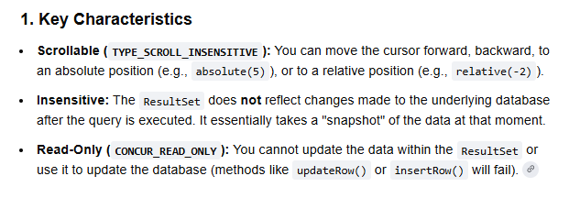
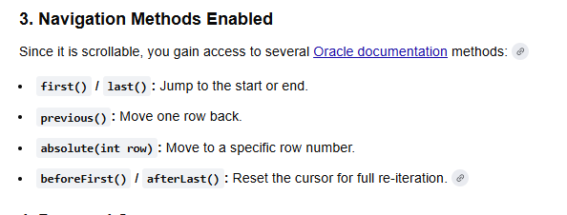
.

Slide 77
ResultSet.TYPE_SCROLL_INSENSITIVE, ResultSet.CONCUR_READ_ONLY are constants used in Java Database Connectivity (JDBC) to specify the type and concurrency Chracteristics of a ResultSet object.
Scrollable: The cursor can move in both forward and backward directions. Methods like next(), previous(), first(), last(), and absolute() can be used to navigate the result set
Insensitive to Changes: The ResultSet does not reflect changes made to the underlying data in the database after the query was executed and the result set was obtained. It contains a static copy of the data present at the time of creation.

Slide 78
ResultSet.CONCUR_READ_ONLY
This constant defines the concurrency (updatability) of the ResultSet
Read-Only: The ResultSet can only be used to read data. It cannot be used to update, insert, or delete records in the underlying database table through the result set itself.

Slide 79
How it is used
These constants are typically passed as arguments when creating a Statement, PreparedStatement, or CallableStatement object, as shown in the following Java example
Statement stmt = connection.createStatement(ResultSet.TYPE_SCROLL_INSENSITIVE, ResultSet.CONCUR_READ_ONLY);
ResultSet rs = stmt.executeQuery("SELECT * FROM your_table");
This code creates a Statement that will produce a ResultSet which you can navigate freely (scrollable), but any changes made to the database by other transactions will not be visible in this result set, and you cannot make updates using this result set's methods.

Slide 80
public void actionPerformed(ActionEvent ae)
{
if(ae.getSource()==b1)
{
int cnt=0;
int i=0;
cnt=Integer.parseInt(tf5.getText());
try
{
st=cn.createStatement(ResultSet.TYPE_SCROLL_INSENSITIVE,ResultSet.CONCUR_READ_ONLY);
//TYPE_FORWORD_ONLY
rs=st.executeQuery("select * from sup");
while(rs.next() &&i<cnt)
{
str=str+(rs.getString(1)+"\t"+rs.getString(2)+"\t"+rs.getString(3)+"\t"+rs.getString(4)+"\t"+rs.getString(5)+"\n");
ta.setText(str);
i++;
}
}
catch(Exception e)
{ } }

Slide 81
if(ae.getSource()==b2)
{
try
{
st=cn.createStatement(ResultSet.TYPE_SCROLL_INSENSITIVE,ResultSet.CONCUR_READ_ONLY);
rs=st.executeQuery("Select * from sup ");
rs.afterLast();
while(rs.previous())
{
str=str+(rs.getString(1)+"\t"+rs.getString(2)+"\t"+rs.getString(3)+"\t"+rs.getString(4)+"\t"+rs.getString(5)+"\n");
ta.setText(str);
}
}
catch(Exception e)
{
System.out.println(e.getMessage());
}
}

Slide 82
if(ae.getSource()==b3)
{
try
{
ps=cn.prepareStatement("Insert into sup values(?,?,?,?,?)");
ps.setString(1,tf1.getText());
ps.setString(2,tf2.getText());
ps.setString(3,tf3.getText());
ps.setString(4,tf4.getText());
if(ch1.getState()==true)
{
ps.setString(5,ch1.getLabel());
}
else
{
ps.setString(5,ch2.getLabel());
}
ps.executeUpdate();
System.out.println("Inserted..");
}
catch(Exception e)
{ System.out.println("Error"+e); }

Slide 83
finally
{
try
{
System.out.println("In finally");
ps=cn.prepareStatement("Update sup set sname=?,sadd=?,email=?,gender=? where sid=?");
ps.setString(1,tf2.getText());
ps.setString(2,tf3.getText());
ps.setString(3,tf4.getText());
if(ch1.getState()==true)
{
ps.setString(4,ch1.getLabel());
}
else
{
ps.setString(4,ch2.getLabel());
}
ps.setString(5,tf1.getText());
ps.executeUpdate();
System.out.println("Updated..");
}
catch(Exception e1) { } } }

Slide 84
Callable Statement in Java:
CallableStatement in java is used to call stored procedure from java program. Stored Procedures are group of statements that we compile in the database for some task. Stored procedures are beneficial when we are dealing with multiple tables with complex scenario and rather than sending multiple queries to the database, we can send required data to the stored procedure and have the logic executed in the database server itself.
JDBC API provides support to execute Stored Procedures through CallableStatement interface. Stored Procedures requires to be written in the database specific syntax and for my tutorial, I will use Oracle database. We will look into standard features of CallableStatement with IN and OUT parameters. Later on we will look into Oracle specific STRUCT and Cursor examples. Let’s first create a table for our CallableStatement example programs with below SQL query.

Slide 85
Callable Statement in Java:
Key points
prepareCall("{call procedure_name(?, ?, ?)}") → used for stored procedures
setXXX() → for IN parameters
registerOutParameter() → for OUT parameters
execute() → runs the procedure
getXXX() → retrieves OUT values

