Slide 1
Cryptocurrency Price Prediction
Using Long short-term memory (LSTM) Network
Spiced Academy Project-Satpal Nijjar

Slide 2
What is the LSTM
Is it a type of recurrent Neural Network
It works by looking at a sequence of data
Orginally used for speech and video
There is some limited research on using it for financial forecasting

Slide 3
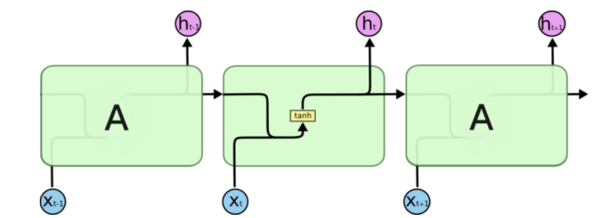
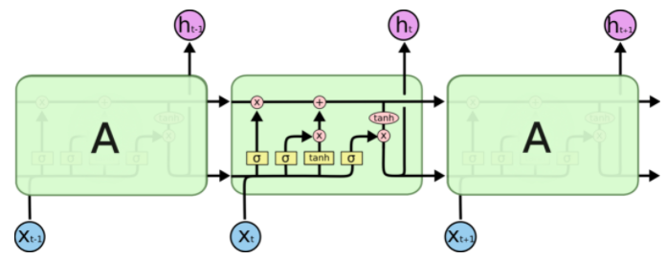
Difference to standard RNN
Sequence to sequence model
Has several nodes to help understand what to “remember“
Standard RNN
LSTM
Picture from https://towardsdatascience.com/lstm-text-classification-using-pytorch-2c6c657f8fc0

Slide 4
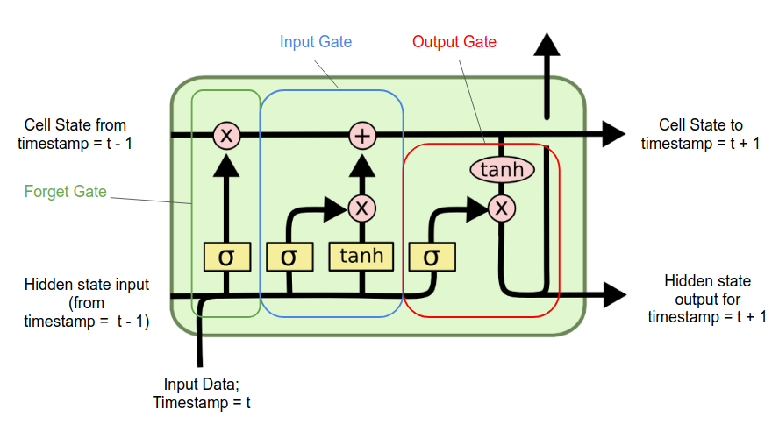
Deeper look at the LSTM node (1)
Picture from https://medium.com/analytics-vidhya/lstms-explained-a-complete-technically-accurate-conceptual-guide-with-keras-2a650327e8f2

Slide 5
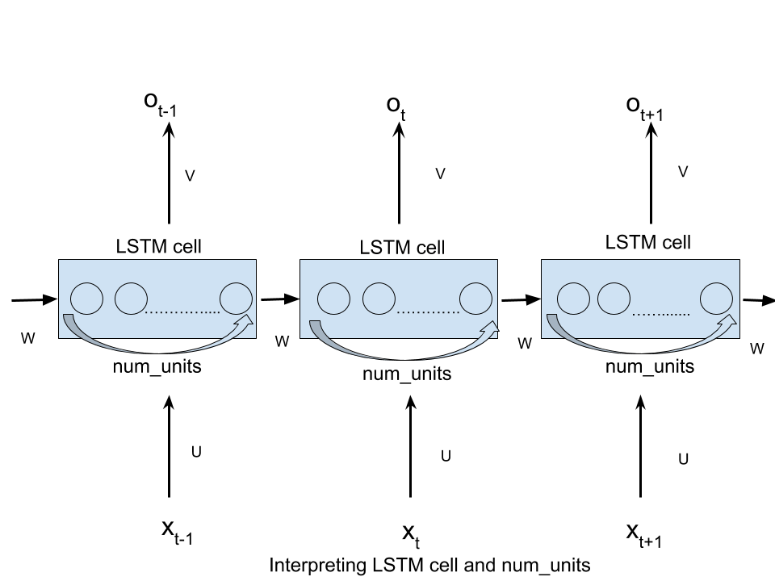
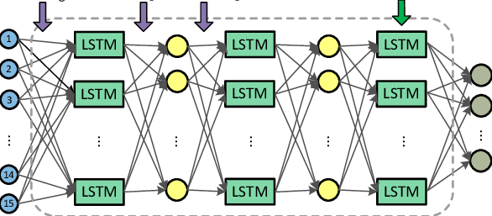
Deeper look at the LSTM node (2)
Picture from https://www.researchgate.net/figure/The-proposed-deep-LSTM-network-with-three-LSTM-layers-and-two-feedforward-layers-For_fig1_283748925 &
https://medium.com/analytics-vidhya/lstms-explained-a-complete-technically-accurate-conceptual-guide-with-keras-2a650327e8f2

Slide 6
How I applied it to my model
4 inputs (X) for each period in my sequence (t – i):
t-1 change in price (percent)
t-1 Volume traded (percent of total market cap)
t-1 volatility ((Max Price – Min Price) / Min Price )
Moving Average of changes in price for last 30 periods (from t-1 to t-31)
1 Output (y) for each predicted future sequence (t + j):
t change in price (percent)
Theoretically i and j can be any value as long there is enough data.

Slide 7
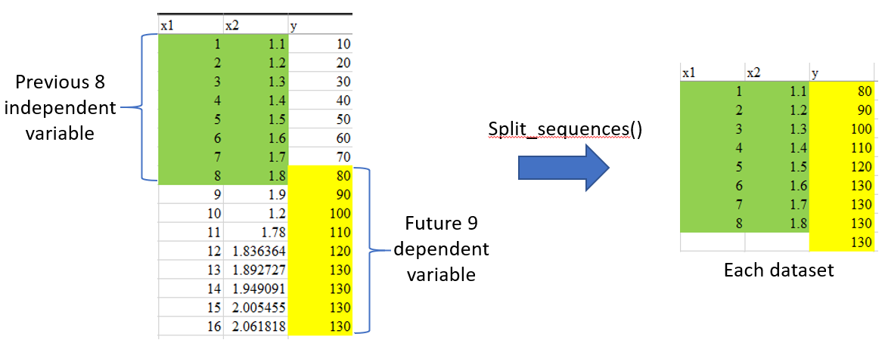
How each sequences look in practice
Picture from https://pangkh98.medium.com/multi-step-multivariate-time-series-forecasting-using-lstm-92c6d22cd9c2

Slide 8
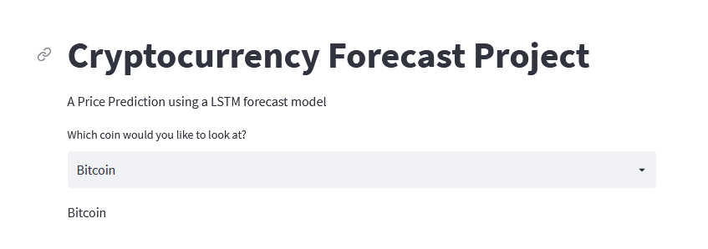
Website demo Time

Slide 9
Does it work?
Not really in its current form
Mean squared error is greater than the variance of the test data

Slide 10
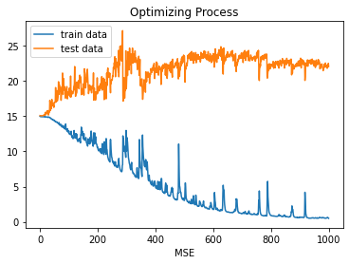
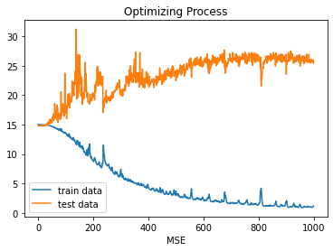
Problems with Converging (samples)
3 Layer Model (128, 64, 64)
Batch Size 64
Sequence in: 30
Sequence Out: 14
3 Layer Model (128, 64, 64)
Batch Size 64
Sequence in: 14
Sequence Out: 14
Last train error: 0.50
Last test/validation error: 22.07
Last train error: 1.2055
Last test/validation error: 25.40
Variance of test data: 14.69

Slide 11
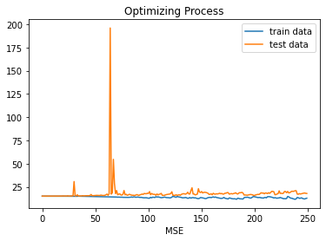
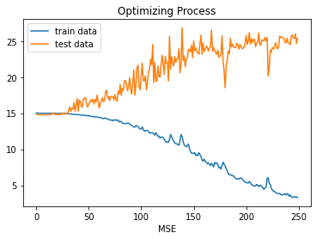
Problems with Converging (samples) (2)
3 Layer Model (128, 64, 128)
Batch Size 64
Sequence in: 30
Sequence Out: 14
3 Layer Model (128, 64, 128)
Batch Size 64
Sequence in: 14
Sequence Out: 14
Last train error: 12.78
Last test/validation error: 17.88
Last train error: 3.30
Last test/validation error: 25.51
Variance of test data: 14.69

Slide 12
Next Steps for this model
Use 2nd order difference of price data
Find and add sentiment data to the model and see if that helps
Play around further with the sequence lengths
Try a categorical target variable
Perhaps with probalistic outcome vs softmax
Group Coins together based upon their properties
Either using KNN or KMeans

Slide 13

Thanks and Questions!

