Slide 1
Resilient Data Routing Algorithms for NextGen Multi-Agent Connected Autonomous Vehicle Networks
Research brief update
by
Mustafa Donmez, Marcley C.

Slide 2
Baseline
The planning models used in the industry is our competition.
At the moment our goal is to eventually reach a model that can work well in comparison, slowly ramping up its complexity. Eventually reaching a model that aligns with our ideal:
  Autonomous Vehicles (AVs) that can improve overall decision making (such as routing) through local communication networks.

Slide 3
Background Information
And
Research
AVs utilize ROS/RTOS, many sensors, actuators and microcontrollers.
  Robotics Operating Systems find themselves as the standard in the industry.
Companies like Waymo use pipelined architectures, promoting the use of many sub-models for handling specific tasks.

Slide 4
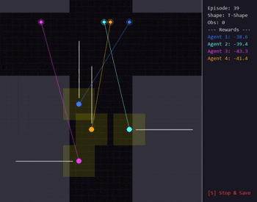
Multi-Agent Grid Navigation with Deep Actor-Critic (MARL (GN) + A2C)
MARL in Pytorch
Environment in Pygame
Current Progress - Sim demo

Slide 5
Metrics to be used
F-measure to know how good the model is to reach the goal
latency to determine how well agents are collaborating
Resource efficiency to compare with the current models

Slide 6
Future Directions
Expand on the models we can implement.
Improve on the models architecture.
Continue to try and get pre-established works (e.g. Waymax) up and running

Slide 7
Q&A and Links
Project research document:
https://www.notion.so/Final-Proj-29d5b7926dc3805b8c84e6000573667e?source=copy_link
Simulation github:
https://github.com/MustafaDon777/360-f25-Proj/

