Slide 1
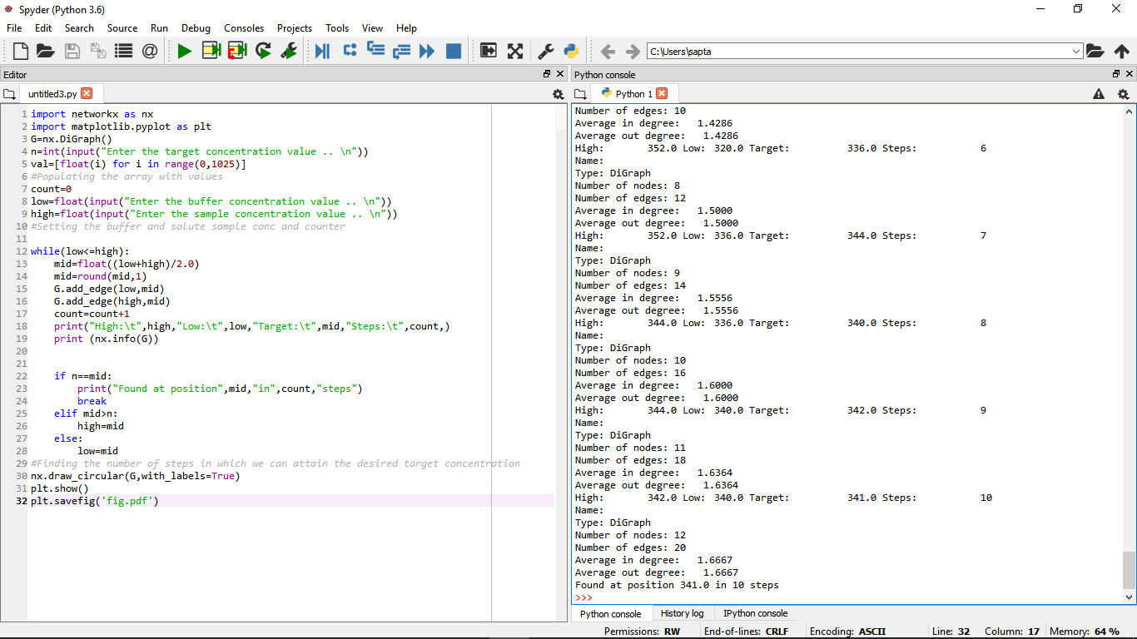

Slide 2
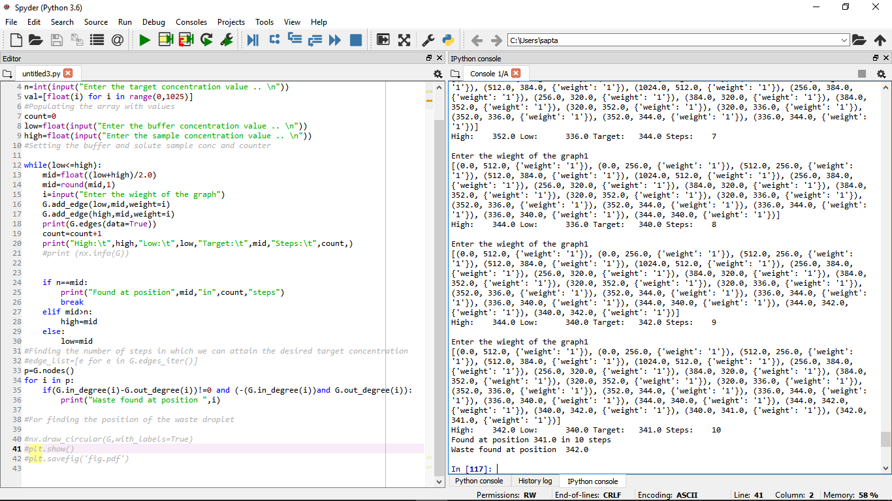

Slide 3
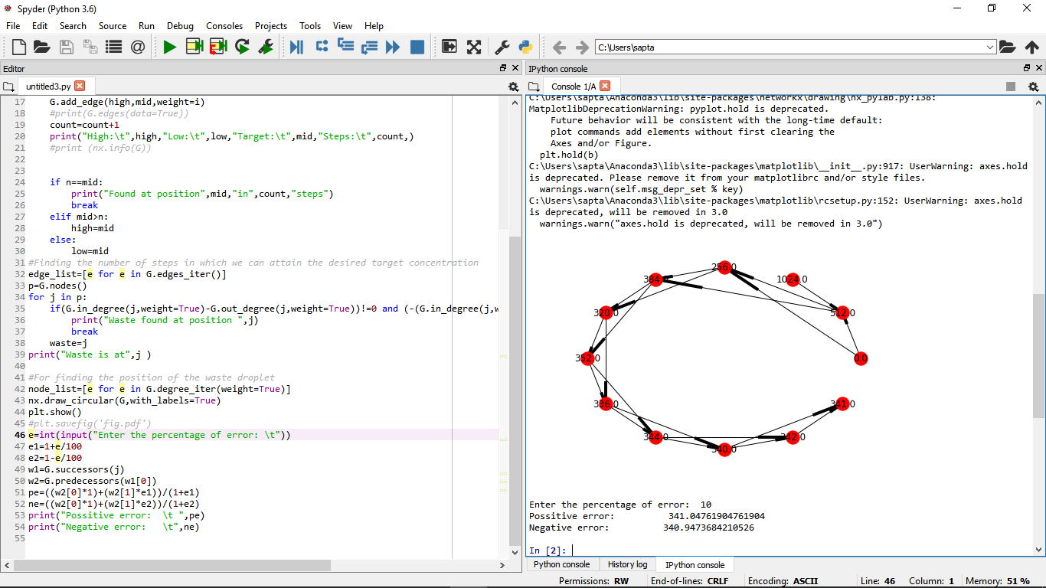

Slide 4
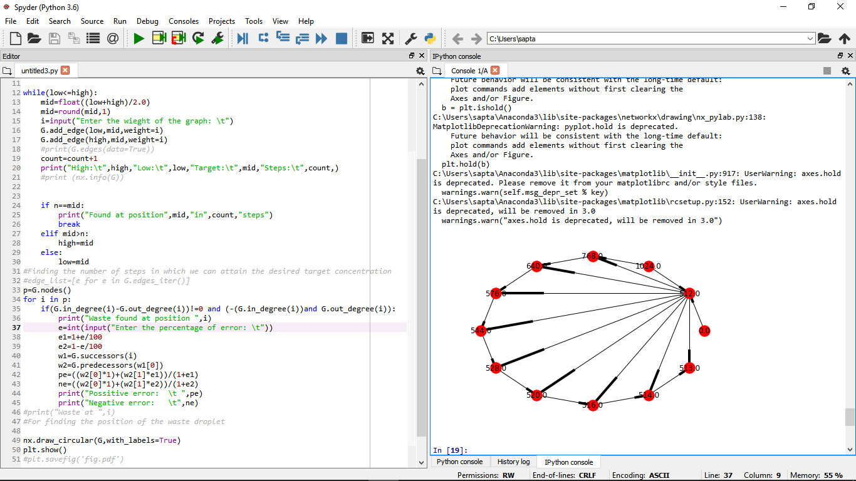

Slide 5
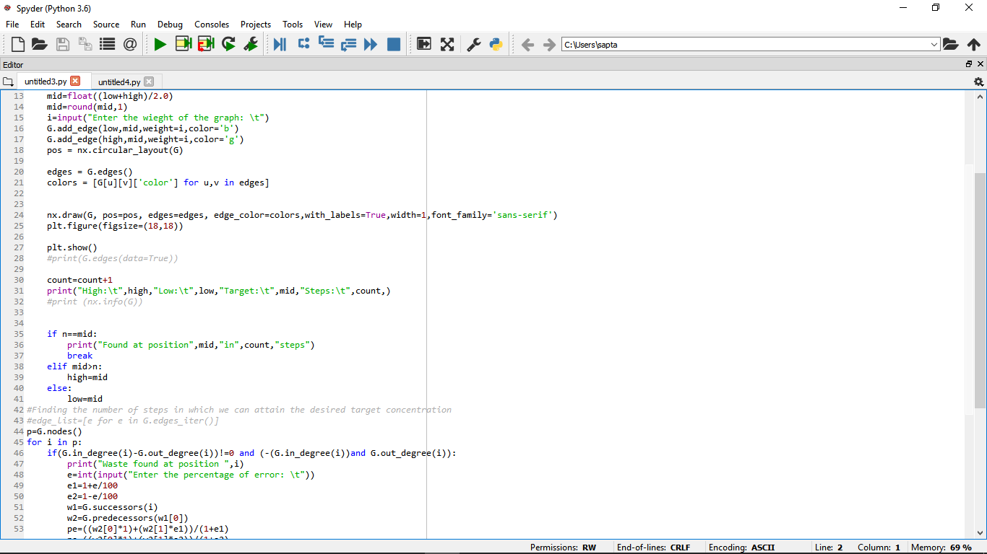

Slide 6
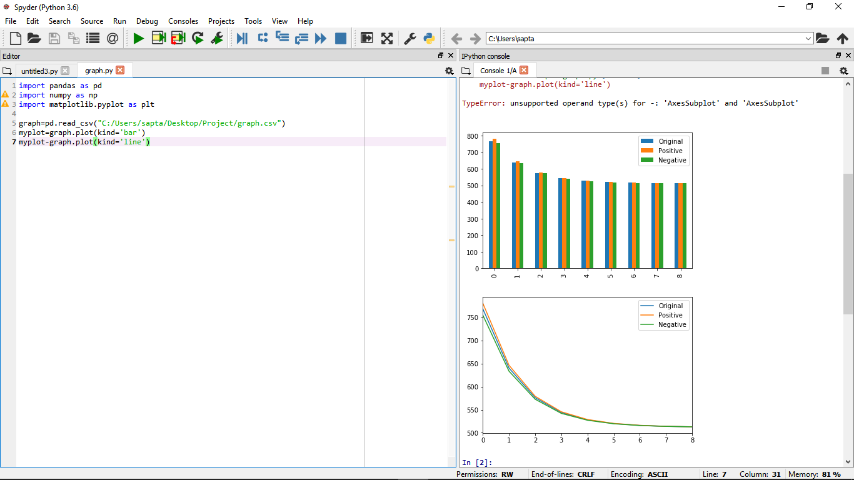

Slide 7
Site Links
https://sites.google.com/view/projectcs-794-dmrw/home
https://sites.google.com/view/projectcs-794-idma/home

