Slide 1
Low-Cost Flow-Based Security Solutions
for Smart-Home IoT Devices
Nama Ravi Teja - 2020H1030143H , Saptarsi Saha - 2020H1030109H

Slide 2
INTRODUCTION
Large heterogeneity of IOT devices poses a formidable challenge for security as each of those have their own hardware,firmware & software.
Novel approach of moving the security solutions to network-level.
Cost/Benefit tradeoff unclear since inspection of network traffic can involve significant costs that may be difficult to recover in a residential market.
Paper deals with cost/benefit analysis of flow-level approach (that predominantly uses information about active flows in the network) against a packet-level approach (that looks into the content of the data packets) for securing smart-home IoT devices.
Notes:
In this method, a summary of the data is collected from routers or switches. Routers generate this data based on the traffic. The data collected, known as flow data, is then sent continuously to the Flow Collector in short intervals. The flow collector analyzes the data and creates a report on the basis of changes and updates. This process is known as Flow Analysis.
As the name suggests, in this technique, we analyze the data packets that are transferred over the network. Here, we are not dealing with a summary of the data but are interested in what is contained in each data packet. Using this technique, we inspect the data being transmitted over the network to see if there is any problem associated with it or not.

Slide 3
Background
Types of IoT security:
Host-Based
Network-Based
Host-Based := These schemes embed security in the IoT device itself, either adapting existing security mechanisms, or developing new ones, to suit the resource constraints of IoT devices. Drawback: The host-based devices are not only low on resources on IoT devices but also lack the motivation amongst vendors who often do not have the time,skills, resources, or financial incentives to embed security in the products.
Network-Based := The aforementioned scheme is better suited to the scale of massive deployment and can be used in diverse use-cases. E.g “An architecture for secure end-to-end communication for IoT is proposed, that moves the expensive authentication and encryption operations out of the IoT device into an external entity with abundant resources.
Examples include Philips Hue light bulb and Nest smoke-alarm which are currently using this scheme.

Slide 4
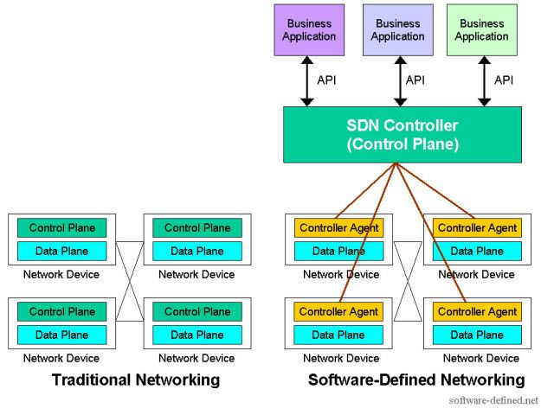
What is SDN?
-The main objective of SDN is to break the
tight relation between the hardware and
software by decoupling the control plane
from the data plane.
-SDN takes the network operating systems
out of the data plane and consolidates
them into the centralized control plane(SDN
CONTROLLER)
-SDN Rest API is used to communicate
between the SDN Controller and the
services and applications running over
the network.
-The northbound APIs can be used to
facilitate innovation and enable efficient
orchestration and automation of the
network to align with the needs of
different applications via SDN network
programmability.

Slide 5
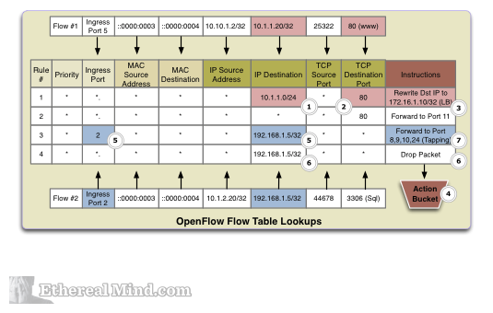
Flow table

Slide 6
In SDN, forwarding entities are referred to as OpenFlow switches and all forwarding decisions are flow-based instead of destination-based as used in the legacy traditional network. An OpenFlow switch contains a flow table with a logical data structure where packets are processed based on a list of prioritizing entries. A flow table can store a set of flow entries made of 15 field tuples.some of the fields are optional but matching fields, action, statistical counter, priority, and timeout mechanism are commonly used. Matching fields are used to match packet meta information such as(medium access control (MAC) source and destination address, ethernet type, internet protocol (IP)source and destination address). These fields can be specified as either exact-match or wildcard-match entries
Wildcard matching entries are assigned with priorities, if multiple packets match multiple wildcards flow the higher priority is the final match. Exact match is usually assigned a higher priority than wildcard flows.If the packet could not match any flow, it will be forwarded to the controller or drop the packet.Other actions may be forward to specific switch port number. The flow lookup is compulsory for every incoming packet.

Slide 7
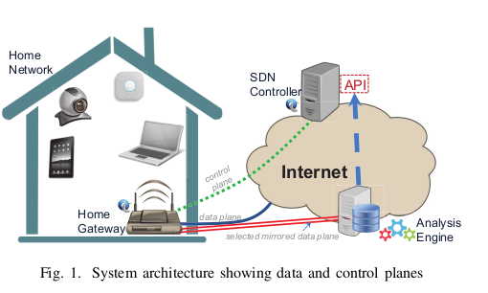
Solution Idea
Inspect only a tiny fraction of data-plane traffic, thereby limiting the processing cost and network bandwidth overheads.
The flows are chosen dynamically and can be changed according to the vulnerabilities.
The process flows are managed from cloud-based software, instead of embedding the processing unit into the home gateway that is difficult to maintain and upgrade like Edge Computing.
Components described in diagram:
Home-Gateway ( eg. router,modem) to which households connect.
SDN enabled home-gateway which is managed by a controller hosted in cloud.
Analysis Engine that interacts with SDN controllers with northbound API’s.It issues requests to the SDN controller on which flows are inspected.
Analysis engine is the heart of the solution.It issues requests to the SDN controller on which flows are inspected. It actively monitor the network activity of IoT devices by inspecting few packets to/from IoT devices with specific headers as well as measuring the load of selected flows and deletes the pertinent rules created by the controller when the analysis is completed.

Slide 8
Analysis Engine
This is the heart of the scheme.
When the mirrored traffic comes in to the analysis engine operating in the cloud, an algorithm is run to inspect the
flow, e.g. recording source and destination entities of certain requests and responses
If needed, specific network rules are setup by the SDN controller on the request of the analysis engine. E.g “responding to IoT devices that are accessed from the Internet. This may involve setting up subsequent rules ensuring not all data-plane traffic is forwarded to the analysis engine.”
Network Rules
Client devices exposed via UPnP port, by which a hacker gains access to IoT devices in the home network via SSDP.This can be followed by a UPnP port forwarding command( these are very common in nature ) to the home router that allows an external attacker to directly attack the IoT device.
Protocol-Specific traffic* characterized by packet headers are captured by home-gateway and mirror copies sent to the analysis engine.
Monitor Internet traffic flows to/from an IoT device to create a richer context around access of a specific device.
The remote access traffic of an IoT device inside the home network can be identified by a rule that matches the source MAC of the default gateway as well as the destination MAC address of the device for downstream traffic from the Internet.
Extracts the IP address of the remote device.
Instructs the controller to install a pair of new higher-priority rules into the home gateway that match source/destination IP of remote host and destination/source IP of the IoT device with action “normal” only (i.e. no more packets for this flow are forwarded to the analysis engine).
This saves a lot of cost since inspection process by the analysis engine can be paused and run periodically once in a day/week/fortnight/month etc.
Notes:
Universal Plug-n-Play (UPnP)
Simple Service Discovery Protocol (SSDP)
*For example, SSDP uses UDP transport protocol on port 1900. Thus, having rule entries that match UDP source/destination port 1900 would capture all SSDP requests and responses transferred in the home network.

Slide 9
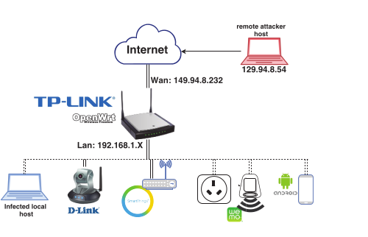
Experimental Setup
Testbed consists of a home-gateway router with OpenWrt firmware version 15.05.
The IoT devices connected to the gateway include Samsung’s Smart Things, D-Link DCS-5300G IP security camera, Belkin’s Wemo switch and Wemo Motion detector.
Two types of attacks carried out via an infected local-host & a remote attacker host outside the network.
LocalHost attack:( We assume that the laptop was “infected” by malicious code (i.e our script), and carried out an attack by enabling port forwarding for selected IoT devices )
Device connected inside of NAT.
3 Step Attack :
1.Discovery ( SSDP Scan )
2.Port-Forwarding
3.Access

Slide 10
Scan: The script sends a multicast SSDP broadcast packet to the required IP address. The IoT devices that implement UPnP would respond with basic information about themselves and a URL which contains an XML file that describes the device functionalities. The url in the XML file is manipulated to proceed with an attack on the intended IoT devices.
Port-Forwarding: This is the next step of the attack which maps an external port to the control URL of the IoT device, allowing an external user to have direct access the internal device.
Attack detection: The attacker was able to successfully conduct the SSDP attack from the internal host and an external attack was also launched which was successfully able to hack into the Wemo Switch and IP Camera.An external attacker would be able to use the camera and see whether the Smart Home was occupied.
Prevention: Using the flow-based analysis as depicted in the paper, the sequence of activity (SSDP scan followed by port-forwarding command followed by external access) is logged, and the potential malicious activity is flagged.

Slide 11
Work Proposal
For implementation of the above given paper we tried and tested few of the leading SDN Controllers available in the market viz POX, OpenVSwitch, OpenDaylight, Floodlight, Ryu Controller, ONOS.
We finally decided to move forward with ONOS ( Open Network Operating System ) as it was a lot simple to use,setup,implement.For the sake of uniformity also,since the author of the given paper has implemented this paper with the help of ONOS controller.
For analyzing the packets captured in wireshark we are proposing to use scapy, plus a few other modules ssdp 1.0.1 & UPnPy 1.1.8. There are few other modules also that we will like to try out like pyshark and pycapfile.
If needed, specific network rules will also be setup by the SDN controller on the request of the analysis engine. E.g “responding to IoT devices that are accessed from the Internet. This may involve setting up subsequent rules ensuring not all data-plane traffic is forwarded to the analysis engine.”

Slide 12
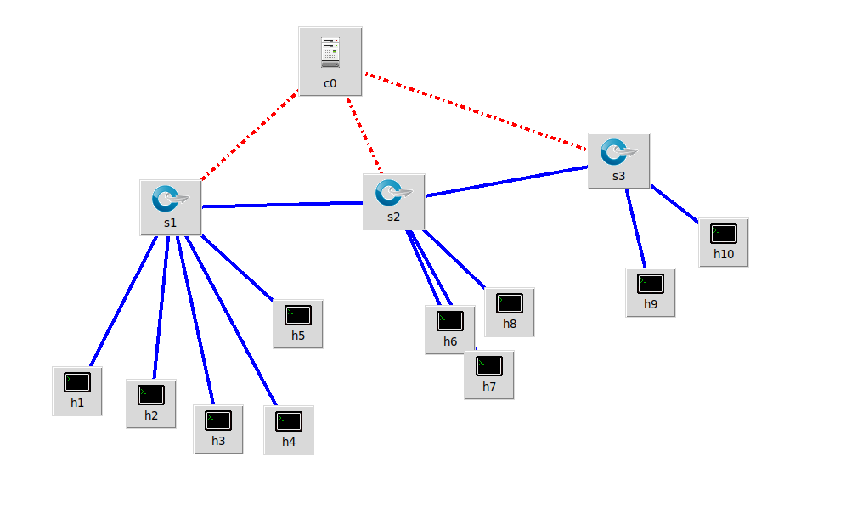
For the practical implementation of the project we are proposing a 3-Layer Plan
Infrastructure Layer: A scaled-out architecture of mininet VM’s
representing the “N” iot-devices controlled by a layer of switches and
a SDN Controller.
Control Layer: For our controller we are proposing to use
Open Network Operating System (ONOS®)which is one of the leading
open source SDN controller for building next-generation
SDN/NFV solutions.
Application Layer: This controller will be responsible for doing the
analysis of the traffic and determining if the network is compromised
or not according to the paper.
Sample Architecture Diagram

