Slide 1
Low-Cost Flow-Based Security Solutions
for Smart-Home IoT Devices
Nama Ravi Teja - 2020H1030143H , Saptarsi Saha - 2020H1030109H

Slide 2
Action Plan
Case 1 : “When malicious node is inside the network”
In order to run an attack we need to setup our topology with a http server to attack. To do that please run the following commands:
sudo mn --controller remote,ip=<ONOS_IP> this will run a simple topology with 2 hosts, 1 switch and it will connect to the ONOS controller with the ONOS_IP. You can get the ONOS controller ip from the ONOS UI.
xterm h1 this will open an emulated terminal for the host 1, which will be our http server.
On the h1 terminal run python -m SimpleHTTPServer 80 this will setup a simple http server on the host 1 that will listen on the port 80.
Then you can do a request to that server by running h2 wget -O - h1 on mininet terminal and you should see some response.

Slide 3
In order to start the attack from host 2 we need to open a new emulated terminal by running xterm h2, on this new terminal we will run the default attack (Slowloris) using the slowhttptest CLI we installed.
We can run the Slowloris attack by running slowhttptest -u <URL_TO_ATTACK>. We will attack h1, thus the url would be http://<H1_IP>, which can be obtained by running h1 ip addr in our case it is 10.0.0.1, thus our url would be http://10.0.0.1, so the full command to run from the h2 terminal would be slowhttptest -u http://10.0.0.1.
After running the attack we can try a request to host 1 http server by running h2 wget -O - h1 on the mininet terminal. The request will be blocked because the attack was successful.
Results: As proposed in the paper, this attack can be particularly harmful for an iot network whereby a user can lose access of his/her devices due to frequent timeouts. This attack has many implications; we can imagine if the SmartThings multipurpose sensor was on a door, acting as a security alert when the door was opened the user would have never been able to come into his own house and be a victim of DOS attack. The attacker could also disable the SmartThings security camera, thereby allowing the attacker physical access to the home.

Slide 4
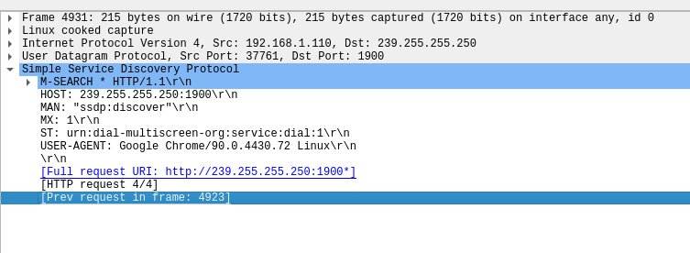
Case 2: “When the attacker is outside the local-network”
For this scenario, we propose to simulate the IoT traffic in the mininet nodes using scapy tool. We have successfully managed to simulate some traffic using the tools and the wireshark traces has confirmed the same. ( SSDP traffic with port 1900 was intended for our purposes )

Slide 5
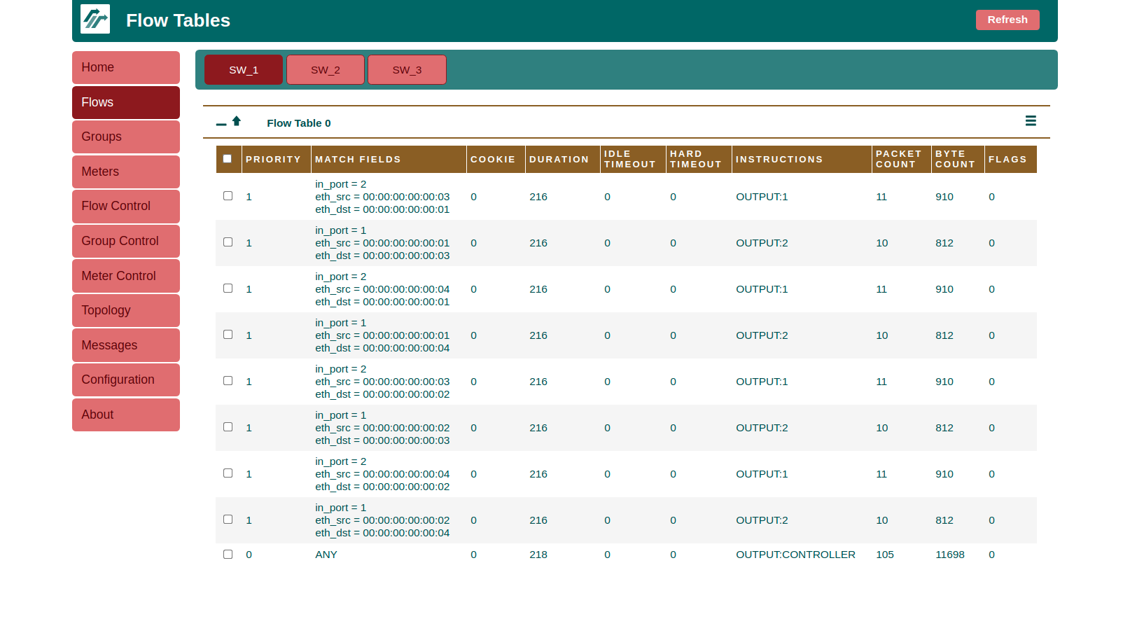
We are further trying to implement and understand the workings of Ryu controller by which we can capture the intended traffic from the required ports and forward and flag accordingly.
Upon processing SSDP messages, the IP and MAC addresses of IoT devices inside the home are discovered by the analysis engine at run time.

Slide 6
Pending Challenges
Need to gain a deeper understanding of SDN flow tables so that we can modify the flow rules and flag the threats accordingly.
Need to figure out the analysis engine and the implementation details of RyU and Onos controller.
Gain a better understanding of scapy to simulate packet simulation from iot pcap files.

