Slide 1
Low-Cost Flow-Based Security Solutions
for Smart-Home IoT Devices
Nama Ravi Teja - 2020H1030143H , Saptarsi Saha - 2020H1030109H

Slide 2
Action Plan
Case 1 : “When malicious node is inside the network”
Attack Simulation : In order to run an attack we need to setup our topology with a http server to attack. To do that please run the following commands:
sudo mn --controller remote,ip=<ONOS_IP> this will run a simple topology with 2 hosts, 1 switch and it will connect to the ONOS controller with the ONOS_IP. You can get the ONOS controller ip from the ONOS UI.
xterm h1 this will open an emulated terminal for the host 1, which will be our http server.
On the h1 terminal run python -m SimpleHTTPServer 80 this will setup a simple http server on the host 1 that will listen on the port 80.
Then you can do a request to that server by running h2 wget -O - h1 on mininet terminal and you should see some response.

Slide 3
In order to start the attack from host 2 we need to open a new emulated terminal by running xterm h2, on this new terminal we will run the default attack (Slowloris) using the slowhttptest CLI we installed.
We can run the Slowloris attack by running slowhttptest -u <URL_TO_ATTACK>. We will attack h1, thus the url would be http://<H1_IP>, which can be obtained by running h1 ip addr in our case it is 10.0.0.1, thus our url would be http://10.0.0.1, so the full command to run from the h2 terminal would be slowhttptest -u http://10.0.0.1.
After running the attack we can try a request to host 1 http server by running h2 wget -O - h1 on the mininet terminal. The request will be blocked because the attack was successful.
Results: As proposed in the paper, this attack can be particularly harmful for an iot network whereby a user can lose access of his/her devices due to frequent timeouts. This attack has many implications; we can imagine if the SmartThings multipurpose sensor was on a door, acting as a security alert when the door was opened the user would have never been able to come into his own house and be a victim of DOS attack. The attacker could also disable the SmartThings security camera, thereby allowing the attacker physical access to the home.

Slide 4
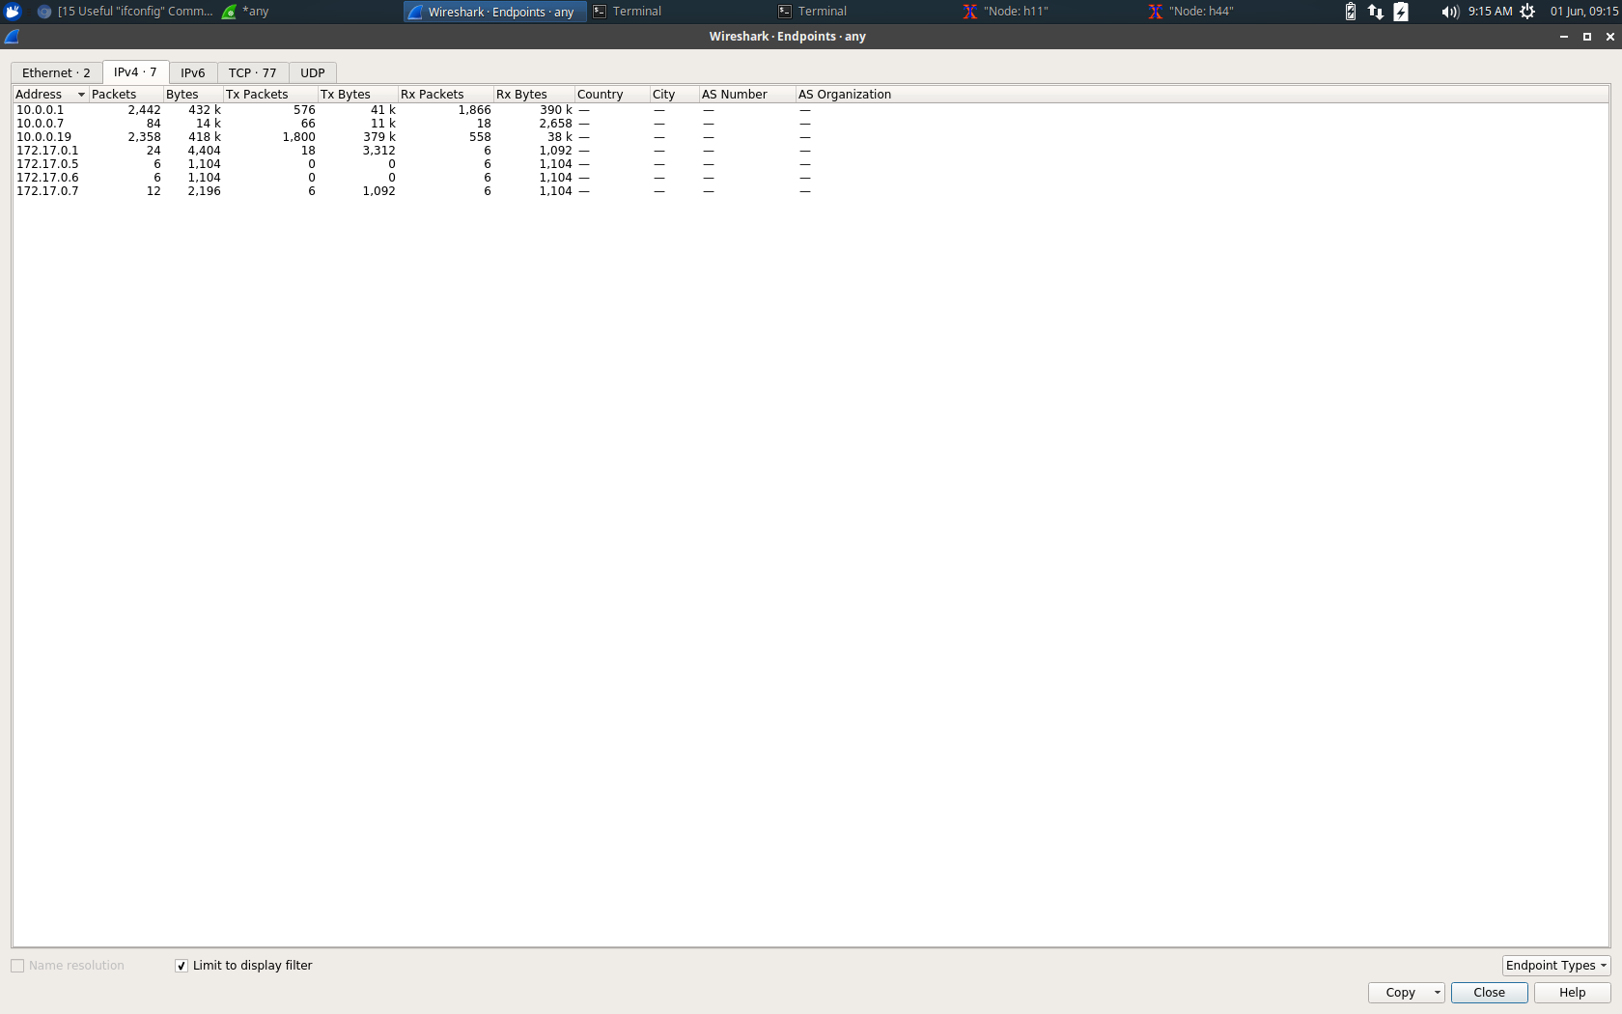
Attack Detection: After looking closely in the wireshark traces we can clearly see that the server ( 10.0.0.1 ) and the attacker ( 10.0.0.19 ) is having the most amount of traffic in the network. This should not have happened in the ideal case where in the server ( 10.0.0.1 ) and the client ( 10.0.0.7 ) should have exchanged the maximum chunk of the traffic.
We can thus fetch and determine the malicious traffic originating from the attacker node ( 10.0.0.19 ) and try to block that node accordingly. This will help solve the problem of the DoS attack when the attacker is inside the local home network.

Slide 5
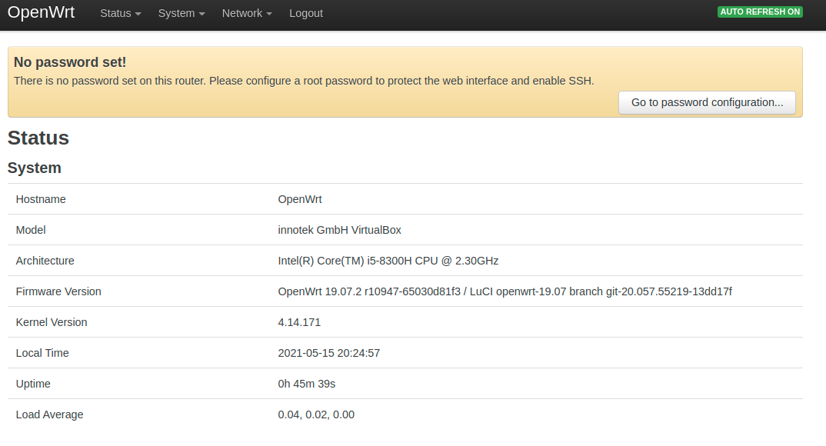
Case 2: “When the attacker is outside the local-network”
Attack Simulation: For this scenario, we are using the OpenWrt which is the framework to build an application without having to build a complete firmware around it.
We are achieving this by using an OpenWrt VM inside our host machine in a virtualbox and setting up the IP to static 192.168.0.251.

Slide 6
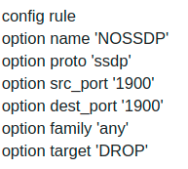
Attack Detection and Blocking : As per the research paper, the subsequent attacks are performed by exploiting SSDP and UPnP ports 1900.
We are writing a custom script in the OpenWrt router to drop all traffic originating from/to port 1900 which is primarily used for SSDP traffic.
Moreover, we also mitigate this by dropping all UDP traffic from port 1900 headed to the wan zone.
This can be achieved by creating a traffic rule in the firewall to reject all packets headed towards port 1900. If the attacker can’t communicate with the internal nodes a possible attack can be avoided.
The internal nodes would also not be harmed in any way thus keeping the system error-free.

Slide 7
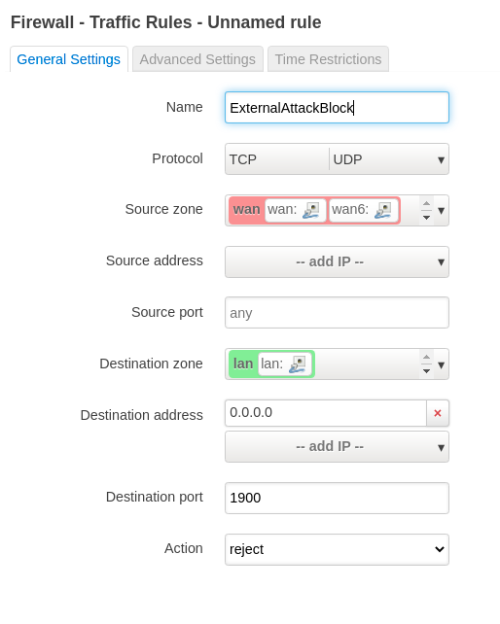
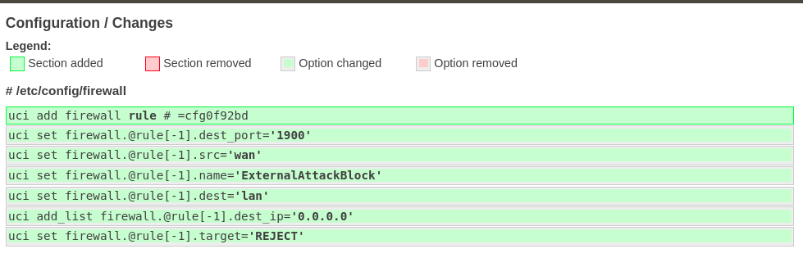
Custom-Rule setup with name “ExternalAttackBlock”
Which works on Protocols “TCP” & “UDP”. The source
zone is the default wifi zone “WAN” for the OpenWrt framework
which will forward the packet to our intended destination
zone “LAN”. The intended rule looks as follows:

Slide 8
Future Scopes

