Slide 1

Consumer Goods Ad-hoc Insights
Atliq Hardwares
Presented by - Saptaswa Basu
Codebasics SQL Project Challenge

Slide 2
AGENDA
CONTEXT
DATASETS
Ad-hoc
Requests

Slide 3
CONTEX
Problem
Atliq is a leading hardware manufacturing company of our country , the management of the organisation wants to expand their data analytics team to get enough insights to make quick & smart decisions.
Task
The director of the analytics team wants to conduct a SQL challenge to check the tech & soft skills of the candidate to decide who’ll be most fit for the role.
Approach
Query the data through SQL to answer the ad-hoc requests.
Transform the acquired data through Powerquery to get suitable data for visualization
Make required visualizations with the help of Powerbi and then present important insights to the management.

Slide 4
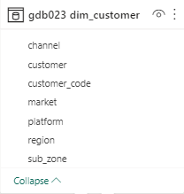
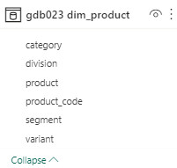
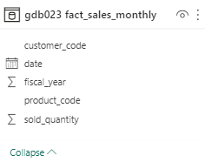
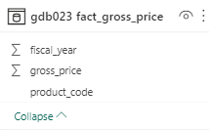
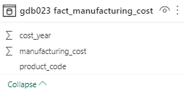
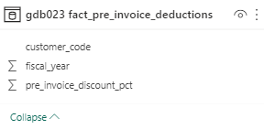
gIven data
The datasets for the challenge which is provided by the Codebasics team is consist of total 6 datasets from 2020 to 2021. All the six tables are respectively belongs to :

Slide 5
03
Ad-hoc requests
There are total 10 ad hoc requests for which the business needs insights and for that we need to run a SQL query to answer these requests and present it to the top-level management.

Slide 6
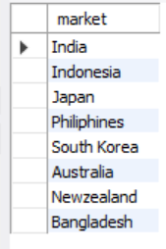
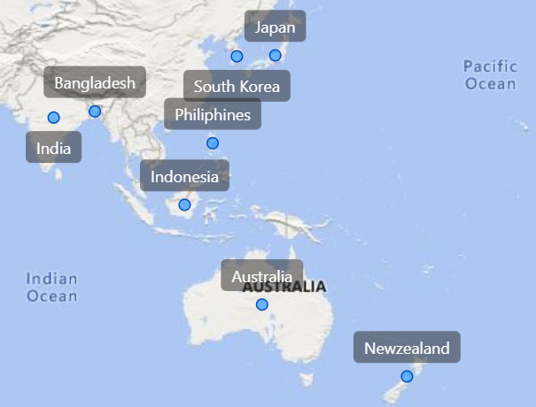
request 1.
Provide the list of markets in which customer "Atliq Exclusive" operates its business in the APAC region.

Slide 7

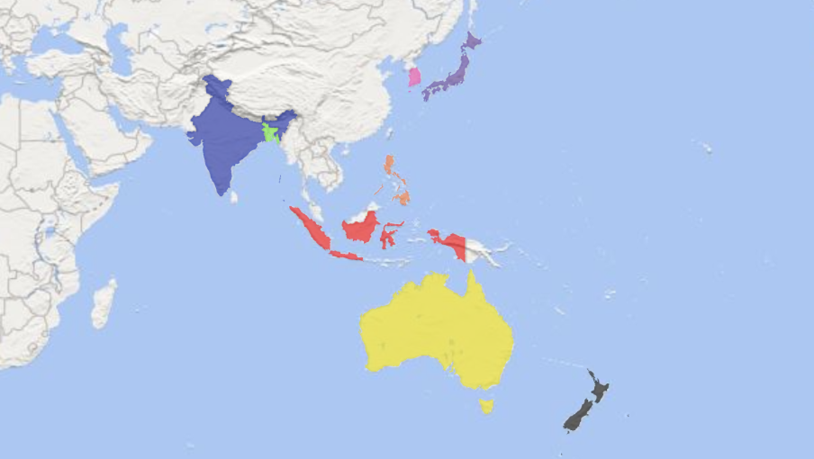
Insights :
As it can be seen from the visualization that Atliq Exclusive present in all the major markets which fall into APAC region.
Now that all the important markets is being captured we need to expand our products to fullfill its supply to all the regions and also keep on innovating unique products based on diff regions,
That we’ll see in the next slide…..

Slide 8

request 2.
What is the percentage of unique product increase in 2021 vs. 2020? The final output contains these fields,
unique_products_2020
unique_products_2021
percentage_chg
245 36.33 334

Slide 9
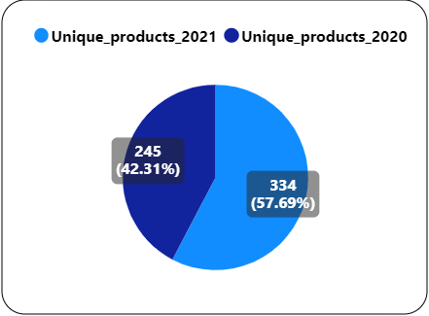
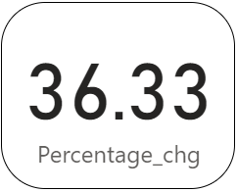
Insights :
As we extend our organization at every major markets , we also tried to innovate some new products in new year to bring more diversity .
As it can be seen we have introduced 89 new product , in total now we have 334 unique products whereas last year we had only 245 unique products.
Even if we talk about percentage point of view there it can be seen around 36% increase, i.e since last year we have introduced around 36.33% more unique products.

Slide 10
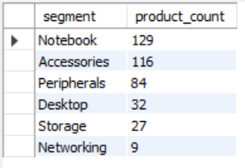
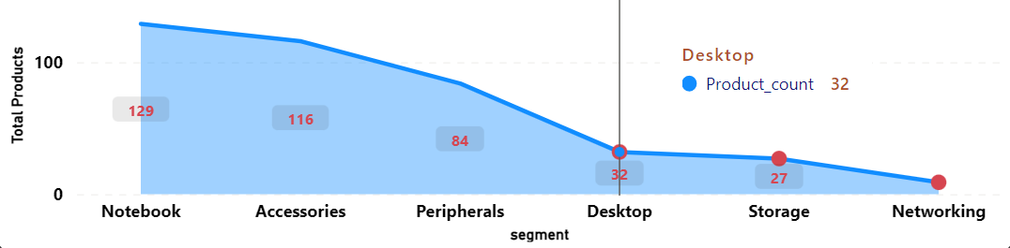
request 3.
Provide a report with all the unique product counts for each segment and sort them in descending order of product counts.
The final output contains 2 fields,
Segment
product_count

Slide 11
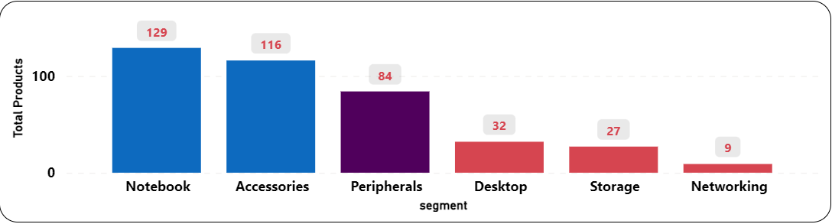
Insights :
As we can see there total of 6 categories in which Atliq Hardware worked in, out of which Notebook segment has the highest number of products and Networking Segment has the lowest number of products.
The top 3 segment which are Notebook, Accessories and Peripherals has an average of around 110 , it can be because of the high demand of these segments in the market.
Whereas Desktop, Storage and Networking has an average of below 25, which is 23 to be precise. As it can be understood that these segment have very less demand.

Slide 12
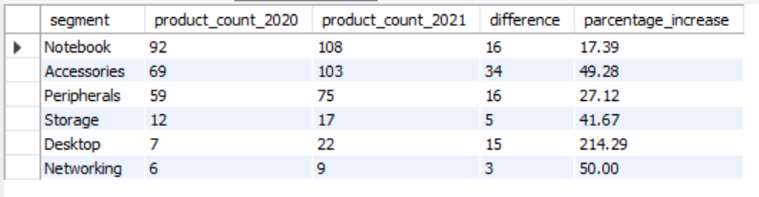
request 4.
Follow-up: Which segment had the most increase in unique products in 2021 vs 2020? The final output contains these fields,
segment
product_count_2020
product_count_2021
difference

Slide 13
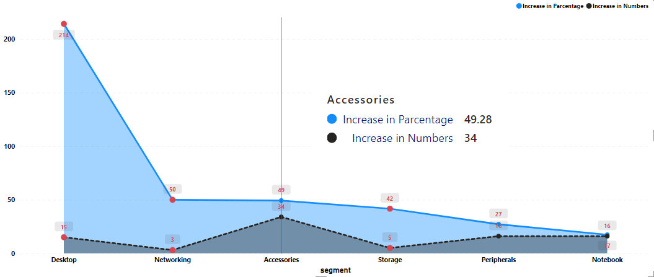
Insights :
Desktop had the highest % of increase in product in this one year
Accessories had the highest number of product increases in this one year
In this one year our organization has increase manufacturing the number of products by significant margins , as we can see in Accessories segment it ensures the highest number of product increases which is basically 34 new products introduced.
Whereas if we talk about % of product increases it can be seen is around 214% increase in Desktop segment , although its only 15 in numbers but still its huge boost for our company .

Slide 14

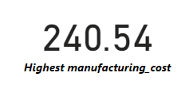
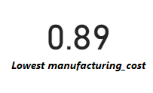
request 5.
Get the products that have the highest and lowest manufacturing costs. The final output should contain these fields,
product_code
product
manufacturing_cost

Slide 15
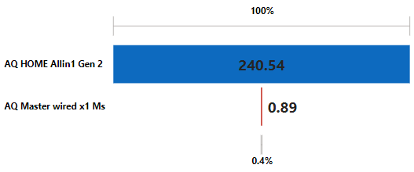
Insights :
As shown above Gen 2 (Desktop) has highest manufacturing cost which tends to increase in overall selling price , now generally high selling price products have less order compared to product with low price, whereas if we look into x1 Ms (Mouse) , it has the least manufacturing cost which tends to decrease in overall selling price , so this product might have comparatively high number of orders.
So, overall product with low manufacturing cost have much better selling price margin compered to the other one.

Slide 16
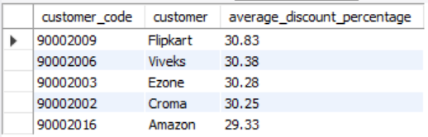
request 6.
Generate a report which contains the top 5 customers who received an average high pre_invoice_discount_pct for the fiscal year 2021 and in the Indian market. The final output contains these fields,
customer_code
customer
average_discount_percentage

Slide 17
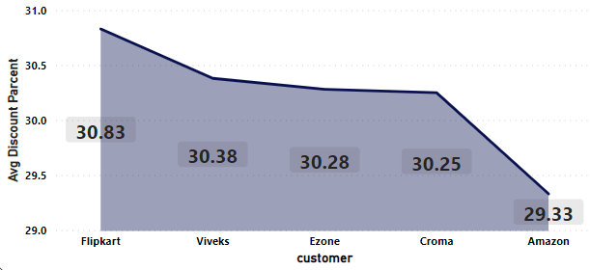





Insights :
As it is seen in the picture that all the companies got similar % of discount by Atliq in the year 2021.
Although out of all of them Filpkart gets its highest discount which is 30.83%, followed by there are Viveks, Ezone and Croma . On the other hand Amazon got the lowest of all % of discounts which is 29.33%.
All the companies with high discount value are mentioned below…….

Slide 18
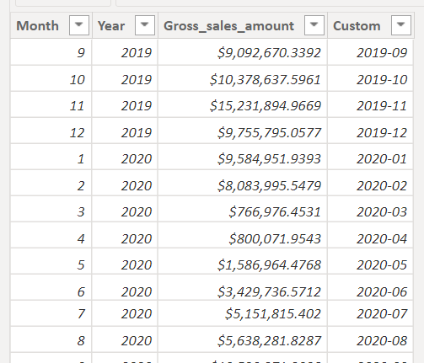
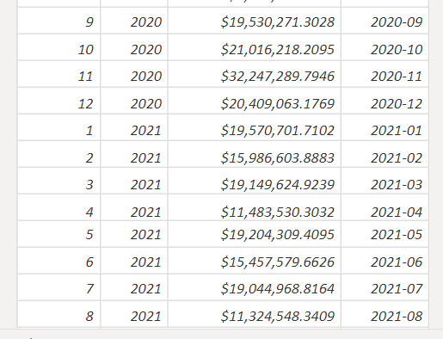
request 7.
Get the complete report of the Gross sales amount for the customer “Atliq Exclusive” for each month. This analysis helps to get an idea of low and high-performing months and take strategic decisions. The final report contains these columns:
Month
Year
Gross sales Amount

Slide 19
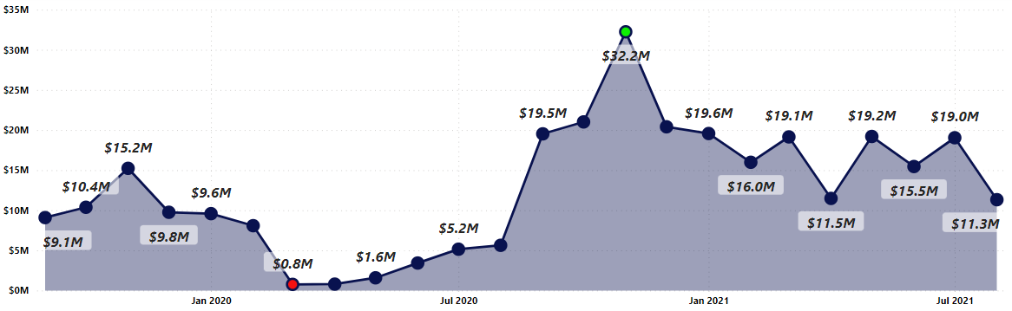
Insights :
g
Nov 20 is the day when gross sales amount was highest , which was around $32.2M to be precise.
Mar 20 is the day when gross sales amount was lowest , which was around $767K to be precise.
On March 2020 companies gross sales hit its lowest point , which is around $767K and its because of low demand. As we know at this time the demand for every product decreases due to covid 19 , Other than medical products.
But as we can see a quick jump after the dark days , as on November 2020 it gained its highest point, i.e. highest gross sales which is around $32.2M , and after that sales stayed at very stable position on an average it was around $12M - $13M per month and hope to grow more in near future also.

Slide 20
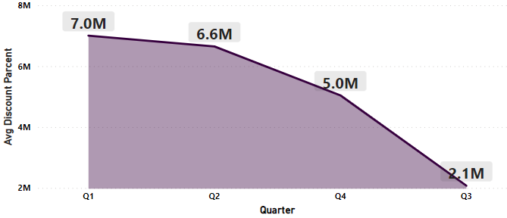
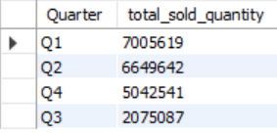
request 8.
In which quarter of 2020, got the maximum total_sold_quantity? The final output contains these fields sorted by the total_sold_quantity,
Quarter
total_sold_quantity

Slide 21
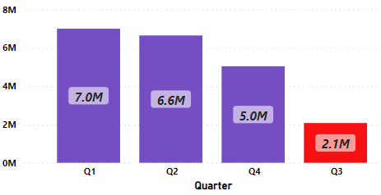
Insights :
As shown in the visualization Q1 of that financial year has got the highest quantity of sales which is around 7 M in quantity and on Q3 it got its lowest which is around 2.1 M in quantity.
Also it can be seen that all remaining quarter had decent sales but Q3 had very low sales, is that normal for Q3 ? Not really !! As Q3 was the time whem covid 19 at its peak , so for definite reasons the sales quantity become very low , although from the next quarter onwards again became normal.

Slide 22
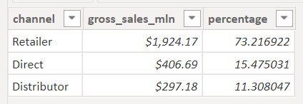
request 9.
Which channel helped to bring more gross sales in the fiscal year 2021 and the percentage of contribution? The final output contains these fields,
channel
gross_sales_mln
percentage

Slide 23
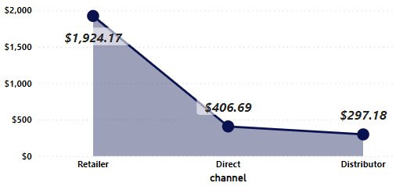
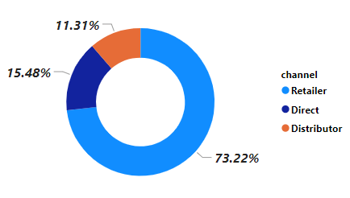
Insights :
Atliq Hardware got most of the gross sales from Retailer which is around $2000 M out of $2700 M, i.e. the remaining two channel combined have around $700 M sales where their Direct sales around $400 M and through Distributor its around $300 M.
Now if we look into percentage we’ll found around 75% sales comes through Retailer as it is mostly a B to B business, so certain % of the gross profit goes into the commission of retailer.
Whereas only 15% of sales comes direct from customers (B to C) , now if we can increase our sales to the direct customer , our net profit might also get boost up.

Slide 24
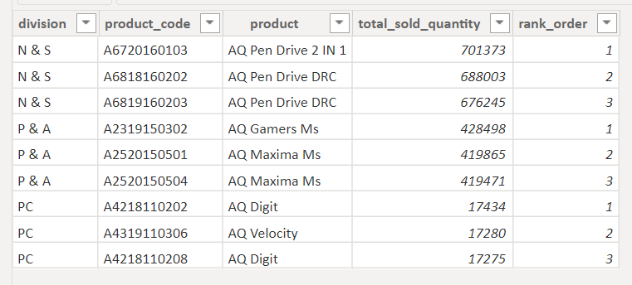
request 10.
Get the Top 3 products in each division that have a high total_sold_quantity in the fiscal_year 2021? The final output contains these fields,
Division
product_code
product
total_sold_quantity
rank_order

Slide 25
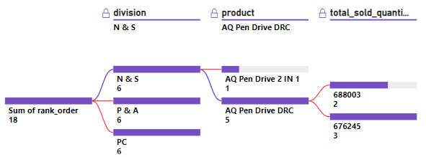


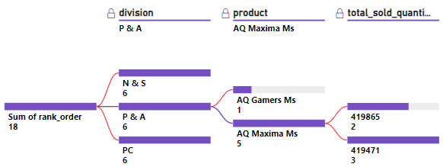

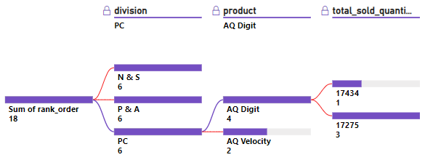

Insights :
N & S
N & S division is the most demanding one, around $ 2 M sales comes from this division alone.
In this division the products are mainly SSD, Pen Drives, Flash Drives etc, out of which Pen Drives are the most demanded products.
P & A
P & A is the 2nd most demanding division, around $1.25 M sales comes from this division alone.
In this division the products are mainly Keyboards, Mouse, Motherboard, Processers etc, out of which Mouse’s are the most demanded products.
PC
PC is the least demanding division, only $50 K sales comes from this division.
In this division the main products are Laptops only, which can be for business , gaming or personal, out of which Personal Laptops are the most demanded
products.

Slide 26

Thank You
Atliq Hardwares
by - Saptaswa Basu
saptaswabasu00@gmail.com

