Slide 1
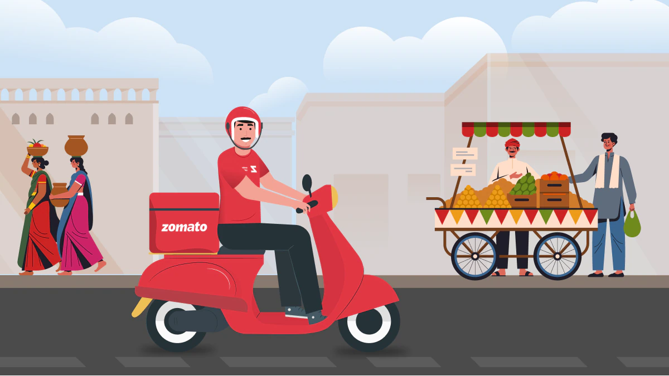
Zomato Case-Study

Slide 2
Content-
Introduction to the case study
Business Problems related to the case study
Query based problem solving
Conclusion

Slide 3
Introduction to the Case-Study
The dataset provided for this project comprises valuable insights gathered from Zomato, a renowned online restaurant discovery and food delivery platform. Zomato offers a comprehensive array of restaurant information, including cuisine types, pricing, services like table booking and online delivery, ratings, and customer feedback in various cities. Leveraging this dataset opens up avenues for understanding the dynamic landscape of the culinary world, exploring trends in dining preferences, analyzing the distribution of restaurant features and ratings across different cities, and uncovering correlations between factors such as pricing, services offered, and customer satisfaction. By delving into this rich dataset, we aim to extract actionable insights that can inform strategic decision-making for restaurateurs, food enthusiasts, and the broader hospitality industry.

Slide 4
List of business problems related to the case
Top Cuisines by City: What are the top 5 cuisines offered in each city based on the number of restaurants?
Table Booking vs. Online Delivery: What percentage of restaurants offer table booking and online delivery?
Average Cost by Cuisine: What is the average cost for two people for each cuisine?
Highly Rated Restaurants: List the top 10 restaurants with the highest ratings.
Most Popular Cuisines: Which cuisine has the highest number of restaurants across all cities?
Delivery Availability: What percentage of restaurants are currently delivering orders?
Price Range Distribution: How many restaurants fall into each price range category?
City-wise Rating Distribution: What is the distribution of restaurant ratings in each city?
Vote Analysis: How are the number of votes distributed across different rating categories?
Comparison of Average Cost: Compare the average cost for two people between different cities.

Slide 5
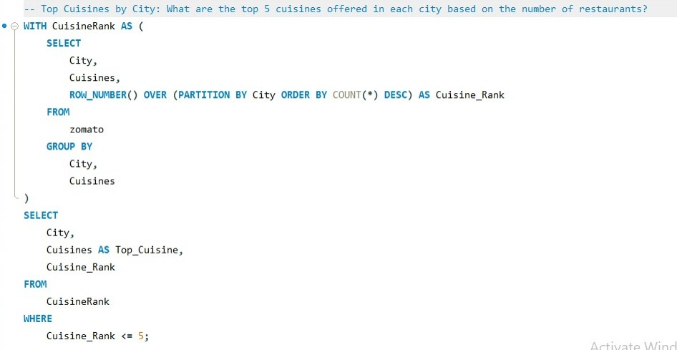
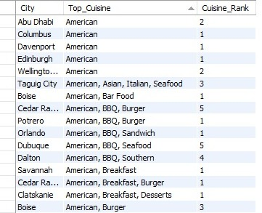
Query Based Problem Solving
What are the top 5 cuisines offered in each city based on the number of restaurants?

Slide 6
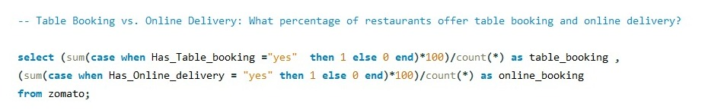

2. What percentage of restaurants offer table booking and online delivery?

Slide 7
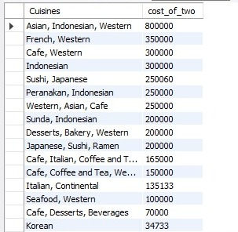
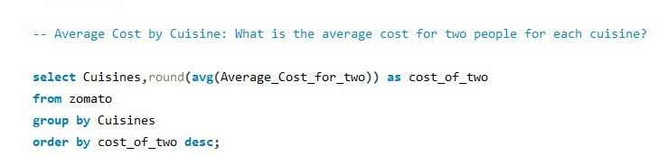
3. What is the average cost for two people for each cuisine?

Slide 8
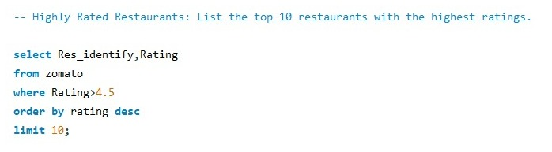
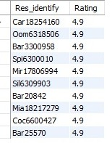
4. List the top 10 restaurants with the highest ratings.

Slide 9
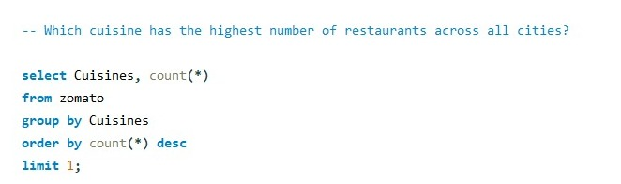

5. Which cuisine has the highest number of restaurants across all cities?

Slide 10
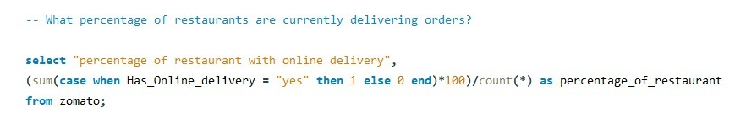

6. What percentage of restaurants are currently delivering orders?

Slide 11
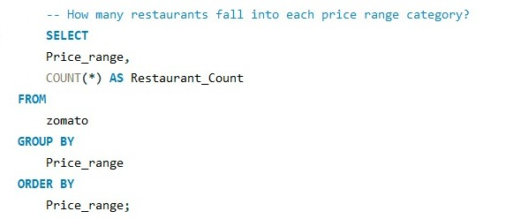

7. How many restaurants fall into each price range category?

Slide 12
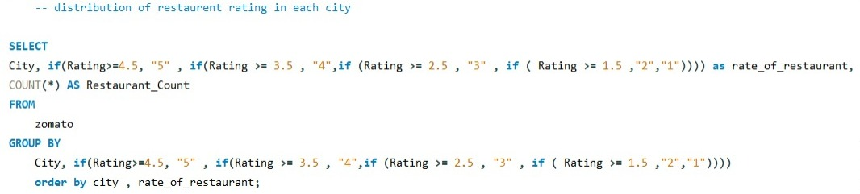
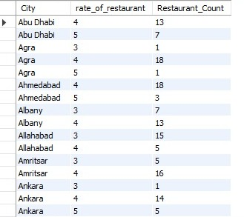
8. What is the distribution of restaurant ratings in each city?

Slide 13
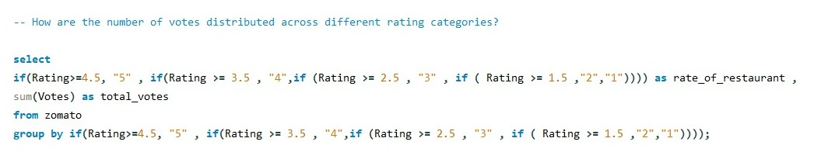
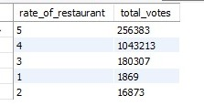
9. How are the number of votes distributed across different rating categories?

Slide 14
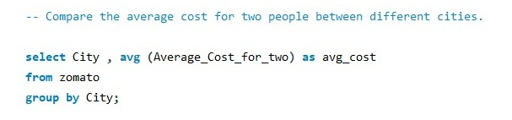
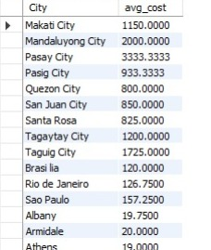
10. Compare the average cost for two people between different cities.

Slide 15
Conclusion
The analysis of the Zomato dataset provides valuable insights into the culinary landscape across various cities, offering a comprehensive understanding of restaurant features, customer preferences, and industry trends. Through exploring questions such as the distribution of cuisines, availability of services like table booking and online delivery, and the correlation between ratings and votes, we've gained actionable insights for stakeholders in the hospitality sector. Our findings highlight the diversity of cuisines offered, the importance of service offerings in attracting customers, and the significance of customer feedback in shaping restaurant reputations. Armed with these insights, restaurateurs can make informed decisions to optimize their offerings, enhance customer experiences, and stay competitive in a dynamic market. Additionally, food enthusiasts and consumers can leverage this information to discover new dining experiences, make informed choices, and contribute to the vibrant culinary culture of their cities. As the culinary landscape continues to evolve, leveraging data-driven insights from platforms like Zomato remains crucial for driving innovation and excellence in the restaurant industry.

