Slide 1
Link state routing simulator
Algorithm and a program to implement link state routing algorithm

Slide 2
Link state routing algorithm
Link state routing protocols maintain complete road map of the network in each router running a link state routing protocol.
The link-state protocol is performed by every switching node in the network. These nodes are known as routers which are designed to forward packets.
The basic concept of link-state routing is that every node constructs a map of the connectivity to the network, in the form of a graph showing which nodes are connected to which other nodes.
Each node then independently calculates the next best logical path from it to every possible destination in the network. The collection of best paths will then form the node's routing table.

Slide 3
Link state routing algorithm
Link state protocols are based on Shortest Path First (SPF) algorithm to find the best path to a destination.
Shortest Path First (SPF) algorithm is also known as Dijkstra algorithm, since it is conceptualized by Dijkstra. In Shortest Path First (SPF) algorithm, whenever a link's state changes, a routing update called a Link-State Advertisement (LSA) is exchanged between routers.
When a router receives an LSA routing update, the link-state algorithm is used to recalculate the shortest path to affected destinations

Slide 4
Link state routing algorithm
When a router receives an LSA routing update, the link-state algorithm is used to recalculate the shortest path to affected destinations
Each router constructs a map of the complete network
Link State Routing Protocols converge more quickly and they are less prone to Routing loops than Distance Vector Routing Protocols
Link State Routing Protocols require more CPU power and memory than Distance Vector routing algorithms.

Slide 5
Link state routing algorithm
Link State Protocols use a hierarchical structure that limits the distance that a Link-State Advertisement (LSA) need to travel
Link State Protocols use multicasts to share the routing information. Only the routers which run Link State protocol only process the updates
Link State routers send updates only when there is a change in the state of the network
Link-state algorithms can be more complex and expensive to implement and support

Slide 6
Working of link state routing simulator
The link state routing simulator is a program which is built to implement link state routing protocol
The program has two functionalities:
Simulate the process of generating connection table for each router in a given network
Compute optimal path with least cost between any two specific routers
The program takes input in the form of a text file, which consists of arbitrary number of routers and costs of links between all directly connected routers. The first command takes the text file as an input and prints the topology matrix.

Slide 7
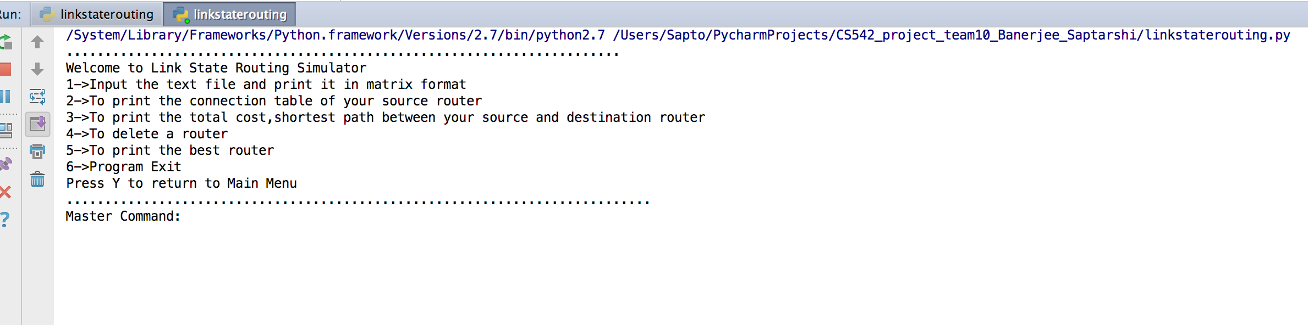
Working of link state routing simulator
For the second command the program takes the source router as input and prints the connection table of the source router by performing shortest path algorithm i.e. Dijkstra
For the third command the program takes the source router and destination router as input and prints the total cost between source and destination and also prints the shortest path between source and destination.
For the fourth command the program takes a router to delete as input ,deletes the router if its down, modifies the topology and then prints the connection table of the previous source router given in command three.
For the fifth command the program prints the best router ,which has minimum cost to all other routers.
For the sixth command the program exits .

Slide 8
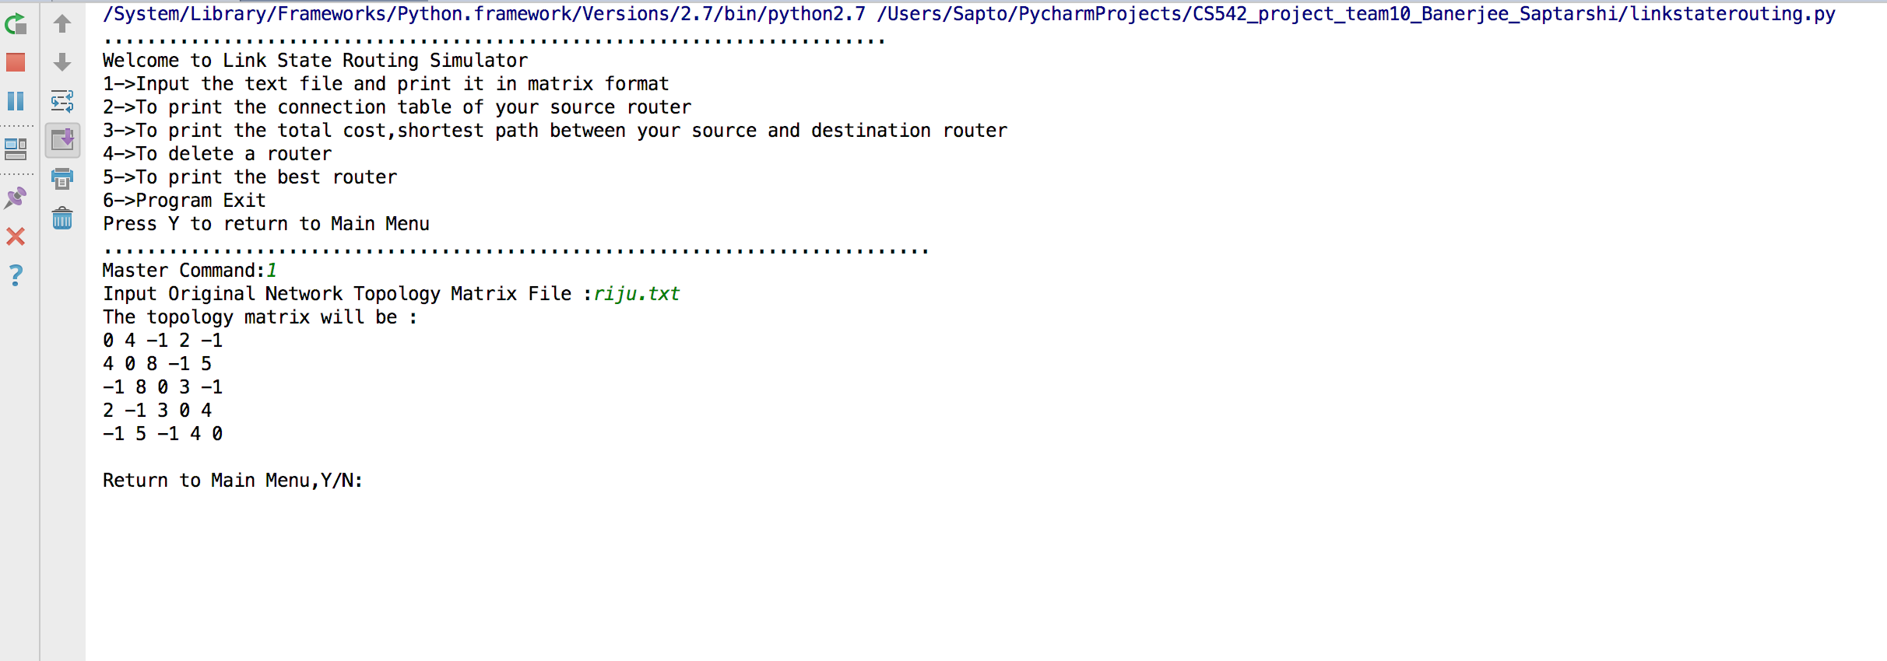
Working of link state routing simulator
So for 1st command the the program takes an input which should be .txt format
After inputting the file it prints the topology matrix .
The routers which are not connected to other routers ,the weights are marked as -1
After the first command is executed the option Return to Menu pops out where if you press Y it will return to main menu otherwise the program will quit .

Slide 9
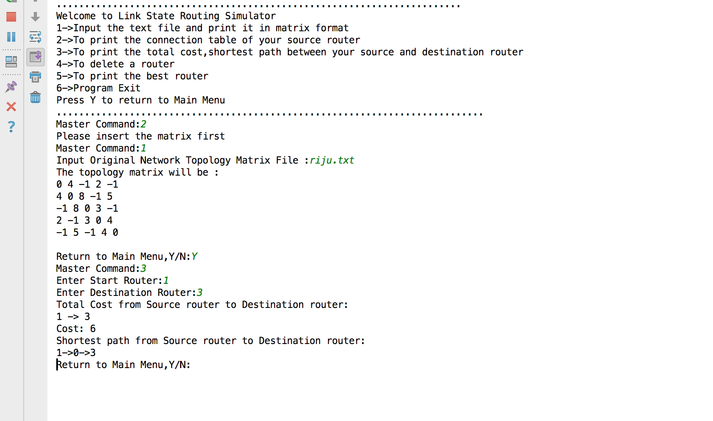
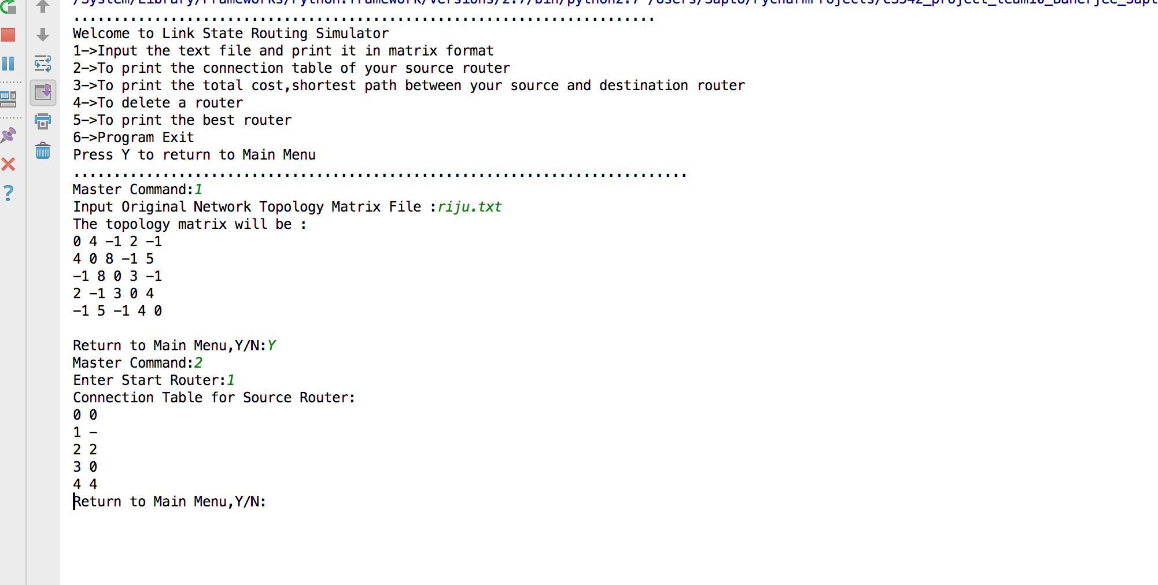
Working of link state routing simulator
When we enter 2 as master command the program takes a source router as input like here and prints its connection table by performing shortest path algorithm.
When we enter 3 as master command the program takes a source and a destination router as an input and prints the total cost between source and destination and also prints the shortest path between source and destination.

Slide 10
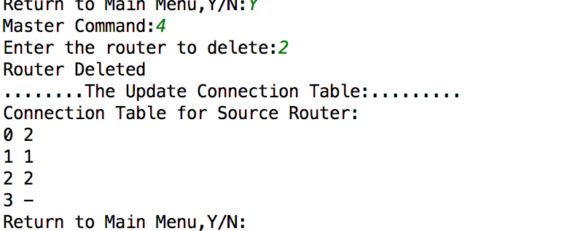
Working of link state routing simulator
When command 4 is pressed the program prints an option to input the router you want to delete
The program deletes the router that is being given by the user and prints the connection table of the source router previously given in option 3.

Slide 11
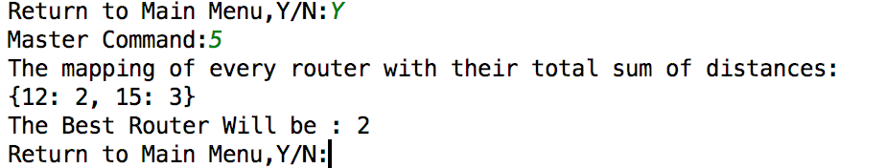
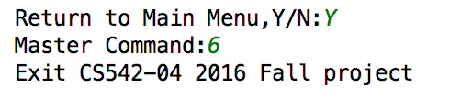
Working of link state routing simulator
The command 5 prints a dictionary showing which router has the shortest total sum of distances and prints which router is the best out of them all.
The command 6 exits the program and prints “Exit CS542-04 Fall project”.

Slide 12
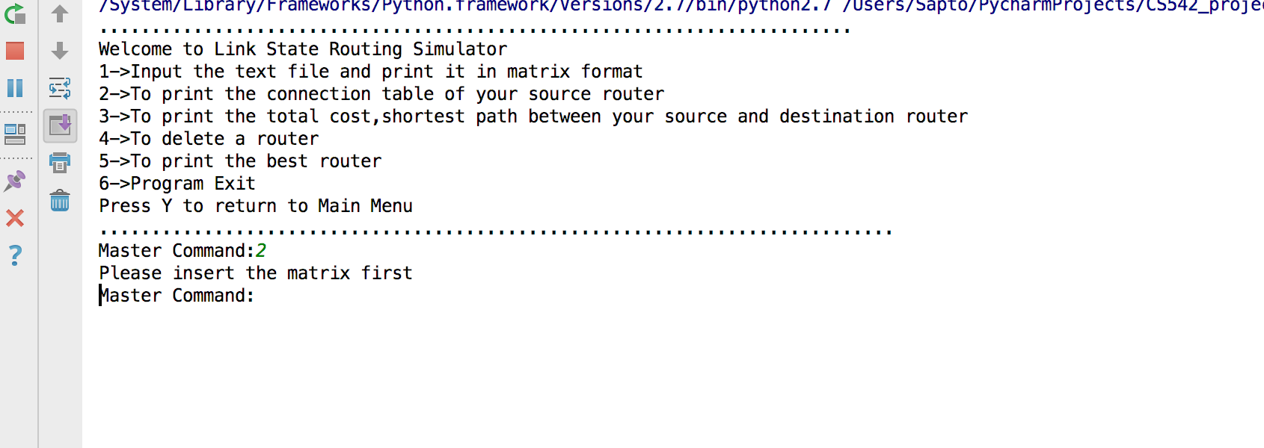
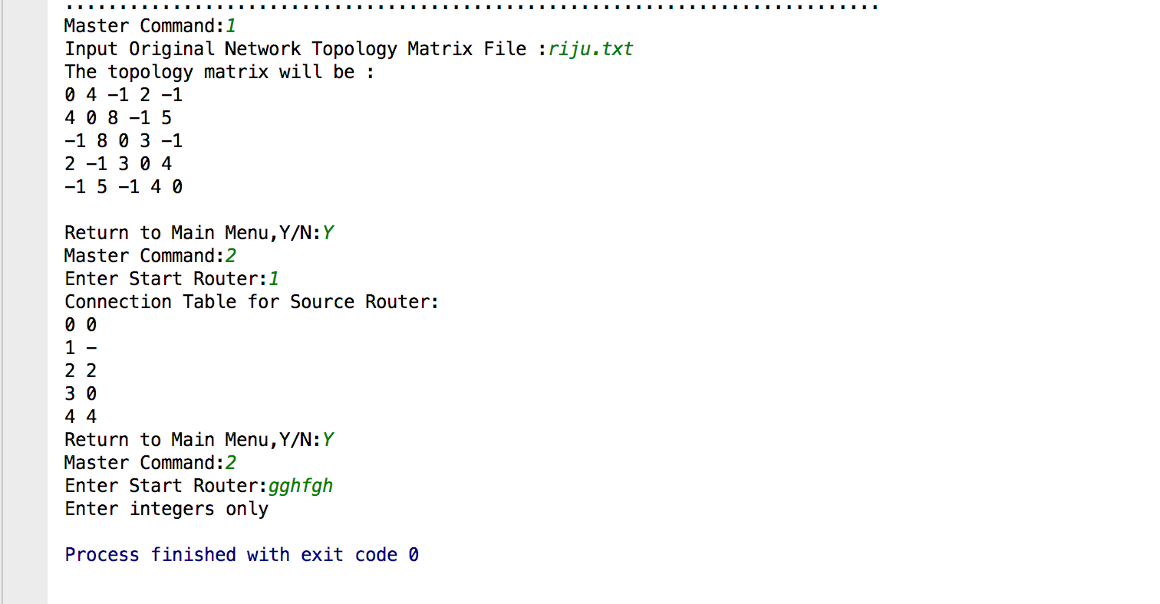
validations
The first validation of the program is that the value of routers should be integer value otherwise it will print a message “Enter integers only ”and exit the program.
The second validation of the program is that the master command 1 should be printed first otherwise an error message will be printed “Please insert the matrix first” and the option for user input Master Command will start again.

Slide 13
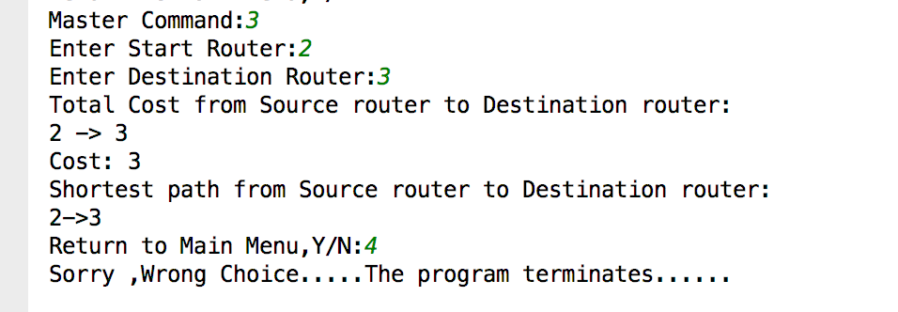
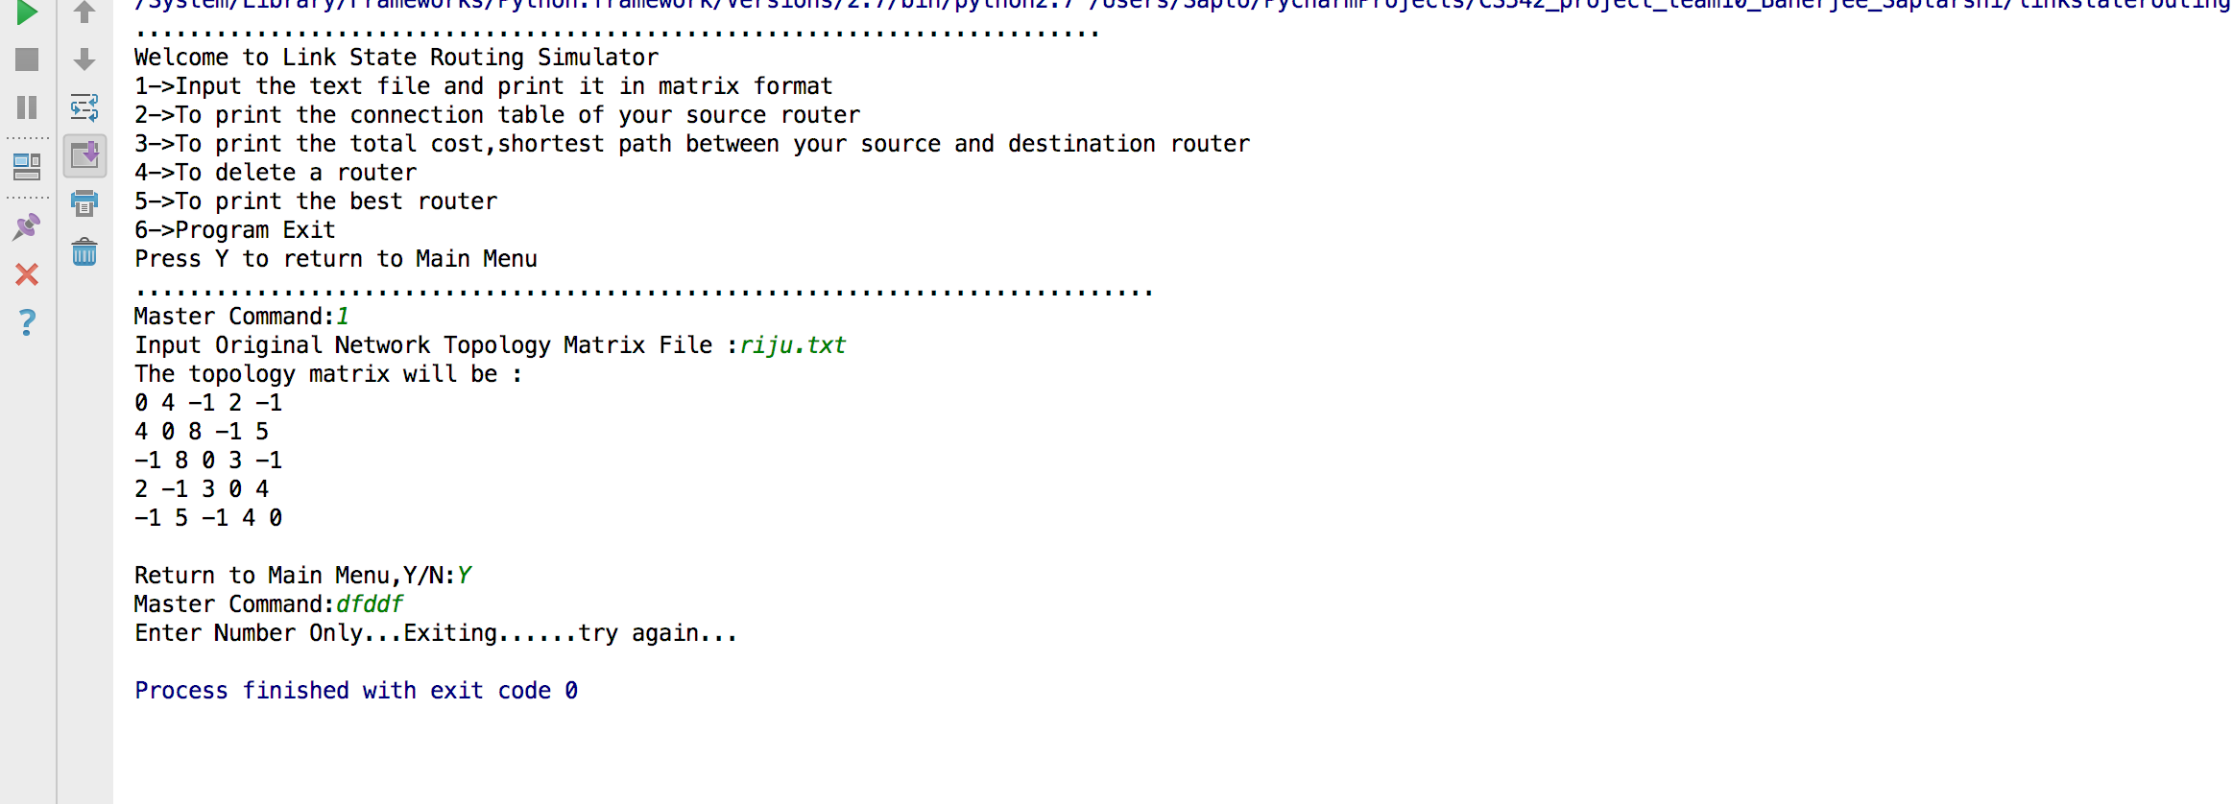
Validations
The next validation is if you input anything other than Y when the option for Return to Main menu asks ,the program prints “Sorry ,wrong choice…..the program terminates….”
The next validation is if we input string value or any value other than integer as an input in master command the program gives an error message “Enter numbers only….exiting....try again”

Slide 14
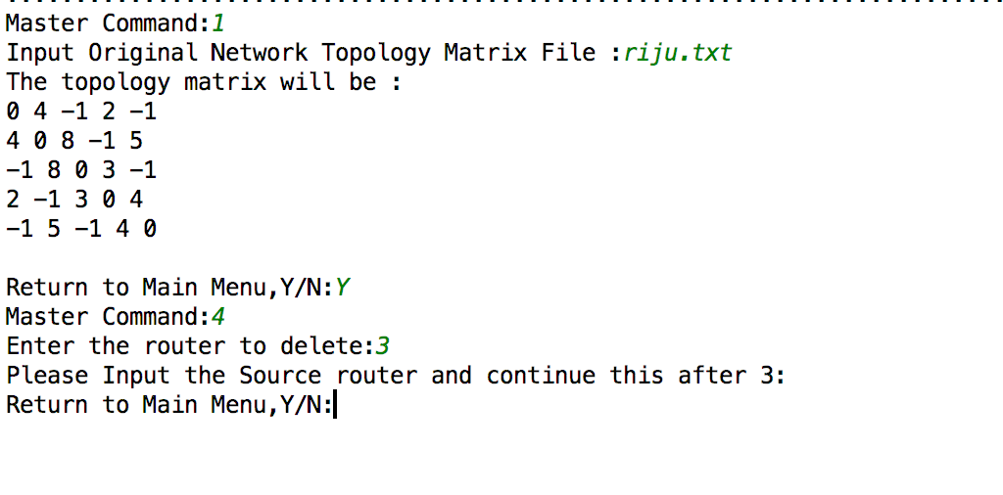
Validations
This validation of the program is that option 4 can’t be performed without option 3 performed as it takes the source router of the previous option to print the updated connection table.

Slide 15
Link state routing simulator
END OF CS542 PROJECT ,THANK YOU!!1

