Slide 1
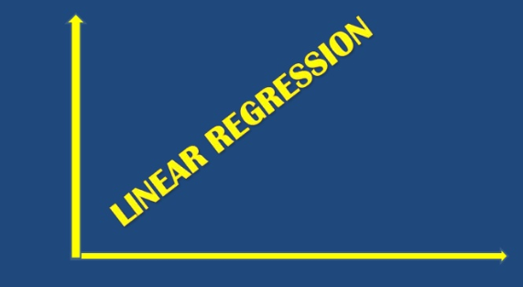

Slide 2
Table of Contents
Introduction
Objectives
Data gathering and preprocessing
Model Development for Simple linear regression
Model Development for Multiple linear regression
Data insights
Conclusion

Slide 3
Introduction
Linear Regression
Simple Linear Regression
Multiple Linear regression

Slide 4
Objective
Simple Linear Regression
Regression of one forecast or dependent variable and one explanatory or independent variable
Multiple Linear Regression
Regression of one dependent variable and two independent variable
Linear relationship between x1, x2 and y given by ‘Y=m1x1+m2x2+c’
Governing equation :
Ʃxy = mƩx²+cƩx
Ʃy=mƩx+nc
Linear relationship between x and y given by ‘Y = mx+c’
Governing equation as:
Ʃx1y = m1Ʃx1²+m2Ʃx1x2+cƩx1
Ʃx2y = m1Ʃx1x2+m2Ʃx2²⁺+cƩx2
Ʃy=m1Ʃx1+m2Ʃx2+cƩ1

Slide 5
y-=mx+c
Find the value of m and c and fit a simple regression curve between x(Independent variable) and y(dependent variable)
Y=m1x1+m2x2+c
Find the value of m1, m2 and c and fit a multiple regression curve between x1, x2 (two Independent variable) and y (dependent variable)

Slide 6
Model Development for Simple linear regression
Following is the various computational steps (in Python) of building simple linear regression model for a given dataset of x,y and finding Correlation coefficient between x and Y
Arrays
x[ ] = Data of x
y[ ] = Data of y
Compute Ʃx, Ʃy and Ʃxy
Solve m, c using
Ʃxy = mƩx²+cƩx
Ʃy=mƩx+nc
Arrays
x[ ] = Data of x
y[ ] = Data of y
Compute X-Xmean and Y-Ymean
Find r by calculating Cov(x,y)/sqrt(variance X * variance Y)

Slide 7
Model Development for Multiple linear regression
Following is the various computational steps (in Python) of building multiple linear regression model for a given dataset of x1,x2 and y
Arrays
x1[ ] = Data of x1
x2[ ] = Data of x2
y[ ] = Data of y
Compute Ʃx, Ʃy and Ʃxy
Solve m1,m2, c using
Ʃx1y = m1Ʃx1²+m2Ʃx1x2+cƩx1
Ʃx2y = m1Ʃx1x2+m2Ʃx2²⁺+cƩx2
Ʃy=m1Ʃx1+m2Ʃx2+cƩ1

Slide 8
Data gathering and preprocessing

Slide 10
Data Insights

Slide 11
Conclusion

