Slide 1


Slide 2
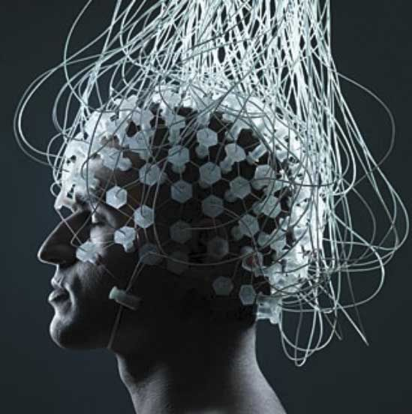
Brain-Controlled Prosthetic Arm for Paralyzed Persons

Slide 3


Mr. Syed Waleed Hussain
Supervisor
Dr. Umair Muneer Butt
Co-Supervisor

Slide 4



Team Members
Email :
22017020004@skt.umt.edu.pk
GitHub : @Saqib54
Email :
22017020017@skt.umt.edu.pk
GitHub : @shahbano53
Email :
22017020013@skt.umt.edu.pk
GitHub : @hibanadeen03

Slide 5
Table Of Content
Introduction
Project Overview
Motivation
Research Objectives
Literature Review
Comparative Study
Problem Statement
Research Question
Requirement Analysis
Data Flow Diagram
System Architecture
Scope & Significance

Slide 6
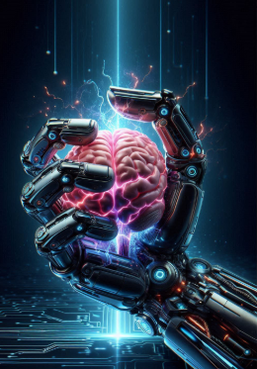
Introduction
Brain-controlled prosthetic arm for paralyzed people.
Uses EEG to read brain signals.
Sends commands to a robotic arm.
Users control the arm by thinking.
Works without muscle movement.
Easier and more useful than traditional prosthetics

Slide 7
Project Overview
Builds a brain-controlled prosthetic arm using EEG signals.
A custom EEG helmet captures and reads brain activity.
Brain signals are processed and converted into movement commands.
The arm moves according to the user’s thoughts in real time.
Focuses on accuracy, quick response, and user comfort.

Slide 8
Motivation
Help people with movement disabilities live more independently
Provide a solution when muscle-based prosthetics cannot be used
Use brain signals to control assistive devices directly
Create a safe, non-invasive, and low-cost system
Handle EEG noise using AI and signal processing
Improve confidence and quality of life for disabled individuals

Slide 9
Objectives
Design a comfortable custom EEG helmet to capture clear brain signal
Convert EEG brain signals into accurate commands for prosthetic movement
Improve the prosthetic arm’s speed, accuracy, and real-world usability

Slide 10
Literature Review
Problem Statements | Key Findings | Limitations
EEG signals are noisy | Combining signals improves accuracy | Heavy processing slows the system
Real-time control is unstable | AI helps recognize patterns | Limited real-world testing
High computation is required | Adaptive calibration improves performance | Strong hardware is needed
System setup is complex | Better electrodes improve signals | Mechanical durability issues
User state affects performance | Low-cost designs are possible | Noise reduces reliability

Slide 11
Comparative Study Of Existing Systems
System Name | Control Type | Technologies / Components | Core Features | Limitations
EMG-Based Prosthetic Arm | EMG control | 3D printing, sensors, servos | Custom grip, flexible, muscle signals | High power use, costly, complex design[14]
High-Response Myoelectric System | Myoelectric | EMG sensor, amplifier, controller | Fast response, smooth motion, real-time | Signal noise, recalibration, limited stability, fine control issues [13]
Multimodal Adaptive Hand | Vision + tactile | Camera, IMU, ML | Sensor fusion, adaptive, precise | Calibration issues, sensor sync delay, maintenance[15]
3D-Printed Grasp Arm | Force + position | FSR, 3D print, servo | Lightweight, grasp detect, safe | Low strength, servo heating, durability, limited range[16]

Slide 12
Problem Statement
EEG signals are weak and easily affected by noise and interference
Real-time system performance is often slow and unreliable
Signal processing causes noticeable response delays

Slide 13
Research Questions
How can we design a custom EEG helmet to reliably capture brain signals for prosthetic control?
How can we extract accurate control commands from EEG data for smooth prosthetic movement?
How can we improve system speed and accuracy to make thought-controlled prosthetic hands practical for daily use?

Slide 14
Functional Requirements
EEG Signal Collection: Collect brain signals using an EEG headset.
Signal Cleaning: Remove noise to make the signals clear and usable.
Command Conversion Change brain signals into movement commands.
Robotic Arm Control: Move the arm quickly and accurately as per commands.
Data Logging: Save signals and results to test and improve the system.

Slide 15
Non-Functional Requirements
Reliability: Works smoothly without losing signals or needing frequent setup.
Accuracy: Moves correctly according to the user’s brain signals.
Response Time: Reacts quickly to the user’s thoughts
Scalability: Can be upgraded easily with more sensors or features.
Affordability: Low-cost design using common parts and free tools.

Slide 16
DFD Level 0 (Context Level)
Component | Description | Data Flow
Process 0.0 | Brain-Controlled Prosthetic Arm System | Receives brain signals, sends motor commands
External Entity: User | Provides brain intent and receives feedback | User → Raw Signals → System; System → Feedback → User
External Entity: EEG Headset | Captures raw EEG signals | EEG Headset → Raw Signals → System
External Entity: Prosthetic Arm | Executes movement commands | System → Motor Commands → Prosthetic Arm
External Entity: Power Supply | Provides electricity for system | Powers System

Slide 17
DFD Level 1 (System Decomposition)
Process | Description | Input | Output | Data Store
1.0 Bluetooth Communication Manager | Handles wireless EEG data reception | Raw Signal Data from EEG Headset | Forwarded Raw EEG Data | -
2.0 EEG Signal Parser | Filters noise and extracts meaningful signals | Raw EEG Data | Parsed EEG Signals (Attention, Meditation) | -
3.0 Command Generation Logic | Decides prosthetic action based on thresholds | Parsed EEG Signals | Action Commands | D1 System Config & Thresholds
4.0 Motor Actuation Controller | Sends commands to prosthetic motors | Action Commands | Motor Signals to Prosthetic Arm | -

Slide 18
DFD Level 2 (Exploding Process 3.0: Command Generation Logic)
Sub-Process | Description | Input | Output | Data Store
3.1 Evaluate Attention | Compares Attention value to threshold | Attention Value | Attention State (High/Low) | D1 Thresholds
3.2 Evaluate Meditation | Compares Meditation value to threshold | Meditation Value | Meditation State (High/Low) | D1 Thresholds
3.3 Apply Decision Rules | Combines states to decide final action | Attention & Meditation States | Final Action Command (Grip/Release/Hold) | D1 Thresholds

Slide 19
System Architecture
Subsystem | Description | Key Components / Function
1. Signal Acquisition (Input Layer) | Captures user’s brain signals and converts them to digital data | Dry EEG electrodes (FP1 position), TGAM Module; performs noise filtering & ADC
2. Wireless Communication | Sends EEG data wirelessly to the processing unit | Bluetooth module; transmits digital EEG packets periodically
3. Embedded Processing (Core Logic) | Processes signals and decides prosthetic actions | ESP32 MCU, Bluetooth UART buffer, Signal Parser, Threshold Decision Unit, Actuator Interface
4. Actuation Subsystem | Converts digital commands to physical movement | Servo motors: Gripper, Wrist/Elbow; executes open/close, rotation, lifting actions
5. Power Control System | Provides stable and sufficient power to all components | 7.4V Li-Po battery, DC-DC Buck Converter for motors, 5V regulator for ESP32

Slide 20
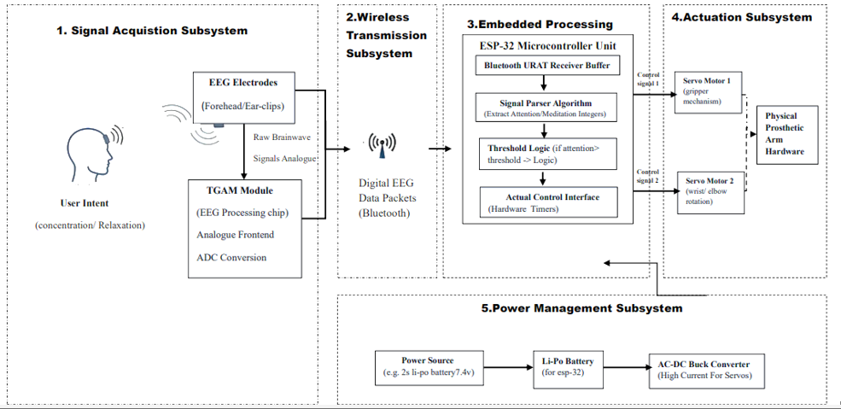
System Architecture Diagram

Slide 21

Scope and Significance
Helps paralyzed people control an artificial arm using brain signals.
Provides a non-invasive and user-friendly assistive solution.
Promotes local innovation in robotics and healthcare technology.
Opens the way for future research in brain-controlled systems.
Improves the quality of life for individuals with physical disabilities.

