Slide 1
Artificial Intelligence
Department of Computer Science
Quaid-i-Azam University
Fall 2025 Semester
Artificial Intelligence
Course Instructor: Onaiza Maqbool

Slide 2
Intelligence
We call ourselves Homo Sapiens – Man -
Our intelligence is so important for us
For thousands of years, we have tried to understand how we think and act
How our brain, a mere handful of matter, can
  perceive,
  understand,
  predict,
  and manipulate
  a world far larger and more complicated than itself
the wise

Slide 3
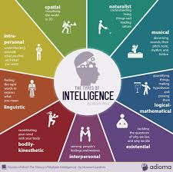
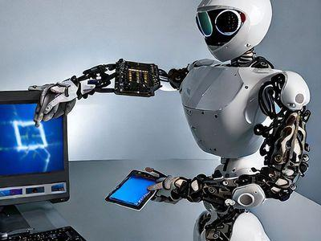
Intelligence
Human Intelligence
  Mental quality that consists of the abilities
    to learn from experience
    adapt to new situations
    understand and handle abstract concepts
    and use knowledge to manipulate one’s environment
Artificial Intelligence
  the ability of a digital computer or computer-controlled robot to perform tasks commonly associated with intelligent beings such as
    the ability to reason
    generalize,
    or learn from past experience
  www.britannica.com

Slide 4
Latest AI developments
Its impact will be “more than anything in the history of mankind”
Language processing
Computer Vision and Image Processing
Games
Robotics
Mobility
Health
Finance
Recommender systems

Slide 5
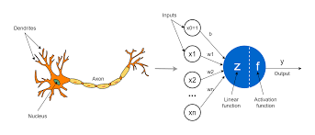
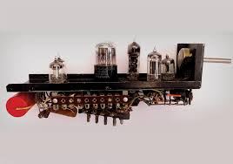
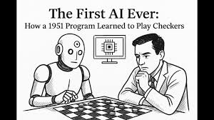
History
1943-1956 | Pre-birth - Inception
1943 | McCulloch & Pitts - artificial neuron, suggested that networks could learn – Hebbian learning
1950 | Turing – Complete vision of AI in article “Computing Machinery and Intelligence” Turing test Machine learning Genetic algorithms Reinforcement learning
1951 | Minsky & Edmonds - first neural network computer SNARC (40 neurons)
1952 | Strachey and Samuel (separately)– Checker playing programs

Slide 6
1956 | Birth of AI. Term coined by McCarthy at Dartmouth Workshop at Dartmouth College; attendees: John McCarthy, Marvin Minsky, Claude Shannon, etc Every aspect of learning or any other feature of intelligence can be so precisely described that a machine can be made to simulate it How to make machines use language, form abstractions and concepts, solve kinds of problems now reserved for humans, and improve themselves

Slide 7
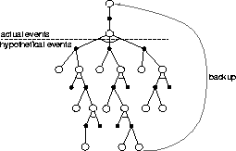
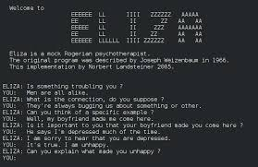
-1969 | Great Expectations
1956 | Newell and Simon - Logic theorist, a reasoning program which proved theorems Subsequently GPS, general problem solver embodied “thinking humanly” approach Order in which the program considered subgoals and possible actions was similar to that in which humans approached the same problems
1956 | Samuel - Checkers program – reinforcement learning (played a better game than its creator) Most influential in the long run
1958 | Lisp defined at MIT by McCarthy - the dominant AI programming language for the next 30 years
1965 | Eliza https://sites.google.com/view/elizaarchaeology/try-eliza

Slide 8
 | Overwhelming optimism... Machines will be capable, within twenty years, of doing any work a man can do. —Herbert Simon Within 10 years the problems of artificial intelligence will be substantially solved. —Marvin Minsky I visualize a time when we will be to robots what dogs are to humans, and I'm rooting for the machines. —Claude Shannon ...underwhelming results Example: machine translation The spirit is willing but the flesh is weak. (Russian) The vodka is good but the meat is rotten. (English)

Slide 9
History (contd…)
1966-1973 | Dose of Reality – The AI Winter Early systems failed on difficult problems Syntactic manipulations don’t work without knowledge e.g. translation Computational complexity of many problems British Govt ended support for AI in all but 2 universities Reasons Limited information how humans perform a task, rather than on a careful analysis of the task, what it means to be a solution, and what an algorithm would need to do to reliably produce such solutions. - Limited computation lack of appreciation of the intractability of many of the problems that AI was attempting to solve “scaling up” to larger problems was simply a matter of faster hardware and larger memories - Fundamental limitations on the basic structures being used to generate intelligent behavior e.g. limitations on basic structures of nn led to reduced funding for research

Slide 10
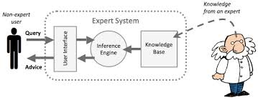
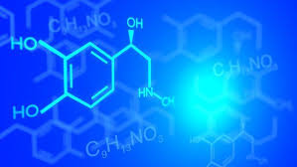
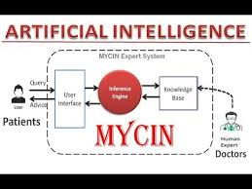
1969-1986 | Knowledge-based (expert) systems Elicit specific domain knowledge from experts in form of rules: if [premises] then [conclusion] Alternatives to weak methods use domain specific knowledge
1969 | Dendral – Inferring molecular structure, embodied special purpose rules
Early 1970s | MYCIN – Diagnosing blood infections (450 rules) incorporated uncertainty

Slide 11
History (contd…)
1970s – 80s | Knowledge based systems - Prolog An Industry R1 – first commercial expert system helped configure orders for DEC (saved $40 million a year) Problems: Knowledge is not deterministic rules, need to model uncertainty Requires considerable manual effort to create rules, hard to maintain
1987 | Collapse of Lisp machines and second AI winter

Slide 12
State of the Art
Which of the following can be done at present?
  Play a decent game of table tennis
  Drive safely along a curving mountain road
  Buy a week's worth of groceries on the web
  Play a decent game of bridge
  Discover and prove a new mathematical theorem
  Design and execute a research program in molecular biology
  Write an intentionally funny story
  Give competent legal advice in a specialized area of law
  Translate spoken English into spoken Swedish in real time
  Converse successfully with another person for an hour
  Perform a complex surgical operation
  Unload any dishwasher and put everything away

Slide 13
Course Outline
Aims:

Slide 14
Course Outline (contd…)
Session | Lecture | Readings
1, 2 | Introduction: Foundations and history of AI, Intelligent Agents | Chapter 1, 2
3, 4 | Types of Problems in AI: Reflex based, state based, variable based, logic based with examples. Modeling, inference and learning paradigm | Slides
5, 6 | Prediction: Types of predictors, linear predictors, features, feature extraction, feature representation
7, 8 | Loss: Loss, Types of loss, Loss minimization framework, Gradient descent and variations
9, 10 | Neural Networks: Components and structure, gradient computations, back propagation
11, 12 | Supervised and Unsupervised learning: Lazy learners, K-means, Generalization and overfitting

Slide 15
13 - 15 | Problem Solving by Searching: Defining and formulating problems, Searching for solutions, Uninformed search strategies: Breadth-first search, Depth-first search, Depth- limited search, Bi-directional search | Chapter 3
16 | Midterm
17 – 19 | Informed Search: Greedy best-first search, A* search, Heuristic functions, Local search algorithms: Hill-climbing, Simulated annealing, Local beam search, genetic algorithms | Chapter 4, 5
20 – 22 | Adversarial Search: Optimal strategies, Minimax algorithm, Alpha-Beta pruning, Games of chance | Chapter 6
23, 24 | Logical Agents: Knowledge-based agents, Prepositional logic: Syntax, semantics and inference. Reasoning and resolution, Propositional inference | Chapter 7
25, 26 | First-order logic and Inference: Syntax and semantics, Inference rules, Forward and backward chaining, Resolution | Chapter 8, 9
27 – 30 | Constraint Satisfaction Problems: Examples, Inference in CSPs, local search for CSPs | Chapter 10
31, 32 | Future Directions | Chapter 6

Slide 16
Course Outline (contd…)
Evaluation Criteria:
  Final exam 50%
  Sessionals 25%
  Assignments+Quizzes 25%
Recommended Readings:
  Stuart Russell and Peter Norvig, Artificial Intelligence - A Modern Approach, Pearson Education, 4th Edition, 2020
  Hastie, Tibshirani, and Friedman, The elements of statistical learning, 2nd Edition

Slide 17
Course Outline (contd…)
Policies
  Late assignments may be accepted with marks reduction. There will be a 10% reduction for assignments submitted up to 24 hours late
  Students who have copied assignments or whose assignments have been copied will both be given a zero
  Plagiarism is not acceptable. Anyone found to be guilty of plagiarism in an assignment will be given a zero in that assignment
  Quizzes will be unannounced
Website

