Slide 1
Artificial Intelligence
Lecture # 2

Slide 2
Learning Objectives
To enable students to
  Describe major AI milestones in history
  Understand and differentiate between types of AI agents

Slide 3
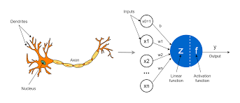
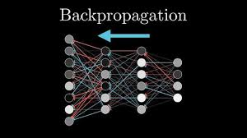
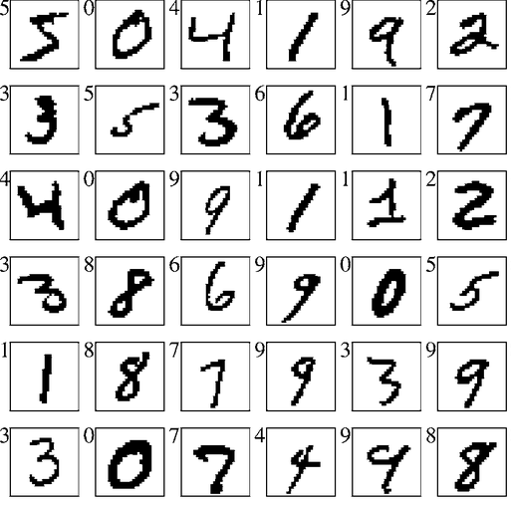
History (contd….)
1986 - Present | Return of Neural Networks 1943: introduced artificial neural networks, connect neural circuitry and logic (McCulloch/Pitts) Knowledge of: neurons, predicate logic, and Turing’s theory of computation 1969: Perceptrons book showed that linear models could not solve XOR, killed neural nets research (Minsky/Papert) Training networks 1986: popularization of backpropagation for training multi-layer networks (Rumelhardt, Hinton, Williams) 1989: applied convolutional neural networks to recognizing handwritten digits for USPS (LeCun)
1987- Present | Machine learning

Slide 4
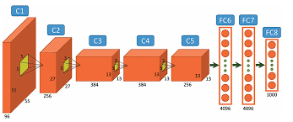
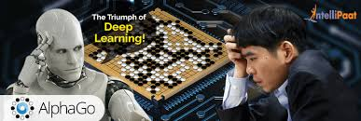
History (contd…)
2001- Present | Big data
2011 - present | Deep learning AlexNet (2012): huge gains in object recognition; transformed computer vision community overnight AlphaGo (2016): deep reinforcement learning, defeat world champion Lee Sedol

Slide 5
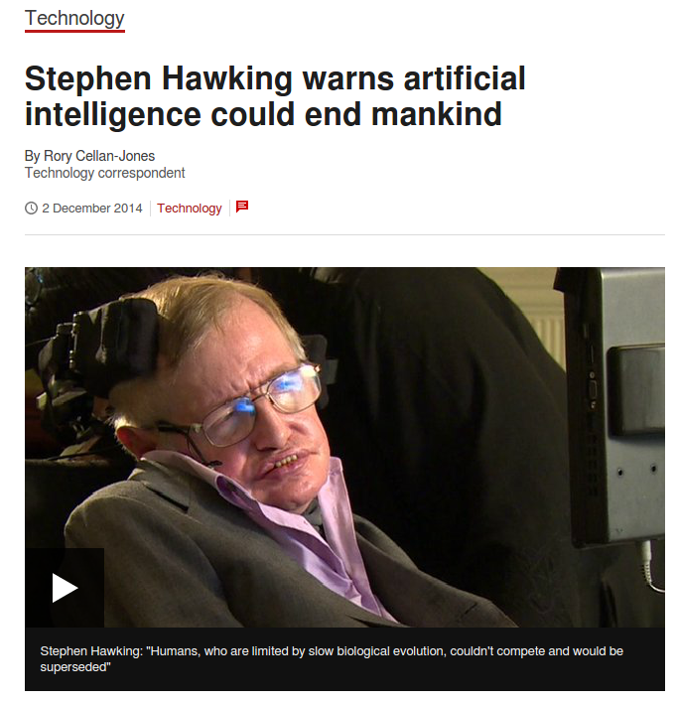
AI in the future
One of the most interesting and fastest growing field
AI is likely to be transformational, what kind of transformation the future will hold, no one knows
It would be easier to create human-level AI by developing learning algorithms and then teaching the machine rather than by programming its intelligence by hand.
He warned that achieving this goal might not be the best thing for the human race

Slide 6
What is AI? Some approaches
Systems that THINK LIKE HUMANS Cognitive modeling approach | Systems that THINK RATIONALLY Laws of thought approach
Systems that ACT LIKE HUMANS Turing test approach | Systems that ACT RATIONALLY Rational agent approach

Slide 7
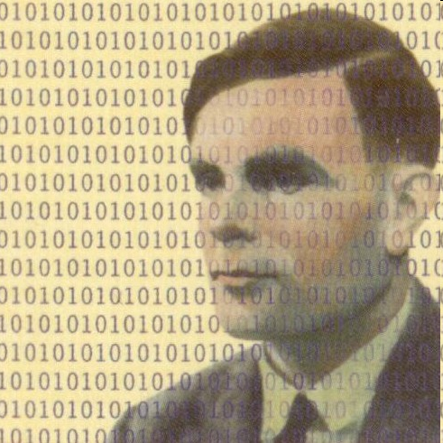
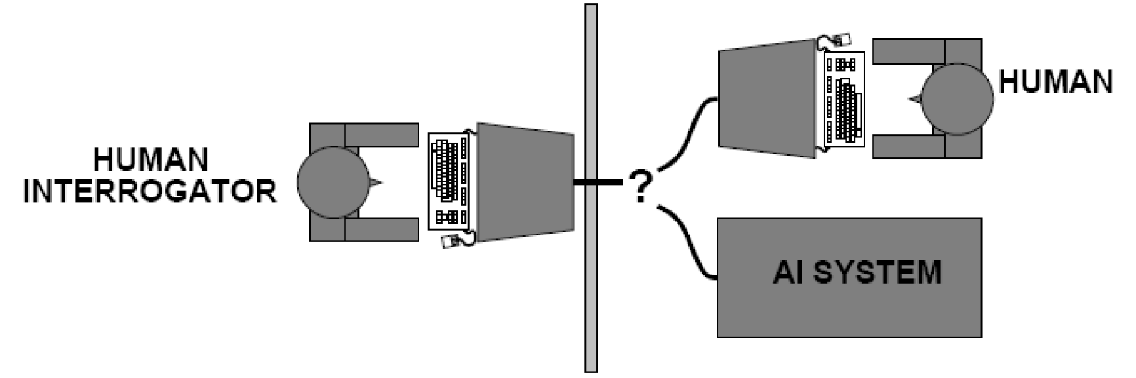
Acting Humanly: The Turing Test
http://www.sjcalums.com/nyc/images/crests/hourly/Alan_Turing_491x491.jpg
Notes:
Can a problem be solved by more than one algorithm?

Slide 8
Acting Humanly (contd…)
To pass the Turing test, computer needs the following abilities:
  Natural language processing: communicate in human language
  Knowledge representation: store what it knows or hears
  Automated reasoning: use stored information to answer questions and draw conclusions
  Machine learning: adapt to new circumstances & to detect and extrapolate patterns
Total Turing Test: Test the computer’s perceptual abilities
  Computer vision: perceive objects
  Robotics: manipulate objects and move about
These six disciplines compose most of AI
AI researchers have devoted little effort to passing the Turing test

Slide 9
Thinking Humanly: Cognitive Modeling
More important to study underlying principles of intelligence than try to duplicate
To make a program think like a human…
  We need to understand how humans think
Cognitive science brings together
  computer models from AI &
  experiments from psychology
  to construct theories of the working of the human mind
AI and cognitive science continue to enrich each other especially in fields e.g. vision and natural language processing

Slide 10

Thinking Rationally: Laws of Thought
Aristotle attempted to codify “right thinking”
i.e. irrefutable reasoning process
Syllogism provides patterns for arguments structures that give correct conclusions from correct premises, e.g.,
  Socrates is a man; all men are mortal; so conclude:
    Socrates is mortal
Initiated the field of logic
Logicist tradition within AI hopes to build on programs written in logical notation to create intelligent systems
Emphasis is on correct inference
Informal knowledge has to be expressed in formal terms - Knowledge may be less than 100% certain

Slide 11
Acting Rationally: Rational Agents
Rationality: Doing the right thing given what you know - Maximize the achievement towards a goal given some information
A rational agent is one that acts so as to achieve the best outcome or, when there is uncertainty, the best expected outcome
Correct inference is sometimes part of being a rational agent
Rationality does not always involve inference
  A reflex action may be more successful than careful deliberation
Achieving perfect rationality may not be feasible in complicated environments (computational demands may be too high)!
Beneficial Machines! Value alignment problem – True preferences and objective

Slide 12
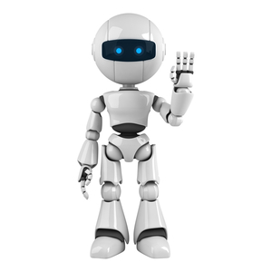

Two views of AI
AI agents: how can we create intelligence?
AI tools: how can we benefit society?

Slide 13
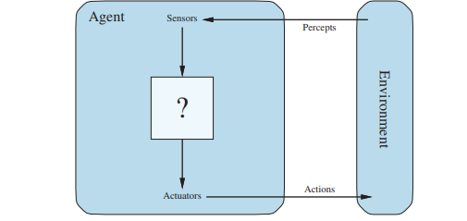
AI Agents
Perception
Robotics
Language
Knowledge
Reasoning
Learning
Each of these is a research area in which there has been progress

Slide 14
Agents and Tasks
Consider, e.g., the task of designing an automated taxi driver:
  Performance measure:
    Safe, fast, legal, comfortable trip, maximize profits
    Goals may conflict - tradeoffs
  Environment:
    Roads, other traffic, pedestrians, customers
    The more restricted the environment, the easier the design problem
  Actuators:
    Steering wheel, accelerator, brake, signal, horn
  Sensors:
    Cameras, sonar, speedometer, GPS, odometer, engine sensors, keyboard

Slide 15
How human are these agents?
Machines: Narrow tasks, millions of examples
Humans: Diverse tasks, very few examples
AlphaGo learned from 19.6 million games, but can only do one thing: play Go. Humans on the other hand learn from a much wider set of experiences, and can do many things

Slide 16
AI Tools
Benefit humans without being human like
  Targeted advertising
  News or product recommendation
Need to think carefully about real-world consequences (e.g., security, biases)
Since machine learning algorithms are based on mathematical principles, they are somehow objective
However, machine learning predictions come from the training data, and the training data comes from society
Any biases in society are reflected in the data and propagated to predictions

