Slide 1
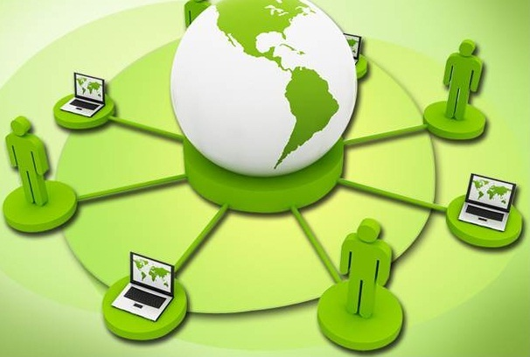
Computer Networks
        Dr. Muazzam A. Khan

Slide 2
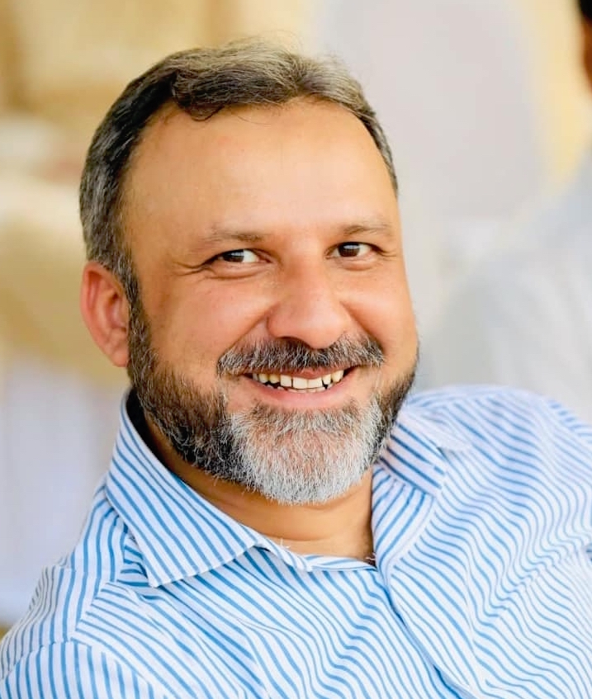
















Prof. Dr. Muazzam A. Khan Khattak (SM NADRA/IEEE/PAS/AAAI)
Listed in Top 2% Scientists of The World 2024, 25/Gold Medal PAS
Director Farabi Centre AI & CS, S&T, ICESCO Chair.
Chairperson UNESCO IFAP National Committee, Pakistan.
Research Areas
Artificial Intelligence (AI), Internet of Things (IoTs), Smart Cities,
Intelligent Networks, Information Security.
Research Profile:
International Grants: 350 M
OIC, ICESCO, UMKC, PAS, CHINA,
International Publications: 230
Impact Factor: 400+
Citations: 6614+
H-Index – 45
Product Developed: Safe Roam, Pollution Moniter
International Collaborations
China
Harbin Institute of Technology, Weihai, Northwest Polytech University, Uni of Electronic Sci & Technology, China.
USA
University of Missouri, Kansas State Uni, UNC Charlotte, TEXAM University.
UK & Germany
Uni of West London , Uni of Glasgow, Uni of Edinburgh, Napier, Uni of Ulm, Uni of Munich.
Kazakhstan & Saudi Arabia
Prince Sultan Uni, Imam Uni, Prince Muqrin Uni,
Türkiye & Malaysia
USAK Uni, University of Malaya, Sunway Uni,
Azerbaijan
Baku State University,
International Editorial and Organiser Roles
Co-Chair HoNET-ICT 2018,19,20,21,22, 23, 24,2025
C-CoDE-2019, 22. I-CoD-2 2022, 2023, 2025
Associate Editor IEEE Access,
Guest Editior in Journal: Computer Material and Continoua.
Reviewer in IEEE Transactions, Elsvier Journals, Springer & Wiley
Notes:
Updated on: 20/11/2016

Slide 3
Course Objectives
After successfully completing the course, students will be able to
  Apply knowledge and analyze some networking protocols.
  Design and implement simple computer networks.
  Identify, formulate, and solve network engineering problems.
  Use techniques, skills, and modern networking tools necessary for engineering practice.

Slide 4
Networking
Computer network A collection of computing devices that are connected in various ways in order to communicate and share resources
Usually, the connections between computers in a network are made using physical wires or cables
  However, some connections are wireless, using radio waves or infrared signals

Slide 5
Networking
The generic term node or host refers to any device on a network
Data transfer rate The speed with which data is moved from one place on a network to another
Data transfer rate is a key issue in computer networks

Slide 6
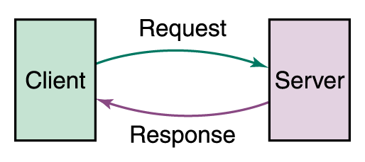
Networking
Computer networks have opened up an entire frontier in the world of computing called the client/server model
Figure 15.1 Client/Server interaction

Slide 7
Networking
File server A computer that stores and manages files for multiple users on a network
Web server A computer dedicated to responding to requests (from the browser client) for web pages

Slide 8
Servers
2 Basic types of servers:
♦ Iterative - server handles one client at a time.
♦ Concurrent - server handles many clients at a time.

Slide 9
Types of Networks
Local-area network (LAN) A network that connects a relatively small number of machines in a relatively close geographical area

Slide 10
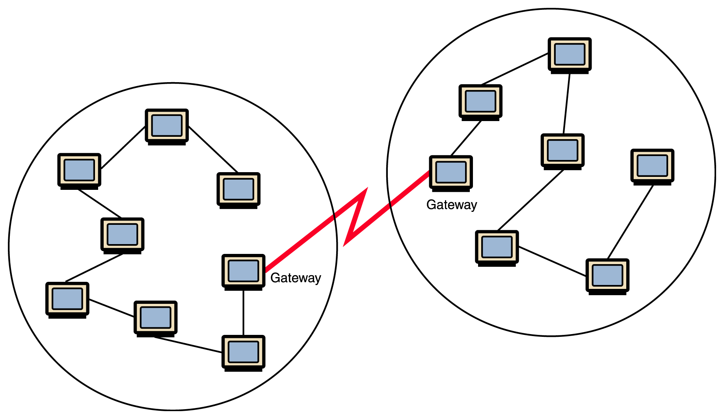
Types of Networks
Figure Local-area networks connected across a distance to create a wide-area network

Slide 11
Types of Networks
Wide-area network (WAN) A network that connects two or more local-area networks over a potentially large geographic distance
  Often one particular node on a LAN is set up to serve as a gateway to handle all communication going between that LAN and other networks
Communication between networks is called internetworking
  The Internet, as we know it today, is essentially the ultimate wide-area network, spanning the entire globe

Slide 12
Types of Networks
Metropolitan-area network (MAN) The communication infrastructures that have been developed in and around large cities

Slide 13
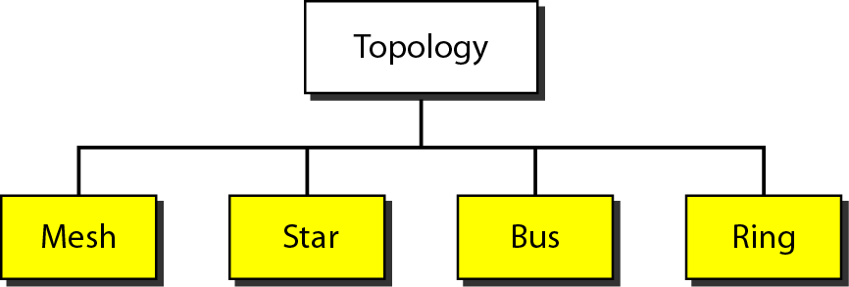
Topology
Physical or logical arrangement
4 basic types: mesh, star, bus, ring, hybrid
May often see hybrid

Slide 14
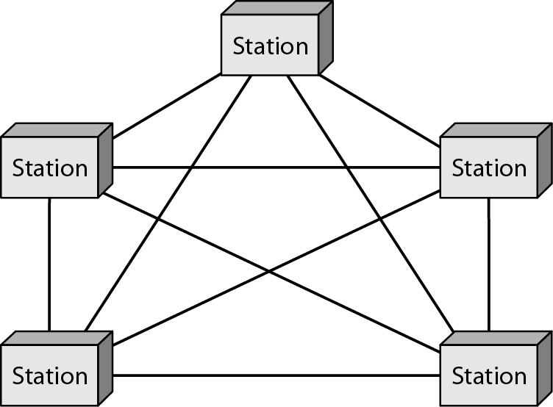
Mesh Topology
Dedicated point-to-point links to every other device
n(n-1)/2 physical channels to link n devices
Every device on network must have n-1 I/O ports
Advantages: Dedicated links, Robust, Security and privacy, Easy fault identification and isolation
Disadvantages: Bulk of wiring, No of I/O ports, expensive, Difficult installation and reconnection

Slide 15
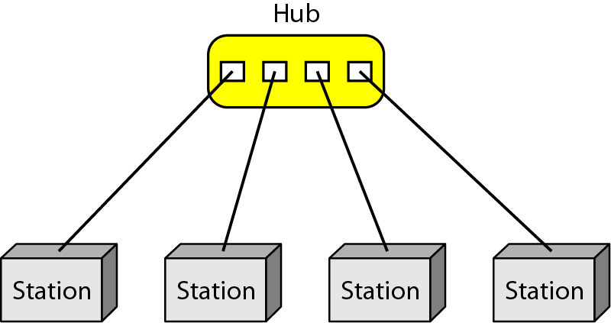
Star Topology
Dedicated point-to-point links to central controller (hub)
Controller acts
as exchange
Advantages: Less expensive then mesh, Easy to install and configure, robustness, easy fault isolation and identification
Disadvantages: More cabling required then ring and bus.

Slide 16
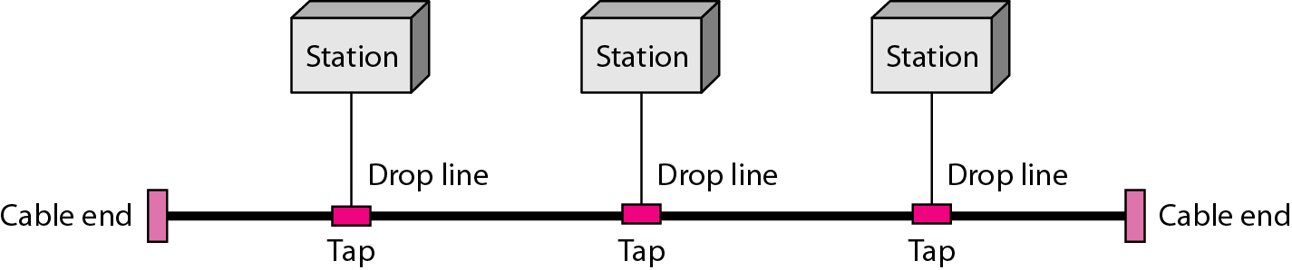
Bus Topology
Multipoint configuration
One cable acts as a backbone to link all devices
Advantages: Less cabling, Easy to install and reconfigure
Disadvantages: Limited no of taps supported, Difficult reconnection and fault isolation.

Slide 17

Ring Topology
Dedicated point-to-point configuration to neighbors
Signal is passed from device to device until it reaches destination
Each device functions as a repeater
Advantages: Less cabling, Easy to install and reconfigure
Disadvantages: Break can disable entire network

Slide 18
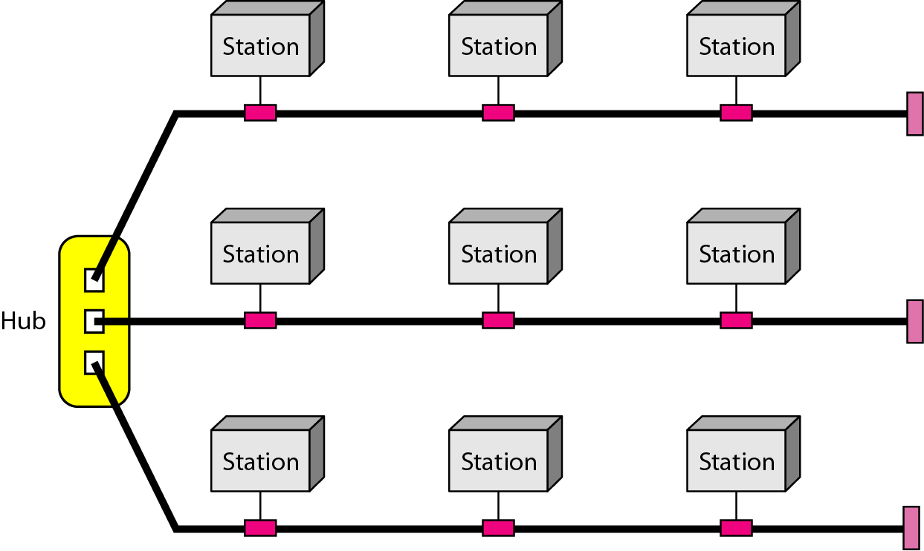
Hybrid Topology

Slide 19
So, who owns the Internet?
Well, nobody does. No single person or company owns the Internet or even controls it entirely. As a wide-area network, it is made up of many smaller networks. These smaller networks are often owned and managed by a person or organization. The Internet, then, is really defined by how connections can be made between these networks.

Slide 20
Internet Connections
Internet backbone A set of high-speed networks that carry Internet traffic
These networks are provided by companies such as AT&T, GTE, and IBM
Internet service provider (ISP) A company that provides other companies or individuals with access to the Internet

Slide 21
Internet Connections
There are various technologies available that you can use to connect a home computer to the Internet
  A phone modem converts computer data into an analog audio signal for transfer over a telephone line, and then a modem at the destination converts it back again into data
  A digital subscriber line (DSL) uses regular copper phone lines to transfer digital data to and from the phone company’s central office
  A cable modem uses the same line that your cable TV signals come in on to transfer the data back and forth

Slide 22
Internet Connections
Broadband A connection in which transfer speeds are faster than 128 bits per second
  DSL connections and cable modems are broadband connections
  The speed for downloads (getting data from the Internet to your home computer) may not be the same as uploads (sending data from your home computer to the Internet)

Slide 23
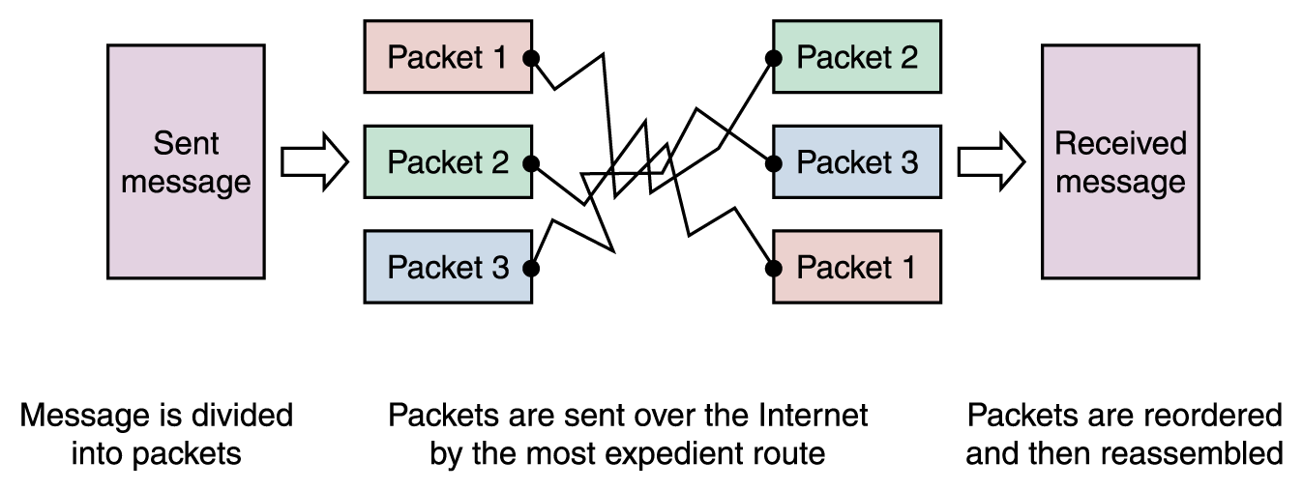
Packet Switching
To improve the efficiency of transferring information over a shared communication line, messages are divided into fixed-sized, numbered packets
Network devices called routers are used to direct packets between networks
Figure
Messages sent by packet switching
15-18

Slide 24
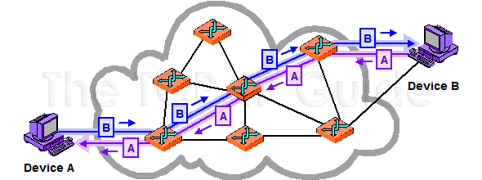
Circuit Switching
  There is a dedicated communication path between two stations (end-to-end)
  The path is a connected sequence of links between network nodes.
  The switches must know how to find the route to the destination and how to allocate bandwidth (channel) to establish a connection.
Figure
Messages sent by Circuit switching
15-18

Slide 25
Systems
Proprietary system
A system that uses technologies kept private by a particular commercial vendor.
Interoperability
The ability of software and hardware on multiple machines and from multiple commercial vendors to communicate.
Open systems
Systems based on a common model of network architecture and a suite of protocols used in its implementation

Slide 26
Network Models
Using a formal model allows us to deal with various aspects of Networks.
We will look at two popular models
1. OSI reference model
2. TCP/IP model
Both models are based on the concept of layering

