Slide 1

COMPUTER VISION · IMAGE CLASSIFICATION
Date Fruit Classification
Fine-grained classification of date-fruit varieties from photographs
10
varieties
THE PROBLEM
This project solves a visual classification problem: identifying the variety of a date fruit from its image.
Manual sorting is slow, inconsistent and needs an expert. The goal: a model that takes one photo of a single date and names its variety automatically.
7,000
labelled photos
1
date per image
Hamza Khan Tariq and Muhammad Saqib

Slide 2
Applications:
1. Farmers
To identify or verify date varieties.
2. Sellers/exporters
To classify date types before packaging or selling.
3. Food processing companies
To automate sorting and labeling.
4. E-commerce platforms
To help label product images correctly.
5. Students/researchers
To study computer vision and agricultural AI.
6. Buyers/inspectors
To check whether a product visually matches the claimed variety.

Slide 3
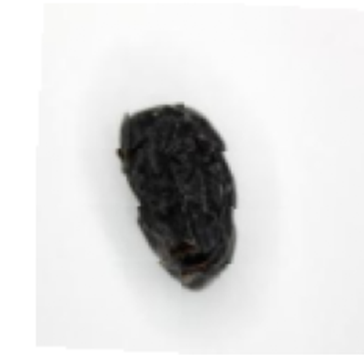
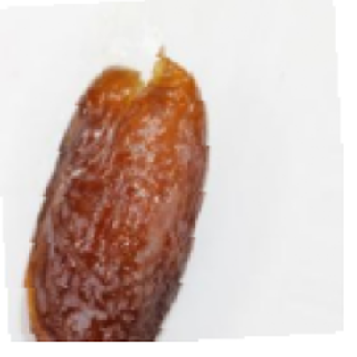
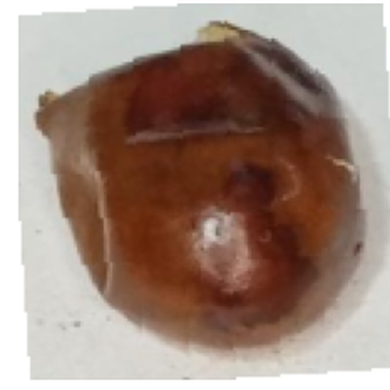
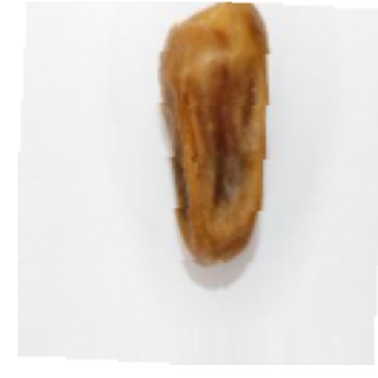
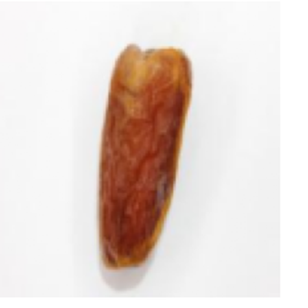
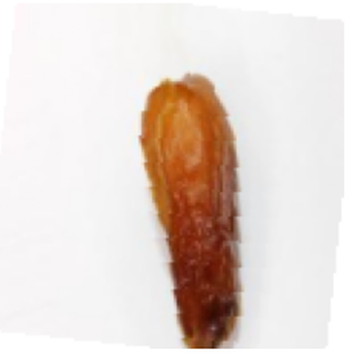
1
The Dataset
7,000 studio photos · 700 per class · perfectly balanced · split 70 / 15 / 15
Ajwa
Medjool
Fasli-Toto
Sokari
Galaxy
Sugaey
near-black, deeply wrinkled
large, glossy, amber-brown
round & plump, dark
pale gold, split skin
slender, reddish-brown
two-tone, matte
700
4,890
1,050
1,060
images / class
training
validation
test (held out)

Slide 4


2
Two Models, One Task
We built and compared two very different approaches to the same 10-class problem
PRETRAINED · TRANSFER LEARNING
CUSTOM · BUILT FROM SCRATCH
ResNet-50
CustomDateCNN
23.5 M parameters
392 K parameters
Input 224 × 224 RGB
Input 128 × 128 RGB
Backbone ImageNet weights, kept as feature extractor
Design 4 conv blocks, 32 → 64 → 128 → 256
Stage 1 freeze backbone, train new head only
Each block Conv 3×3 → BatchNorm → ReLU → MaxPool
Stage 2 unfreeze layer4 + head, fine-tune
Head AdaptiveAvgPool → Flatten → Dropout → Linear
New head Dropout 0.3 → Linear (2048 → 10)
Weights random init — no pretraining at all
Tricks discriminative LRs, mixed precision
Footprint ~60× smaller than ResNet-50

Slide 5





3
Pipeline
Overall training pipeline
1
2
3
4
5
Audit & split
Preprocess
Two-stage training
Regularise & tune
Evaluate & diagnose
Checked 7,000 images for corruption (0 bad), confirmed class balance, split 70/15/15 with a fixed seed = 42.
Resize, ImageNet-style normalisation, and light augmentation — random crop, flip, rotation, colour jitter — train-only.
Froze the ResNet backbone first for a stable baseline, then fine-tuned layer4 with smaller, separate learning rates.
Dropout, weight decay, AdamW, and a ReduceLROnPlateau scheduler chosen and hand-tuned per model.
Confusion matrix, per-class precision / recall / F1, confidence analysis, and inspection of every misclassified date.
Reproducible by design — fixed seeds, deterministic evaluation transforms, and best-checkpoint saving on validation accuracy.

Slide 6
4
How They Differ
Same dataset, same 10 classes — opposite philosophies
ResNet-50 · pretrained
CustomDateCNN · scratch
Strategy
Transfer learning
Trained from scratch
Parameters
23.5 M
392 K
Input size
224 × 224
128 × 128
Pretrained?
Yes — ImageNet
No
Depth
50 layers (residual)
4 conv blocks
Epochs
5 frozen + 8 fine-tune
15
Epoch time
~42 s
~12 s
The deeper, pretrained network is far heavier — yet, as the results show, heavier did not mean better here.

Slide 7


5
The Result
Final accuracy on the 1,060-image held-out test set
PRETRAINED
FROM SCRATCH
ResNet-50
CustomDateCNN
93.87 %
VS
96.79 %
test accuracy · loss 0.173
test accuracy · loss 0.118
The 60× smaller model won.
Our from-scratch CNN beat the pretrained ResNet-50 by +2.9 points with ~1.7% of its parameters — because at 128px the simpler model fit this fine-grained, single-object task well and avoided over-capacity.

Slide 8
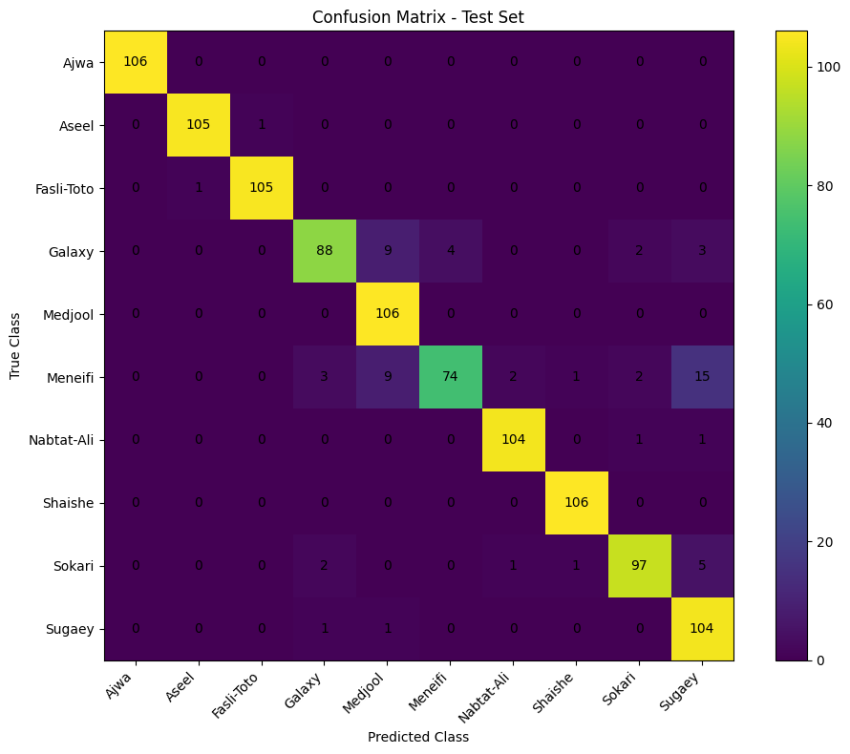
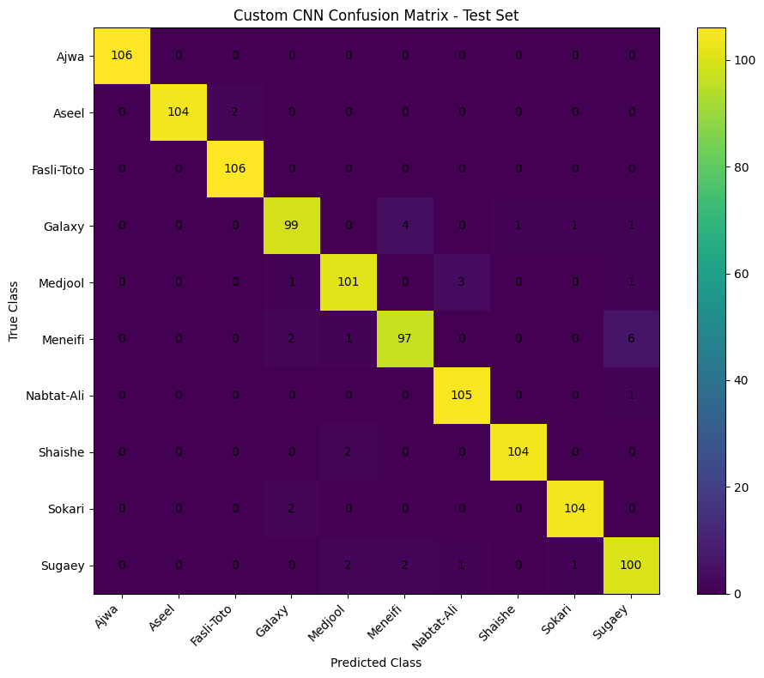

6
Where They Get Confused
Confusion matrices on the test set — the diagonal is correct, off-diagonal is error
ResNet-50 · 93.87%
CustomDateCNN · 96.79%
Same weak spot for both models — Meneifi is the hardest class, most often mistaken for Sugaey and Medjool. The custom CNN still recovers more of it (97 vs 74 correct).

Slide 9
7
Per-Class F1 Score
Both models nail the easy classes; the custom CNN is steadier on the hard ones
F1 = balance of precision & recall (1.0 is perfect). Axis starts at 0.70 to show the gaps.

Slide 10


8
What We Learned
Why the lightweight model came out ahead — and what it means
Bigger isn't always better
The task is fine-grained
ImageNet pretraining is built for complex, cluttered scenes. Our task is one centred date on a plain background — a custom 392K-parameter network had ample capacity and generalised better.
Classes differ by skin texture and shade, not object type. A compact model trained end-to-end on exactly these images learned those cues directly.
Engineering moved the needle
Diagnosis guides next steps
Balanced data, careful augmentation, regularisation and a two-stage schedule mattered more than raw model size.
Confusion analysis pinpoints Meneifi as the weak spot — the obvious target for more data or targeted augmentation.

Slide 11
Ten dates, named from a photo — at 96.8% accuracy.
A from-scratch CNN that out-performed a pretrained ResNet-50 at a fraction of the size — the result of careful data handling, deliberate architecture choices, and honest evaluation.
96.79%
392K
10
+2.9
best accuracy
params, winning model
classes
pts over ResNet-50

