Slide 1
Analysis & Design for Software Systems
Department of Computer Science
Quaid-i-Azam University
Spring 2025 Semester
Course Instructor: Onaiza Maqbool
Readings:
Pressman Chapter 1
Notes:
1

Slide 2
Learning objectives
To understand the notion of software and it’s importance
To understand the characteristics of software that make it different from other products
To be able to identify different software applications
2
Adapted from
Software Engineering A Practitioner’s Approach by R.S. Pressman
& Software Engineering A lifecycle approach by P. Mohapatra
Lecture1

Slide 3
Software
Software is
  instructions (computer programs) that when executed provide desired function and performance
  data structures that enable the programs to adequately manipulate information
  descriptive information in both hard copy and virtual forms that describes the operation and use of the programs
3
Adapted from
Software Engineering A Practitioner’s Approach by R.S. Pressman
& Software Engineering A lifecycle approach by P. Mohapatra

Slide 4
Software - Importance
Software has a dual role.
  Product
      delivers the computing potential embodied by computer hardware, is an information transformer
  Vehicle for delivering the product
      control of the computer, communication of information, creation of programs
Software - Single most important technology
  Creates new technologies (genetic engineering), extends existing (telecommunication), radical change in older ones (media)
Encompasses all aspects of our lives - We depend upon it more and more - Sometimes even for our lives
  The message: It better be right!!!
4

Slide 5
Software Characteristics
  Software is a logical rather than a physical element
    engineered, not manufactured
  Software does not wear out
    it does deteriorate
  Software is often custom-built
    There are no spare parts
5
Adapted from
Software Engineering A Practitioner’s Approach by R.S. Pressman
& Software Engineering A lifecycle approach by P. Mohapatra

Slide 6
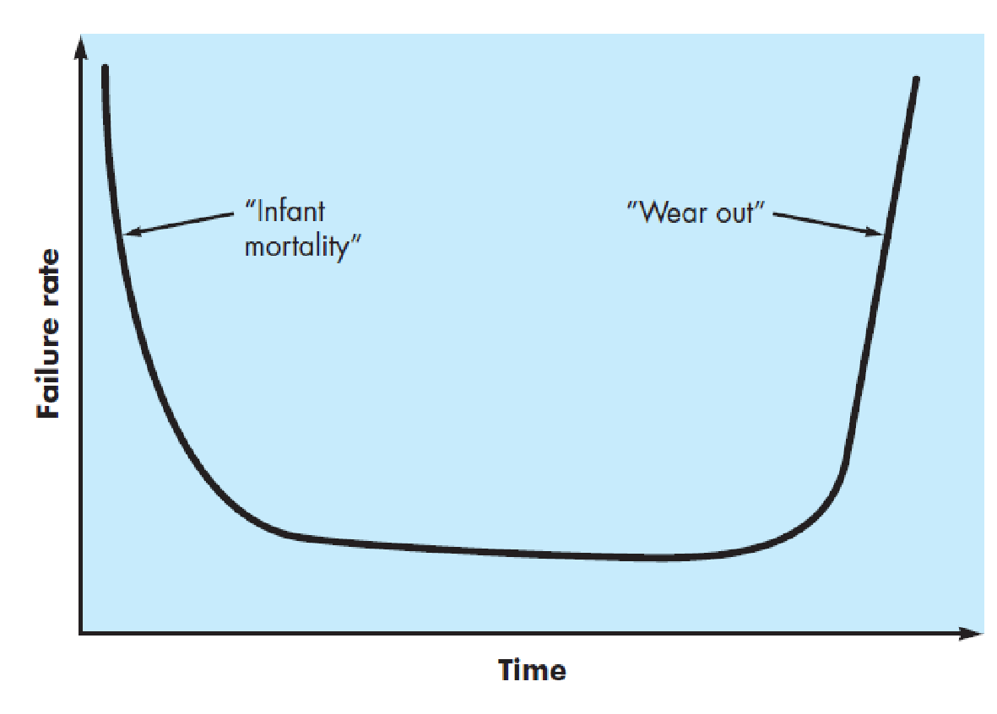
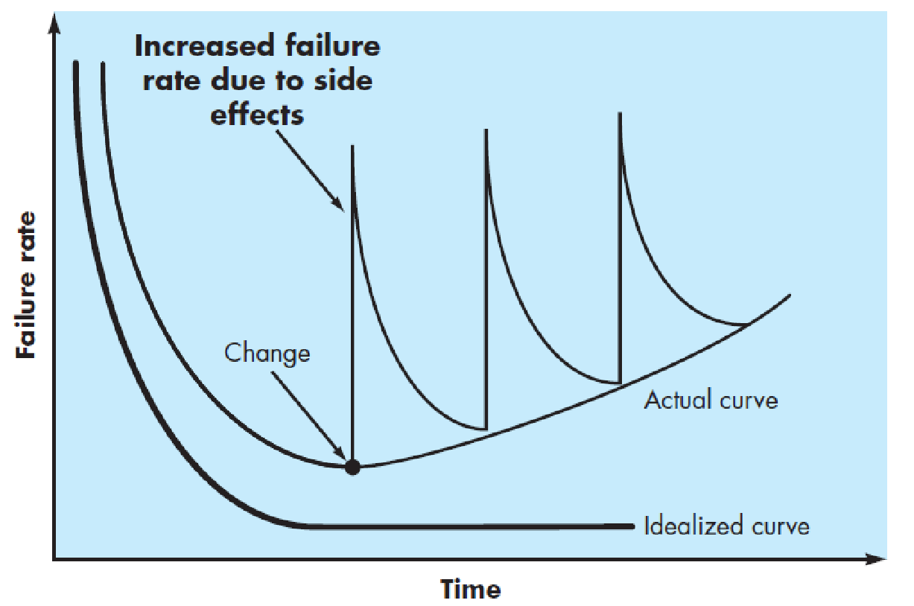
Wear vs. Deterioration
6
Adapted from
Software Engineering A Practitioner’s Approach by R.S. Pressman
& Software Engineering A lifecycle approach by P. Mohapatra

Slide 7
Software Applications
  System software
  Application software
  Engineering/scientific software
  Embedded software
  Product-line software
  WebApps (Web applications)
  AI software
  Cloud computing
  Ubiquitous computing—wireless networks
  Netsourcing—the Web as a computing engine
  Open source—“free” source code open to the computing community
  Legacy Software
7
Adapted from
Software Engineering A Practitioner’s Approach by R.S. Pressman
& Software Engineering A lifecycle approach by P. Mohapatra

Slide 8
Software Crisis
  Software delivered had errors
  Software delivered did not meet user requirements
  Software was not delivered on time
  Software cost much more to develop and maintain than estimated
  Measuring progress was difficult
Two conferences were devoted to the topic in 1968 and 1969 (Naur and Randell, 1968), (Buxton and Randell, 1969). Here, the term ‘software engineering’ was coined

Slide 9
Course outline
Aims:
This course is intended to provide students with an understanding of the concepts and methods for the analysis and design of software systems. The purpose is to inculcate a disciplined approach to software analysis and design. The course discusses important software development activities, emphasizing on practical aspects. Thus the course enables students:
  to understand the concepts & principles that guide software analysis & design
  to understand the methodologies used for software development (structured and object oriented, with emphasis on object-oriented)
  to have knowledge of various tools available for analysis and design
  to apply the principles and methodologies to analyze and design software, using tools where needed
9
Adapted from
Software Engineering A Practitioner’s Approach by R.S. Pressman
& Software Engineering A lifecycle approach by P. Mohapatra

Slide 10
S. No. | CLO | BT Level | PLO
CLO1 | Explain the analysis & design concepts & activities in the software engineering process and differentiate between them | C2 | PLO2
CLO2 | Analyze a system and develop analysis models in a standard notation for a software system using structured and object oriented methodologies | C3 | PLO3
CLO3 | Develop design models using a standard notation for a software system | C3 | PLO4
CLO4 | Analyze a design/compare designs for good design principles | C4 | PLO4

Slide 11
Course outline (contd…)
Sessions | Lecture | Readings
1,2 | The need for software, importance of software, systems and computer-based systems, software development process and major activities
3,4 | Software process models
5,6 | Requirement inception and elicitation
7-9 | Structured analysis and modeling
10-12 | Object-oriented analysis and modeling
13-15 | Requirements description and validation
16 | Mid term
11
Adapted from
Software Engineering A Practitioner’s Approach by R.S. Pressman
& Software Engineering A lifecycle approach by P. Mohapatra

Slide 12
Course outline (contd…)
17 | Test plans and acceptance test cases
18,19 | Design concepts and principles
20-22 | Architectural/user interface /data design
23,24 | Structured design
25-29 | Object-oriented design
30 | Design verification and validation
31,32 | Overview of coding, maintenance, measurement and evaluation
12
Adapted from
Software Engineering A Practitioner’s Approach by R.S. Pressman
& Software Engineering A lifecycle approach by P. Mohapatra

Slide 13
Course outline (contd…)
Evaluation Criteria:
  Final exam 50%
  Sessionals 25%
  Assignments+Quizzes 25%
Recommended Readings:
  Roger S. Pressman, Software Engineering - A Practitioner's Approach, McGraw Hill, 8th Edition, 2015
  Craig Larman, Applying UML and Patterns, Pearson Education, Third edition, 2005
  Ian Sommerville, Software Engineering, Addison Wesley, Tenth Edition, 2016
  Pratap Mohapatra, Software Engineering A Lifecycle Approach, New Age Publications, 2010
  Hans Vliet, Software Engineering - Principles and Practice, Wiley, 3rd Edition, 2008
  Shari Pfleeger & Joanne Atlee, Software Engineering – Theory and Practice, 4th edition, 2010
13
Adapted from
Software Engineering A Practitioner’s Approach by R.S. Pressman
& Software Engineering A lifecycle approach by P. Mohapatra

Slide 14
Course outline (contd…)
Policies
  Late assignments may be accepted with marks reduction. There will be a 10% reduction for assignments submitted up to 24 hours late.
  Students who have copied assignments or whose assignments have been copied will both be given a zero
  Plagiarism is not acceptable. Anyone found to be guilty of plagiarism in an assignment will be given a zero in that assignment
  Quizzes will be unannounced
  Failure to show up for discussion, or being late will result in deduction of marks
Website
Office Hours
  TBA
14
Adapted from
Software Engineering A Practitioner’s Approach by R.S. Pressman
& Software Engineering A lifecycle approach by P. Mohapatra

