Slide 1
Analysis & Design for Software Systems
Readings:
Pressman Chapter 1, Pressman Chapter 2 Sections 2.1
Notes:
1

Slide 2
Learning objectives
To understand the need for an organized approach to software development
To differentiate between software analysis and design
To understand steps in engineering and differentiate it from craft
To understand what software engineering is
To define and differentiate between the different aspects of quality
2
Adapted from
Software Engineering A Practitioner’s Approach by R.S. Pressman
& Software Engineering A lifecycle approach by P. Mohapatra

Slide 3
Software Crisis
  Software delivered had errors
  Software delivered did not meet user requirements
  Software was not delivered on time
  Software cost much more to develop and maintain than estimated
  Measuring progress was difficult
Two conferences were devoted to the topic in 1968 and 1969 (Naur and Randell, 1968), (Buxton and Randell, 1969). Here, the term ‘software engineering’ was coined

Slide 4
How to Solve it
As software engineers, we use our knowledge of computers to solve problems
In his book, How to Solve It, written before modern computers existed, George Polya outlined the essence of problem solving:
Understand the problem (communication and analysis)
Plan a solution (modeling and software design)
Carry out the plan (code generation)
Examine the result for accuracy (testing and quality assurance)

Slide 5
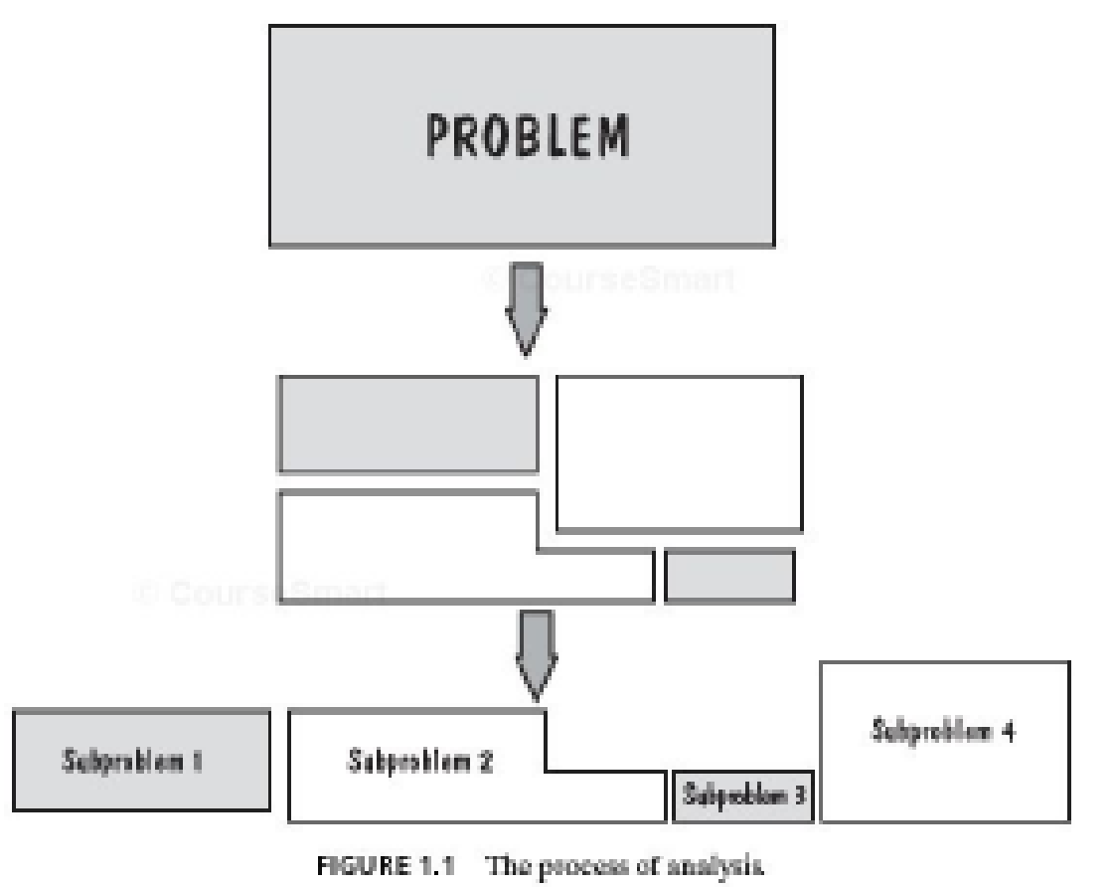
Analysis
An effort should be made to understand the problem before a software solution is developed
Most of listen for a few seconds and then think, Oh yeah, I understand, let’s get on with solving this thing. Unfortunately, understanding isn’t always that easy. It’s worth spending a little time to understand:
  Who are the stakeholders?
  What functions and performance are required to properly solve the problem?
  Is it possible to represent smaller problems that may be easier to understand?
  Can the problem be represented graphically? Can an analysis model be created?

Slide 6
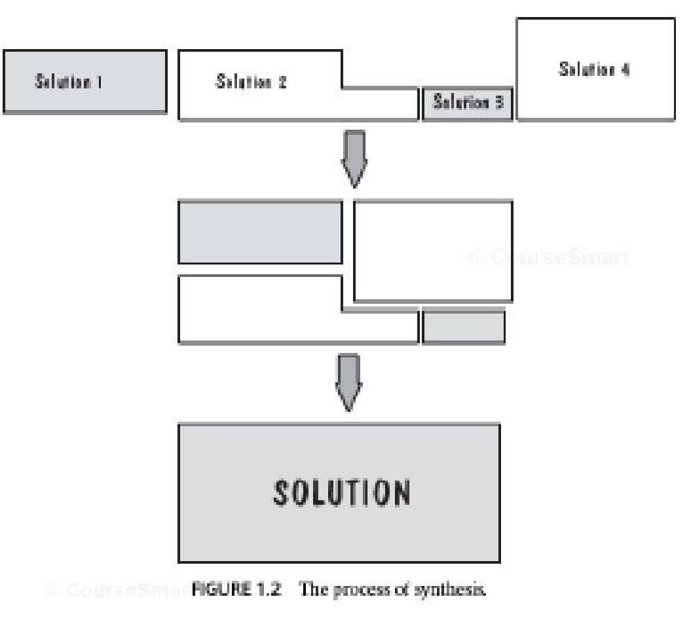
Design
The complexity of new computer-based systems and products demands careful attention to the interactions of all system elements. Design becomes a pivotal activity.
  Have you seen similar problems before? Are there patterns that are recognizable in a potential solution?
  Has a similar problem been solved? If so, are elements of the solution reusable?
  Can subproblems be defined? If so, are solutions readily apparent for the subproblems?
  Can you represent a solution in a manner that leads to effective implementation?

Slide 7
Engineering
“creates cost-effective solutions to practical problems by applying scientific knowledge to building things in the service of humankind”
Engineers
  Adopt a systematic and organized approach to their work
  Use appropriate tools and techniques depending on
    the problem to be solved
    the development constraints and
    the resources available

Slide 8
Engineering
Steps of Engineering Process
  Problem formulation
  Problem analysis
  Search for alternatives
  Decision
  Specification, and
  Implementation

Slide 9
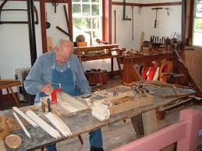
Craft
Design and Construction in the small
  Personal skill, experience, flexible materials
Complete view of problem
One person in control
Focus on final goal
Personal skills

Slide 10

Engineering
Design and Construction in the large
  Motorway, Skyscraper
  Complex problem
  Decomposed goal
  Many people involved
  Logistics, management, costs
  Quality control, safety

Slide 11
Software Engineering
(Software Engineering is) the establishment and use of sound engineering principles in order to obtain economically software that is reliable and works efficiently on real machines
(Fritz Bauer, NATO conference, 1969)
Software Engineering: (1) The application of a systematic, disciplined, quantifiable approach to the development, operation, and maintenance of software, that is, the application of engineering to software. (2) The study of approaches as in (1)
(IEEE Standard 610.12-1990, IEEE 1993)
Types of maintenance: Corrective, Adaptive, Preventive and perfective
11
Adapted from
Software Engineering A Practitioner’s Approach by R.S. Pressman
& Software Engineering A lifecycle approach by P. Mohapatra

Slide 12
A Layered Technology
Software Engineering
tools
methods
process model
a “quality” focus
12
Adapted from
Software Engineering A Practitioner’s Approach by R.S. Pressman
& Software Engineering A lifecycle approach by P. Mohapatra

Slide 13
Quality
FURPS
Functionality
  Capabilities of the program
Usability
  Users can learn it and fast and get their job done easily
Reliability
  It does what it is required to do without failing
Performance
  Considers response time, resource consumption
Supportability
  The ability to extend the program (extensibility), adaptability - a more common term, maintainability
External and internal view of quality
13
Adapted from
Software Engineering A Practitioner’s Approach by R.S. Pressman
& Software Engineering A lifecycle approach by P. Mohapatra

Slide 14
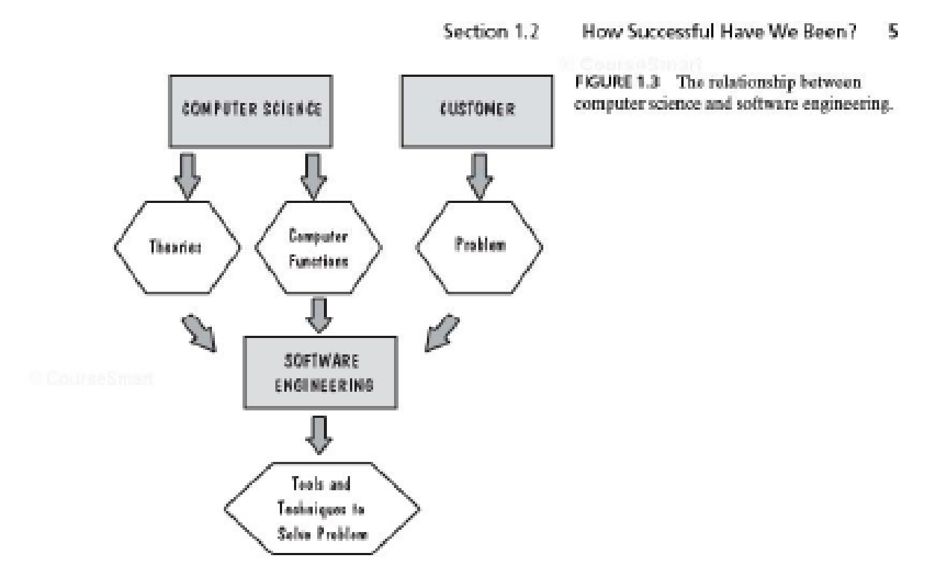
The Relation between CS and SE
14
Adapted from
Software Engineering A Practitioner’s Approach by R.S. Pressman
& Software Engineering A lifecycle approach by P. Mohapatra

Slide 15
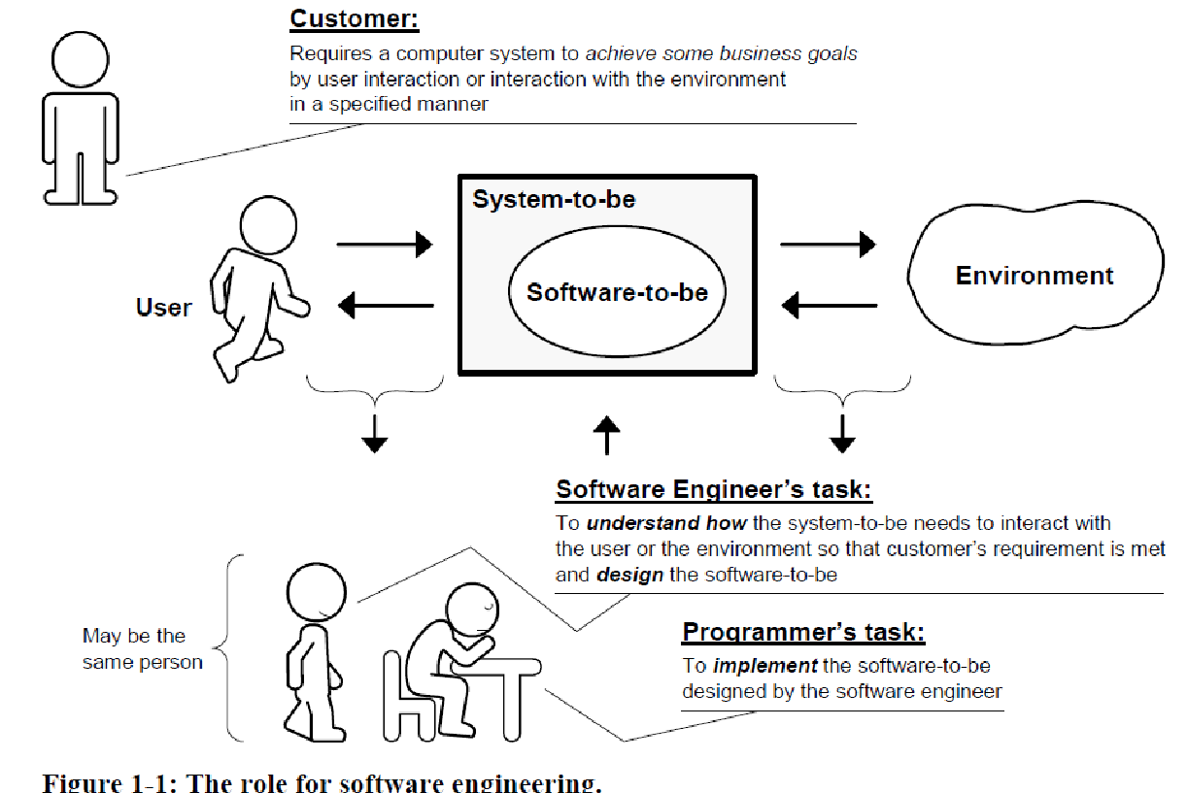
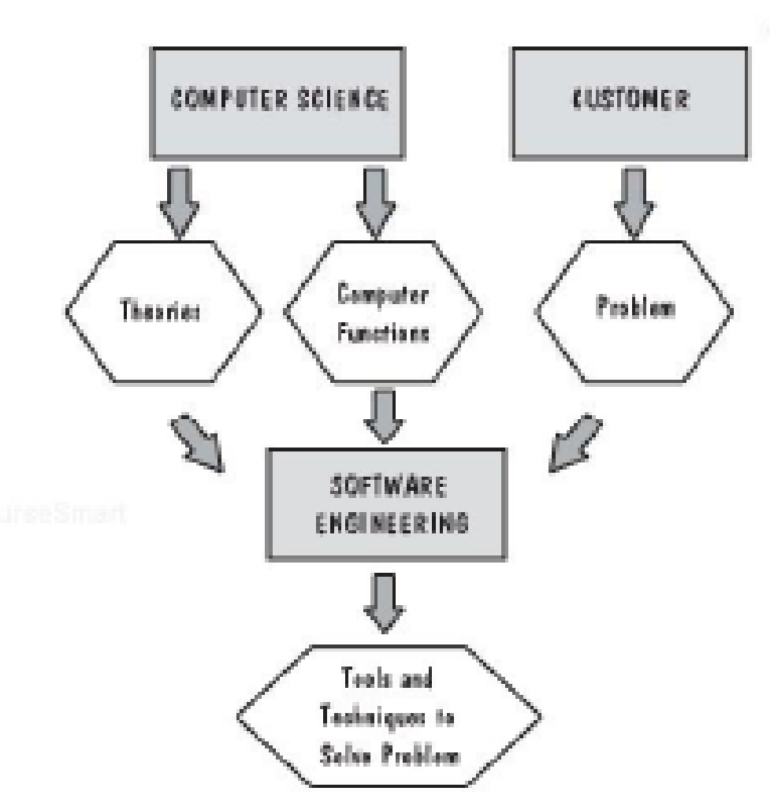
15
Adapted from
Software Engineering A Practitioner’s Approach by R.S. Pressman
& Software Engineering A lifecycle approach by P. Mohapatra

