Slide 1
Analysis & Design for Software Systems
Readings:
Readings:
Pressman Chapter 2 Sections 2.1
(Do Section 2.4 yourself)
Vliet Chapter 1 Section 1.1
Notes:
1

Slide 2
Learning objectives
To understand the big picture i.e. the principles that guide software engineering as a whole
To appreciate the software engineering characteristics to be kept in mind during software development
To be able to identify the various activities during software development and understand the effort distribution
To identify common process models and their characteristics
2
Adapted from
Software Engineering A Practitioner’s Approach by R.S. Pressman
& Software Engineering A lifecycle approach by P. Mohapatra

Slide 3
A Layered Technology
Software Engineering
tools
methods
process model
a “quality” focus
3
Adapted from
Software Engineering A Practitioner’s Approach by R.S. Pressman
& Software Engineering A lifecycle approach by P. Mohapatra

Slide 4
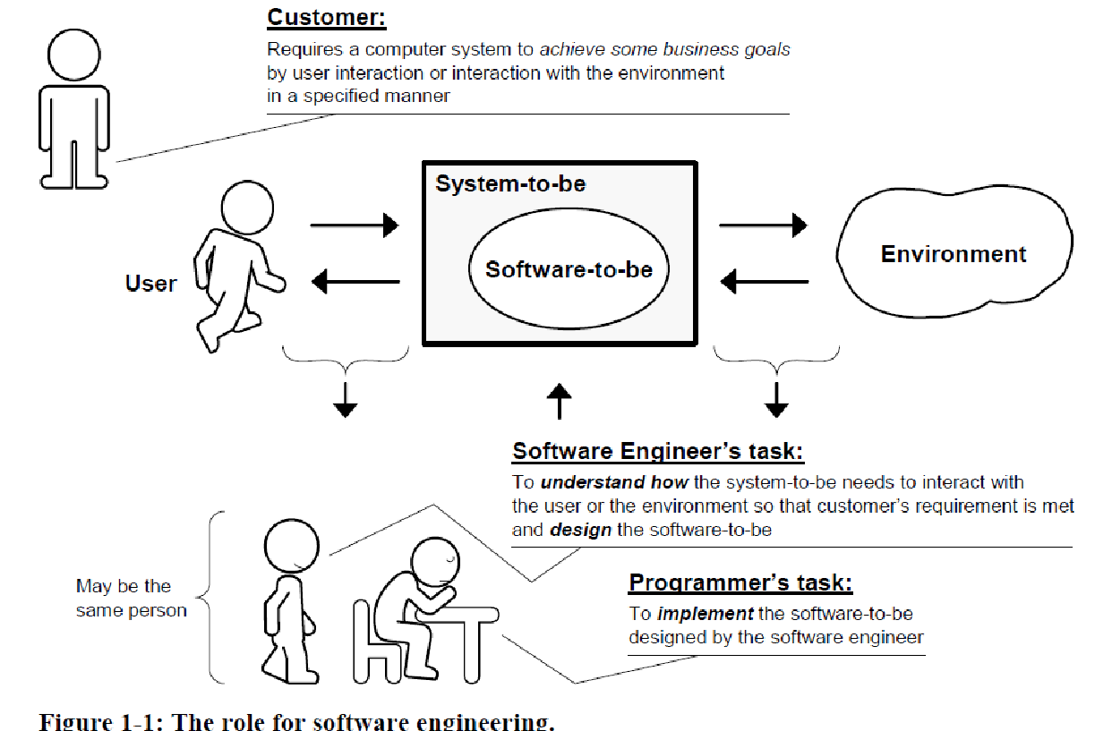
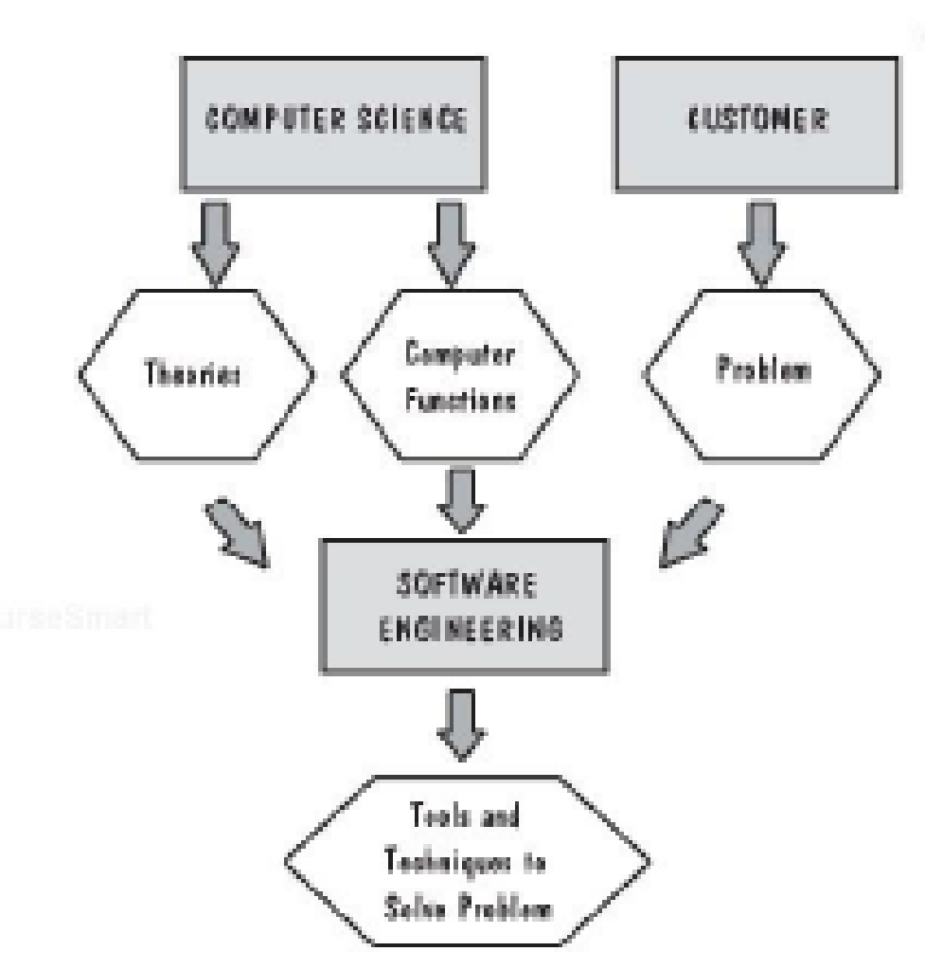
4
Adapted from
Software Engineering A Practitioner’s Approach by R.S. Pressman
& Software Engineering A lifecycle approach by P. Mohapatra

Slide 5
System
A collection of inter-related components that work together to achieve some objective
Characteristics
  They exist to achieve a purpose
  They interact with the environment
  They may be composed of sub-systems
  They have emergent properties
Types
  Technical computer based systems e.g. television, mobile phone
  Socio-technical systems – Have operational processes, and include people
5
Adapted from
Software Engineering A Practitioner’s Approach by R.S. Pressman
& Software Engineering A lifecycle approach by P. Mohapatra

Slide 6
Computer based Systems
Elements are:
  Software
  Hardware
  People
  Documentation
  Procedures
6
Adapted from
Software Engineering A Practitioner’s Approach by R.S. Pressman
& Software Engineering A lifecycle approach by P. Mohapatra

Slide 7
Hardware/Software Costs
Before about 1960 (typically)
  30% software
  70% hardware
By 1970 this had reversed
  70% software
  30% hardware
Now for many large systems
  90% software
  10% hardware
7
Adapted from
Software Engineering A Practitioner’s Approach by R.S. Pressman
& Software Engineering A lifecycle approach by P. Mohapatra

Slide 8
Software Development and Programming
Programming is only a fraction of the software development process
Writing a program is easy
Developing a software product is hard
8
Adapted from
Software Engineering A Practitioner’s Approach by R.S. Pressman
& Software Engineering A lifecycle approach by P. Mohapatra

Slide 9
Principles
The reason it all exists – to provide value to its users
Keep it simple
Maintain the vision
What you produce, others will consume
Be open to the future
Plan ahead for reuse
Think!
9
Adapted from
Software Engineering A Practitioner’s Approach by R.S. Pressman
& Software Engineering A lifecycle approach by P. Mohapatra

Slide 10
Essential Characteristics of SE
Software engineering concerns the development of large programs
The central theme is mastering complexity
Software evolves
The efficiency with which software is developed is of crucial importance
Regular cooperation between people is an integral part of programming-in-the-large
The software has to support its users effectively
Software engineering is a field in which members of one culture create artifacts on behalf of members of another culture
Software engineering is a balancing act
10
Adapted from
Software Engineering A Practitioner’s Approach by R.S. Pressman
& Software Engineering A lifecycle approach by P. Mohapatra
Notes:
10

Slide 11
Software Process
Process
  a series of steps involving activities, constraints, and resources that produce an intended output of some kind (software)
Involves a set of tools and techniques
Good processes
  lead to Good Software
  enhance Visibility
  reduce Risks
A number of process steps that must be part of all software projects
11
Adapted from
Software Engineering A Practitioner’s Approach by R.S. Pressman
& Software Engineering A lifecycle approach by P. Mohapatra

Slide 12
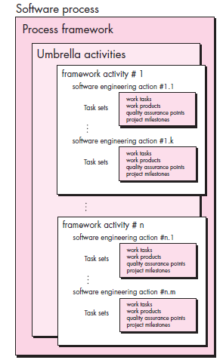

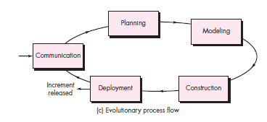
A Process Framework
12
Adapted from
Software Engineering A Practitioner’s Approach by R.S. Pressman
& Software Engineering A lifecycle approach by P. Mohapatra

Slide 13
Framework Activities
Communication
Planning
Modeling
  Analysis of requirements
  Design
Construction
  Code generation
  Testing
Deployment
13
Adapted from
Software Engineering A Practitioner’s Approach by R.S. Pressman
& Software Engineering A lifecycle approach by P. Mohapatra

Slide 14
Another View
  System Requirements Definition
  System Design
  System Modeling
  Sub-system Development
  Systems Integration
  System Evolution
14
Adapted from
Software Engineering A Practitioner’s Approach by R.S. Pressman
& Software Engineering A lifecycle approach by P. Mohapatra

Slide 15
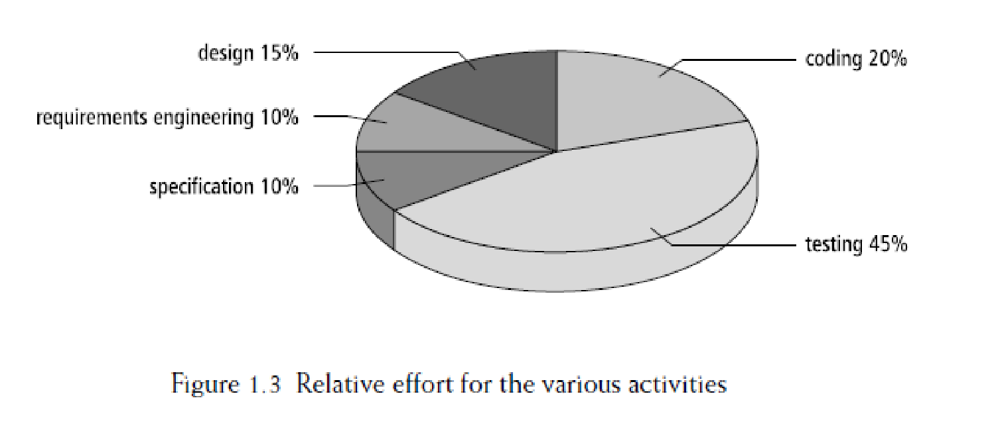
Maintenance takes up what %age of the total effort?
15
Adapted from
Software Engineering A Practitioner’s Approach by R.S. Pressman
& Software Engineering A lifecycle approach by P. Mohapatra

