Slide 1
Artificial Intelligence
Lecture # 4

Slide 2
Learning objectives
To enable students to
  Understand basics of linear models for classification

Slide 3
Reflex models

Slide 4
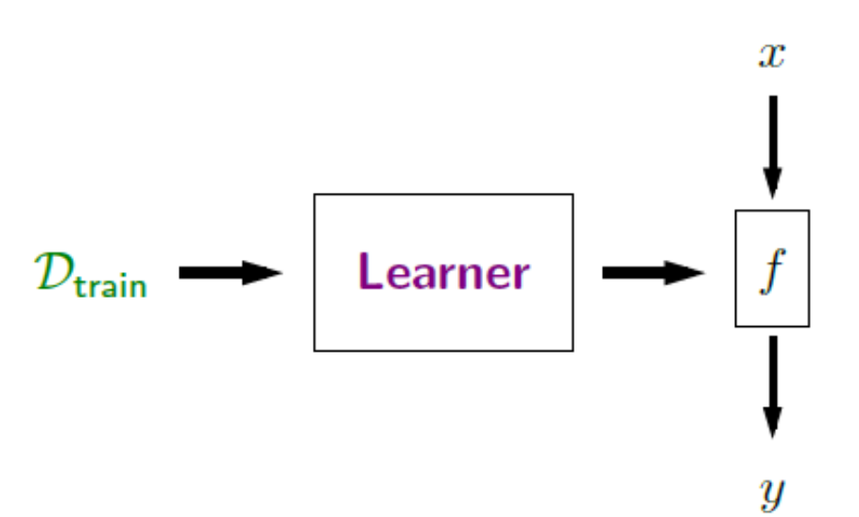
Modelling, learning and inference
Learner has to learn beyond the training examples – Can’t be a rote learner
This is generalization

Slide 5
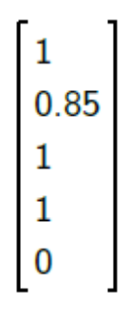
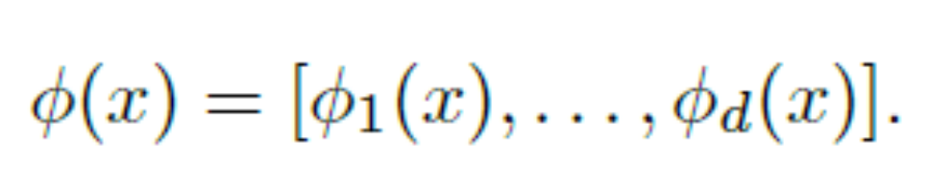
Features and Feature vector
Extracted from x, helpful in predicting y
May be of different types, eventually converted to numeric
Example task: Predicting whether a student will get an ‘A’ grade
Feature vectors are points in a high-dimensional vector space

Slide 6
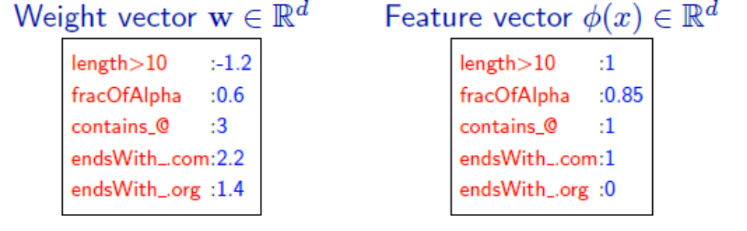
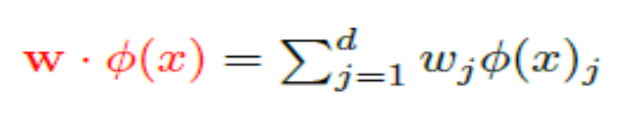
Weights and Weight vector
For each feature j, we would have a weight
Represents contribution of a feature to the prediction
Weight vectors do not depend on the input x as such, unlike features

Slide 7
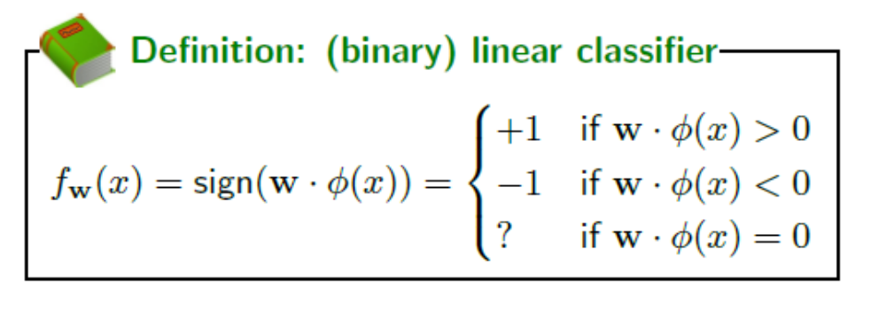
Linear Predictors (Classifiers)
Geometric interpretation

Slide 8
Loss Minimization
The learner in this framework is an algorithm, which is learning the weights of the function

Slide 9
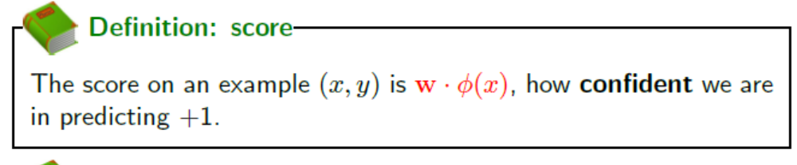
Score
Correct label y
Predicted label y`
Score can be both positive or negative, correct?
Which is better?

